Slide 1
Risks
Nano or Mega?
By: Rezgar ahmadi

Slide 2
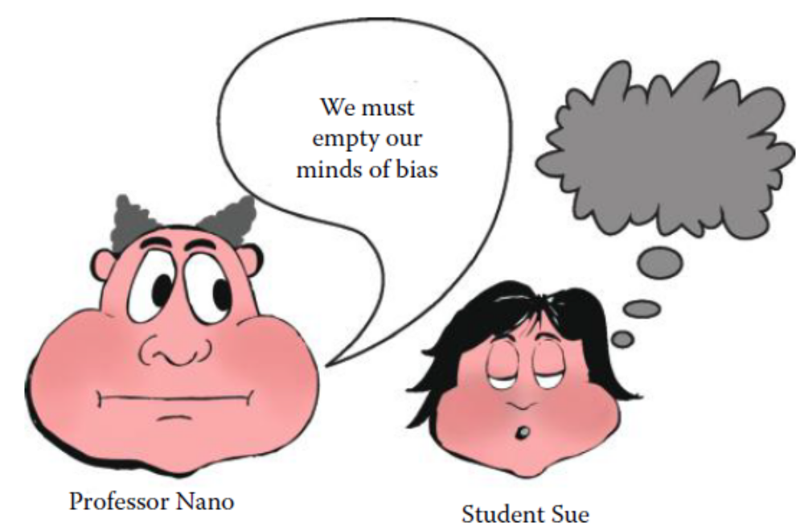
Outline
The purpose is to describe the potential risks of micro/nanoparticles on the health and safety to society
It is a “nanorisk” if the risk is small and a “megarisk” if the risk is large
Risk is part of our everyday lives
  automobile accident, airplane crash, earthquake or tornado
Nanotechnology is no different from other technological risks in life
There are both benefits and dangers
  Some of the benefits include antioxidation, early detection of diseases, drug delivery, therapeutic treatment, and molecular imaging
  Some of the possible dangers are oxidative stress, cell dysfunction, and cytotoxicity
Risk is defined as the potential for realizing some unwanted and “negative consequences” (possible dangerous outcomes or hazards) of an “event” (the manufacturing and utilization of micro-/nanomaterials)
the hazards of micro- and nanotechnology are not completely known or understood
  Although micro-/nanomaterials can be hazardous, currently these materials are not known to have caused any serious environmental hazard or disease.
  In addition, if these materials happen to be hazardous, they still may be safely handled, contained, and controlled.
  Hence, we should not jump to quick conclusions about their danger to society.
Bit of Anatomy,
Definitions Relating to Risk,
Chemical and Physical Factors,
Benefits versus Risks,
Risk Assessment

Slide 3
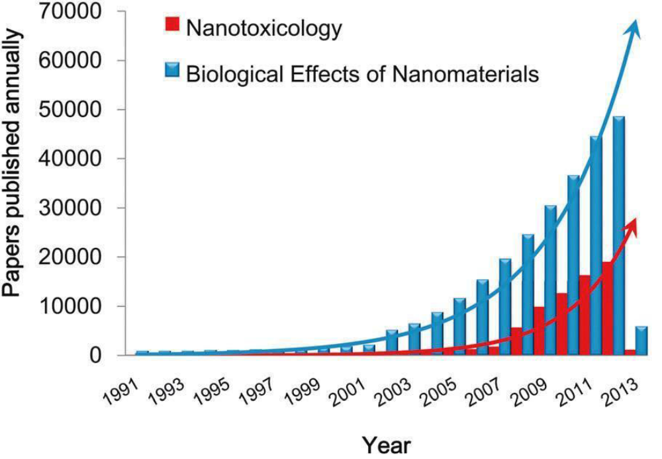
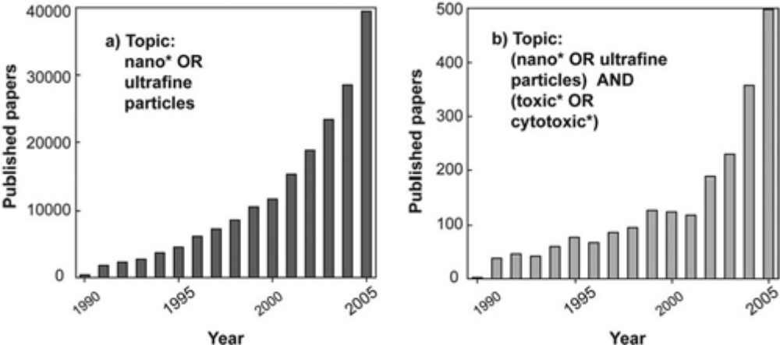
Nanomaterials and nanotoxicology publications statistics
The number of publications on the topic of nanomaterials has increased at an almost exponential rate since the early 1990s
a search on the ISI Web of Knowledge database

Slide 4
BIT OF ANATOMY
The different ways these materials can enter the body are by ingestion, through our skin, and by inhalation. In this regard, the anatomy of these systems will be discussed
  Digestive System
  Skin
  Upper Respiratory Tract
  Lower Respiratory Tract
Injections and implants are other possible routes of exposure

Slide 5
Digestive System
The digestive system is also called the gastrointestinal (GI) system
  It has an upper GI system and lower GI system
  The upper GI system contains the mouth, pharynx, esophagus, and stomach
  the lower GI system 4.5 m long small intestine (including pancreas, liver, gallbladder) and ∼1 m long large intestine
The scientific data indicate that ingesting micro- and nanoparticles do not appear to be hazardous
  very fine SiO2 powder is used in such food products as vitamins, nutritional supplements, and tooth paste
  In 2007, Rice University researchers raised fruit flies on a diet of yeast and nanotubes
nanoparticles were investigated in foods (corn, tomatoes, rice) and medicines.
  It was inconclusive on whether nanoparticles posed any toxicity problem to plants or humans

Slide 6
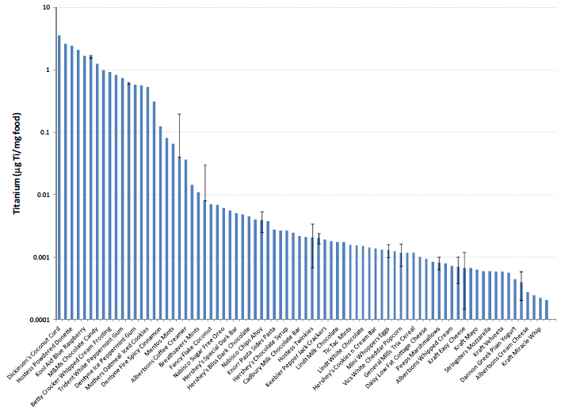
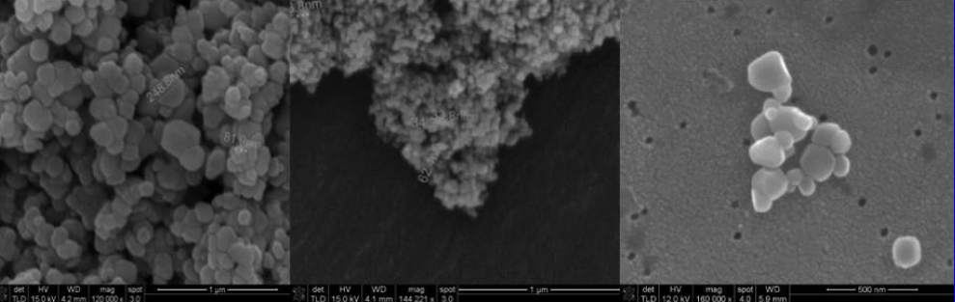
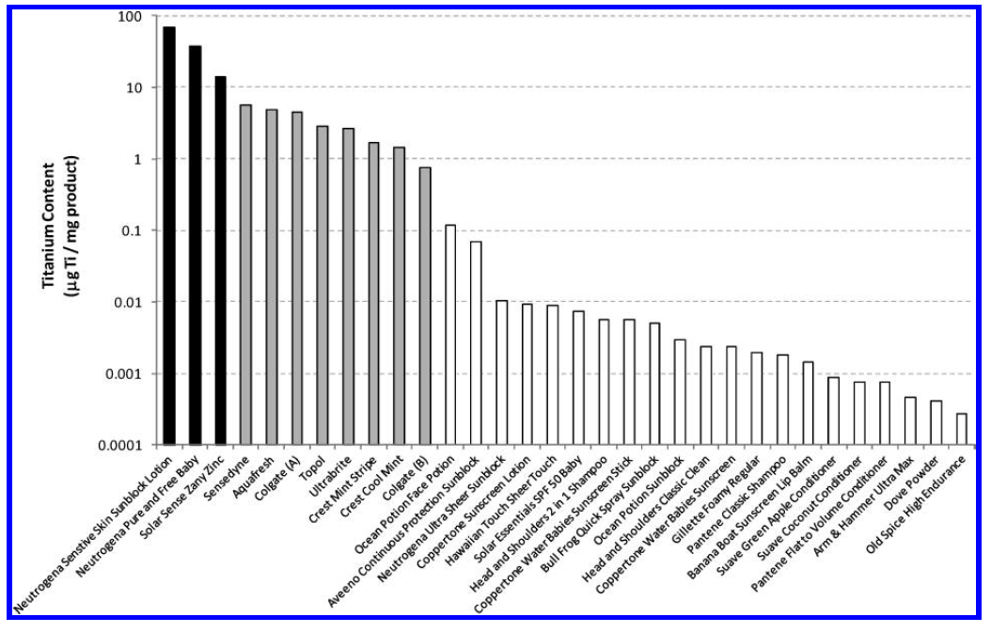
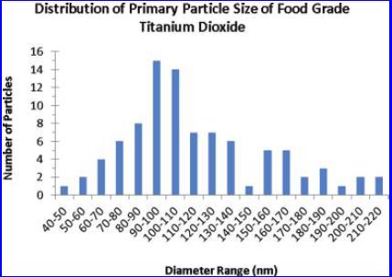
Titanium Dioxide Nanoparticles in Food and Personal Care Products
Normalized titanium concentration for all foods
Toxicity studies mainly report a risk from nanoparticular TiO₂ due to inhalation (inflammation and possible link to asthma), but titania has also been linked to Crohn’s disease from gastrointestinal intake and it has been classified as a possibly carcinogen
E171
P25
Chewing gum (Trident White)
Total titanium concentration for personal care products (PCPs)

Slide 7
Skin
The skin is the outer coating of the body, which protects it from water penetration and pathogens like foreign particles and toxins
In humans, the skin has three principal layers
  the epidermis (top layer),
    The epidermis is made up of about 10–30 cells, and it has a thickness range of 0.1 mm (e.g., on eyelids) to 1 mm (e.g., on the palms of hands and soles of feet)
  dermis (intermediate layer),
    The dermis is much thicker than the epidermis—0.3 mm to 3 mm.
    The dermis provides elasticity and mechanical cushioning to the body.
    The dermis consists of fibrous tissue, and it contains such articles as blood capillaries, sweat glands, and hair follicles
  hypodermis or subcutis (lower layer).
    The hypodermis lies under the dermis, and it attaches the skin to muscles and bone.
    The hypodermis consists of fibrous tissue and elastin, and it provides blood and nerves to the muscle and bone

Slide 8
Skin
Nanoparticles are commonly used in sunscreens and cosmetics
Scientists measured the penetration of zinc oxide (ZnO) nanoparticles from sunscreen after a 24 hour exposure
  Their results indicated there was minimal penetration of nanoparticles through the epidermis
the Environmental Working Group (EWG), an American nonprofit environmental protection organization, concluded that nanoparticles (ZnO or TiO₂) did not appear to penetrate the skin to living tissue, which would cause toxicity

Slide 9
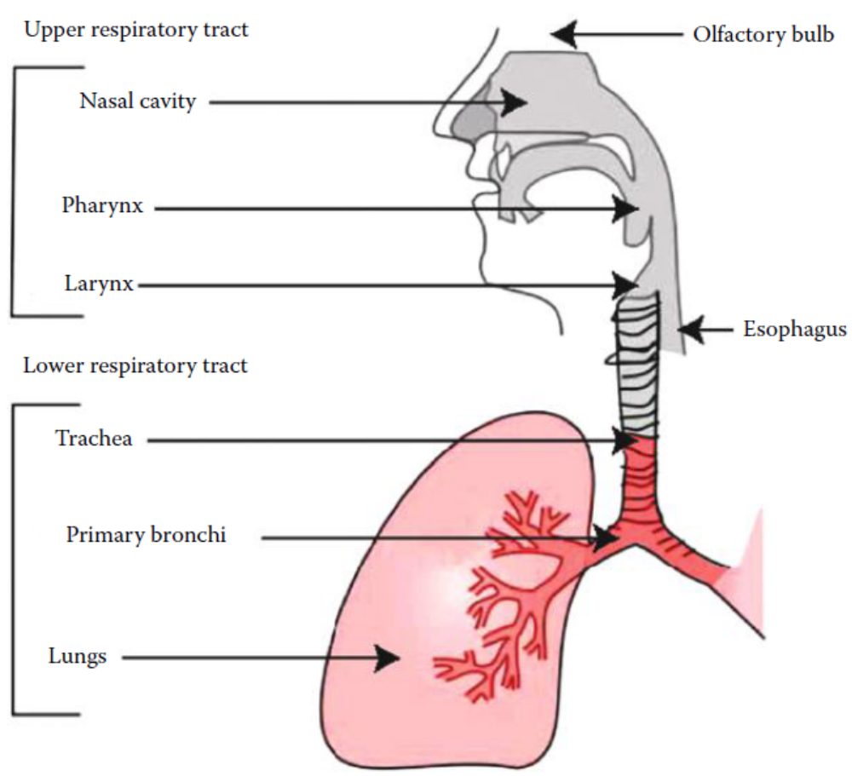
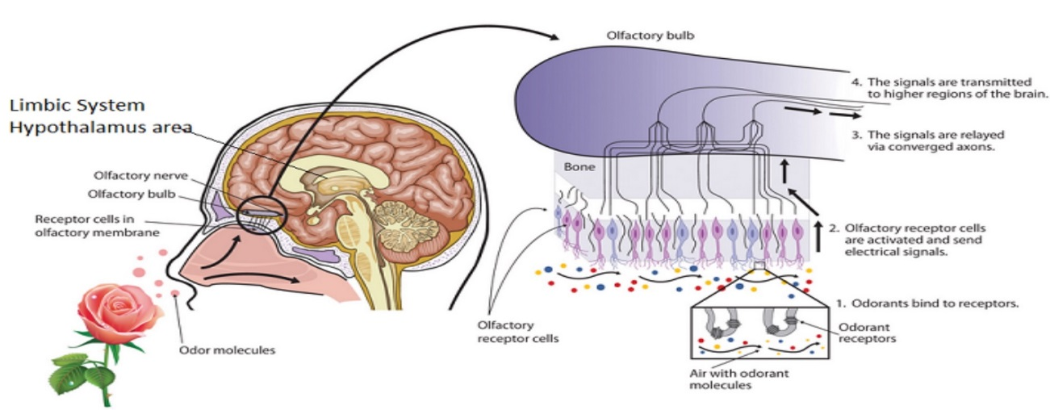
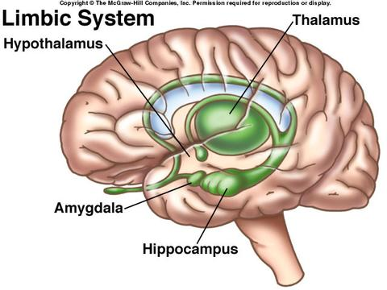
Upper Respiratory Tract
The entrance of inhaled air into the body is through the nose and mouth
The nose inhales air and transports it to the olfactory bulb, a region of the brain above the nasal cavity
  The olfactory bulb consists of nerve cells (sensory neurons) in the brain that are responsible for detecting odors (the sense of smell).
  The olfactory bulb connects to the limbic system, which contains the hippocampus
It has been shown that TiO₂ nanoparticles can be inhaled through the nose and can travel to the brain, where they might cause brain cell damage in mice

Slide 10
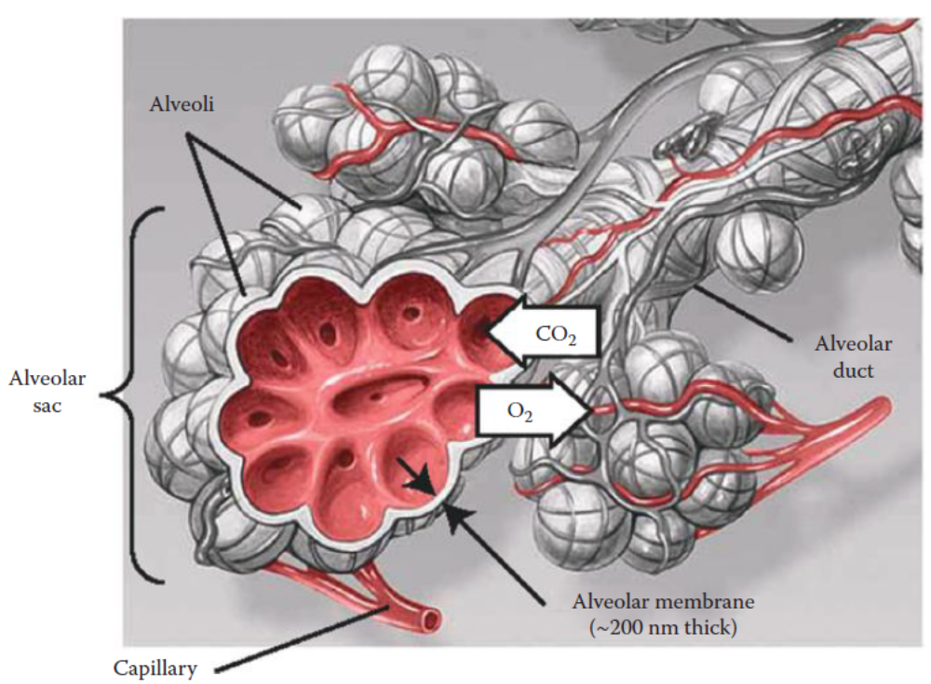
Lower Respiratory Tract
When air is inhaled through the nose and mouth, it also passes into our lower respiratory system
The lungs have bronchi paths that connect to the alveolar ducts, which feed into the alveolar sacs (many alveoli)
The bronchi deliver oxygen to the alveoli, which are surrounded by a network of blood capillaries
The alveoli are air sacs with a very high surface area, ∼80 m²
The purpose of the alveoli is to transfer oxygen from the lungs to the blood stream though the network of capillaries that surround the alveoli.
Each lung has about 300 million alveoli, and each alveolus has a diameter of ∼250 μm
The wall thickness of the alveolar membrane is extremely thin (∼200 nm),
Oxygen diffuses through the alveolar membrane and into the capillaries, which oxygenates the blood that is pumped to the heart
Carbon dioxide (CO₂) diffuses through the alveolar membrane in the opposite direction
There is concern that nanoparticles could pose a problem if they are inhaled

Slide 11
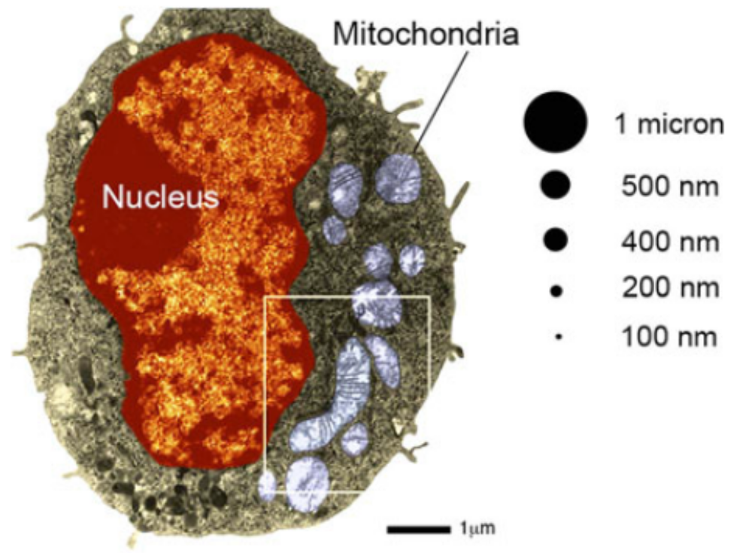
DEFINITIONS RELATING TO RISK
We will define some of the common terms that will be used which relate to risk.
  Pulmonary Inflammation and Toxicity
  Oxidative Stress and Cytotoxicity
  Free Radicals
  Antioxidants
  Bulk and Surface Structure
  Aggregation

Slide 12
Pulmonary Inflammation and Toxicity
pulmonary inflammation and pulmonary toxicity are terms that are used to describe lung damage at the tissue and organ level
Pulmonary inflammation is the massive irritation and swelling of the lungs
The extreme case of pulmonary inflammation is pulmonary toxicity, which can lead to respiratory disorders
Pulmonary toxicity occurs during the latter stages of pulmonary inflammation, when the nanoparticles may prevent the division of lung cells

Slide 13
Oxidative Stress and Cytotoxicity
Stress and cytotoxicity describe lung damage at the molecular level and cellular level, respectively
Oxidative stress (also called oxygen injury) is cell damage, which is caused by the generation of reactive oxygen species (free radicals) at the molecular level
  Continued oxidative stress leads to cell toxicity
  Oxidative stress can cause the cells to become dysfunctional, which can eventually lead to cell death
  The mechanism of oxidative stress is the formation of free radicals
Nanoparticles may prevent the division of lung cells, which may cause the cells to become dysfunctional and lead to cell death.
The free radicals can attack the macromolecules inside our cells, which can disrupt their normal functions.
If this continues, it can lead to an extreme case of oxidative stress, which is called cytotoxicity, and this can cause cell death

Slide 14
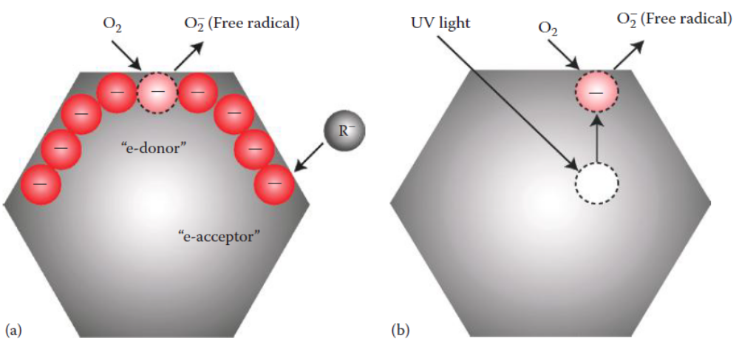
Free Radicals
free radicals are molecules that have an unpaired electron in their outer orbital
They include reactive oxygen species like superoxides (O₂⁻ ) , hydrogen peroxide (H₂O₂), and hydroxyl radicals (OH⁻), which are formed as by-products of metabolism in the cell’s mitochondria
The reactive oxygen species can be formed in two ways

Slide 15
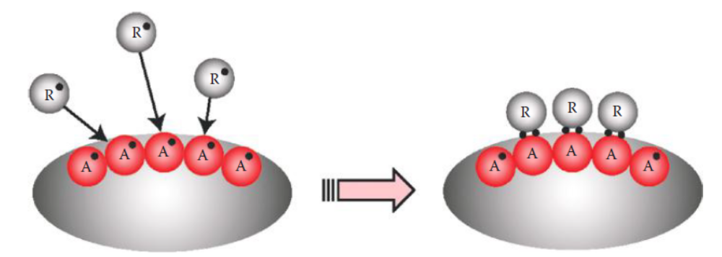
Antioxidants
Oxidation reactions in human cells produce free radicals
An antioxidant is a molecule that attacks oxide free radicals in order to neutralize them
Antioxidants in foods (and in buckyballs and nanotubes) are able to absorb free radicals
  Nanotubes and buckyballs have very high surface areas and plenty of dangling bonds to act as antioxidants
  nanoparticles have negatively charged surfaces, they are candidates for being either e-acceptors (good) or e-donors (bad)

Slide 16
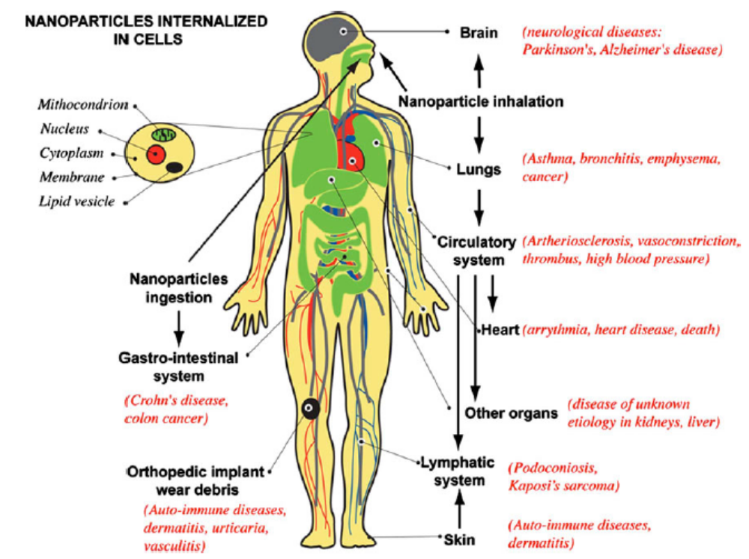
Schematics of human body with pathways of exposure to nanoparticles, affected organs, and associated diseases from epidemiological, in vivo and in vitro studies
not all nanoparticles produce these adverse health effects—the toxicity of nanoparticles depends on various factors, including size, aggregation, composition, crystallinity, surface functionalization, etc.

Slide 17
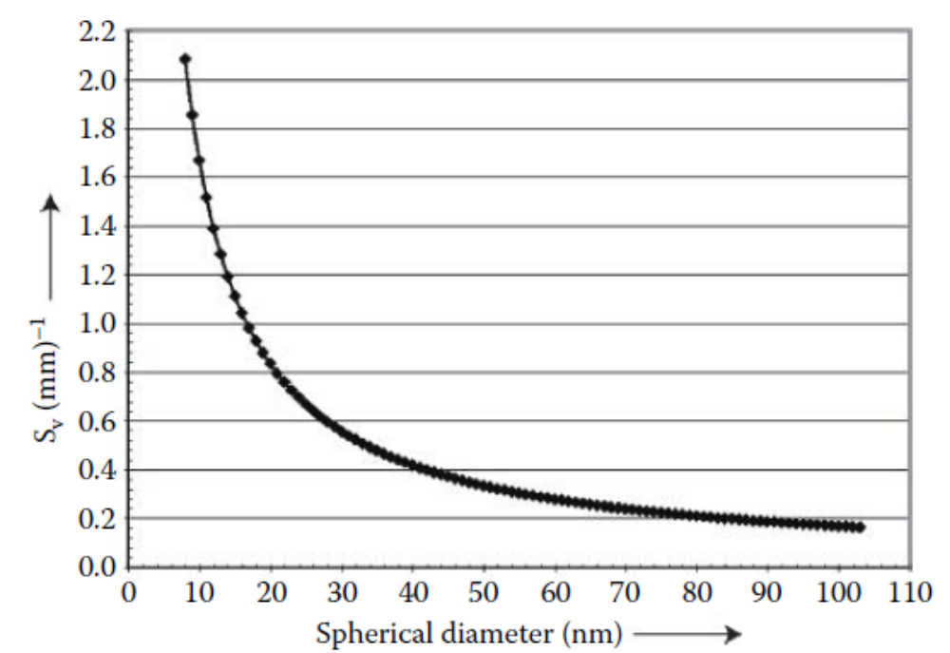
Bulk and Surface Structure
When the particle size is large (above ∼2 μm), its surface area-to-volume ratio is low
  its properties are more dependent upon the material’s volume (or “bulk structure”)
As the particle size becomes smaller (<100 nm),
  the bulk (volume) plays a lesser role, and the “surface structure” plays a more dominate role
The surface structure has more dangling bonds, which give nanoparticles their negative charge.
Aggregation
The term “aggregation” is sometimes called agglomeration or flocculation
Due to the surface charge on nanoparticles, there is a tendency for them to flock together—thus reducing their surface area-to-volume ratio

Slide 18
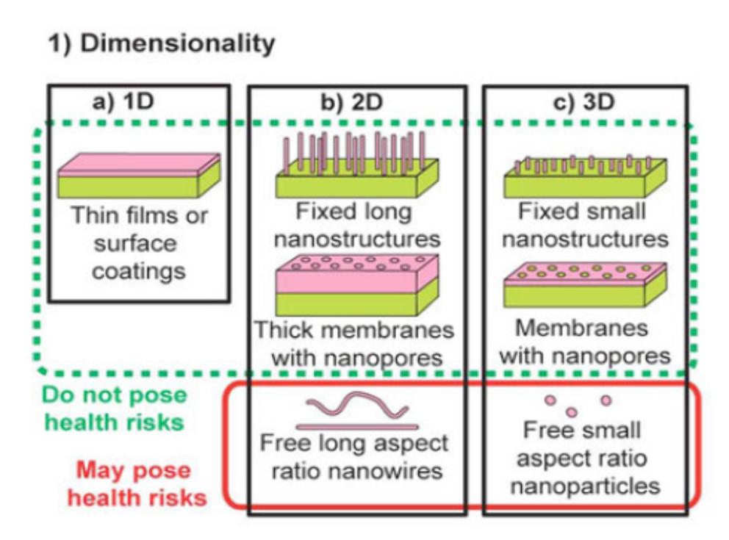
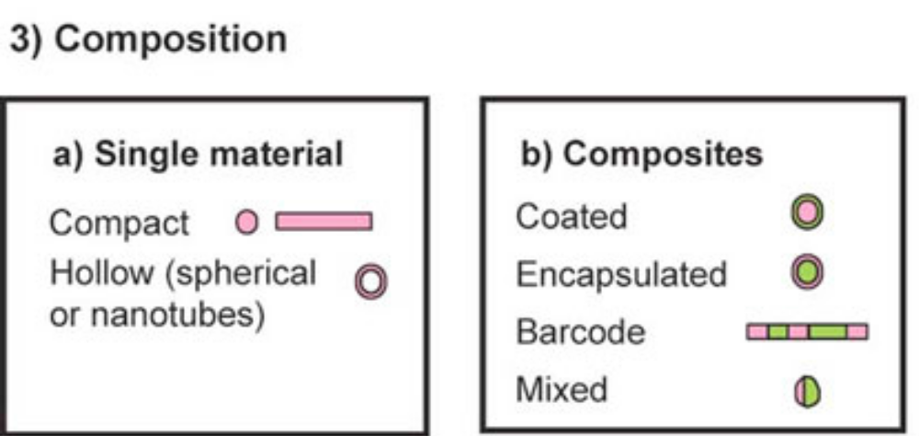
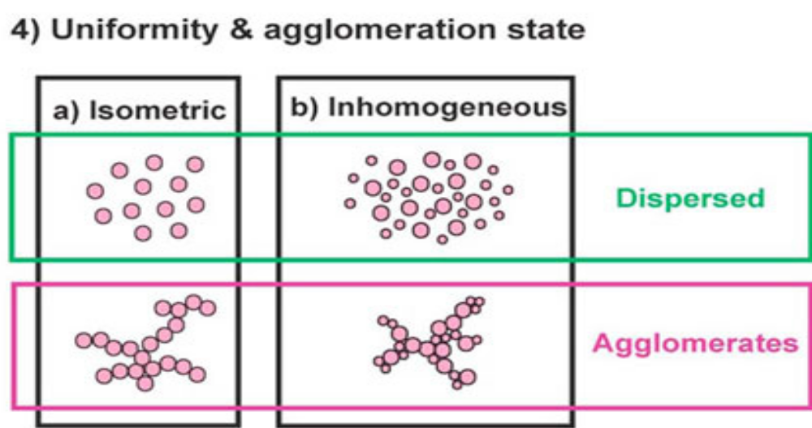
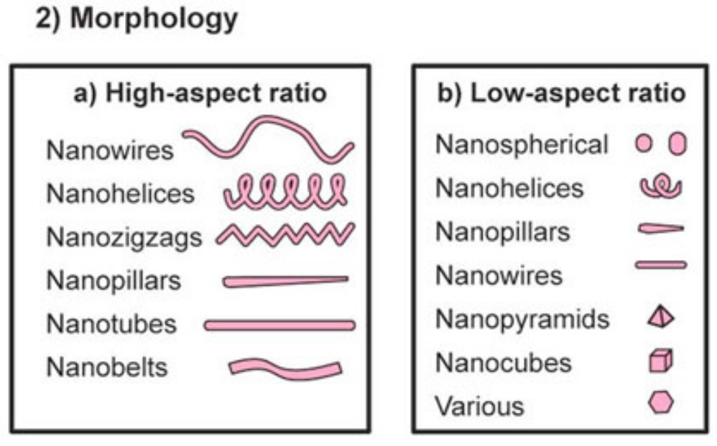
NANOPARTICLE CLASSIFICATION

Slide 19
CHEMICAL AND PHYSICAL FACTORS
Once these particles enter the body, they can potentially affect one’s health and safety
It is important to learn how micro- and nanomaterials might react with biological systems cells, membranes, organelles, nucleic acid molecules, and proteins
Some of the chemical and physical factors that can influence micro/nanotoxicity are
  Bulk Chemistry
  Particle Size
  Particle Concentration
  Particle Shape
  Surface Effects
  Solubility

Slide 20
Bulk Chemistry
The material’s chemistry is considered to be a “bulk property.”
It has little to do with the surface structure of the material
There are several materials that are known to be hazardous to humans due to their bulk chemistry
  Some of the most commonly dangerous elements are the heavy metals
    cadmium (Cd), mercury (Hg), and lead (Pb)
  Toxic elements
    arsenic (As)
  toxic compounds
    silica (SiO₂) and beryllium (Be) alloys

Slide 21
Chemistry of Heavy Elements and Toxic Elements
Heavy metal compounds of Cd, Pb, and Hg are toxic when they are inhaled, ingested, or injected into the body
They can cause a host of mental and physical diseases, which can lead to death
These materials have many technological uses
  CdSe is a very popular Qdot material, which is used for molecular imaging
  PbS is a semiconductor that is used in infrared detectors
  PbO is used in paints, glasses, and lead-acid car batteries
  Mercury is present in fluorescent light bulbs, thermometers, and dental fillings
  The metal is also present in our food chain
  Small concentrations of As and its compounds are used in drugs and pesticides

Slide 22
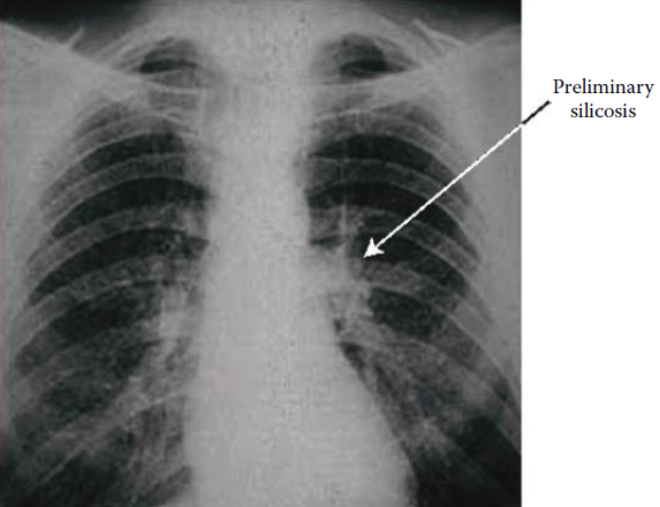
Chemical and Physical Risks
All of the aforementioned materials are toxic due to their bulk chemistry, independent of particle size
other materials by virtue of their chemistry become toxic when their particle size is small
  like SiO₂ and Be compounds
    Silica is used in such products as glass, nanoelectronics, and food
    beryllium alloys are used in stiff, lightweight aerospace structures.
dust particles (less than 10 μm in size) can be inhaled and can cause silicosis
  Silicosis (also called “black lung” disease) used to be common among miners when they drilled for coal, minerals, and metals
  The silica particles can cause pulmonary toxicity and cancer
    proper filters in respiratory devices
Inhaling Be compounds can cause berylliosis, which is an inflammatory lung disease that is similar to tuberculosis
  Although it can be treated, the disease is incurable
It is noteworthy to mention that not all nanoparticles have exhibited potentially hazardous effects
When MnO₂ (a toxic oxidizing agent) was inhaled, the particles passed through both the rat’s olfactory bulb and lungs without causing brain damage or pulmonary inflammation (2006)

Slide 23
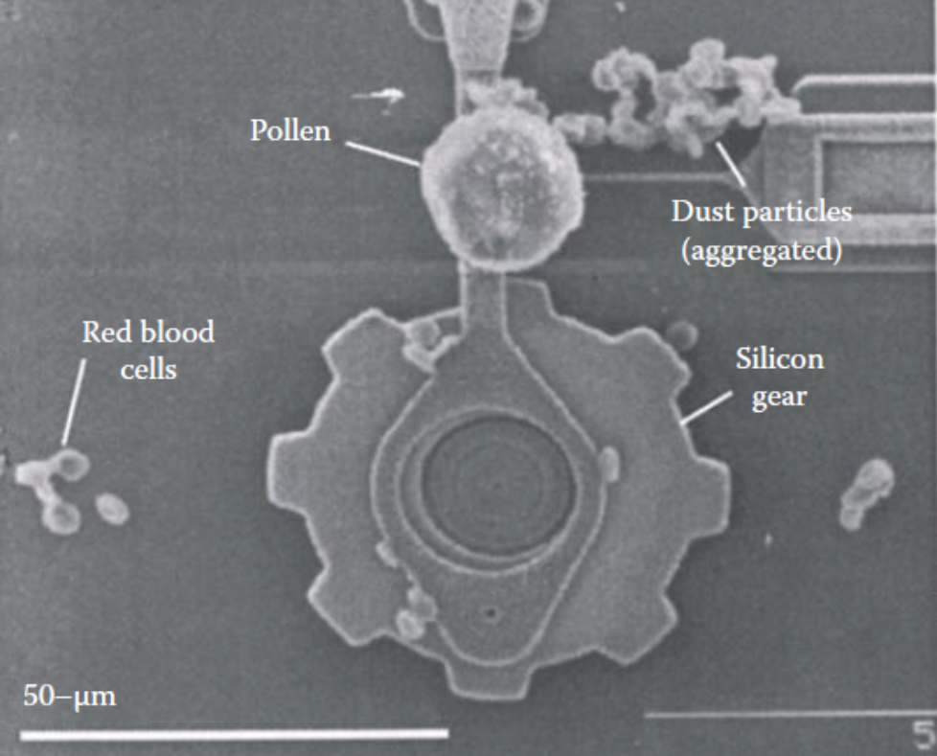
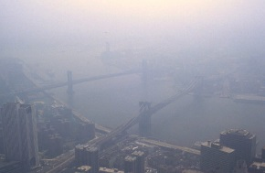
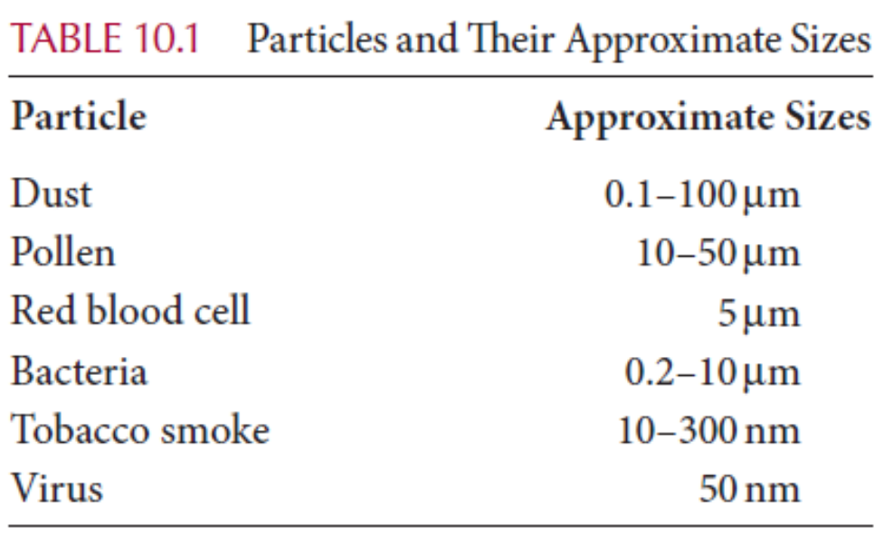
Particle Size
“Is smaller better?”
If smaller (nano) particles cause health and safety risks, are they necessarily better?
The EPA defines particle pollution
  solids or liquids that are suspended in air and can be inhaled
    carbon (soot), reactive metals, acids, hydrocarbons, and organic chemicals
  Airborne particulate matter (PM) is the key ingredient in polluted air
  Particles emitted from diesel trucks, buses, automobiles, and coal-burning factories caused clotting in the coronary arteries of mice
    This could increase risk of heart attacks in people with cardiovascular disease
Categories of particle sizes
  (1) coarse particles, (2) fine particles, (3) very fine particles, (4) ultrafine particles,

Slide 24
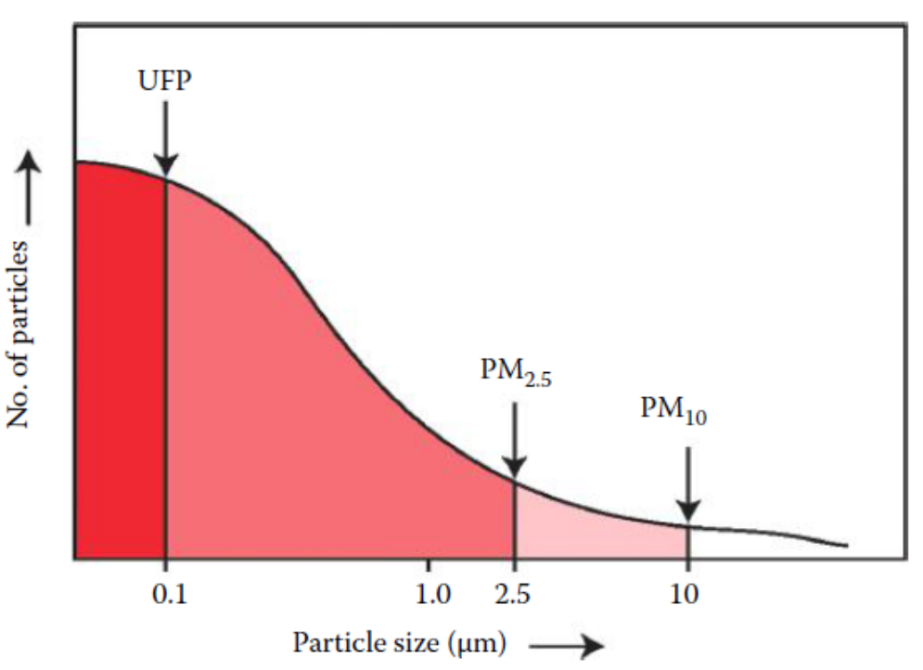
Particle Size
Coarse Particles
  Coarse particles above 10 μm are not dangerous to one’s health
    allergens—like pollen (10–50 μm), dust mites, and mold spores
  The properties of coarse particles are mainly dominated by their bulk structure
Fine Particles
  The EPA has classified airborne PM by the acronym PM_{S}
    where S = size range of the particles as measured in micro-meters
  Bacteria and red blood cells are also classified as fine particles
  Fine particles can cause pulmonary inflammation and toxicity,
    which can lead to respiratory problems
PM = particulate matter
UFP = ultrafine particles

Slide 25
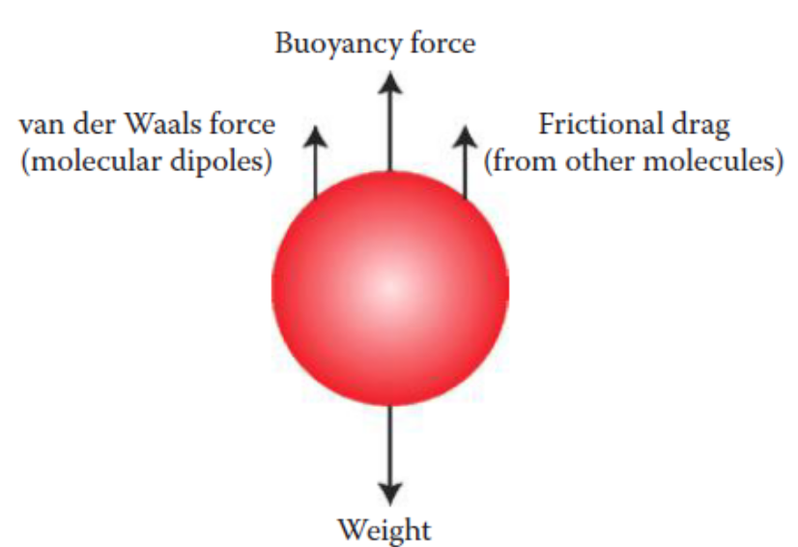
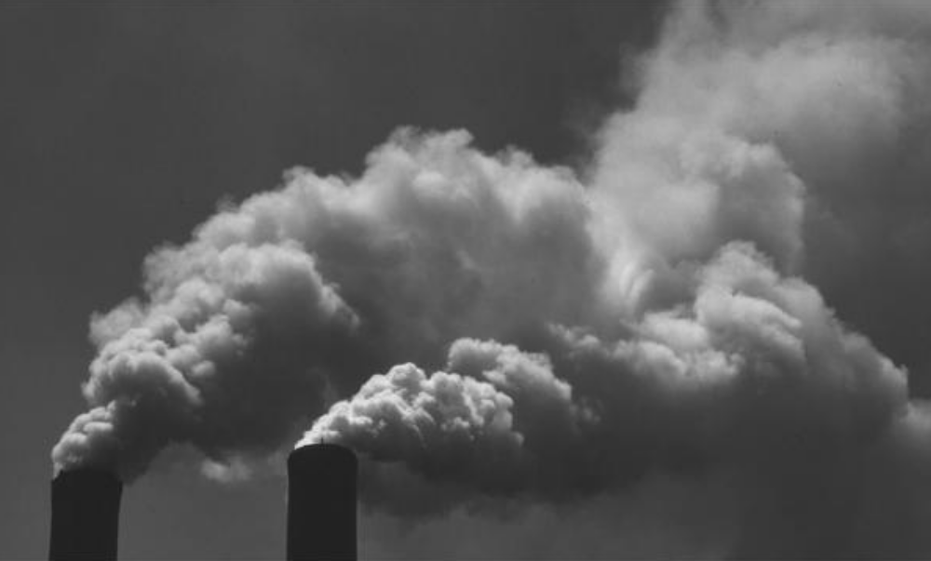
Particle Size
Very Fine Particles
  Very fine particles are classified as PM ≤2.5 μm in size
  They consist of microscopic and submicroscopic particle sizes
    fog droplets have sizes of ∼2.5 μm diameter or smaller
    Some dust particles
    soot, acids, and hydrocarbons that are emitted from automobiles
      Aggregated soot particle
    the burning of fossil fuels in factories and power plants
the gravitational force on nanoparticles is negligible, because surface effects predominate over gravity
Very fine particles can infiltrate deeper into the respiratory system than fine particles
Particles ≤2.5 μm can clog the alveolar membrane.
Very fine particles can cause pulmonary inflammation and toxicity that can lead to emphysema and cancer
Very fine particles are so small in mass they can remain suspended in air, and they will not settle to the ground by gravity

Slide 26
Particle Size
Ultrafine Particles
  Particle sizes ≤100 nm (≤0.1 μm) are commonly called UFPs (ultrafine particles) by the EPA
  Carbon soot is the main ingredient of UFPs that is created by burning fossil fuels
  The UFP sizes are potentially the most dangerous, because they can migrate into the olfactory (odor sensory) nerves and into the blood stream
  Only the very small nanoparticles would be expected to diffuse through the alveolar membrane
  Once inside the membrane, these UFPs could enter the bloodstream. Then they could deposit in the circulatory system
  They also could penetrate cells and lodge inside the cell structures, like the mitochondria, which could cause cell damage and even cell death (apoptosis)
  Once inside the cell, the nanoparticles could penetrate the cell nucleus and react with DNA.
    They could generate free radicals which could be harmful to cell membranes, DNA, RNA, and proteins
  tobacco smoke and viruses are in the UFP size range
  In vitro nanoparticles of carbon have been reported to cause oxidative stress and lung inflammation in humans

Slide 27
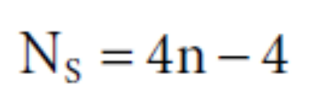
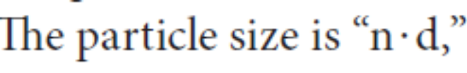

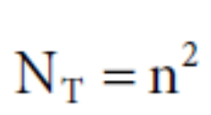

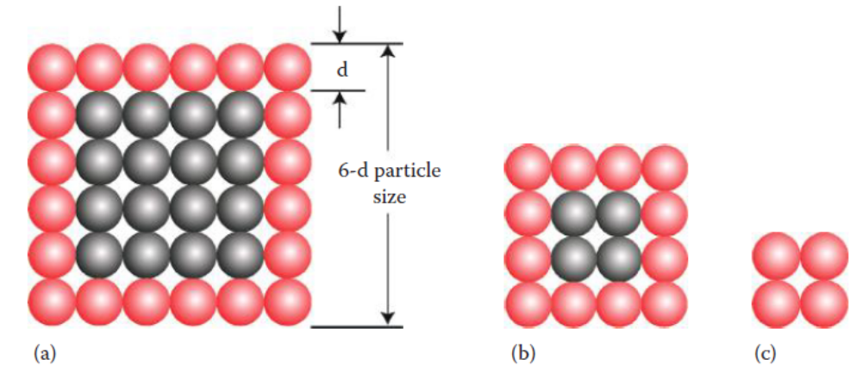
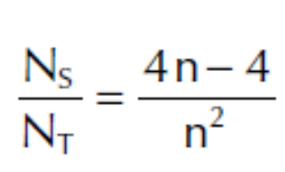
Particle Size
Surface Atoms and Size Dependence
  The increased chemical reactivity of nanoparticles was due to a greater number of surface atoms
  Decreasing the nanoparticle size increases the fraction of atoms on the surface, and the surface atoms have broken (or dangling) bonds, which are also called “reactive sites.”

Slide 28
Particle Size
Some Lessons Learned
  There are examples where micro- and nanosized particles have been tested on animals, rodents, and fish
  Although the materials may be chemically inert inside one’s body (like carbon, mineral dust, gold, and TiO2), when their size was <100 nm, the lungs of animals were injured—causing inflammation, oxidation stress, and pulmonary toxicity (or cytotoxic cell response)
  when nanoparticles were aggregated, the effects appeared to be nontoxic
  Buckyballs caused oxidative stress of cell membranes in the brain of large-mouth fish
  at high concentrations, the effect disappeared (which could have been due to particle aggregation)
  Cases indicate that exposure to very fine particles and UFPs can cause health problems
    After the collapse of the World Trade Center (September 11, 2001) in New York City, fire fighters and workers at Ground Zero inhaled very fine and UFPs of concrete dust. Hundreds of fire fighters developed severe respiratory illness and became disabled, and unfortunately some died
    cigarette smoking has been well documented to cause pulmonary injury, and it has been linked to lung cancer

Slide 29

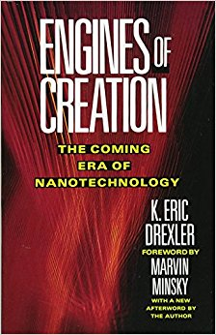
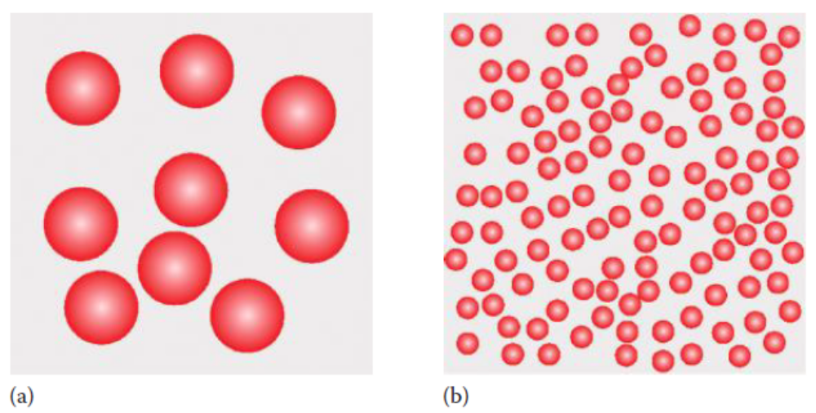
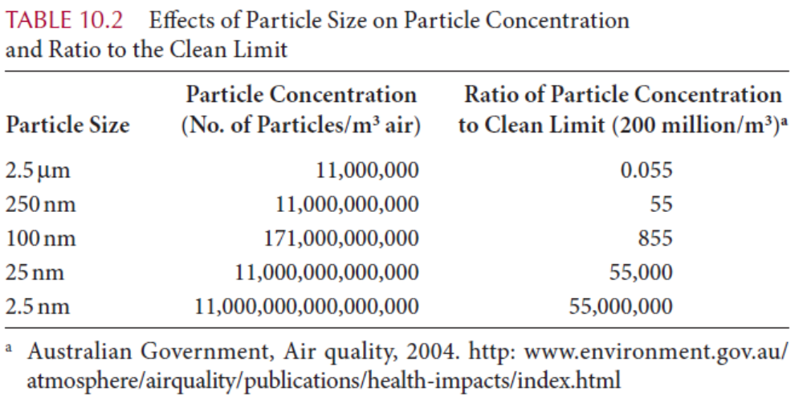
Particle Concentration
Mass concentration is a measure of air quality that is reported for particle pollution
The EPA measures air quality as particle mass per cubic meter of air volume, or μg/m³ of air
in terms of air quality, any measurement <2 × 10⁸ particles/m³ (or 200 million particles/m³ air) is considered “clean” air
What happens to the particle concentration when the particle sizes are less than 2.5 μm?
when the particle size is reduced by 10³, both the particle concentration and ratio of particle concentration-to-clean limit increase by 10⁹
Engines of Creation and Prey
134 μg/m³
1.5 g/cm³
bacteriophages
  viruses that inject their DNA into bacteria and multiply very quickly

Slide 30
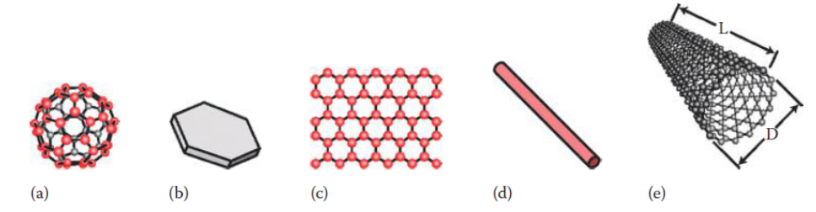
Particle Shape
Nanomaterials come in various shapes
  spheroidal shapes—Qdots, buckyballs, and colloids.
  platelet-shaped particles—like graphene and clay particles.
  fiber-like shapes—like nanotube and nanowires.
Particle shape plays a major role in nanotubes and nanowires, because they are very similar to fibers

Slide 31
Fiber Shapes
The World Health Organization (WHO) has defined fibers as elongated particles with a length (L)-to-diameter (D) ratio of L/D ≥3
The L/D ratio is also called “aspect ratio.”
Particles are classified as fibers when their lengths are greater than 5 μm and their diameters less than 3 μm
Nanotubes can have high aspect ratios of L/D ∼50–1000
Their diameters can range from ∼1 nm for single-walled nanotubes (SWNT) to ∼50 nm for multiwalled nanotubes (MWNT)
Nanotubes and nanowires (L > 100 nm and D ∼3 nm) fall under the definition of fibers

Slide 32
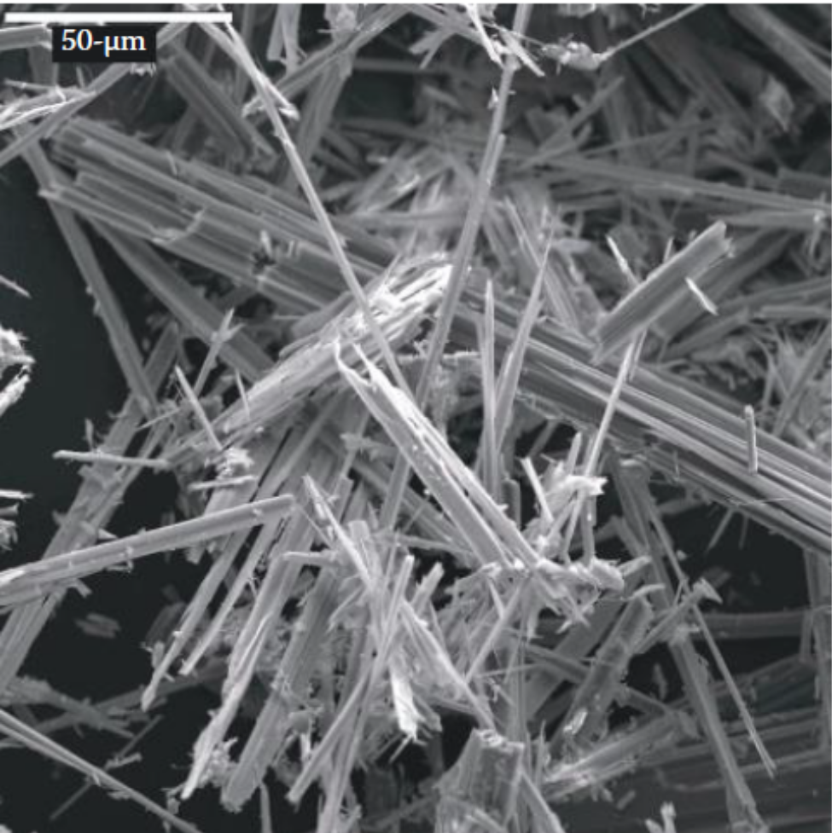
Fiber Risks
It has been known for over 100 years that fibers (when inhaled) can become embedded in the lung tissue
This behavior causes inflammation, cell growth, and tissue thickening around the fibers, which is called pulmonary fibrosis
The most common fibers are asbestos and quartz
Many years ago asbestos was not viewed as being dangerous. It had been installed in building insulation, drywall, vinyl tile, acoustic ceilings, and a host of other products, such as auto brake pads
nanotubes are also high-aspect-ratio fibers, they could be potentially as dangerous as asbestos
  inhaled carbon nanotubes can have the same sort of pulmonary inflammation and oxidative stress as asbestos (2004)
  chemically unmodified carbon nanotubes (without surface groups) were injected into the bloodstream of rabbits, the nanotubes were rapidly cleared from their livers. No immediate harmful health effects were observed (2006)
Conflicts in test data are common

Slide 33
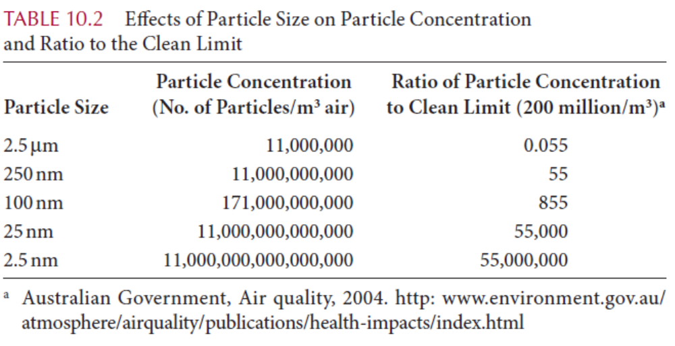
Surface Effects
the main risk of nanoparticles is not from their bulk chemistry
The main risk is from their reactive surface sites, which is caused by their small particle sizes
surface effects are influenced by
  surface charge
  surface coatings

Slide 34
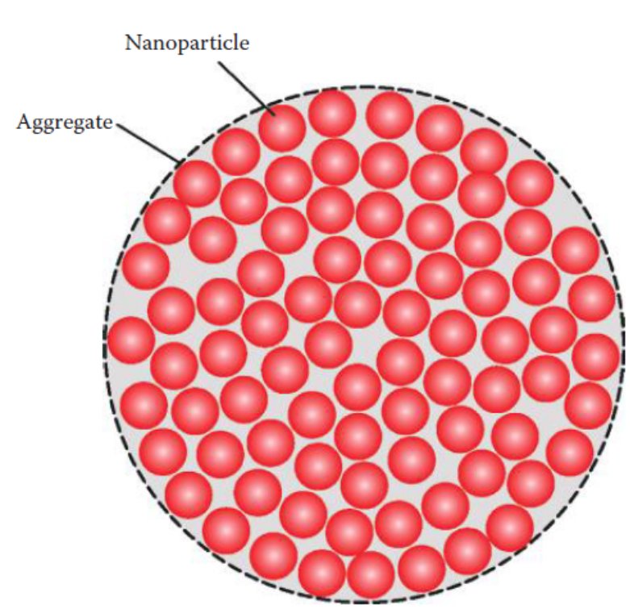
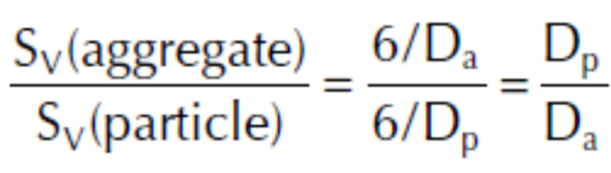
Surface Charge
Many nanoparticle surfaces have negatively charged surfaces, which is caused by an asymmetry of their electron orbitals about the atom’s nucleus
  Their negative surface charge also occurs due to dangling bonds
Nanotubes and buckyballs are good candidates for being either e-acceptors or e-donors
  If they are e-acceptors, they act as antioxidants and soak up the free radicals, which is very desirable
  If they are e-donors, they create free radicals, which is harmful
  we are not sure whether the surface charge will be helpful or harmful.
“aggregation” occurs when groups of nanoparticles flock together to form a clump
  The effective particle size has increased
  the toxic effects of nanosized particles disappeared
    increasing the concentration of nanoparticles appears to be desirable
    When aggregation increases the particle size above 2.5 μm
      the toxic effects of nanoparticles can be drastically reduced

Slide 35
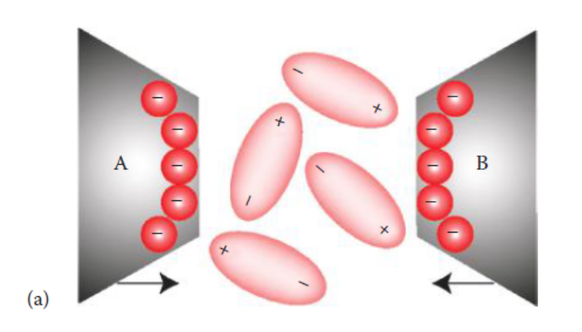
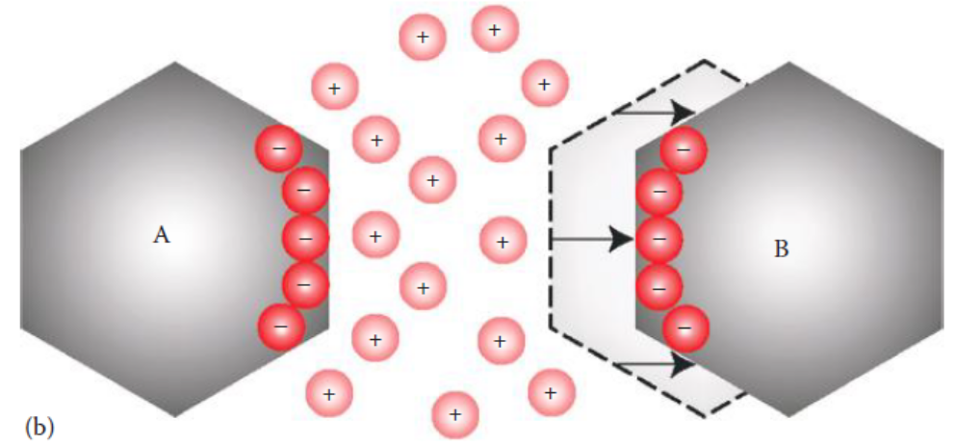
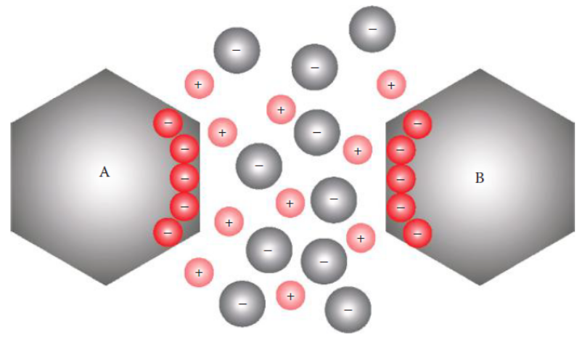
Surface Charge
2006, ∼40 nm size unmodified C60 buckyballs showed some aggregation in breast epithelial cell cultures
  The aggregated buckyballs were absorbed by the cells,
  they were reported to be nontoxic to the cells and did not alter cell growth.
  It was suggested that these fullerenes could be used as nanocarriers for treatment in biomedical applications.
The polarized surface charge between the particles will induce dipoles to form in the particle’s environment. The particles will be weakly attracted to each other by dipole–dipole or dipole-induced dipole (van der Waals) forces
The acidic environment will have a high concentration of H⁺ ions. The hydrogen ions will overpower the dipole–dipole interactions, and they will neutralize the negative nanoparticle charge. The high concentration of H⁺ ions will cause the particles to separate (or de-aggregate)
Semilar situation where the particles are in a salt solution

Slide 36
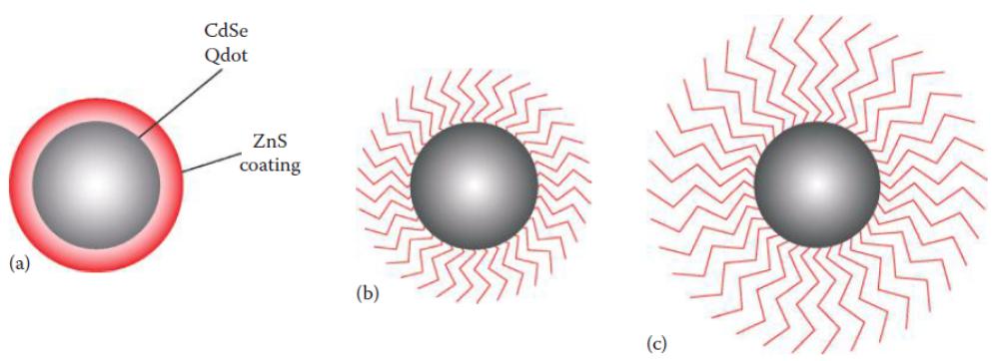
Surface Coatings
Surface coatings are another means of modifying the reactive surfaces of nanoparticles
Surface coatings that are applied directly to the nanomaterial are used to protect the nanoparticle
Two types of coatings that have been used are
  continuous coatings
    Continuous ZnS coatings can be used to prevent the Cd ions in CdSe from leaking out, which could release this toxic chemical into the body
  polymer-like coatings
    It has been shown the Qdots prepared with low and high molecular mass functional coatings reduced cellular absorption, and they were nontoxic to cells
Treating the surfaces of nanoparticles with functional groups is desirable
  to deactivate the fullerenes and nanotubes
Gum arabic (food additive) has been used to stabilize gold (Au) nanoparticles
  Gum arabic is a nontoxic substance (consisting of sugars and proteins) that coats Au nanoparticles for in vivo medical applications
  to make Au nanoparticles nontoxic, stable, and biocompatible, so the body would not reject them
hydrophilic polymer coatings were applied to 30 nm size TiO2 nanoparticles in sunscreens
  to be effective in blocking O ₂⁻ free radical generation under UV radiation
Also DNA mixed with the polymer-coated nanoparticles showed nearly no damage

Slide 37
Solubility
Solubility is defined as the ability of one substance (a solute) to dissolve in another substance (solvent)
Solubility can be achieved by using functional groups and attaching the molecules to nanoparticles
Surface Groups
  Surface groups are also called functional groups
  The process of attaching the molecules to the surfaces of nanoparticles is called surface modification or surface treatment
  They modify the surface chemistry of nanoparticles in order to perform specific functions
    Hydrophobic
      silanes, like trimethylsilanol [3(CH₃) ・ SiOH],
    Hydrophilic
      polyethylene glycol (PEG)
    changing the cellular absorption (“uptake”),
    protecting the nanoparticle surface

Slide 38
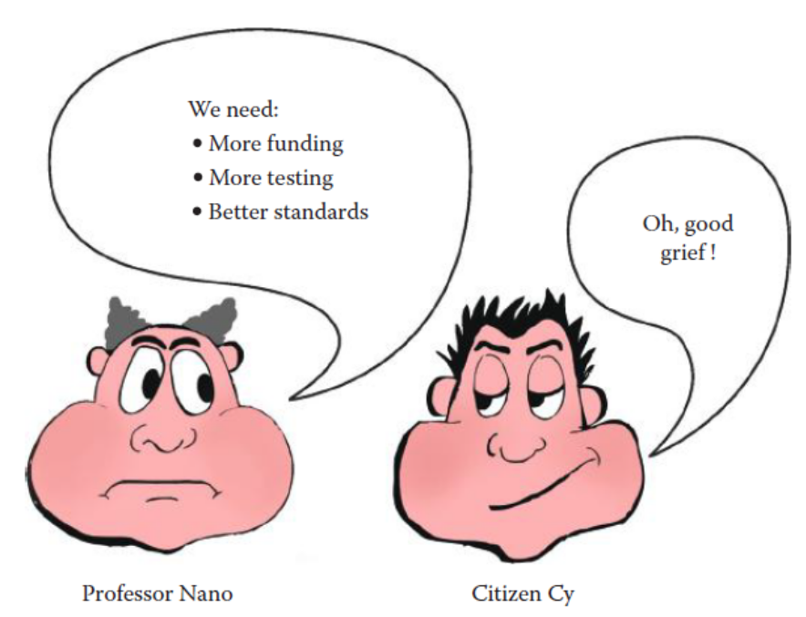
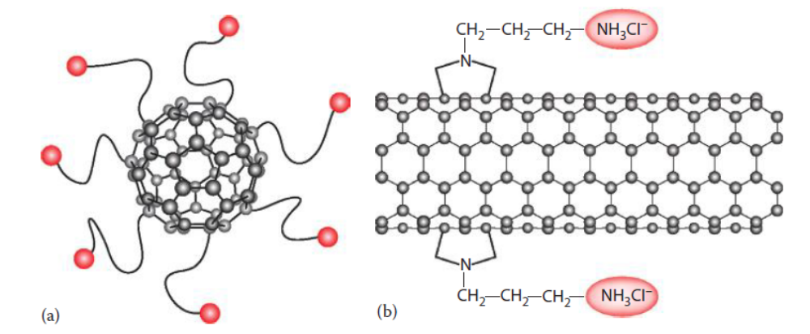
Solubility
How do these surface groups work?
The functional groups usually form a covalent bond and attach themselves to the surface of nanotubes and buckyballs
lipid membranes act as barriers to hydrophilic nanoparticles
  the polar nanoparticles are not easily absorbed by the cell membranes
  nonpolar (hydrophobic) nanoparticles will be readily absorbed and will pass through the cell membrane
  cellular toxicity can be reduced if the nanoparticles have polar end groups

Slide 39
SOURCES OF NANOPARTICLES AND THEIR HEALTH EFFECTS
Natural sources of nanoparticles
  The aerosols generated by human activities are estimated to be only about 10% of the total, the remaining 90% having a natural origin
    mineral aerosols primarily from soil deflation (wind erosion) with a minor component (<1%)
    from volcanoes (16.8 Tg),
    sea salt (3.6 Tg),
    natural and anthropogenic sulfates (3.3 Tg),
    products of biomass burning excluding soot (1.8 Tg),
    industrial sources including soot (1.4 Tg),
    natural and anthropogenic nonmethane hydrocarbons (1.3 Tg),
    natural and anthropogenic nitrates (0.6 Tg),
    and biological debris (0.5 Tg)
“Tg” here denotes terragram, equal to 10¹² g

Slide 40
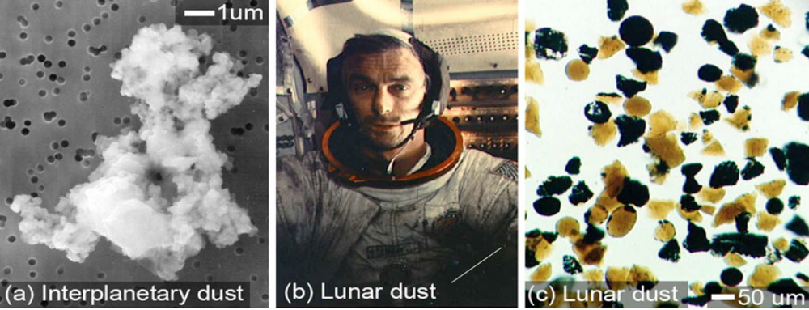
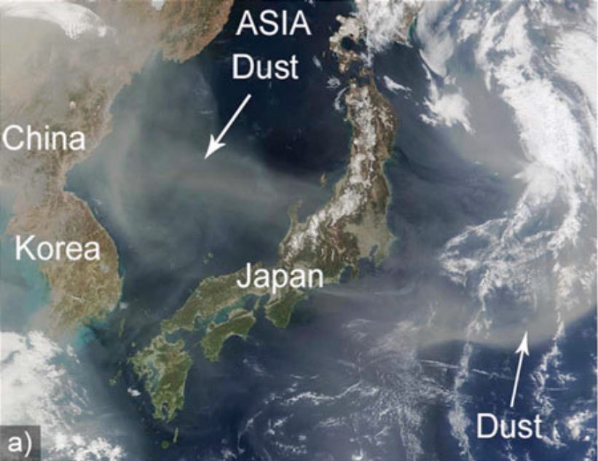
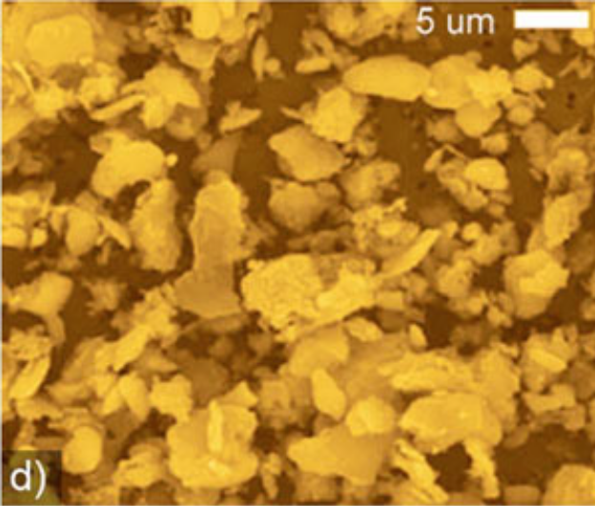
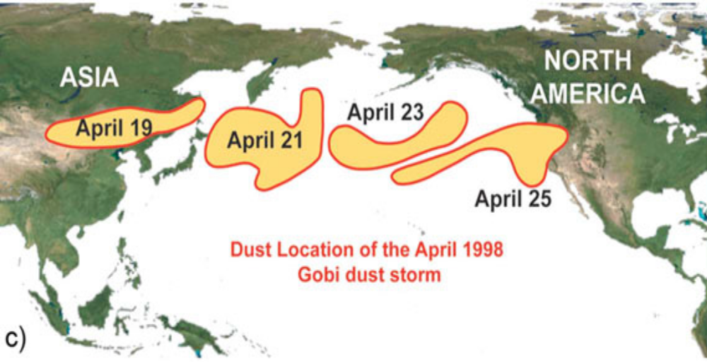





SOURCES OF NANOPARTICLES AND THEIR HEALTH EFFECTS
Dust storms and health effects
  Terrestrial dust storms.
    Approximately 50% of troposphere atmospheric aerosol particles are minerals originating from the deserts
    The size of particles produced during a dust storm varies from 100 nm to several microns
    One third to a half of the dust mass being smaller than 2.5 µm.
    Particles in the range 100–200 nm can reach concentrations of 1500 particles/cm³
    200 types of viable bacteria and fungi have been found to survive ultraviolet light exposure during intercontinental journeys from Africa to America
  Extraterrestrial dust
    The extraterrestrial dust poses major environmental problems for astronauts as well as for equipment
    The lunar dust contains a considerable amount of magnetic nanoparticles, clinging to electrostatically charged surfaces such as the astronauts’ space suits rendering it nearly impossible to remove
    On Mars, dust accumulating on the solar panels of the exploration robots has limited the power available to them for locomotion, sensing, and communication
    Various research projects are directed towards the fabrication of filters or thin film coatings that repel dust

Slide 41


SOURCES OF NANOPARTICLES AND THEIR HEALTH EFFECTS
Forest fires and health effects
  Patients with preexisting cardiopulmonary conditions reported worsening symptoms during smoke episodes
  Around 75% of fire-related deaths are due to respiratory problems related to smoke inhalation and not necessarily burns

Slide 42





SOURCES OF NANOPARTICLES AND THEIR HEALTH EFFECTS
Volcanoes and health effects
  When a volcano erupts, ash and gases containing particulate matter ranging from the nanoscale to microns are propelled high into the atmosphere, sometimes reaching heights over 18 000 m
  a single volcanic eruption can eject up to 30×10⁶ tons of ash
  Volcanic ash that reaches the upper troposphere and the stratosphere can spread worldwide and affect all areas of the Earth for years
  blocking and scattering of radiation from the sun
  the highest levels of particulate matter are found in areas within tens of kilometers from the volcano
  Health effects
    respiratory effects
    eye and skin irritation
    diseases of lympho-endothelial origin
      Podoconiosis
      Kaposi’s sarcoma

Slide 43

SOURCES OF NANOPARTICLES AND THEIR HEALTH EFFECTS
Ocean and water evaporation, and health effects
  A large amount of sea salt aerosols are emitted from seas and oceans around the world
  These aerosols are formed by water evaporation and when wave-produced water drops are ejected into the atmosphere
  Their size ranges from 100 nm to several microns
Health effects
  No adverse health effects have been associated with sea salt aerosols
  Beneficial health effects have been suggested from the use of salt aerosols in the restoration of the mucociliary clearance in patients with respiratory diseases
    The unique microclimate of salt mines is a popular way to treat asthma
  However, sea salt aerosols may transport pollutants and microorganisms that themselves may cause adverse health effects

Slide 44

SOURCES OF NANOPARTICLES AND THEIR HEALTH EFFECTS
Organisms and health effects
  Many organisms are smaller than a few microns including viruses (10–400 nm) and some bacteria (30 nm–700 µm).
  we should make a clear distinction between what we call “particles” (microparticle or nanoparticle) and nanoorganisms or their components (including bacteria, viruses, cells, and their organelles).
  Many organisms, both uni- and multicellular, produce nanoparticulate inorganic materials through intracellular and extracellular processes
    Magnetotactic bacteria (magnetite Nanoparticles)
    Diatom (siliceous materials)
    S-layer bacteria (calcium carbonate)
    Nanobacterium (calcium phosphate)
Health effects and treatment
  Among these biological nanoparticles, diatoms might pose a health risk
  biogenic magnetite is associated with neurodegenerative diseases
  nanobacteria shells were found in humans and animals
    the cause at least in part for many diseases involving calcifications, such as artery plaque, aortic aneurysm, heart valves, renal stone formation, chronic prostatitis, ovarian and breast tumors

Slide 45








SOURCES OF NANOPARTICLES AND THEIR HEALTH EFFECTS
Anthropogenic nanomaterials
  Diesel and engine exhaust nanoparticles
    Most particles from vehicle exhaust are in the size range of 20–130 nm for diesel engines and 20–60 nm for gasoline engines
  Indoor pollution
  Cigarette smoke
    tobacco smoke is composed of nanoparticles with size ranging from around 10 nm up to 700 nm, with a maximum located around 150 nm
  Building demolition
  Cosmetics and other consumer products
  Engineered nanomaterials

Slide 47

BENEFITS VERSUS RISKS
In order for nanotechnology to be accepted by society, the public needs to be made aware of its benefits and risks
  Benefits are defined as favorable or desirable consequences (advantages)
  risks are defined as the probability (chance) of having undesirable consequences
we need to learn the public’s opinion and concerns about nanotechnology
  “How risky and beneficial do you consider each of the following items for the U.S. society?”
In a 2007 study at Rice University, researchers found they could feed carbon nanotubes to fruit flies without any adverse effects
a 2007 poll found that only 7% of Americans would purchase food enhanced with nanomaterials, even though previous studies have indicated that nanoparticles could be safe to ingest
Benefits vs. risks of nanotechnology against other technologies

Slide 48
RISK ASSESSMENT
The definition of risk assessment is the knowledge and skill in evaluating risk data, which are sometimes variable and uncertain
In order to establish a risk assessment plan on nanomaterials, the following questions need to be answered
  Do nanoparticles have adverse effects? If so, what are they?
  What are the dose–response relationships?
  What are the occupational/environmental safe levels in different media?
  What is their calculated risk?
Once these questions are answered, exposure guidelines, safe practices, and risk assessment can be determined
  Regulation Anybody?
  In Search of Standards
  Standardized Testing
  Risk Classification

Slide 49
Regulation Anybody?
U.S. governmental agencies that have a stake in regulating nanotechnology products are
  Food and Drug Administration (FDA),
    The FDA is interested in overseeing nanotechnology products in areas such as foods, animal feeds, cosmetics, drugs, biologics, and medical devices
    the FDA made recommendations for a staged approach to determine the risk of nanotechnology
    The FDA will not regulate it without knowing the exposure guidelines and health/safety limits
  Environmental Protection Agency (EPA),
    The EPA works with the same agencies as the FDA. However, their role in nanotechnology is different
    The EPA wants to ensure unintended consequences and exposures to humans and ecosystems are either prevented or minimized
    The EPA’s Nanotechnology Toxicity Program is engaged in ecology and safety research on some common nanomaterials— fullerenes, carbon nanotubes, TiO2, cerium oxide, silver, and iron
  National Institutes of Health (NIH),
  National Institute for Occupational Safety and Health (NIOSH).
    The NIOSH is not a regulating agency
    NIOSH has the power to force nanomaterial manufacturers to follow its rules
    NIOSH is one of the first agencies to distribute guidelines on the exposure of nanoparticles.
      2010 - exposure limit of CNTs at 7 μg/m³ of air in an 8 h shift-the smallest detection in air samplings

Slide 50
In Search of Standards
There are organizations and universities involved in developing standards for risk assessment of nanotechnology
  The American Society for Testing and Materials (ASTM)
    The ASTM is an international society with the purpose of developing technical standards that guide in the design, manufacturing, and trade of products
    In 2005, ASTM formed Committee E56 on nanotechnology to develop standards and guidelines for handling nanomaterials
    Various subcommittees have also been formed—Committee 56.01 to develop nanotech terminology and nomenclature,
    Committee 56.03 to develop occupational exposure guidelines, risk assessment, monitoring, and disposal of nanomaterials.
  The International Council on Nanotechnology (ICON)
    ICON was established in 2005 at Rice University in conjunction with University of California, Santa Barbara (UCSB)
    The mission of ICON is to access, communicate, and reduce the nanorisks while maximizing the societal benefits
    The organization provides an online database of the scientific findings related to the risks and benefits of nanotechnology
  Rice University and UC, Santa Barbara’s Center for Nanotechnology in Society (CNS)

Slide 51
Standardized Testing
whether nanoparticles are a “nano” or “mega” risk?
  Well, that depends
  There seems to be conflicting data.
  It depends on whether their surfaces are modified.
  Individual nanosize particles have been reported to be harmful at certain concentrations.
  if the nanoparticles are aggregated and if they are coated with polymers or with certain functional groups, they appear to be nonhazardous
Standardized testing should consist
  (1) surface area characterization including aggregation and surface modification,
  (2) concentration of nanoparticles in air (for μg/m³ and particles/m³),
  (3) exposure time,
  (4) no dogs. Testing rats and mice is OK, but no dogs.

Slide 52

Risk Classification
Risk classification is a method of defining the different levels of risk in terms of their consequences
Since the 1970s, the aerospace industry has classified risks using failure mode and effects analysis (FMEA)
  FMEA is a detailed risk analysis on the possible failure of components in complex engineering systems—like airplanes and nuclear reactors
  In FMEA, risk depends upon the probability of failure of its components and their effects
  FMEA is a method of documenting the failure probability and its consequences
The risks of nanotechnology can be modeled after the risk classification for engineering systems in FMEA

Slide 53


RISK MANAGEMENT
Risk management is defined as making decisions within tolerable limits
It normally occurs after the risks have been assessed and classified. In other words, decisions on nanotechnology risk can be made based on what we are willing to tolerate
a practical example of risk management
  In 2006, there were ∼42,000 people who were killed on U.S. highways from automobile accidents. Assuming the U.S. population in 2006 was 300 million, the probability of highway death from cars is about 1.4 × 10⁻⁴ (or 14 persons out of 100,000 people). Understanding the probability of occurrence and its consequences, we can decide whether to drive our car on the highway
Decisions in risk management can be made by creating a diagram
manufacturing Qdots for biomedical imaging

Slide 54
Conclusion
So far micro- and nanomaterials have not presented a serious danger to the environment or to humans
Even if these materials happen to be hazardous, they still may be safely handled, contained, and controlled
An example of proper containment and safe handling is the electronics industry
The potential risk of most micro- and nanoparticles is usually not from their bulk chemistry
The risk is from materials with tiny particle sizes (with high surface-to-volume ratios)
The five risk factors that determine the potential toxicity of nanoparticles are material chemistry, particle size and concentration, particle shape, surface effects, and solubility
Micro- and nanoparticles can enter the body by inhalation, ingestion, or through the pores in our skin
Inhalation appears to be the most harmful, and ingestion appears to be nontoxic
Micro- and nanoparticles were correlated with airborne particulate matter (PM) in our environment
Testing on rodents has indicated when particle aggregation increases above ∼2.5 μm, the toxic effects of nanoparticles seem to disappear
Surface-modified nanotubes and buckyballs with functionalized molecules appear to be nontoxic
Nanoparticles can be polymer coated with hydrophilic functional groups, so they will be water soluble and will not permeate cell membranes
Surface modification and aggregation appears make nanoparticles nontoxic
More data are necessary to understand the risk assessment of micro- and nanoparticles
Experimental testing has yielded conflicting results
The test methods need to be standardized according to surface area (or particle size), concentration, exposure time, and surface modification
Solving the “risk assessment” issue is a difficult problem, which needs to be attacked through the global cooperation of governmental agencies, academia, and private industry in a multidisciplinary effort
Outside of the EPA’s control of airborne particles that pollute our environment, micro- and nanoparticles are currently unregulated
Until risk assessment is in place, regulation appears to be premature
The method of risk management can be applied from the aerospace industry
The question on whether micro-/nanomaterials are a “nano” or “mega” risk still remains to be answered

Slide 55
Title and Content Layout with Chart

Slide 56
Two Content Layout with Table
First bullet point here
Second bullet point here
Third bullet point here
Class | Group A | Group B
Class 1 | 82 | 95
Class 2 | 76 | 88
Class 3 | 84 | 90

Slide 57
Two Content Layout with SmartArt
Group A
Task 1
Group B
Task 1
Task 2
Task 2
Group C
Task 1
Task 2
First bullet point here
Second bullet point here
Third bullet point here

