Slide 1
Classification of tourism

Slide 2
Classification of tourism
Region of tourism
Number of tourists
Duration of tourism
Season
Purpose of tourism
Attraction
Approach of tourism

Slide 3
Region of tourism
Domestic Tourism:
In this type of tourism the tourist visited the tourist spots within the boundaries of their country.
Foreign Tourism:
The tourist travels to such countries which are different from the countries of their residence. In this tourism visa, passport and other documents are essential for the tourist.

Slide 4
Number of Tourists
Individual Tourism:
Sometimes tourist goes individually on tours.
Mass Tourism:
In mass tourism large numbers of people set out at a time together for enjoying their leisure time.

Slide 5
Duration of Tourism
Short Term Tourism:
In short term tourism the duration of tourism is only one week to ten days.
Long Term Tourism:
In this type of tourism the duration of tourism is longer than short term tourism.

Slide 6
Season
Winter Tourism:
- skating and skiing
- ski and snow festival
Summer Tourism:
sunbath, water sports, and rain dance
Rainy Season Tourism:
Tourists are eager to take experience of heavy rainfall, fog and waterfalls. So the tourist arranges their tours at the high rainfall spot in rainy season.

Slide 7
Purpose of Tourism
Cultural Tourism
Heritage Tourism
Historical Tourism
Health Tourism
Medical Tourism
Religious Tourism
Educational Tourism
Rural Tourism
Agricultural Tourism
Farm Tourism
Political Tourism: political events and important national celebrations
Holiday Tourism
Wilderness Tourism

Slide 8
Attraction
Mountain Tourism
Space Tourism
Adventure Tourism
Sports Tourism
Dark Tourism

Slide 9
Mountain Tourism
The mountain tourism is big business in many hilly regions. Because mountaineering, trekking, rock climbing, skiing, river rafting, golf are the major attraction for the tourist besides natural scenic attractions.

Slide 10
Space Tourism
Space tourism encompasses not only tourist activities in space but also visiting earth based museum such as National Air and Space Museum, participating in space camps, enjoying theme parks. Space campers spend two weeks learning about the universe and space flight, riding in simulators using astronaut.

Slide 11
Dark Tourism
Dark tourism involving travel to sites associated with death and suffering. This tourism is identified by Lenon and Foley in 2000. This type of tourism involves visits to “dark” sites such as battlegrounds, scenes of horrific crimes or acts of genocide. This includes sites of pilgrimage such as the site of St. Peter‟s death in Roam battlefields in Scotland, sites of disaster either natural or man-made such as ground zero in New York. Prisons are now open for the public such as Boaumaris prison in Anglesey and Wales one of must notorious destination for dark tourism in the Nazi extermination camp at Auschwitz in Poland.

Slide 12
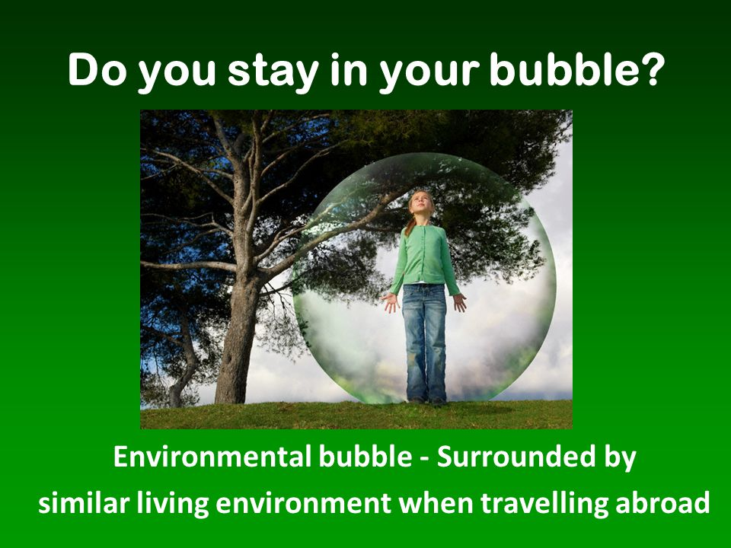

Slide 13
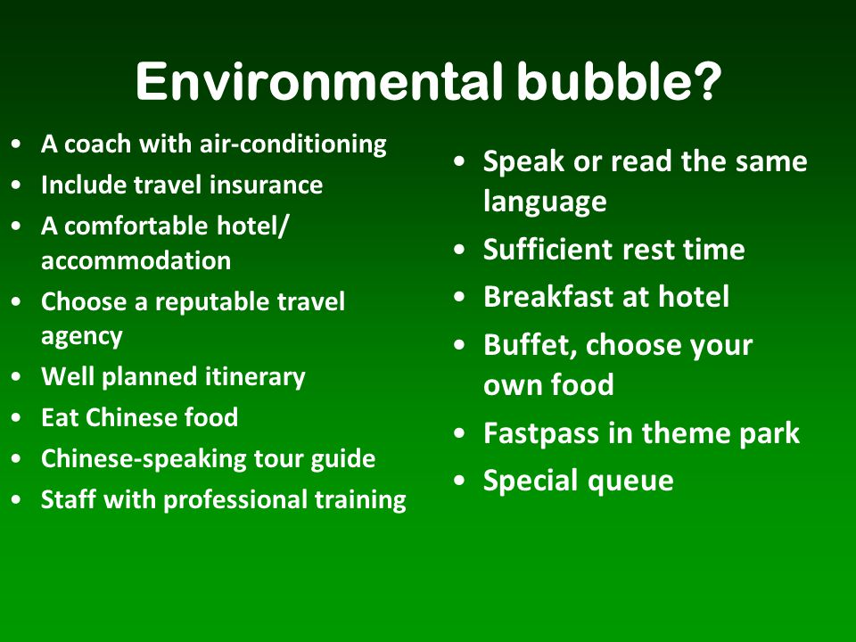

Slide 14
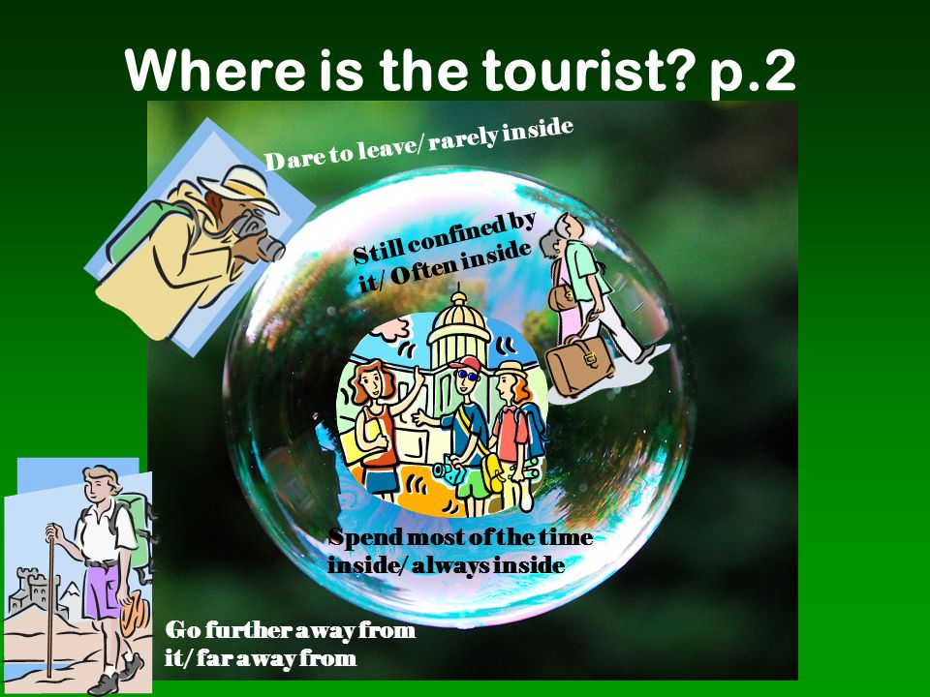

Slide 15
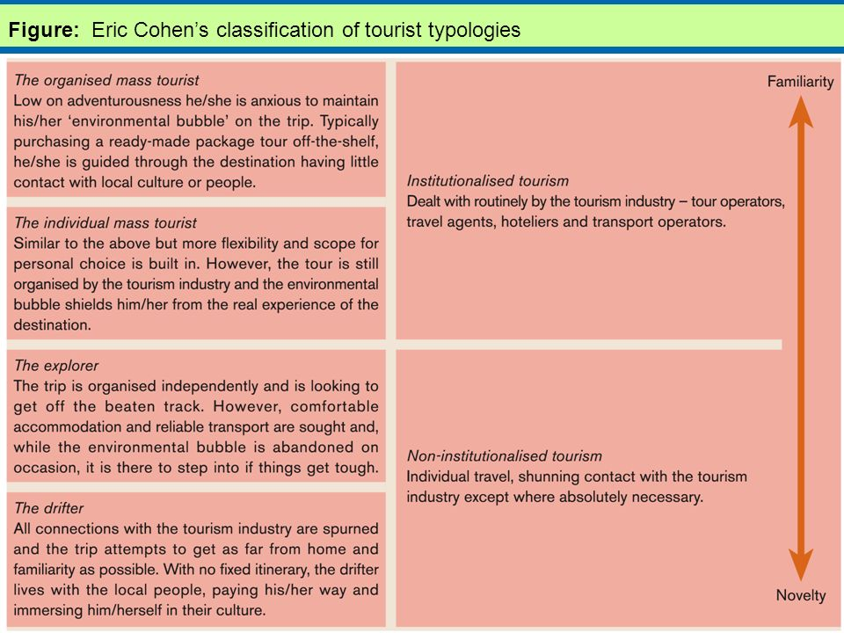

Slide 16
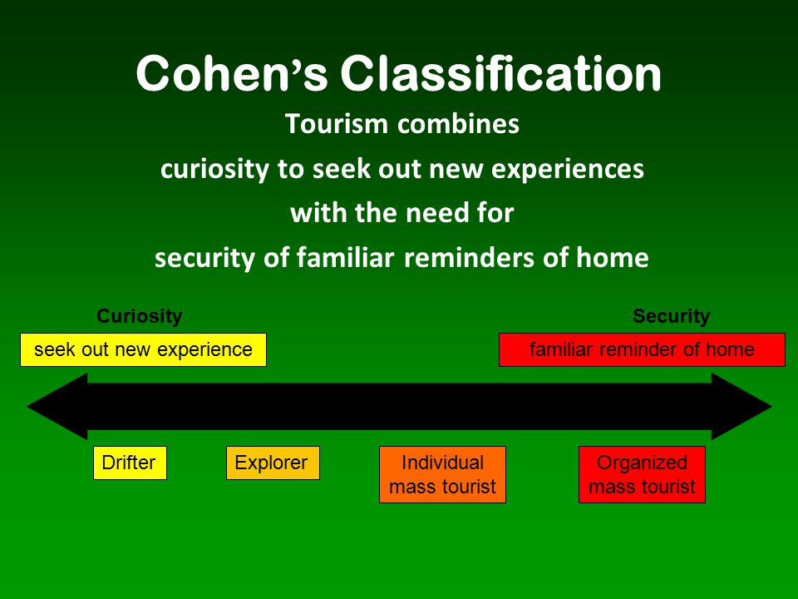

Slide 17
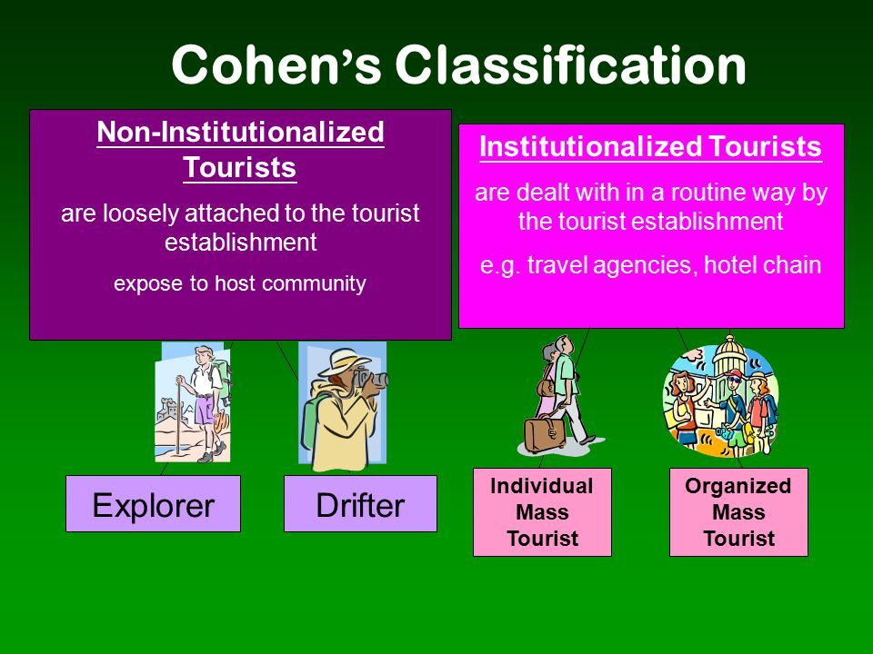

Slide 18
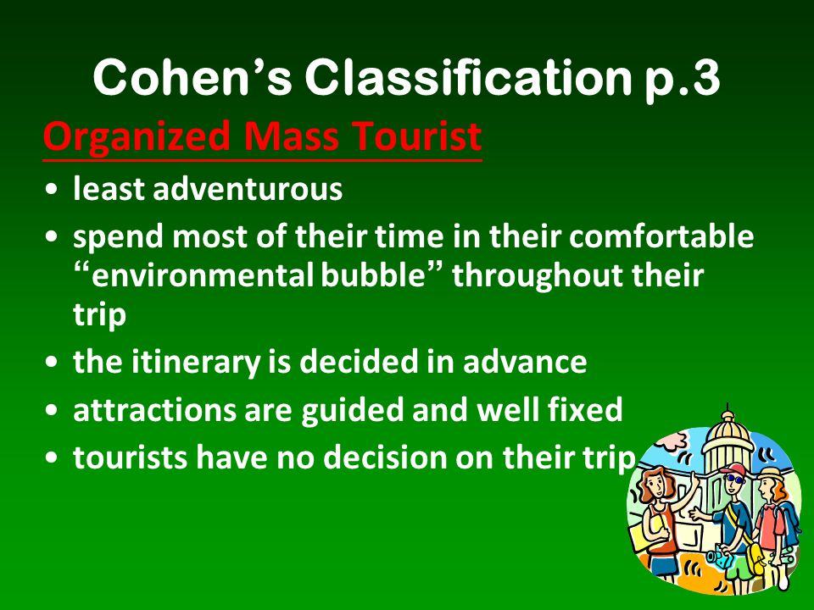

Slide 19
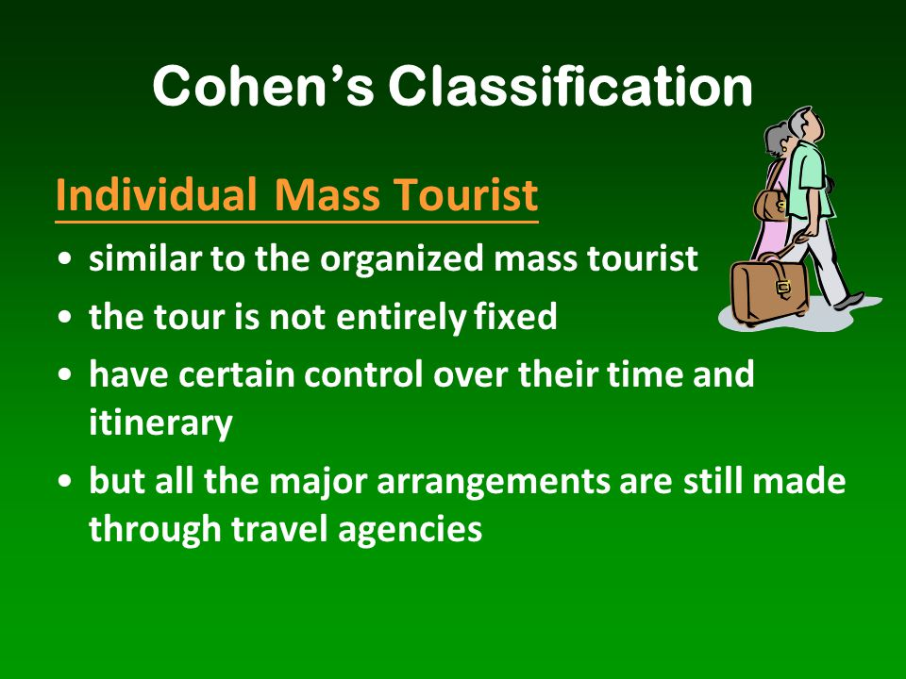

Slide 20
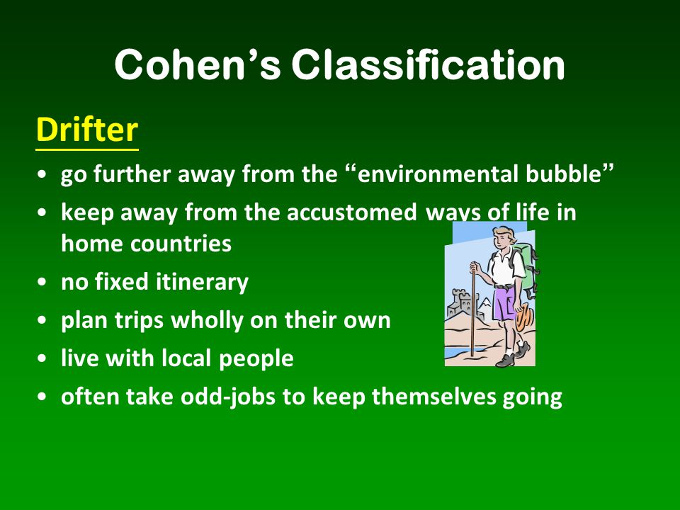

Slide 21


