Slide 1


Internet of Things (IoT)
Professor: Dr. Sadoon Azizi s.azizi@uok.ac.ir
Faculty of Engineering
Department of Computer and IT Engineering

Slide 2
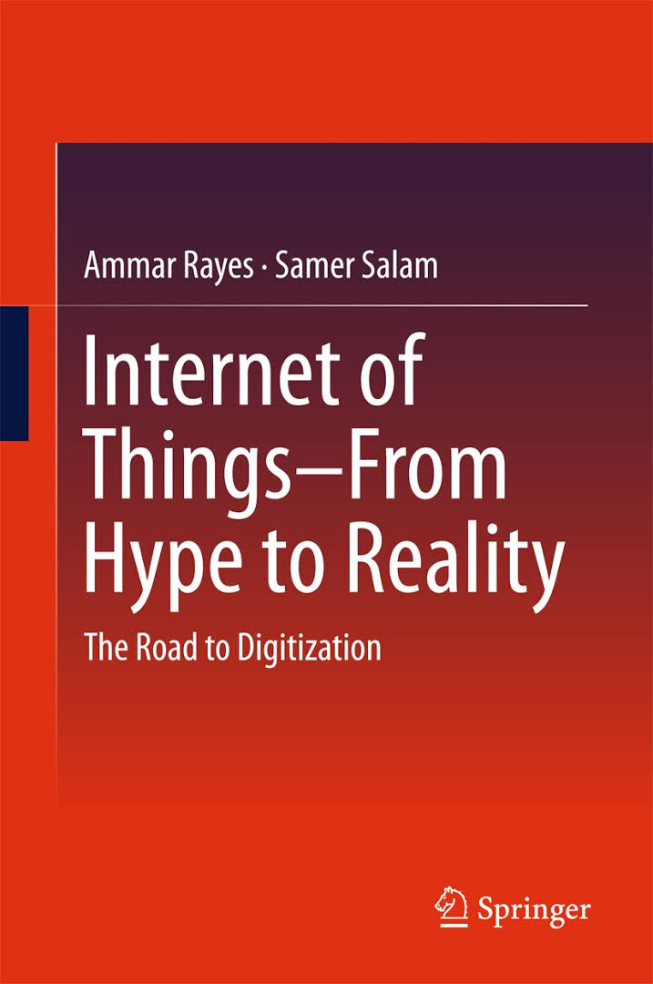
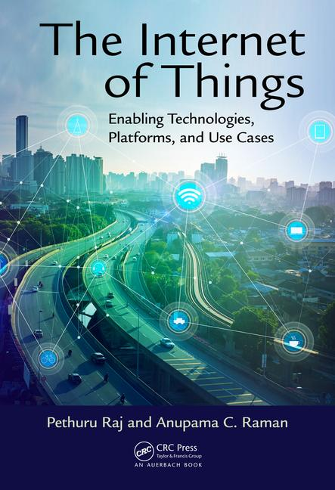
References
Internet of Things From Hype to Reality: The Road to Digitization by Ammar Rayes and Samer Salam, Springer, (2017)
The Internet of Things Enabling Technologies, Platforms, and Use Cases, by Pethuru Raj, Anupama C. Raman, CRC Press, (2017)

Slide 3
Headlines
an introduction to the Internet of Things
a glance over the traditional Internet
sensors, actuators, RFID
IoT requirements for networking protocols
IoT protocol stack
Fog Computing
some related papers

Slide 4
Evaluation
10 % | Homework
30 % | Research, Report, Presentation
30 % | Project
25 % | Final Exam
5 % | Class Activity

Slide 5
Ways to contact
azizi.cse@gmail.com
s.azizi@uok.ac.ir

