Slide 1
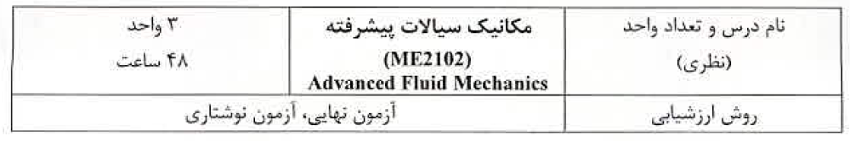

Slide 2


Slide 3
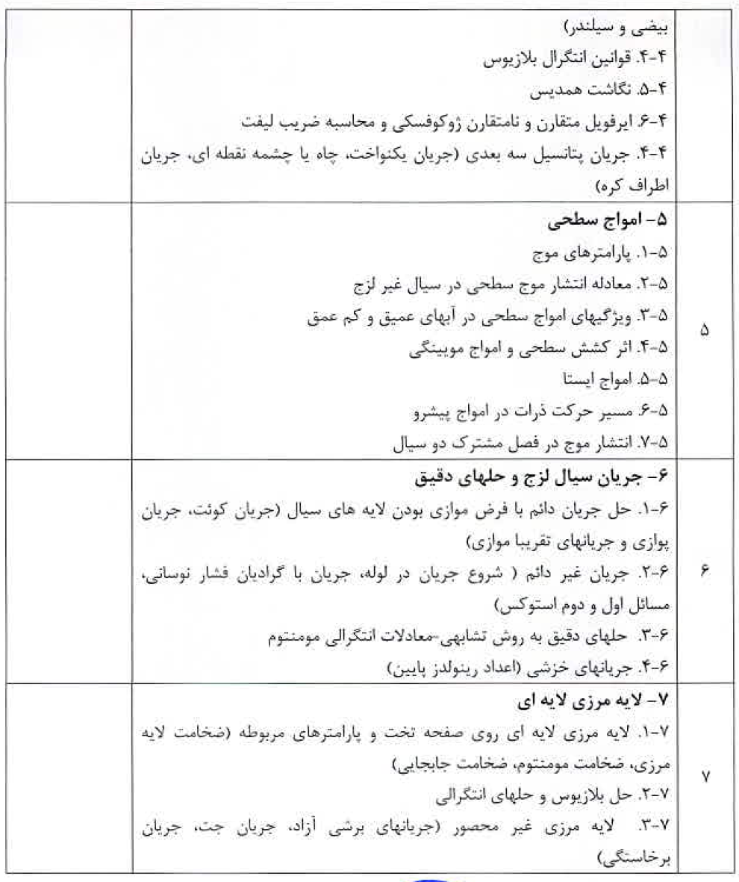

Slide 4
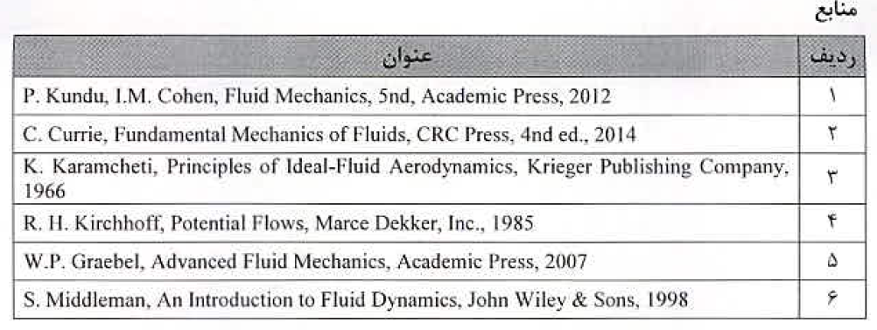


Slide 5
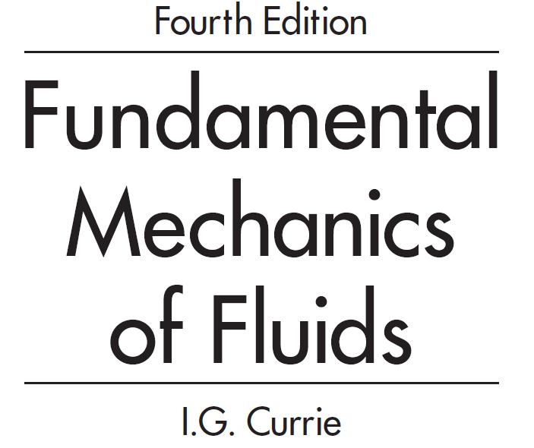

Slide 6
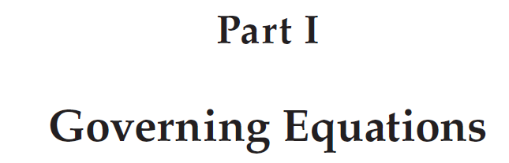
The essential purpose of this chapter is to derive the set of equations that results from invoking the physical laws of conservation of mass, momentum, and energy.

Slide 7
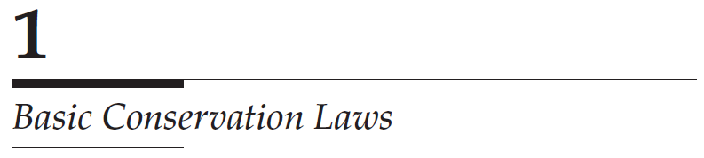

Slide 8
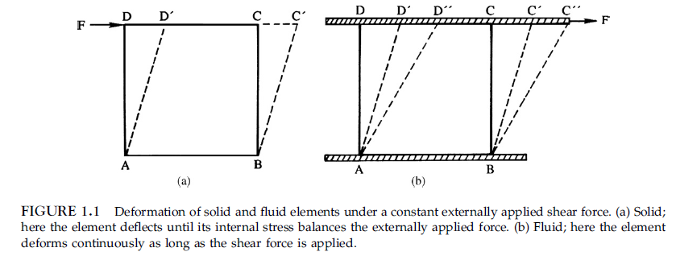
Solid and fluid, the difference

Slide 9
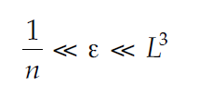
Continuity condition
n: is the number of molecules per unit volume
L is the smallest significant length scale in the flow field, which is usually called the macroscopic length scale.
The characteristic microscopic length scale is the mean free path between collisions of the molecules.
The above condition states that the continuum concept will certainly be valid if some volume ε that is much larger than the volume occupied by a single molecule of the fluid but much smaller than the cube of the smallest macroscopic length scale (such as cylinder diameter) can be found.
Since a cube of gas, at normal temperature and pressure, whose side is 2 μm contains about 2 × 10^8 molecules and the corresponding figure for a liquid is about 2 × 10^11 molecules, the continuum condition is readily met in the vast majority of flow situations encountered in physics and engineering.

Slide 10
Eulerian and Lagrangian Coordinates
In the Lagrangian approach, attention is fixed on a particular mass of fluid as it flows
In the Eulerian framework, the independent variables are the spatial coordinates x, y, and z and time t. This is the familiar framework in which most problems are solved.

Slide 11


Material Derivative
Let α be any field variable such as the density or temperature of the fluid. From the Eulerian viewpoint, α may be considered to be a function of the independent variables x, y, z, and t. During the time δt, the change in α may be calculated from differential calculus to be
$$δα=$$

Slide 12






vector form
$$\vec{u}=ui+vj+wk$$
tensor form

Slide 13
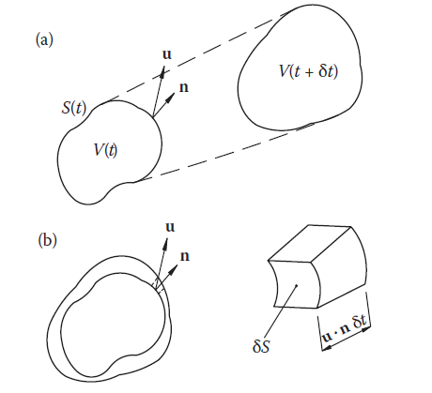

Reynolds’ Transport Theorem

Slide 14
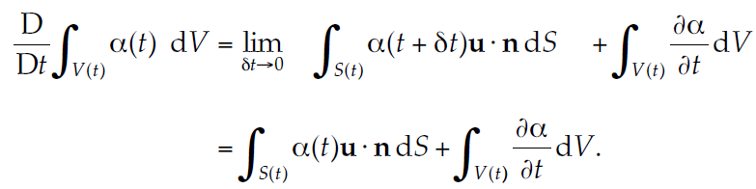
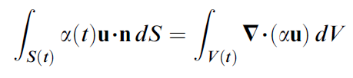
Gauss’ theorem

Slide 15
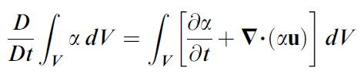
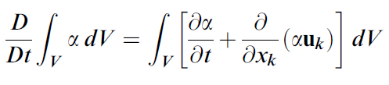
Substituting this result into the foregoing expression and combining the two volume integrals give the preferred form of Reynolds’ transport theorem:
or, in tensor notation,

Slide 16
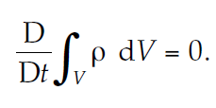

Conservation of Mass

Slide 17
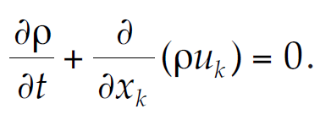
Since the volume V was arbitrarily chosen, the only way in which the above equation can be satisfied for all possible choices of V is for the integrand to be zero. Then, the equation expressing conservation of mass becomes
Why sometime the above equation is called continuity equation?
Notes:
Equation (1.3a) expresses more than the fact that mass is conserved. Since it is a partial di¡erential equation, the implication is that the velocity is continuous. For this reason Eq. (1.3a) is usually called the continuity equation

Slide 18
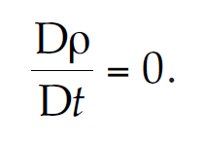
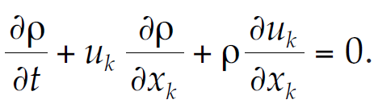
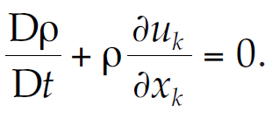
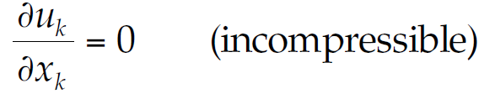
Incompressible fluids:

Slide 19
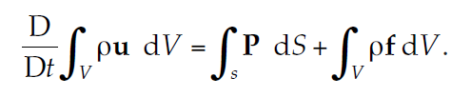
Conservation of Momentum

Slide 20
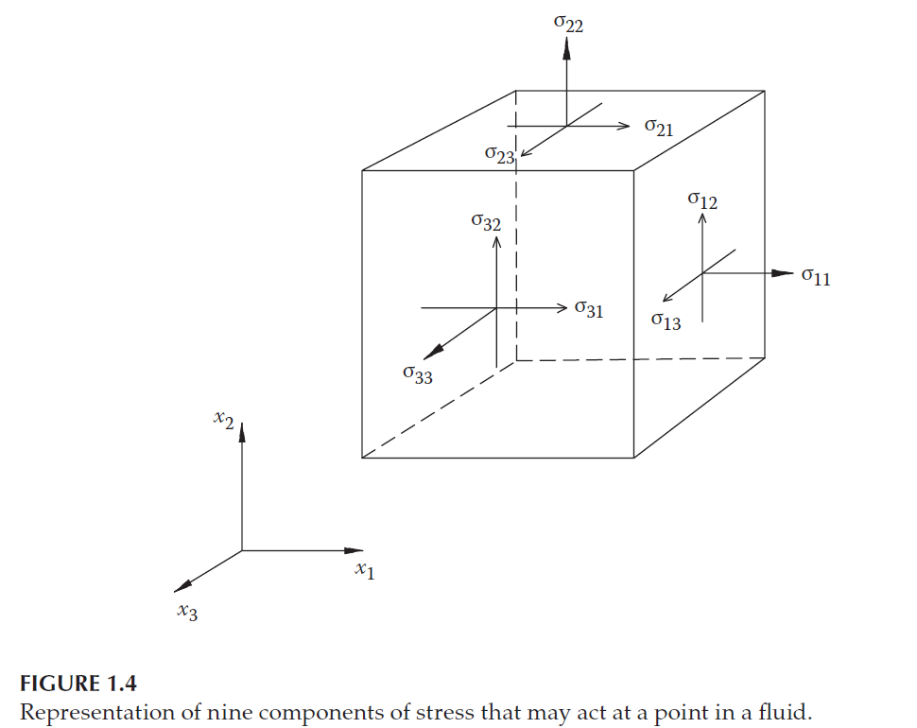
Stress tensor:

Slide 21

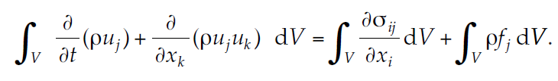
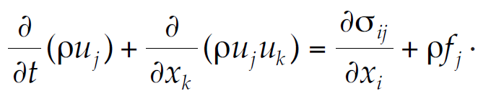

Divergence
theorem and
material derivative
تمرین

Slide 22
Conservation of Energy
The principle of conservation of energy amounts to an application of the first law of thermodynamics to a fluid element as it flows.
The first law of thermodynamics applies to a thermodynamic system that is originally at rest and, after some event, is finally at rest again.
Under these conditions, it is stated that the change in internal energy, due to the event, is equal to the sum of the total work done on the system during the course of the event and any heat that was added.

Slide 23
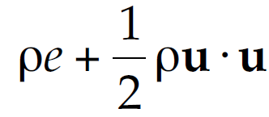

Deriving basic equations:
we again consider any arbitrary mass of fluid of volume V and follow it in a Lagrangian frame of reference as it flows.
The total energy of this mass per unit volume is:
so that the total energy contained in V will be:

Slide 24
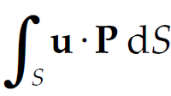

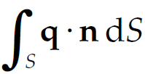
Work of external forces and heat leaving the fluid element:
Work of stress:
Work of body force:
the net amount of heat leaving the fluid per unit time:

Slide 25

The energy conservation equation:
In this way, the expression of the statement that the rate of change of total energy is equal to the rate at which work is being done plus the rate at which heat is being added becomes
q
n
q

Slide 26
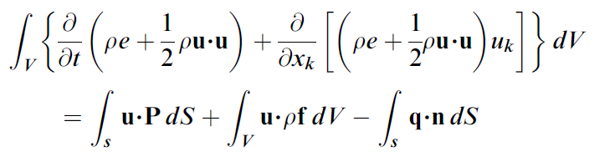
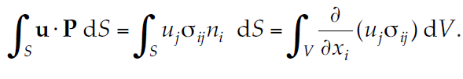
Using material derivative, Reynolds transport and divergence theorem
Material derivative:
Divergence theorem:

Slide 27

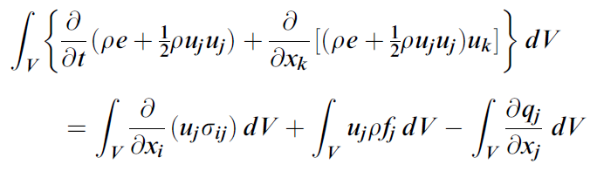
Divergence theorem:
As a result:

Slide 28
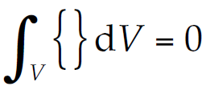
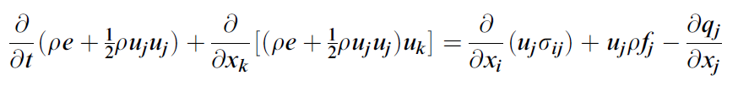
Every term is written in volume integral form:

Slide 29

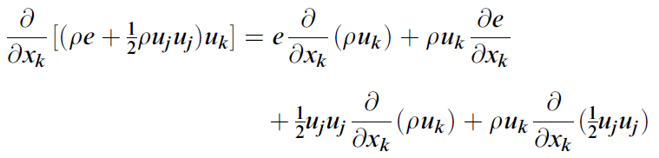
Simplifying the energy equation:
The first term of left side of the previous equation:
The second term of left side of the previous equation:

Slide 30

In this last equation, the quantity ∂ (ρuk)/ ∂xk, which appears in the first and third terms on the right-hand side, may be replaced by –∂ρ/ ∂t in view of the continuity equation. Hence, it follows that

Slide 31
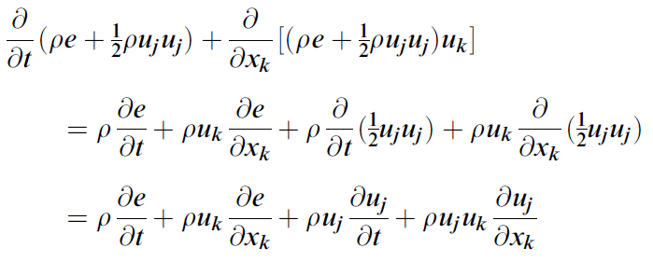
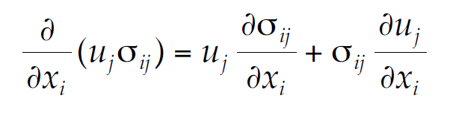
So that the left hand side will be:
Also:

Slide 32
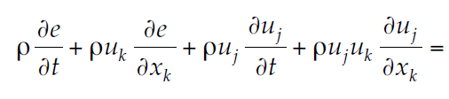
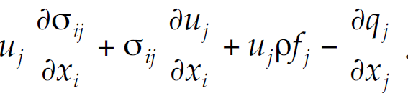
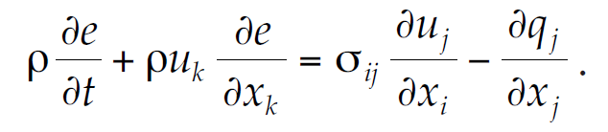
Cancelation of momentum equation hidden in the energy equation:

Slide 33
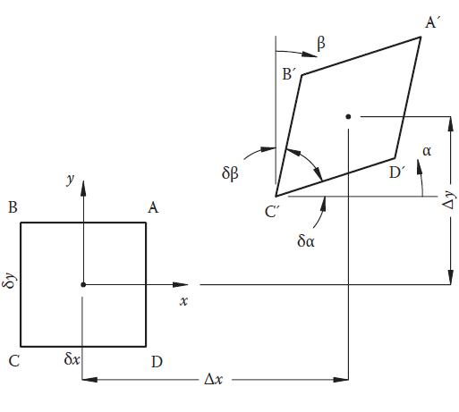
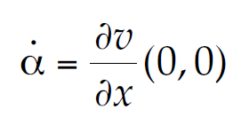
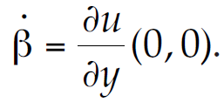
Rotation and Rate of Shear
Infinitesimal element of fluid at time t = 0 (indicated by ABCD) and at time t = δt (indicated by AʹBʹCʹDʹ).
Alfa=Dv*dt/dx
Alfa/dt=Dv/dx

Slide 34
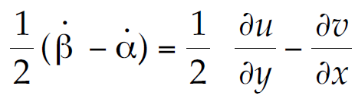
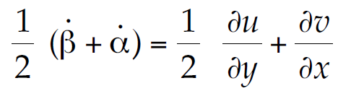
Rotation and Rate of Shear
the rate of clockwise rotation
Likewise, the shearing action is measured by the rate at which the sides BʹCʹ and DʹCʹ are approaching each other and is therefore given by the quantity:
(
)
(
)
Notes:
)

Slide 35
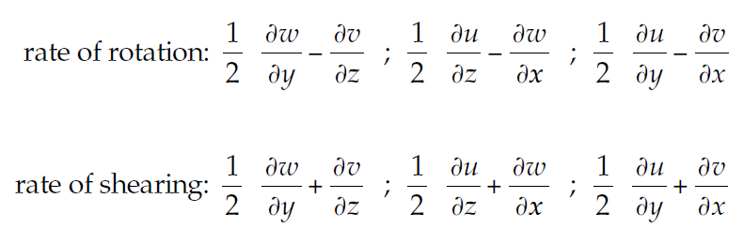
Rotation and Rate of Shear

Slide 36
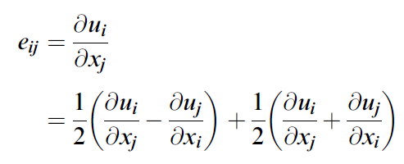
Rotation and Rate of Shear
Both of these quantities may be represented by a tensor of rank 2, as we will now show. Define the deformation-rate tensor eij and split it into its symmetric and antisymmetric parts as follows:

Slide 37
Constitutive Equations
In this section, the nine elements of the stress tensor σij will be related to the nine elements of the deformation-rate tensor ekl by a set of parameters.
All these parameters except two will be evaluated analytically, and the remaining two, which are the viscosity coefficients, must be determined empirically.
In order to achieve this end, the postulate (assumption) for a Newtonian fluid will be introduced directly.

Slide 38
conditions the stress tensor to satisfy
1. When the fluid is at rest, the stress is hydrostatic and the pressure exerted by the fluid is the thermodynamic pressure.
2. The stress tensor σij is linearly related to the deformation-rate tensor ekl and depends only on that tensor.
3. Since there is no shearing action in a solid-body rotation of the fluid, no shear stresses will act during such a motion.
4. There are no preferred directions in the fluid, so that the fluid properties are point functions.

Slide 39

Constitutive Equations
Condition 1 requires that the stress tensor σij be of the form
where τij depends upon the motion of the fluid only and is called the shear-stress tensor.
The quantity p is the thermodynamic pressure and δij is the Kronecker delta.
The pressure term is negative since the sign convention being used here is that normal stresses are positive when they are tensile in nature.

Slide 40
Condition 2:
Condition 2 postulates that the stress tensor, and hence the shear-stress tensor, is linearly related to the deformation-rate tensor. This is the distinguishing feature of Newtonian fluids.

Slide 41
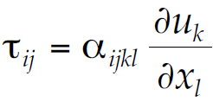
The tensor relating shear stress to deformation:
There are nine elements in the shear-stress tensor τij, and each of these elements may be expressed as a linear combination of the nine elements in the deformation-rate tensor ekl
That is, each of the nine elements of τij will, in general, be a linear combination of the nine elements of ekl so that 81 parameters are needed to relate τij to ekl. This means that a tensor of rank 4 is required. So that:

Slide 42
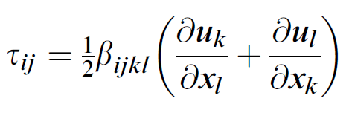
Condition 3.
It was shown in the previous section that the tensor ∂uk/ ∂xl, like any other tensor of rank 2, could be broken down into an antisymmetric part and a symmetric part.
Here, the antisymmetric part corresponds to the rate of rotation of a fluid element, and the symmetric part corresponds to the shearing rate.
According to condition 3, if the flow field is executing a simple solid-body rotation, there should be no shear stresses in the fluid.
However, for a solid-body rotation, the antisymmetric part of ∂uk/ ∂xl, namely,½(uk/xl − ul/xk ), will not be zero.
Hence, in order that condition 3 may be satisfied, the coefficients of this part of the deformation-rate tensor must be zero.
That is, the constitutive relation for stress must be of the form

Slide 43
Condition 4
The 81 elements of the fourth-rank tensor βijkl are still undetermined, but condition 4 has yet to be imposed.
This condition is the so-called condition of isotropy, which guarantees that the results obtained should be independent of the orientation of the coordinate system chosen.

Slide 44

…..
it is pointed out that the most general isotropic tensor of rank 4 is of the form
where λ, μ, and γ are scalars.

Slide 45
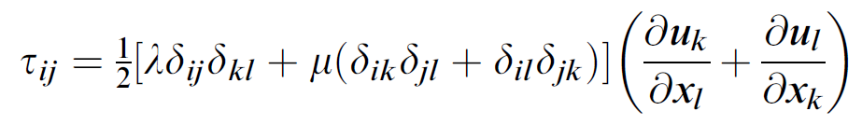
In the case of the fourth-rank tensor relating the shear stress tensor to the deformation-rate tensor, namely, βijkl, not only must it be isotropic but it must be symmetric in view of condition 3 as well.
That is, the coefficient γ must be zero in this case so that the expression for the shear stress becomes

Slide 46
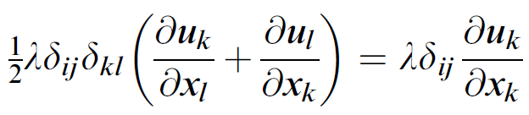
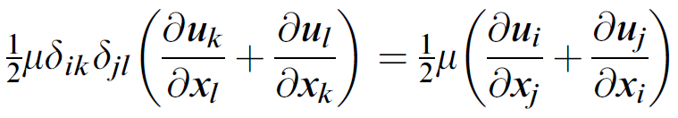
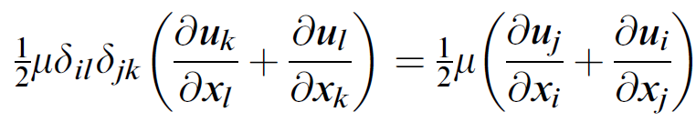
Using the fact that δkl = 0 unless l = k shows that:
replacing k by i and l by j shows that
replacing l by i and k by j shows that

Slide 47


So that:

Slide 48
Discussion:
The nine elements of the stress tensor σij have now been expressed in terms of the pressure and the velocity gradients, which have all been previously introduced, and two coefficients λ and μ.
These coefficients cannot be determined analytically and must be determined empirically.
Up to this point, both λ and μ are just coefficients, but their nature and physical significance will be discussed in the next section.

Slide 49

The second constitutive relation involves the heat flux vector qj, which is due to conduction alone.
Fourier’s law of heat conduction states that the heat flux by conduction is proportional to the negative temperature gradient so that

Slide 50


VISCOSITY COEFFICIENTS
Consider a simple shear flow of an incompressible fluid in which the velocity components are defined by:
y
دیواره متحرک
سیال
x
ساکن

Slide 51


Average mechanical pressure

Slide 52

difference between the thermodynamic and mechanical pressure
K=bulk viscosity
That is, the difference between the thermodynamic pressure and the mechanical pressure is proportional to the divergence of the velocity vector.
The proportionality factor is usually referred to as the bulk viscosity and is denoted by K.

Slide 53
Bulk viscosity for poly atomic gases and liquids
The mechanical pressure is a measure of the translational energy of the molecules only,
the thermodynamic pressure is a measure of the total energy, which includes vibrational and rotational modes of energy as well as the translational mode.
For liquids, other forms of energy are also included such as intermolecular attraction.

Slide 54
….
These different modes of molecular energy have different relaxation times, so that in any given flow field, it is possible to have energy transferred from one mode to another.
The bulk viscosity is a measure of this transfer of energy from the translational mode to the other modes

Slide 55

Bulk viscosity for monoatomic gases and liquids
If the fluid is a monatomic gas, the only mode of molecular energy is the translational mode.
Then, for such a gas, the mechanical pressure and the thermodynamic pressure are the same, so that the bulk viscosity is zero. That is
which is called Stokes’ relation

Slide 56
Discussion:
For polyatomic gases and for liquids, the departure from K = 0 is frequently small, and many authors incorporate Stokes’ relation in the constitutive relation for stress.
In any case, for incompressible fluids, shows that it is immaterial whether or not , for then the term involving λ is zero by virtue of the continuity equation.

Slide 57


Navier–Stokes Equations, Newtonian, incompressible fluid
0
????

Slide 58

Finally

Slide 59

Euler equation
معادله اویلر–جریان غیر ویسکوز
لایه مرزی
معادله نویر استوکس –جریان ویسکوز

Slide 60



ENERGY EQUATION, for Newtonian fluid
0 incompressible
Notes:
0 incompressible

Slide 61


Slide 62

Finally

Slide 63

Governing equations for Newtonian fluids

Slide 64
1, 2, 4,6, 8, 9

Slide 65
Chapter 2
Flow Kinematics

Slide 66
FLOW LINES
Three types of flow lines are used frequently for flow-visualization purposes.
These flow lines are called streamlines, pathlines, and streaklines, and in a general flow field, they are all different.

Slide 67
Streamlines
Streamlines are lines whose tangents are everywhere parallel to the velocity vector.
For unsteady flow:
Since, in unsteady flow, the velocity vector at a given point will change both its magnitude and its direction with time, it is meaningful to consider only the instantaneous streamlines in the case of unsteady flows.

Slide 68






Streamline equation
$$\text{dl}\text{=}\text{dxi}\text{+}\text{dyj}\text{+}\text{dzk}$$
$$\overset{⃑}{V}=ui+vj+wk$$
$\frac{dl}{\overset{⃑}{V}}$=
$$dl$$

Slide 69






Example of stream line:
suppose the streamlines passing through the point (1, 1) at t=0.
t=0

Slide 70

Pathlines
A pathline is a line traced out in time by a given fluid particle as it flows.
Since the particle under consideration is moving with the fluid at its local velocity, Pathlines must satisfy the equations

Slide 71





Example of pathline:

Slide 72
Streaklines
A streakline is a line traced out by a neutrally buoyant marker fluid that is continuously injected into a flow field at a fixed point in space. The marker fluid may be smoke.
A particle of the marker fluid that is at the location (x, y, z) at time t must have passed through the injection point (x0, y0, z0) at some earlier time t = τ.

Slide 73

…
Then, the time history of this particle may be obtained by solving the equation for the pathline subject to the initial conditions that x = x0, y = y0, and z = z0 when t = τ.
Then, as τ takes on all possible values in the range –∞ ≤ τ ≤ t, all fluid particles on the streakline will be obtained.
That is, the equation of the streakline through the point (x0, y0, z0) is obtained by solving pathline equation subject to the initial conditions that when t = τ, x = x0, y = y0, and z = z0. This will yield an expression of the form

Slide 74





Example:
Using the initial conditions that x = y = 1 when t = τ, these equations become:

Slide 75


Slide 76
تمرین
در اسلاید قبلی مطلوب است رسم منحنی streamline ، pathline، و streakline برای نقاط گره در ناحیه مستطیل 4 در 4 در لحظه t=0
خطوط جریان روی یک نمودار نشان داده شود و همچنین برای pathline و streakline نیز به همین صورت عمل شود.

Slide 77

Circulation
The circulation contained within a closed contour in a body of fluid is defined as the integral around the contour of the component of the velocity vector that is locally tangent to the contour. That is, the circulation Γ is defined as:
where dl represents an element of the contour. The integration is taken counterclockwise around the contour, and the circulation is positive if this integral is positive.

Slide 78


Vorticity
The vorticity of an element of fluid is defined as the curl of its velocity vector. That is, the vorticity ω is defined by:
vorticity vector is numerically twice the angular speed of rotation of the fluid element about its own axes

Slide 79



1
3
2

Slide 80


Stocks theorem: the relation between circulation and vorticity

Slide 81
STREAM TUBES
Is a region whose sidewalls are made up of streamlines.

Slide 82
Vortex line
By analogy with streamlines and stream tubes, the useful concepts of vortex lines and vortex tubes may be introduced.
A vortex line is a line whose tangents are everywhere parallel to the vorticity vector.

Slide 83
VORTEX TUBES
Then, for any closed contour in a flow field, each point on the contour will have a vortex line passing through it, and the series of vortex lines defined by the closed contour form a vortex tube.

Slide 84

n
n
u
n

Slide 85



KINEMATICS OF VORTEX LINES
Since the divergence of the curl of any vector is identically zero, it follows that
The continuity equation for an incompressible fluid is

Slide 86







Gauss’ theorem:
$$\int_{Wall}{u.n dA}$$
+
0

Slide 87
Result:
which states that the volume of fluid crossing the area A1 per unit time is equal to that crossing the area A2 per unit time.
Since the fluid was assumed to be incompressible, this result appears intuitively obvious.

Slide 88








Gauss’ theorem:
$$\int_{Wall}{ω.n dA}+$$
0

Slide 89
Result
the circulation at each cross section of a vortex tube is the same.
This means that if the cross-sectional area of the vortex tube increases, the average value of the vorticity across that section must decrease, just as the average velocity would decrease to satisfy continuity.

Slide 90


…
In fact, the result Γ1 = Γ2 may be put in the form of the simple, one-dimensional continuity equation. If ω1 denotes the average vorticity across the area A1 and ω2 denotes that across A2, the result:

Slide 91
result
The fact that the vorticity vector ω is divergence-free means that vortex tubes must terminate on themselves, at a solid boundary or at a free surface.
Smoke rings terminate on themselves, while a vortex tube in a free surface flow over a solid boundary may have one end at the solid boundary forming the bottom and the other end at the free surface.

Slide 92
2, 4,6, 8

Slide 93
CHAPTER 3
Special Forms of the Governing Equations

Slide 94
Special Forms of the Governing Equations
Some alternative forms of the governing equations, as derived in Chap.1,will be discussed here.
The results are all obtained from the governing equations under various degrees of approximation such as negligible viscous effects.
Some of the results are frequently referred to as theorems. They are used either as alternatives to the general equations derived in Chap. 1, under the specified restrictions, or as supplementary information to these equations.

Slide 95
The equations presented in this chapter
The first result established is Kelvin’s theorem. This theorem establishes the conditions under which irrotational motion remains irrotational and so justifies the simplifying methods of analysis that are utilized for irrotational flows.
Then the Bernoulli equations are derived. These equations are integrals of the Euler equations under certain conditions. They are used to relate the pressure and velocity fields when the velocity is established separately from, for example, the condition of irrotationality.
Crocco’s equation is derived next. This equation relates the entropy of the fluid to the vorticity and shows that under certain conditions isentropic flows are irrotational, and vice versa.
Finally, the vorticity equation is derived for a fluid of constant density and viscosity. This equation is useful in the study of rotational flows.

Slide 96
KELVIN’S THEOREM
This theorem states that for an inviscid fluid in which the density is constant, or in which the pressure depends on the density alone, and for which any body forces that exist are conservative, the vorticity of each fluid particle will be preserved.

Slide 97

Deriving the KELVIN’S equation
Suppose that any body force fi per unit mass that may act on the fluid is conservative, such as gravity. Then fi may be written as the gradient of some scalar function G:

Slide 98


…
the equations of motion for an inviscid fluid subjected to only conservative body forces are
Material derivative:

Slide 99

…
In order to determine the rate of change of vorticity associated with a given fluid element, the material derivative of the circulation G will be calculated.

Slide 100



….
0

Slide 101



Slide 102




…
$$\frac{g′(ρ)}{ρ}=F′→\oint{F^{′}dρ=\oint{dF=0}}$$

Slide 103

BERNOULLI EQUATION
For an inviscid fluid in which any body forces are conservative and either the flow is steady or it is irrotational, the equations of momentum conservation may be integrated to yield a single scalar equation called the Bernoulli equation.

Slide 104



…
dl=dx.i+dy.j+dz.k

Slide 105





…
$$ω$$
u
$$u×ω$$

Slide 106



Considering first steady flow

Slide 107


Slide 108


Slide 109


CROCCO’S EQUATION
This equation relates the vorticity of a flow field to the entropy of the fluid.
Under certain conditions it will be shown that isentropic flows are irrotational, and vice versa. (No body forces is applied and inviscid flow).

Slide 110





…
Also:
$$v=\frac{1}{ρ}$$
Since:
h=u+pv

Slide 111


Since:

Slide 112




Since:
This result will now be used to eliminate the pressure and the density that appear on the right-hand side of the Euler equations
Crocco’s equation

Slide 113


Proving that h0 is constant along streamline: stagnation enthalpy
Assumptions: steady, adiabatic, inviscid, no body force
The energy equation for adiabatic flow of an inviscid fluid is
The Euler equations for a flow without body forces are:

Slide 114


scalar product of Euler equation with the velocity vector u gives:
Adding this equation to the energy equation derived above yields:
Result:
Then, for steady flow, the right-hand side of this equation will be zero. That is, for steady, adiabatic flow of an inviscid fluid in which there are no body forces, the quantity Dh0/Dt will be zero. Hence the stagnation enthalpy h0 will be constant along each streamline.

Slide 115





Crocco’s equation for the steady flow:
where the quantity h0 is constant along each streamline. Hence h0 will be a vector perpendicular to the streamlines. But is also perpendicular to the streamlines, so that the remaining vector, namely, must also be perpendicular to the streamlines. Then the above vector equation may be written in the following scalar form:
(3.3b)

Slide 116


True or false? Pay attention to the diffuser and nozzle flow for the current conditions

Slide 117
VORTICITY EQUATION
The equation to be satisfied by the vorticity vector ω for a fluid of constant density and constant viscosity will be derived in this section.
Such an equation is useful in the study of viscous flows in incompressible fluids, which is the topic of Part III of this book.
One reason that the vorticity equation is of interest is that it enables us to learn more about the physics of given flow fields.
Also, in the analysis of some flow fields it is frequently possible to make some statement about the vorticity distribution that facilitates the analysis if the problem is posed in terms of the vorticity.

Slide 118



The vorticity equation is obtained by taking the curl of this equation and noting that the curl of the gradient of any scalar is zero
0
0

Slide 119


In 3 dimensional flow:
In 2 dimensional flow: For two-dimensional flows the vorticity vector will be perpendicular to
the plane of the flow. Then

Slide 120
1, 2, 3

Slide 121
Part 2
IDEAL-FLUID FLOW

Slide 122
Part 2: chapters 4, 5 and 6
This part of the book deals with the flow of ideal fluids, that is, fluids that are inviscid and incompressible. The results are therefore limited to flow fields in which viscous effects of the fluid are negligible and compressibility of the fluid is unimportant.
Then, any phenomena that are predicted by the governing equations will be due to the inertia of the fluid. The mathematical simplification that results from neglecting viscous and compressible effects is great, and consequently the topic of ideal-fluid flow is, mathematically, the best understood

Slide 123

Governing Equations and Boundary Conditions
where n is the unit normal to the surface of the body and U is the velocity
vector of the body.

Slide 124



Potential Flows
If the flow of an ideal fluid about a body originates in an irrotational flow, such as a uniform flow, for example, then Kelvin’s theorem guarantees that the flow will remain irrotational even near the body. That is, the vorticity vector ω will be zero everywhere in the fluid.
Continuity
Notes:
Continuity

Slide 125
Chapter 4: Two-Dimensional Potential Flows
STREAM FUNCTION:
The velocity potential Φ was defined in such a way that it automatically satisfied the condition of irrotationality.
The continuity equation then showed that Φ had to be a solution of Laplace’s equation.
A second function (Ψ) may be defined by a complementary procedure for two-dimensional incompressible fluid flows.
That is, a function may be defined in such a way that it automatically satisfies the continuity equation, and the equation it must satisfy will be determined by the condition of irrotationality.

Slide 126

The continuity equation, in Cartesian coordinates
Incompressible
2D
Steady

Slide 127

Introducing stream function:

Slide 128




Vorticity in 2D irrotational flow:
Components of the vorticity
0

Slide 129


Equation of ψ=cte

Slide 130




Calculating flow rate: Q

Slide 131




Ψ and Φ orthogonal to each other
Equation of φ=cte

Slide 132


COMPLEX POTENTIAL AND COMPLEX
VELOCITY
Cauchy-Riemann equations

Slide 133


…
Where z=x+iy . Now if F(z) is an analytic function, it follows that φ and ψ will automatically satisfy the Cauchy-Riemann equations.
That is, for every analytic function F(z) the real part is automatically a valid velocity potential and the imaginary part is a valid stream function.

Slide 134
complex velocity

Slide 135

complex velocity
WHY?

Slide 136



Properties of complex velocity
In addition:
Notes:
CONJUGATE مزدوج

Slide 137


Complex velocity in cylindrical coordinate:
$$θ$$

Slide 138


…

Slide 139



UNIFORM FLOWS
The simplest analytic function of z is proportional to z itself, and the corresponding flow fields are uniform flows.

Slide 140


…
Thus the complex potential for such a flow whose velocity magnitude is U in the positive x direction will be

Slide 141





…
Next consider the complex potential to be proportional to z with an imaginary constant of proportionality. Then:

Slide 142





…

Slide 143



SOURCE, SINK, AND VORTEX FLOWS
Complex potentials that correspond to the flow fields generated by sources, sinks, and vortices are obtained by considering F(z) to be proportional to logz.

Slide 144

Sink-source and vortex

Slide 145


Source strength
Sources are characterized by their strength, denoted by m, which is defined as the volume of fluid leaving the source per unit time per unit depth of the flow field. From this definition it follows that
w=c/z =c/(R*e^(i*teta))= c/R*e^(-i*teta)

Slide 146

Source at point Z0
The source corresponding to this complex potential is located at the origin, the location of the singularity. Then the complex potential for a source of strength m located at the point z = z0 will be:

Slide 147
sink
Clearly, the complex potential for a sink, which is a negative source, is obtained by replacing m by -m

Slide 148



Vortex:
Now consider the constant of proportionality in the logarithmic complex potential to be imaginary. That is, consider
where c is real and the minus is included to give a positive vortex. Then, using cylindrical coordinates,

Slide 149


…
Hence the direction of the flow is positive counterclockwise) for c > 0, and the resulting flow field is called a vortex.

Slide 150


Vortex strength:

Slide 151

Vortex at Z0

Slide 152



FLOW IN A SECTOR
The flows in sharp bends or sectors are represented by complex potentials that are proportional to z^n where n>=1
Since:

Slide 153




Velocity in corners:

Slide 154

تمرین: رسم خطوط جریان در گوشه برای n=3

Slide 155




FLOW AROUND A SHARP EDGE
The complex potential for the flow around a sharp edge, such as the edge of a flat plate, is obtained from the function z^(1/2). Then consider the complex potential

Slide 156


Velocity in sharp edges:

Slide 157



تمرین: رسم خطوط جریان در در اطراف لبه تیز
تمرین: رسم خطوط جریان در لبه تیز

Slide 158
FLOW DUE TO A DOUBLET
The function 1/z has a singularity at z = 0, and in the context of complex potentials, this singularity is called a doublet

Slide 159


Slide 160


Slide 161



Slide 162


Slide 163



The equation of streamlines:

Slide 165


Velocity components of doublet

Slide 166

Doublet at Z0

Slide 167
SUPERPOSITION
Superposition is valid here, since the governing equation, for either the velocity potential or the stream function, is linear.
Consider the superposition of a uniform rectilinear Flow and a doublet at the origin

Slide 168



CIRCULAR CYLINDER WITHOUT
CIRCULATION

Slide 169

SPECIAL CASE:CYLINDER

Slide 170



Slide 171


CIRCULAR CYLINDER WITH CIRCULATION

Slide 172



Slide 173


On the surface of the cylinder

Slide 174

STAGNATION POINT
VELOCITY COMPONENTS ARE ZERO:

Slide 175


Slide 176
Lift and drag on the circular cylinder
The flow fields for the circular cylinder with circulation, exhibit symmetry about the y axis. Then it may be concluded that there will be no drag force acting on the cylinder.
However, the existence of the circulation around the cylinder has destroyed the symmetry about the x axis. so there will be some force acting on the cylinder in the vertical direction.
For the negative circulation shown, the velocity on the top surface of the cylinder will be higher than that for no circulation, while the velocity on the bottom surface will be lower. Then, from Bernoulli’s equation, the pressure on the top surface will be lower than that on the bottom surface, so that the vertical force acting on the cylinder will be upward. That is, a positive lift will exist.
In order to determine the magnitude of this lift, a quantitative analysis must be performed, and this will be done in the next section.

Slide 177
BLASIUS’ INTEGRAL LAWS
In the previous section it was argued that a lift force exists on a circular cylinder that has a circulation around it. However, the magnitude of the force can be established only by quantitative methods.
The obvious way to evaluate the magnitude of this force is to establish the velocity components from the complex potential.
Knowing the velocity components, the pressure distribution around the surface of the cylinder may be established by use of the Bernoulli equation.
Integration of this pressure distribution will then yield the required force acting on the cylinder.
Notes:
Velocity from the potential function

Slide 178
…
The difficulty with the foregoing procedure is that it would have to be carried out for each pressure distribution and for each body under consideration.
The Blasius laws provide a convenient alternative. It will be shown that if the complex potential for the flow around a body is known, then it is possible to evaluate the forces and the turning moment acting on the body by means of simple contour integrals.
These contour integrals, in turn, may be readily evaluated by use of the residue theorem. The Blasius laws are actually two separate laws, one for forces and one for the hydrodynamic moment acting on the body.

Slide 179


Slide 180



Newton second law:

Slide 181


Omitting P in the equations:

Slide 182



$$i=\sqrt{−1}$$

Slide 183





Moment calculations

Slide 184



Slide 185


FORCE AND MOMENT ON A CIRCULAR
CYLINDER

Slide 186



Slide 187


Kutta-Joukowski law
Kutta-Joukowski law: For flow around a circular cylinder, there will be no lift force on the cylinder if there is no circulation around it, and if there is a circulation, the value of the lift force will be given by the product of the magnitude of this circulation with the free-stream velocity and the density of the fluid.

Slide 188



Moment calculation:

Slide 189

CONFORMAL TRANSFORMATIONS definition:

Slide 190
The purpose of using conformal transformation:
1-Transforming complicated flow boundaries to simple one
2-The basis of the complex potential was that both the velocity potential and the stream function had to satisfy Laplace’s equation.
3- Hence, in order to establish the effect of a conformal transformation on complex potentials, their effect on Laplace’s equation should be studied.
4- This will be done by transforming the second derivatives with respect to x and y into derivatives with respect to the new coordinates.
5- In addition the impact of transformation on the circulation and strength of vortex, sink and source should be studied.

Slide 191

ζ=ξ+iη=f(z), z=x+iy

Slide 192



The impact of transformation on the potential function:

Slide 193


SECOND ORDER DERVIATIVES:

Slide 194

CAUCHY-RIEMANN EQUATIONS

Slide 195



Slide 196


Slide 197



Slide 198
Result:
That is, Laplace’s equation in the z plane transforms into Laplace’s equation in the ζ plane, provided these two planes are related by a conformal transformation.
This means that if the solution for some simple body is known in one of these planes, say the z plane, then the solution for the more complex body may be obtained by substituting ζ=f(z) in the complex potential F(ζ).

Slide 199


The impact of transformation on the complex velocity.
That is, complex velocities are not, in general, mapped one to one, but they are proportional to each other, and the proportionality factor depends on the mapping function.

Slide 200
The impact of transformation on the circulation and strength.
PROVE THAT: That integral of complex velocity around a closed contour containing sinks, sources, and vortices is Γ+im in which the real and imaginary parts are equivalent strength of vortices and sinks /sources.

Slide 201


Slide 202



Slide 203

Conforming strenthes:

Slide 204

conclusions

Slide 205

JOUKOWSKI TRANSFORMATION
One of the most important transformations in the study of fluid mechanics is the Joukowski transformation.
By means of this transformation and the basic flow solutions already studied, it is possible to obtain solutions for the flow around ellipses and a family of airfoils. The Joukowski transformation is of the form

Slide 206
Important property of JOUKOWSKI transformation
It is identity mapping if ζ→∞ because in this case z=ζ.

Slide 207
Singular point of JOUKOWSKI and its location
so that there is a singular point in the Joukowski transformation at ζ = 0.
Since we are normally dealing with the flow around some body, the point ζ = 0 is normally not in the fluid, and so this singularity is of no consequence.

Slide 208

Critical points of JOUKOWSKI
Points at which dz/dζ vanishes, at ζ = ±c.
Since smooth curves passing through critical points of a mapping may become corners in the transformed plane, it is of interest to investigate the consequence of a smooth curve passing through the critical points of the Joukowski transformation.

Slide 209

according to the Joukowski transformation the points ζ=±c map into the points z =±2c.
z =-2c
z =2c
ζ=-c
ζ=c

Slide 210





Slide 211


This last result shows that if a smooth curve passes through the point ζ= c, the corresponding curve in the z plane will form a knife-edge or cusp.

Slide 212

That is, if a smooth curve passes through either of the critical points ζ=± c, the corresponding curve in the z plane will contain a knife-edge at the corresponding critical point z =±2c.

Slide 213

CIRCULAR CYLINDER TRANSFORMATION BY Joukowski

Slide 214
SYMMETRICAL JOUKOWSKI AIRFOIL
A family of airfoils may be obtained in the z plane by considering the Joukowski transformation in conjunction with a series of circles in the z plane whose centers are slightly displaced from the origin.
These airfoils are known as the Joukowski family of airfoils.

Slide 215

ζ= - (c+2m)
ζ=c

Slide 216



Determining the chord length of the airfoil:
(mapping) ζ=c → z=2c
(mapping) ζ=-(c+2m)=-c(1+2ε) →

Slide 217






Determining the airfoil profile:
m=cε

Slide 218

Attention

Slide 219


Then:

Slide 220



Slide 221



points on the surface of the airfoil

Slide 222

The airfoil profile

Slide 223



Airfoil thickness
The location of the maximum and minimum thickness

Slide 224



$$3\sqrt{3}/2$$
$$−3\sqrt{3}/2$$

Slide 225


Slide 226
THE AIRFOIL
تمرین
X | Y1 | Y2
-0.19 | 0.000487 | -0.00049
-0.1478 | 0.008609 | -0.00861
-0.1056 | 0.00996 | -0.00996
-0.06333 | 0.009678 | -0.00968
-0.02111 | 0.008501 | -0.0085
0.02111 | 0.0068 | -0.0068
0.06333 | 0.004839 | -0.00484
0.1056 | 0.002845 | -0.00285
0.1478 | 0.001075 | -0.00108
0.19 | 3.85E-09 | -3.85E-09

Slide 227
Kutta condition:
The velocity magnitude becomes infinite in sharp points.
The leading edge of real airfoils have a finite thickness and so have a finite radius of curvature at the leading edge. So that the velocity is finite in the leading edge.
However, the trailing edge of airfoils is usually quite sharp, so that the difficulty of infinite velocity components still exists there.

Slide 228
…
This would be accomplished if a circulation existed around the flat plate and the magnitude of this circulation was just the amount required to rotate the rear stagnation point so that its location coincides with the trailing edge.
This condition is called the Kutta condition

Slide 229
Kutta condition, in brief
For bodies with sharp trailing edges that are at small angles of attack to the free stream, the flow will adjust itself in such a way that the rear stagnation point coincides with the trailing edge.
In fluid flow around a body with a sharp corner the Kutta condition refers to the flow pattern in which fluid approaches the corner from both directions, meets at the corner and then flows away from the body. None of the fluid flows around the corner and remains attached to the body.

Slide 230




جریان حول لبه تیز باعث ایجاد سرعت بی نهایت می شود. لذا بایستی یک گردابه با جهت مخالف این چرخش سیال اضافه گردد تا نتقط سکون به انتهای ایرفویل منتقل گردد و دیگر چرخش جریان حول لبه فرار نداشته باشیم.

Slide 231


Notes:
Stagnation point of

Slide 232



$$α$$

Slide 233

The complex potential

Slide 235


Slide 236
CIRCULAR-ARC AIRFOIL
It was shown in the two previous sections that, using the Joukowski transformation, a circle of radius c centered at the origin of the z plane produced a flat-plate airfoil while a slightly larger circle centered a small distance along the real axis from the origin produced a thin symmetrical airfoil.
It will now be shown that a circle whose radius is slightly larger than c and whose center is located on the imaginary axis of the z plane produces an airfoil that has no thickness but has curvature of camber.

Slide 237


Slide 238


The parametric equation of airfoil in the z plane
Substituting ζ in the Joukowski transformation

Slide 239

Eliminating R

Slide 240




Eliminating v

Slide 241





Slide 242

Arc airfoil characteristics

Slide 243

The arc airfoil curve

Slide 244

Plot of arc airfoil
تمرین
l=0.4
h=0.02
x^2+(y+l^2/(8*h))^2=l^2/4*(1+l^2/(16*h^2))

Slide 245





Kutta condition and lift coefficient:

Slide 246



The complex potential of the arc airfoil:

Slide 247

JOUKOWSKI AIRFOIL

Slide 248

JOUKOWSKI AIRFOIL
Arc airfoil
Symmetric airfoil

Slide 249



Lift and lift coefficient

Slide 250
m
c

Slide 251
Three-Dimensional Potential
Flows
Chapter 5

Slide 252
Introduction
Although there are no significant phenomena associated with three-dimensional flows that do not exist in two-dimensional flows, the method of analyzing flow problems is completely different. The method of employing analytic functions of complex variables cannot be used here in view of the three-dimensionality of the problems.

Slide 253

Spherical coordinate

Slide 254



Velocity potential for axisymmetric flow
The Laplace equation must be solved:

Slide 255


The Laplace equation
Now consider the velocity components to be related to a function ψ in the following way:

Slide 256

STOKES’ STREAM FUNCTION

Slide 257


Flow rate:
It will now be shown that the quantity 2πψ corresponds to the volume of fluid crossing the surface of revolution which is formed by rotating the position vector OP, in Fig. 5.1, around the reference axis.
Fig. 5.2 shows that a quantity of fluid crosses a unit area of this surface so that:

Slide 258


Ψ=ψ(r,θ) then:

Slide 259



SOLUTIONOF THE POTENTIAL EQUATION

Slide 260


Slide 261




Solutions of the two equations

Slide 262


The Legendre function of the first kind that is defined by:

Slide 263



UNIFORM FLOW

Slide 264





Streamline of uniform flow

Slide 265



area perpendicular to the velocity vector

Slide 266




SOURCE AND SINK

Slide 267





Calculating B0 according to flow rate

Slide 268

Doublet

Slide 269

FLOWDUE TO A DOUBLET

Slide 270


Slide 271



Slide 272



Slide 273

Determining ψ

Slide 274

…

Slide 275

…

Slide 276

FLOWAROUNDA SPHERE
The stream function for a uniform flow past a sphere may be obtained by superimposing the solution for a uniform flow and that for a doublet.

Slide 277



Ψ=0 is the sphere suface

Slide 278

φ
Φ(r,θ)

Slide 279
Part III. Viscous Flows of Incompressible Fluids
Exact Solutions

Slide 280

Governing equation in this part

Slide 281
COUETTE FLOW
One of the simplest viscous-flow fields is that for flow between two parallel surfaces, whose size in the z direction is supposed to be very large compared with their separation distance h.
The flow between these plates is taken to be in the x direction, and since there is no flow in the y direction, the pressure will be a function of x only.
That is, since there are no inertia, viscous, or external forces in the y direction, there can be no pressure gradient in that direction.

Slide 282

Case 1:
Fluid flows in x direction due to a pressure gradient in the x-dir
$$h$$

Slide 283

Governing equations for Newtonian fluids
$$\frac{∂u}{∂y}=0$$
u=u(y)
X-dir
Y-dir

Slide 284


:solution

Slide 285




Boundary conditions:

Slide 286


Case 2.
$$h$$
move one of the two surfaces.
such a situation, which is referred to as plane Couette flow.

Slide 287
Governing equations for Newtonian fluids
$$\frac{∂u}{∂y}=0$$
u=u(y)
X-dir
Y-dir

Slide 288


Governing equations and solution

Slide 289


B.C.

Slide 290
CASE 3
A more general situation is one in which either of the two surfaces is moving at constant velocity and there is also an external pressure gradient.
Such a situation is referred to as general Couette flow

Slide 291

Solution: superposition

Slide 292

(a) Flow between parallel surfaces, (b) plane Couette flow, and (c) general
Couette flow.

Slide 293
POISEUILLE FLOW
The steady flow of a viscous fluid in a conduit of arbitrary but constant cross section is referred to as Poiseuille flow.

Slide 294

Viscous flow along conduits of various cross sections: (a) arbitrary,
(b) circular, (c) elliptic.

Slide 296

Governing equations for Newtonian fluids
0=$\frac{∂u}{∂x}$
u=u(y,z)
X-dir
Y-dir

Slide 297


Governing equations

Slide 298


Solution for circular cross section

Slide 299



B.C.

Slide 300

SOLUTION FOR ELLIPTIC

Slide 301
STOKES’ FIRST PROBLEM
The x axis coincides with an infinitely long flat plate above which a fluid exists. Initially, both the plate and the fluid are at rest. Suddenly, the plate is jerked into motion in its own plane with a constant velocity. Under these conditions, what will be the response of the fluid to this motion on the boundary?

Slide 302
Conditions:
it may be reasonably assumed that the motion of the fluid will also be in direction of motion. Thus the only nonzero velocity component will be u, and this velocity component will be a function of y and t only.
Then the pressure will be independent of y, and since u is independent of x, so will P be independent of x.
That is, the pressure will be constant everywhere in the fluid.

Slide 303

STOKES’ FIRST PROBLEM

Slide 305
Governing equations for Newtonian fluids
u=u(y,t)
X-dir
Y-dir

Slide 306


G.E. and B.C.

Slide 307

SIMILARITY SOLUTION

Slide 308


Slide 309




Slide 310

Determining α

Slide 311

the differential equation to be solved

Slide 312



Solution of the equation:

Slide 313

Applying the B.C. and I.C.

Slide 314



Slide 315

Thickness of the layer affected by the plate motion

Slide 316
STOKES’ SECOND PROBLEM
Stokes’ second problem differs from Stokes’ first problem only in the condition that the boundary y = 0 is oscillating in time rather than impulsively starting into motion.

Slide 317


Slide 318

G.E. and I.C.

Slide 319

Solution

Slide 320




Slide 321


Applying boundary conditions
The condition that the velocity be finite requires that the constant B should be zero.

Slide 322


….

Slide 323


Thickness of the layer affected by the plate motion

Slide 324
Pulsating flow between parallel surfaces
Another type of unsteady-flow situation for which an exact solution exists is that of an oscillating pressure in a fluid layer that is bounded by two parallel planes.
We consider the two parallel surfaces to be located at y = ± a and consider the pressure gradient in the x-direction to oscillate in time. Then the velocity will be in the x direction only and will also oscillate in time. That is, the only nonzero velocity component will be u(y,t).

Slide 325


G.E. and B.C.

Slide 326



Slide 327


SOLUTION:

Slide 328


Applying boundary condition

Slide 329


FINALLY

Slide 330
%syms y
a=0.005;
y=-a:a/1000:a
v=0.000002;
p=100000;
n=pi;
rho=1000;
for t=0:0.5:1.5
u=real((i*p/(rho*n))*[1-[cosh((1+i)*sqrt(n/(2*v))*y)/cosh((1+i)*sqrt(n/(2*v))*a)]]*exp(i*n*t));
plot(u,y)
hold on
end
title('u=real((i*p/(rho*n))*[1-[cosh((1+i)*sqrt(n/(2*v))*y)/cosh((1+i)*sqrt(n/(2*v))*a)]]*exp(i*n*t))')
xlabel('y')
ylabel('u')

Slide 331

تمرین

Slide 332

Flow Over A Porous Wall

Slide 333
Problem description
A solution to the foregoing problem will be sought in which P is a constant and u depends upon y only.
The magnitude of the suction is adjusted in such a way that the tangential velocity component is independent of x.

Slide 334
X-DIR
Y-DIR

Slide 336


Slide 337

B.C.

Slide 338



Integrating the continuity equation
The momentum equation:
integrating

Slide 339

Solution and applying the B.C.

Slide 340

Thickness of the layer affected by VISCOSITY

Slide 341
HOME WORK
1,2,4,5,8,10

Slide 342
Low-Reynolds-Number Solutions
CHAPTER 8

Slide 343

THE STOKESAPPROXIMATION
Nondimensionalizing the N.S. equation

Slide 344






Substituting into the N.S. equation
In low Reynolds No. case

Slide 345


Alternative form of Stokes eq.

Slide 346

UNIFORM FLOW

Slide 347

DOUBLET
any potential flow is an exact solution of the full Navier-Stokes equations, since the viscous term is identically zero for potential flows.
Then, for any steady potential flow, the Stokes equations will be satisfied provided the pressure term is zero. That is, for steady flow, all the inertia terms are zero to the Stokes approximation, and for potential flows the viscous term will be zero.
Hence, potential flows are also solutions to the Stokes equations provided

Slide 348





The doublet solution in potential flow

Slide 349
ROTLET
In this section a solution to the Stokes equations will be sought in which the vorticity is different from zero and the pressure is constant. That is, a rotational-flow solution will be sought. The resulting solution will involve a singularity at the origin that is known as a rotlet.

Slide 350

Velocity and pressure of ROTLET

Slide 351


Slide 352



Force and moment by a ROTLET

Slide 353

F=0

Slide 354






Moment

Slide 355



After simplifications and mathematic works…
Or, in vector form, this expression is

Slide 356





Slide 357

STOKESLET
Pressure and velocity field of a STOKSLET

Slide 358





Force exerted by a SOKESLET on the fluid

Slide 359



Mathematical works

Slide 360



Slide 361



Slide 362


ROTATING SPHERE IN A FLUID

Slide 363


Applying B.C.

Slide 364

Moment exerted on the sphere by the fluid

Slide 365

UNIFORM FLOW PASTA SPHERE

Slide 366

Applying B.C.

Slide 367



Slide 368





STOKES DRAG LAW

Slide 369


Slide 370
Boundary Layers
CHAPTER 9

Slide 371
B.L.
Boundary layers are the thin fluid layers adjacent to the surface of a body in which strong viscous effects exist.

Slide 372


Slide 373


BOUNDARY-LAYER THICKNESSES
U

Slide 374

displacement thickness
the thickness of a zero-velocity layer that has the same mass-flow defect as the actual boundary layer.

Slide 375


$\dot{m}$=UH$ρ$
U
δ*
H
U
U
U
U
H

Slide 376
DETA*
U
u
u_out_center>U
u
DETA*

Slide 377

Mathematical displacement thickness

Slide 378




کانال اصلاح شده
$$δ^{∗}$$
$$δ^{}$$
1
2
$$δ^{}$$
$$δ^{∗}$$

Slide 379

momentum thickness θ
The momentum thickness is defined as that thickness of layer which, at zero velocity, has the same momentum defect, relative to the outer flow, as the actual boundary layer.

Slide 380

THE BOUNDARY-LAYER EQUATIONS

Slide 382

Scale analysis
؟

Slide 383


Scale analysis
1/RE
1
1
1

Slide 384



First result

Slide 385


N.S. in x and y directions

Slide 386

….

Slide 387


In addition

Slide 388


Boundary layer eq.

Slide 389

BLASIUS SOLUTION
For flow over a flat plate, U=cte, and δ is a function of x only

Slide 390


Solution

Slide 391



Similarity solution
The value of n for the case of a flat surface is ½ , so that the similarity variable η is chosen to be
بی بعد

Slide 392



Slide 393


Slide 394



Slide 395

The stream function

Slide 396



Shear stress on the wall

Slide 397



Drag coefficient

Slide 398


Boundary layer thickness

Slide 399


Displacement and momentum thickness

Slide 400
پروژه:
مطلوب است محاسبه پروفیل سرعت، و تنش برشی روی دیواره برای جریان روی صفحه تخت با استفاده از یکی از نرم افزارهای تجاری، و همچنین حل عددی معادله بلازیوس با استفاده از روشهای حل عددی.
فرضیات: تمام فرضیات مربوط به مساله لایه مرزی بلازیوس برقرار است.
از جمله جریان پایا، دوبعدی، آرام، تراکم ناپذیر، دما ثابت
نتایج بدست آمده از دو روش محاسباتی با هم مقایسه شوند.
تا 25 ام بهمن آخرین مهلت تحویل پروژه است.
حدود 3 تا 5 نمره مربوط به این پروژه خواهد بود.

Slide 401
FALKNER-SKAN SOLUTIONS
A whole family of similarity solutions to the boundary-layer equations were found by Falkner and Skan.
These solutions are obtained by seeking general similarity-type solutions and interpreting the flow field for each solution so obtained.

Slide 402




Look for general similarity solutions of the form
the equation to be satisfied by ψ is

Slide 403


Slide 404



Slide 405



Slide 406


Slide 407


Solution procedure

Slide 408




Slide 409


FLOW OVER A WEDGE

Slide 410





Slide 411




Slide 412


the problem to be solved for the function f is

Slide 413


Slide 414

STAGNATION-POINT FLOW

Slide 415

Solution:

Slide 416


FLOW IN A CONVERGENT CHANNEL

Slide 417






Slide 418



Slide 419

GENERAL MOMENTUM INTEGRAL
1
3
?
2
u*
1
+
2
=
3

Slide 420




Integrating the continuity equation shows that:

Slide 421



انتگرال جزء به جزء

Slide 422






Slide 423


Slide 424


KARMAN-POHLHAUSEN APPROXIMATION
The general momentum integral, when used in conjunction with a fourth order polynomial to represent the velocity profile, is known as the Karman- Pohlhausen method. The velocity profile is taken to be of the form

Slide 425
The coefficients a, b, c, d, and e will, in general, be functions of x, so that solutions which are not similar may be obtained.
The foregoing velocity profile can satisfy five boundary conditions, and these are taken to be:

Slide 426

B.C.

Slide 427

Applying B.C.

Slide 428



Slide 429




Slide 430


Slide 431


Slide 432


Slide 433

The foregoing expressions relate the displacement and momentum thicknesses and the surface shear stress to the boundary-layer thickness, which as yet, is unknown.

Slide 434





Slide 435




Slide 436



Slide 437



Slide 438





Substituting the previous terms in the momentum integral equation

Slide 439





Slide 440


Slide 441


Slide 442






Slide 443




Slide 444


Procedure:

Slide 445

results

Slide 446



Slide 447


