Slide 1
The impacts of protected area tourism

Slide 2
The impacts of protected area tourism
Tourism in protected areas can have a variety of positive and negative impacts. The types of impacts are broad in their range, and affect protected area resources, local economies, local communities, and the tourists themselves. Sometimes the balance is difficult to establish.

Slide 3
Positive and negative impacts
As more infrastructure has been built in some protected areas in response to increased visitation, concerns have been expressed about the negative environmental and social impacts of visitors and the facilities required to serve them.
For example, in Yellowstone National Park (USA), at the popular Fishing Bridge area, it was recognised that much of the infrastructure was located in important grizzly bear (Ursus arctos) habitat and that this infrastructure, because it attracted visitors, contributed to a growing number of conflicts between them and bears.

Slide 4
Impacts of tourism on protected areas
Impacts of tourism on protected areas fall into three broad, often overlapping, categories: environmental, economic, and social. (The term ‘environmental’ includes biophysical impacts, while ‘social’ includes cultural, community and other heritage-related impacts.)

Slide 5
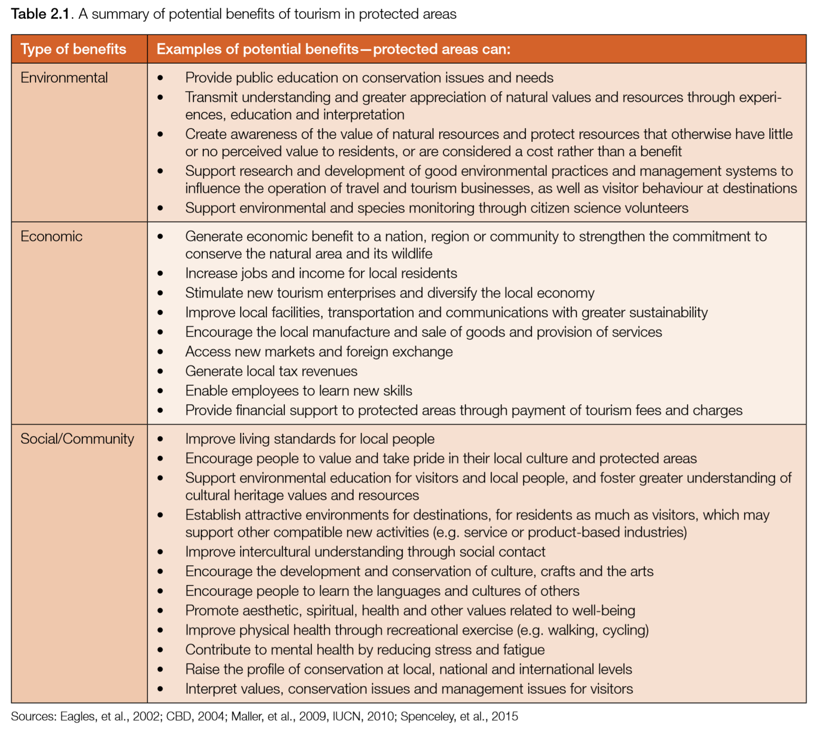

Slide 6
Multiple benefits from mountain gorilla tourism in Volcanoes National Park (Rwanda)
Within the 160-km2 area of Volcanoes National Park (VNP) in Rwanda, the endangered mountain gorilla (Gorilla beringei beringei) is the main tourist attraction.
n Rwanda, nature-based tourism has been enthusiastically supported by government and conservationists, and plays a crucial role in conserving mountain gorillas.
Mountain gorillas are severely threatened by agricultural conversion and illegal resource use (e.g. hunting with snares).

Slide 7
Multiple benefits from mountain gorilla tourism in Volcanoes National Park (Rwanda)
Some of the benefits from mountain gorilla tourism include:
• Environmental: While there are many other variables that affect mountain gorilla populations, Fawcett (2009) suggested that the presence of tourists acted as a deterrent to poachers.
• Economic: Employment opportunities are offered to local people (including ex-poachers) as guides, trackers and anti-poaching guards.
• Social: Between 2005 and 2010, about US$ 428,000 has been directly invested in Rwandan community projects, including building schools, environmental protection projects (e.g. tree planting, soil erosion control), the installation of over 30 water tanks that serve at least 1,250 people, and implementing food security initiatives. The projects were financed through a revenue-sharing scheme whereby 5% of tourism revenues from the park fees are used in community projects around the protected area.

Slide 8
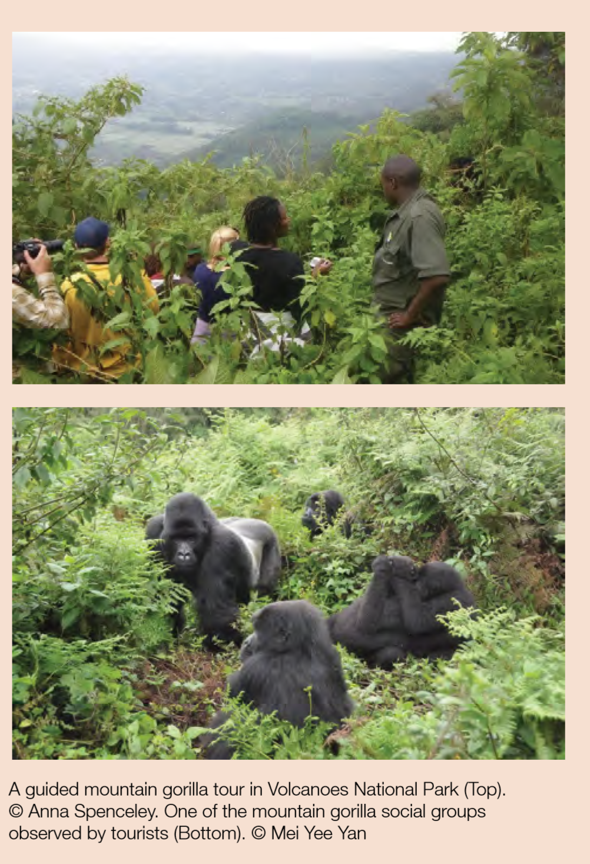

Slide 9
Positive or negative—Who decides? Who benefits?
Note that ‘impacts’ is a neutral term by definition, as impacts perceived as positive by one person or group can be seen as negative by another.
“Who decides whether an impact is positive or negative?”

Slide 10
Positive or negative—Who decides? Who benefits?
Tourists spend a considerable amount of money in protected areas or on activities associated with them through entrance fees, payments for accommodation, charges for activities (e.g. guided drives and walks), and purchases of food, drink and crafts.
This money can be accrued by governments, protected area agencies, travel agents, tour operators, accommodation providers, retailers, service providers and members of local communities.
How should these benefits be allocated?
Tourism in protected areas must contribute to conservation of nature and associated cultural values

Slide 11
Privately protected areas: partners in tourism and conservation
Privately protected areas have long been a part of the conservation movement. In addition to private landowners, trusts, foundations and many non-governmental organisations, such as Conservation International, The Nature Conservancy and the Leadership for Conservation in Africa Network, have acquired areas for protection and research.
There are now many models for private enterprises, landholders, trusts and foundations, NGOs, and communal organisations to own or manage land, wholly or partly for conservation, either solely or in various partnerships. These models differ greatly across countries due to factors such as land use history, land tenure systems, legislation and culture.

Slide 12
Privately protected areas: partners in tourism and conservation
the private sector can be a strong partner in conservation to complement, but not substitute for, public protected areas. Common to these efforts is making the economic benefits of conservation more tangible and explicit, and thus giving protected areas the value they deserve. The recent IUCN WCPA publication The Futures of Privately Protected Areas describes a preliminary framework and examples of good practice guidance for privately protected areas.

Slide 13
NGO-run protected areas: the Royal Society for the Conservation of Nature (Jordan)
Established in 1966 under the patronage of the late King Hussein, The Royal Society for the Conservation of Nature (RSCN) is a non-governmental organisation devoted to the preservation of Jordan’s natural resources. It is one of the few organisations in the Middle East to be granted this kind of public service mandate to manage public lands.

Slide 14
Linking biodiversity and livelihoods: a sustainable protected areacommunity partnership
Kenting National Park (KNP) was established in 1982 as the first national park in Taiwan, Province of China.
It is one of Taiwan’s most popular protected areas, receiving millions of tourists coming to enjoy the park’s coastlines, coral reefs, wetlands and biodiversity.
KNP is threatened by extensive tourism-driven coastal development nearby. To protect valuable natural resources while supporting local community development, the KNP Administration Office (AOKNP) initiated an ecotourism programme with the Shirding community to promote community-based green tourism.

Slide 15
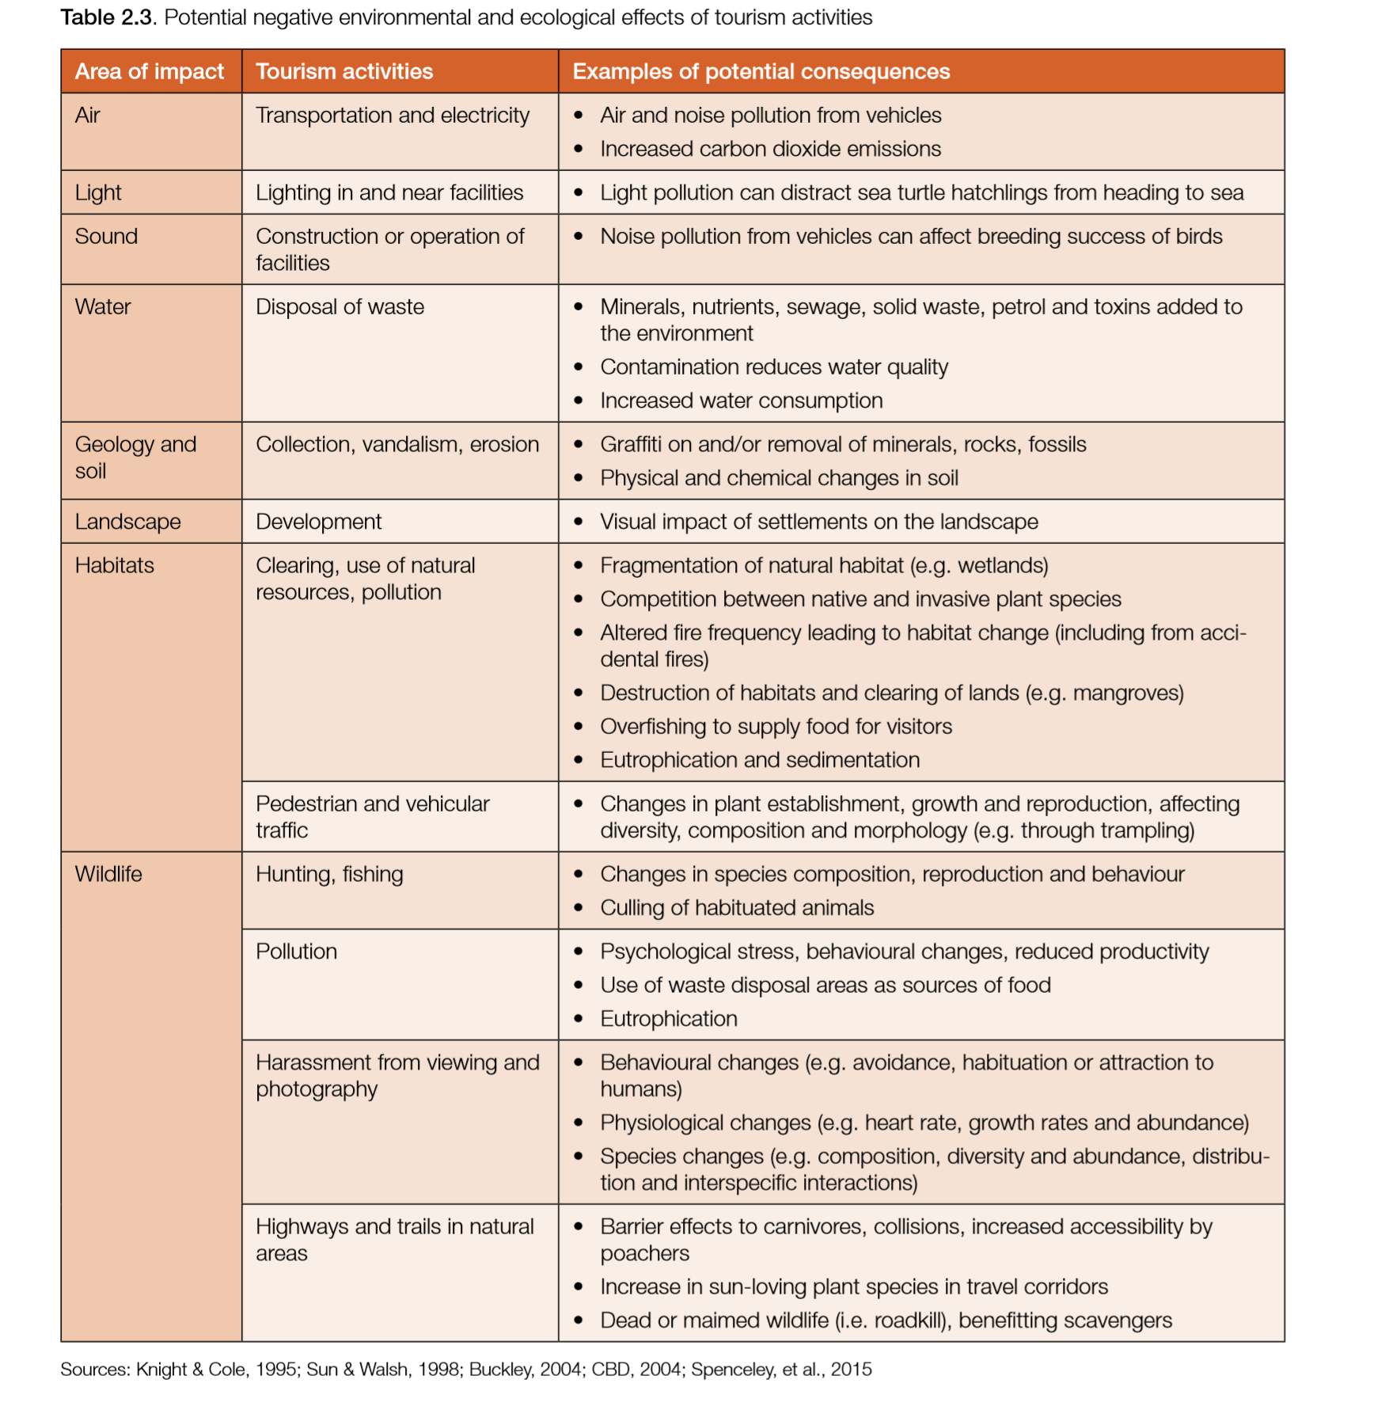

Slide 16
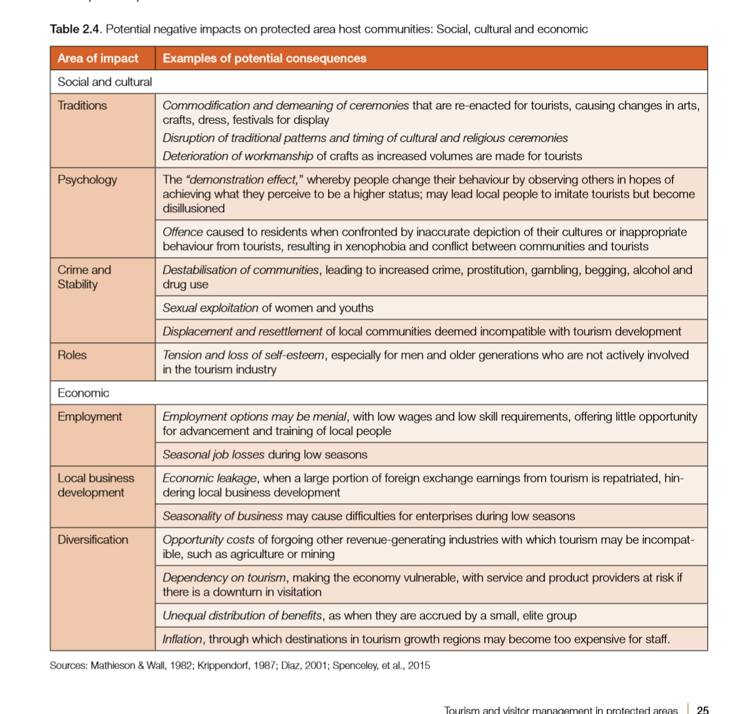

Slide 17
Best practices
• Encourage national tourism policies that fulfil the ‘triple bottom line’ by requiring protected area tourist activities to explicitly contribute to the conservation of nature, generate economic benefits to both protected area authorities and local communities, and account for and minimise negative social impacts.
• Support community-based delivery of tourism services that is market related. Consider partnerships between community enterprises and the private sector to improve the chances of commercial success.
• Build training in business development and management skills into community-based delivery of tourism services, and include community members, NGO representatives and protected area managers in the training. • Re-imagine recreational activities in protected areas as a way to meet community needs and address larger societal goals, such as those related to human health and well-being.

