Slide 1
Principles of Botany
Chapter
Stem Structure and Function
Shahla Hosseini

Slide 2
Stem Functions
Stems have the following 4 functions or jobs:
  Support
  Conduction
  Growth
  Storage

Slide 3
Support
Stems support the plant’s leaves, flowers, and fruits.

Slide 4
Conduction
Like roots, stems contain vascular tissue (xylem and phloem).
Xylem conducts water and minerals.
Phloem conducts the sugars created during photosynthesis.

Slide 5
Growth
During the growing season, cell division and elongation are occurring in both the apical and lateral meristems of dicots.
This results in plant growth.
The same things are occurring in the intercalary meristems of monocots.

Slide 6
Storage
Stems are sometimes modified to store food and (or) water.
Plants that store large amounts of water in their stems or leaves are called succulents.

Slide 7
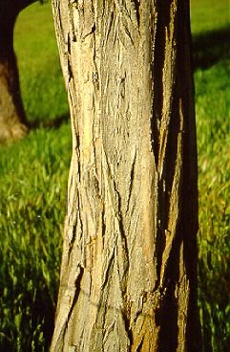
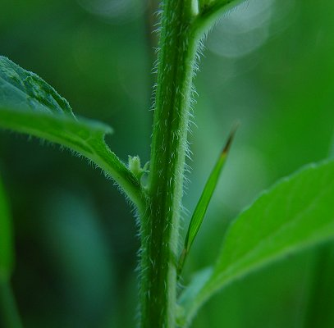
Types of stems
Herbaceous vs. Woody stems

Slide 8
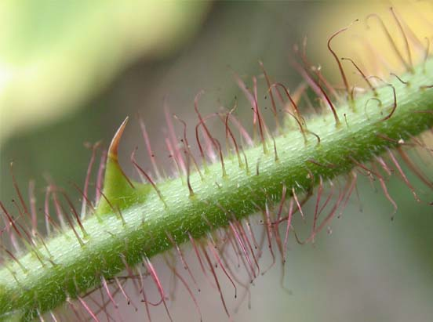
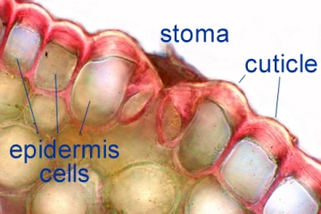
Tissues of stems
Epidermis (Dermal tissue type)
Provides protection
Has cuticle (wax) prevents water loss
Trichomes (hairs) for protection, to release scents, oils, etc.

Slide 9
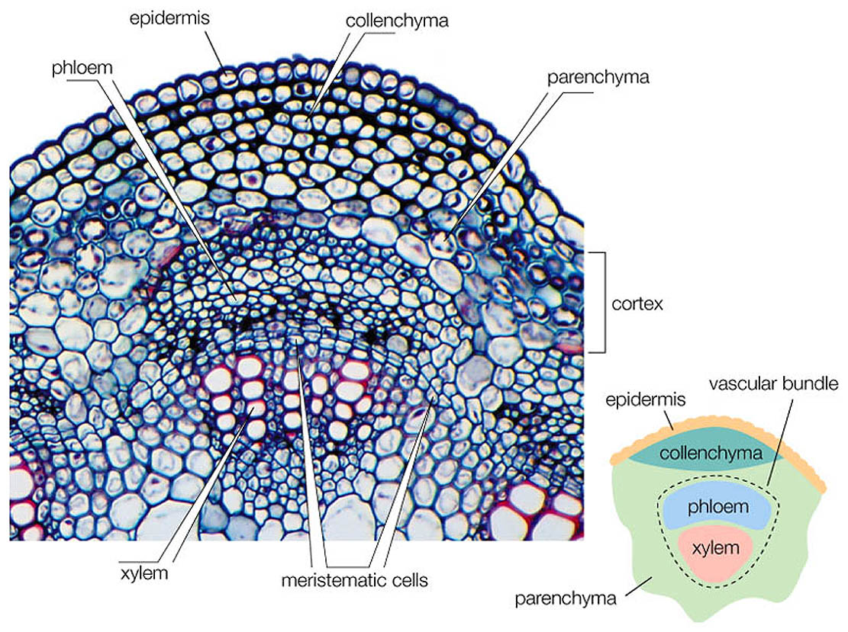
Stem Vascular tissue
Vascular bundles – composed of both xylem and phloem
Xylem
  Conducts water
  Support
Phloem
  Conducts food
  Support
Vascular
cambium

Slide 10
Woody Dicot Stem Morphology
Nodes: places on stems where leaves or buds are located.
Leaf axil: where a leaf petiole attaches to a stem (the angle created by the intersection of the petiole and stem).
Internodes: the sections of a stem located between the nodes.

Slide 11
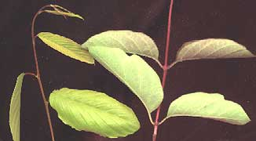
Woody Dicot Stem Morphology
Leaf Axil
Leaf blade
Petiole

Slide 12
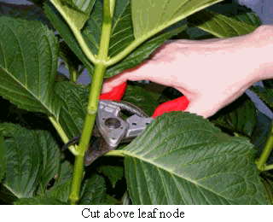
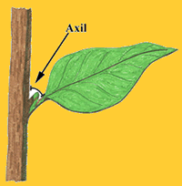
Node

Slide 13
Stem Morphology, continued
Bud: a structure on a stem containing a dormant apical meristem.
  Buds are usually, but not always, covered by protective scales.
  Can be terminal or lateral in position.
  Come in 3 basic types:
    Vegetative
    Flower
    Mixed

Slide 14
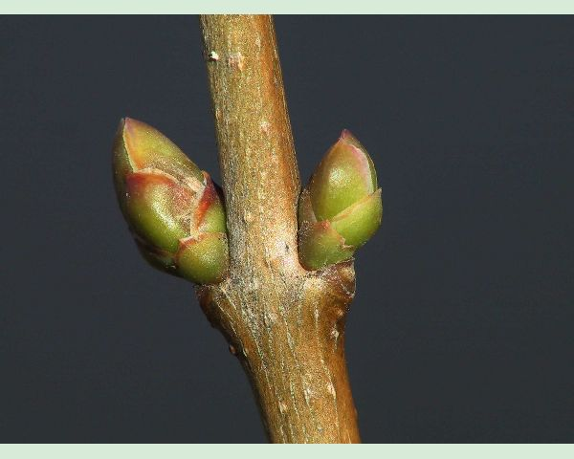
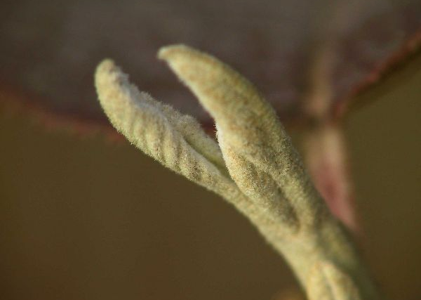
bud scales
naked bud of V. carlesii

Slide 15
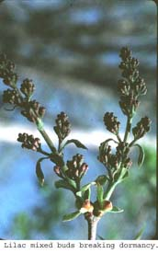
Woody Dicot Stem Morphology
Mixed buds of Lilac are opening up to reveal both stems/leaves and flowers.

Slide 16
Stem Morphology, continued
Terminal bud scale scars: mark the location of last seasons terminal bud.
Leaf scars: scars marking the location of last seasons leaves.
Vascular bundle scars: found inside leaf scars, these scars mark the location of the vascular bundles that passed from the stem, through the leaf petiole, and into the leaf blade.

Slide 17
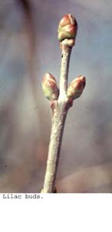
Woody Dicot Stem Morphology
Terminal bud
Lateral buds

Slide 18
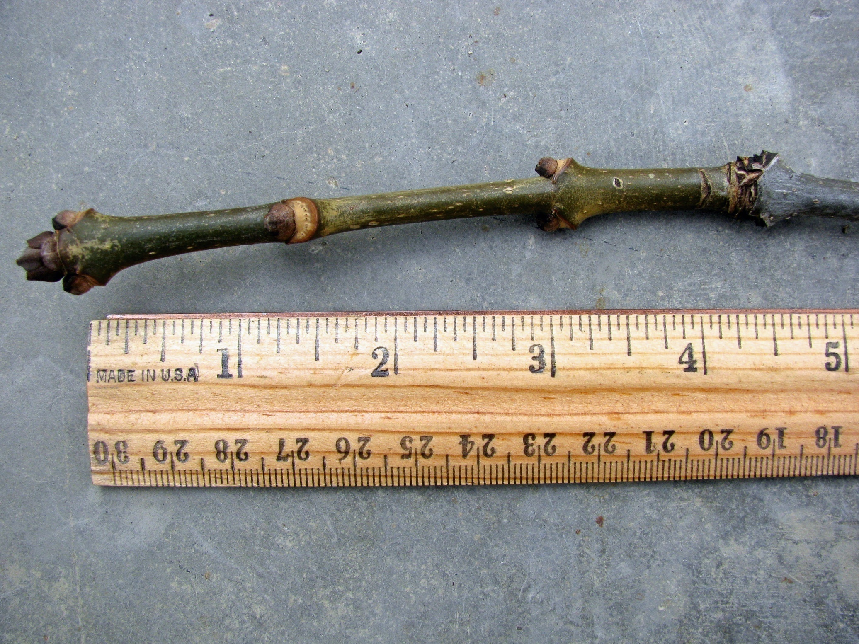

Slide 19
Stem Morphology, continued
Lenticels: dot-like structures on stems that consist of loosely packed cells that may play a role in gas exchange between the atmosphere and stem. Not all stems have lenticels.

Slide 20
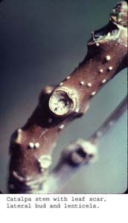
Woody Dicot Stem Morphology
Lenticel on Catalpa stem
Leaf scar on Catalpa stem

Slide 21
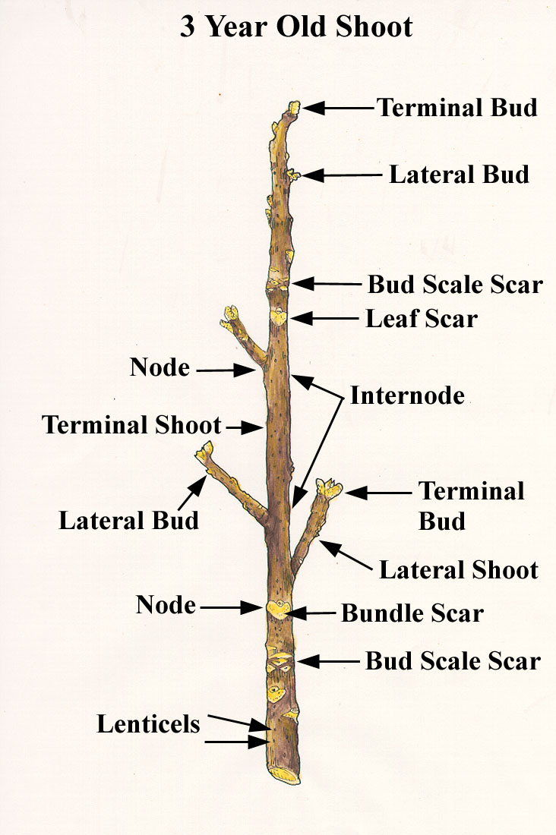
Woody Dicot Stem Morphology

Slide 22
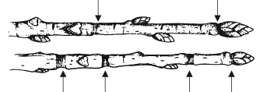
Woody Dicot Stem Morphology
Arrows mark the position of the terminal bud scale scars

Slide 24
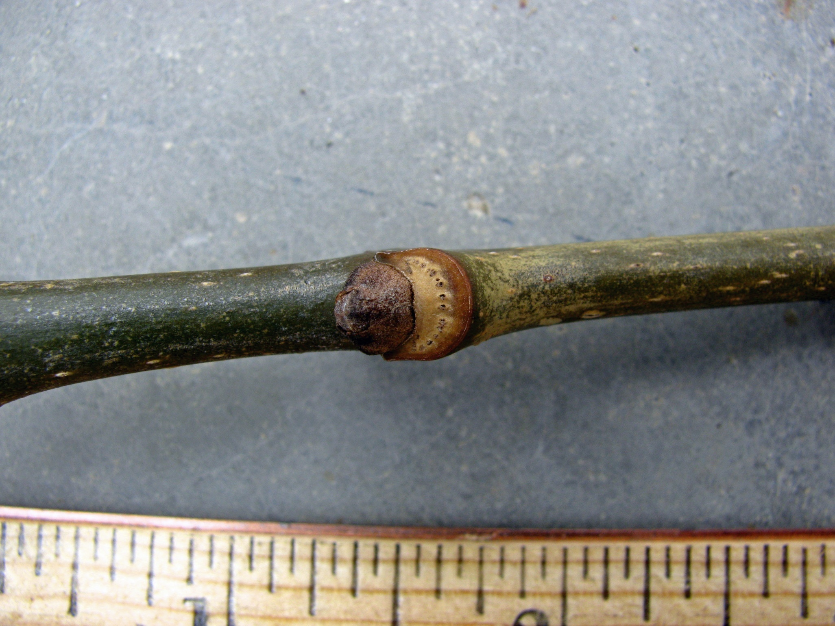

Slide 25
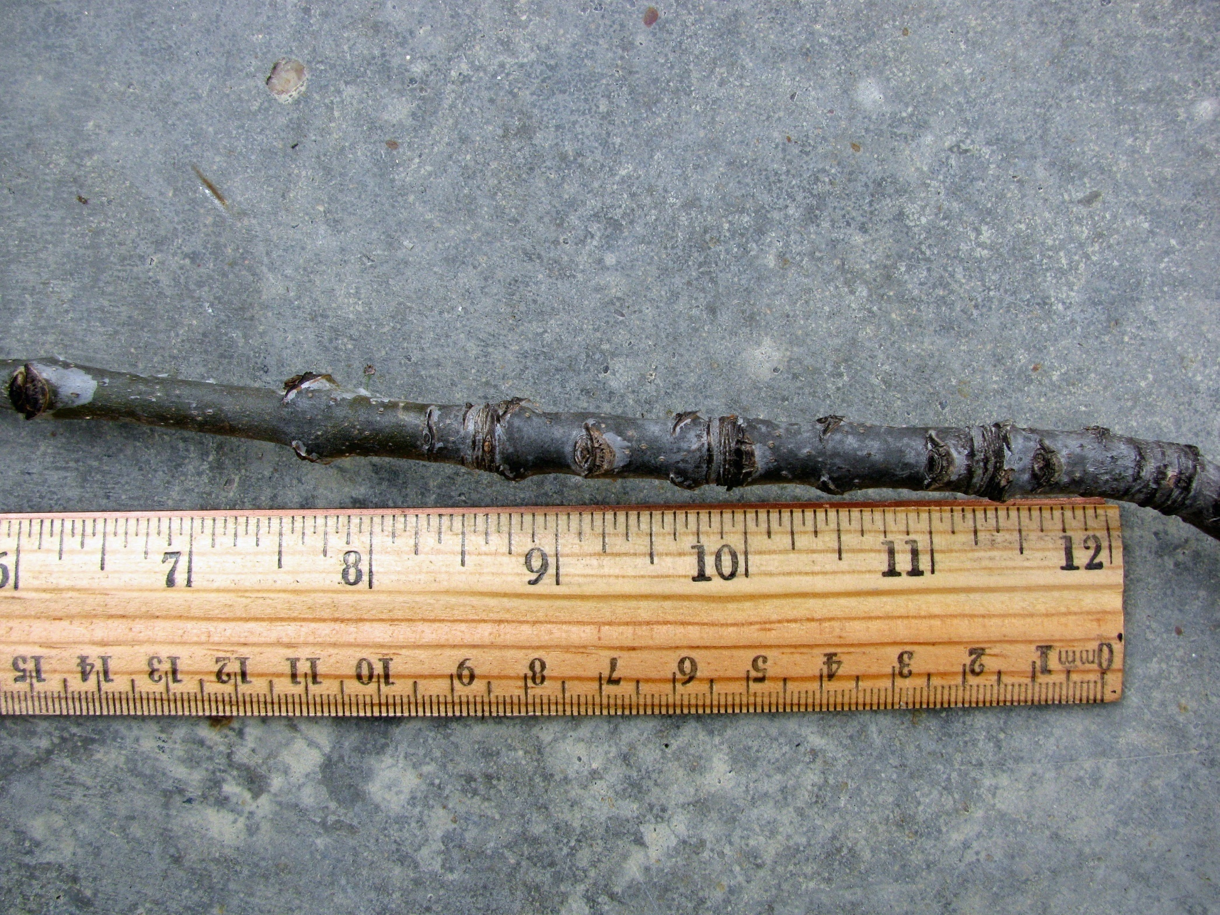

Slide 26
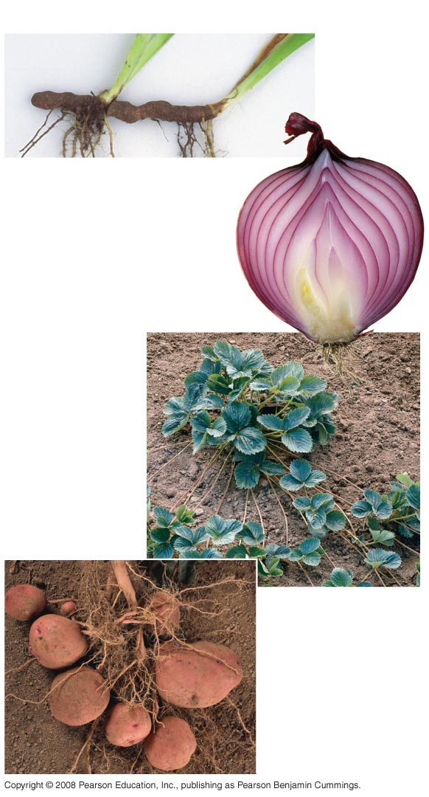
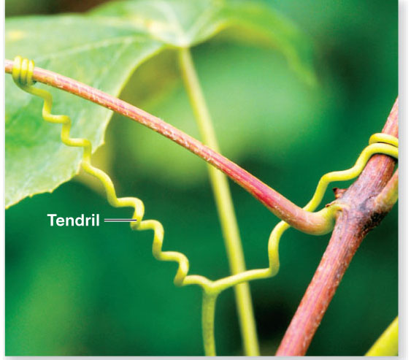
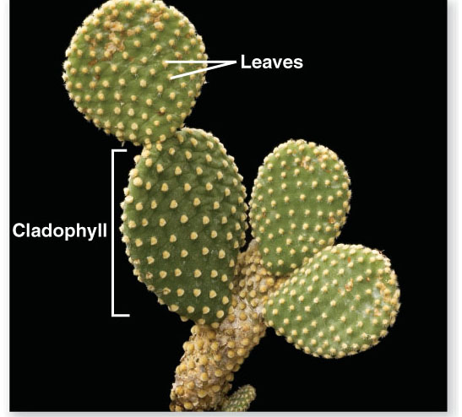
Rhizomes
Stems – Many Plants Have Modified Stems
Bulbs
Storage leaves
Stem
Stolons
Stolon
Tubers
Notes:
26
Figure 35.5 Modified stems

Slide 27
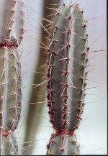
Succulents
Cacti are examples of succulent plants that store water in their stems.
The spines are modified leaves.

Slide 28
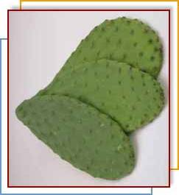
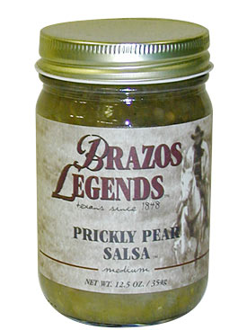
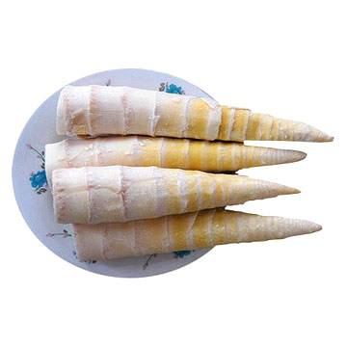
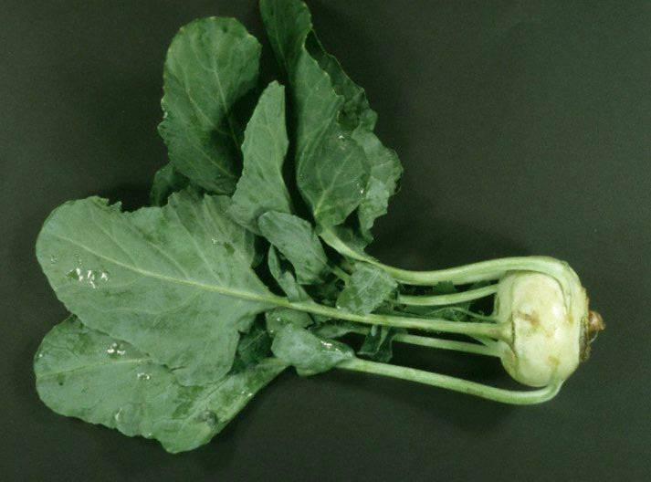
Food Storage Stems
Prickly Pear Cactus
Bamboo Shoots
Kohlrabi

Slide 29
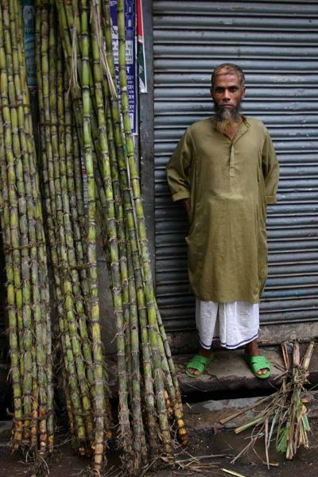
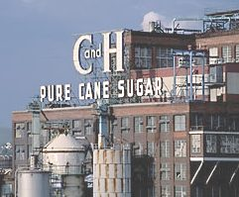
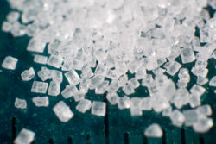
Food Storage Stems - Sugarcane

Slide 30
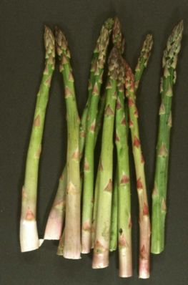
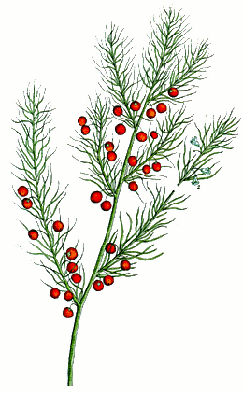
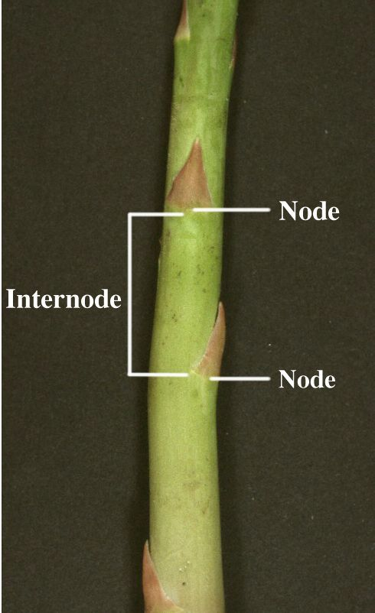
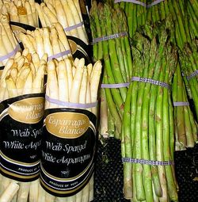
Food Storage Stems - Asparagus

Slide 31
Tuber
A potato is a special type of underground stem called a tuber.
Tubers store excess carbohydrates manufactured during photosynthesis.
Don’t confuse tubers with tuberous roots. Tuberous roots are root modifications, tubers are modified stems.

Slide 32
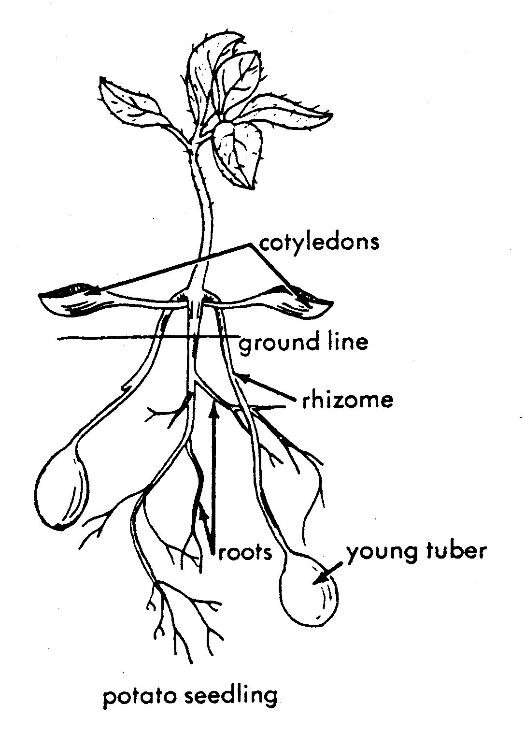
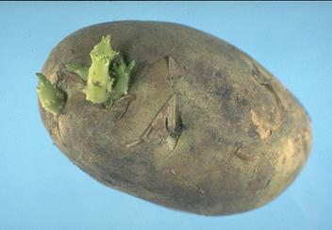
The Potato is a Tuber
mature tuber

Slide 33
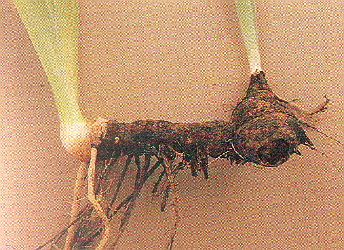
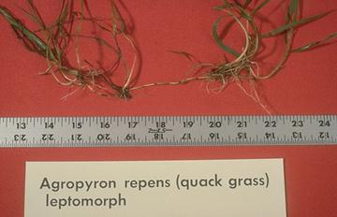
Rhizomes
An underground stem.
Usually grows horizontally.
Capable of producing new shoots and roots.
Iris

Slide 34
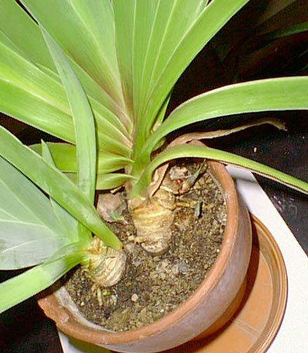
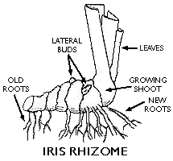
Rhizomes
Rhizomes - horizontal stems that grow below the ground with adventitious roots
Examples of plants that can produce rhizomes are irises, ferns, and grasses.

Slide 35
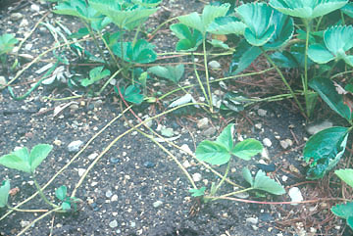
Stolons
Aboveground stems that “run” across the soil surface.
Horizontally growing.
Produce new shoots and roots.
Strawberry stolons

Slide 36
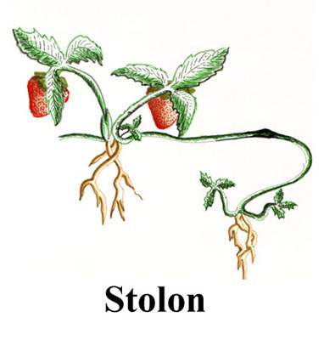
Stolons
Stolons or runners - horizontal stem that grows above the ground with long internodes
Examples of plants that can produce stolons are strawberry and airplane plants

Slide 37
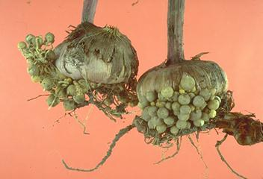
Corms
Compressed, swollen vertical stem.
Papery covering.
Found underground.
Crocus and Gladiolus are examples.
Gladiolus corms

Slide 38
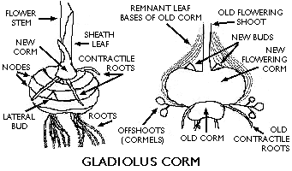
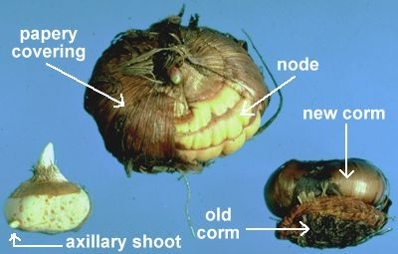
Corm
Corms - resemble bulbs but composed entirely of stem tissue surrounded by a few papery scale like leaves, food storage organs with adventitious roots at the base of corms
Examples include crocus and gladiolus.

Slide 39
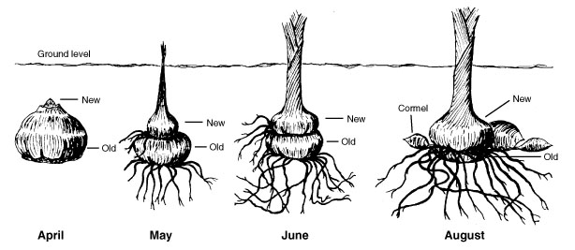
Corm Development

Slide 40
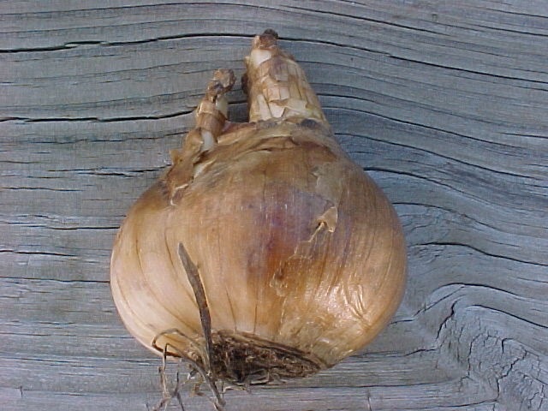
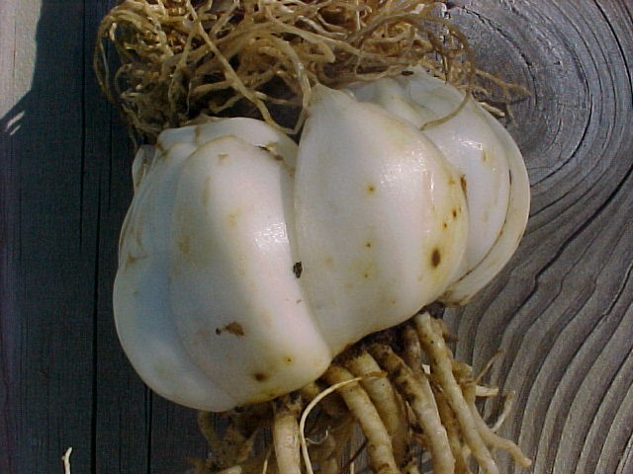
Bulbs
Underground.
Two different kinds:
  Tunicate bulbs have a papery outer covering. An onion is an example.
  Scaly bulbs lack a papery outer covering. Lily bulbs are an example.
Tunicate bulb
Scaly bulb

Slide 41
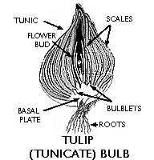
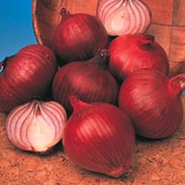
Bulb
Bulbs - large buds with a small stem at the lower end surrounded by numerous fleshy leaves, adventitious roots at base
Examples include onion, tulip, and lily

Slide 42
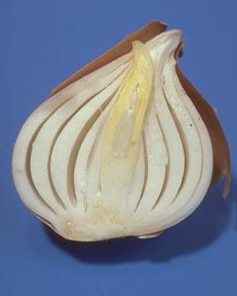
Parts of a Bulb
Scales: modified leaves that store carbohydrates
Apical bud: sits on top of the basal plate. Will eventually form a shoot bearing leaves and flowers
Basal plate: modified stem

Slide 43

Offset Bulbs
Original bulb
Offset bulbs

Slide 44

Rosette
Rosette - stem with short internodes and leaves attached at nodes

Slide 45


Cladophylls
Cladophylls - leaf-like stems; examples include butcher's broom, asparagus

Slide 46



Thorns
Honey locust (modified stem)
Black Locust (modified leaf stipules)

Slide 47


Tendrils
Grape Tendrils

Slide 48
Woody Dicot Stem Anatomy
The cells in the stem of a woody, dicot plant are oriented in 2 different directions.
Xylem and phloem are vertically arranged tissues.
The vascular cambium produces bundles of horizontally arranged cells called vascular rays or just rays for short.
Rays pass through both xylem and phloem.

Slide 49
Internal Anatomy of Stem

Slide 50



STEM APICAL MERISTEM

Slide 51


Slide 52

Apical Dominance
Apical dominance refers to the suppression of growth by hormones produced in the apical meristem. The Christmas tree pattern of pines indicates strong apical dominance. Bushy plants have weak apical dominance. If apical meristem is eaten or destroyed, plants may become bushy.
  Lateral branch growth are inhibited near the shoot apex, but less so farther from the tip.
  Apical dominance is disrupted in some plants by removing the shoot tip, causing the plant to become bushy.

Slide 53

Monocotyledonous & Dicotyledonous Flowering Plants

Slide 54

INTERNAL STEM ANATOMY

Slide 55

Plant Growth
Two lateral meristems: vascular cambium and cork cambium
Primary growth in stems
Epidermis
Cortex
Shoot tip (shoot
apical meristem
and young leaves)
Primary phloem
Primary xylem
Pith
Lateral meristems:
Vascular cambium
Secondary growth in stems
Cork cambium
Axillary bud
meristem
Periderm
Cork
cambium
Cortex
Pith
Primary
phloem
Primary
xylem
Root apical
meristems
Secondary
phloem
Secondary
xylem
Vascular cambium
Notes:
Figure 35.11 An overview of primary and secondary growth

Slide 56

Plant Growth
Stem – Secondary Growth:
primary phloem
  thicker, stronger stems
  Vascular Cambium: between primary xylem and phloem
vascular cambium
primary xylem
epidermis
  Produces inside stem:
pith
A) Secondary xylem
  moves H₂O, inward
B) Secondary phloem
  moves sugars, outward
cortex
primary xylem
dividing
vascular
cambium
primary phloem

Slide 57

Plant Growth
Vascular Cambium:
primary
xylem
Secondary growth
new
secondary
xylem
secondary phloem
dividing
vascular
cambium
primary phloem
primary xylem
secondary xylem
new
secondary
phloem
primary
phloem
vascular cambium
pith
cortex
Vascular cambium
Growth
Vascular
cambium
X
X
C
P
P
Secondary
xylem
Secondary
phloem
X
X
C
P
C
X
C
P
C
C
C
C
X
C
C
C
After one year
of growth
After two years
of growth
C
C

Slide 58

Plant Growth
Stem – Secondary Growth:
  Cork Cambium:
Located under outer surface; produces periderm
Growth
ring
Dead at maturity
Protection
Vascular
ray
Heartwood
Secondary
xylem
Sapwood
Vascular cambium
Secondary phloem
Bark
Layers of periderm

Slide 59

Plant Growth
Stem – Secondary Growth:
heartwood
(xylem)
sapwood
(xylem)
vascular
cambium
phloem
annual ring
Sapwood = Young xylem, water
Heartwood = Old xylem, support
Seasonal Growth = annual rings
Secondary phloem = grows outward older phloem crushed
late
xylem
early
xylem

Slide 60

Plant Growth - Stems
In most monocot stems, the vascular bundles are scattered throughout the ground tissue, rather than forming a ring
Phloem
Xylem
Sclerenchyma
(fiber cells)
Ground tissue
connecting
pith to cortex
Ground
tissue
Pith
Epidermis
Key
to labels
Epidermis
Cortex
Dermal
Vascular
bundles
Vascular
bundle
Ground
1 mm
Vascular
1 mm
(a)
Cross section of stem with vascular bundles forming
a ring (typical of eudicots)
(b)
Cross section of stem with scattered vascular bundles
(typical of monocots)
Notes:
Figure 35.17 Organization of primary tissues in young stems

Slide 61

Typical Stem Cross Section (Dicot Stem)
Helianthus annuus-
sun flower annual
Epidermis
Cortex
A ring of vascular bundles
Pith

Slide 62

Epidermis
- window, reduce water loss
Cortex Collenchyma
- extensible support
Cortex Parenchyma
- photosynthesis, etc.
Fibers- rigid support
Functional Phloem
- conduct sugars etc. away from leaf to rest of plant
Vascular Cambium
- adds 2° xylem and 2° phloem
Xylem
conduct water and minerals
up from soil
Pith
water storage, defense?

Slide 63


Monocot Stem – cross section

Slide 64

Springwood-Summerwood
Cross-sectional view of a 3-year old woody, dicot stem
Vascular Cambium
Summerwood yr 3
Springwood yr 1
Summerwood yr 1
Springwood yr 2
Summerwood yr 2
Springwood yr 3

Slide 65

Plant Growth
RESULTS
2
1.5
Ring-width
indexes
1
0.5
0
1600
1700
1800
1900
2000
Year
Using dendrochronology to study climate
Notes:
Figure 35.21

Slide 66
Vascular Rays
Rays allow for the lateral movement of water, dissolved minerals, sugars, and waste products within the stem.

Slide 67

Woody Dicot Stem Cross-Section
Ray

Slide 68
Heartwood
Heartwood: As xylem ages it becomes plugged with resins and other waste products.
When this happens the xylem (wood) becomes stained a dark color.
Heartwood is not functional xylem. It no longer conducts water.
It does, however, help strengthen the trunk of a tree.

Slide 69
Sapwood
Sapwood: xylem that is actively conducting water.
Lighter in color than heartwood.
Surrounds the heartwood.

Slide 70

Heartwood/Sapwood

Slide 71

Plant Growth
Living tree or dead tree?
Notes:
Figure 35.23 Is this tree living or dead?

Slide 72


The trees pictured below have long lost their epidermis on the woody portion of the stem
Sequoia sempervirens - giant sequoia

Slide 73

Three years of Secondary Growth
Tilia - basswood
Secondary
Phloem
cambium
Secondary
Xylem

Slide 74

A cork cambium differentiates and produces a periderm.
Epidermis
cutin
suberin
Cork Cells
Cork Cambium
Phelloderm

Slide 75

Bark =
epidermis + periderm + cortex + phloem + vascular cambium
Wood =
secondary xylem only!
Pith =
a small percentage of tree diameter at maturity

Slide 76


Anatomy of a Woody Stem

