Slide 1
Presentation No. 2

Slide 2
Lag Time: میزان کند بودن انجام یک فرایند
-a period of time between two related actions or an interval of time between two related phenomena (Merriam Webster Dictionary)
-Fail to keep up with another or others in movement or development
Example:
-There's a time lag between when you see a stop sign and when your foot steps on the brake.
-a lag time between infection and symptoms
-
Time Delay: تاخیر در دریافت سیگنال
a delay between transmitting and receiving broadcast material
-a live program is underway but it would have a short time delay built into the transmission of sound.
Example: sending a print page to a printer but not responding instantly

Slide 3
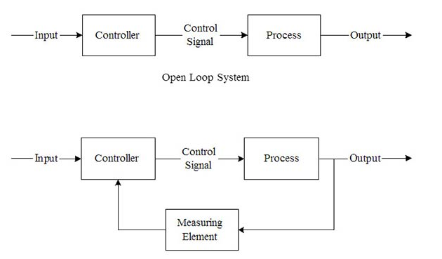
Closed-loop
In control systems engineering there are two systems:
1. Open loop system which is also called as Manual control system.
2. Closed loop system which is also named as automatic control system.

Slide 4
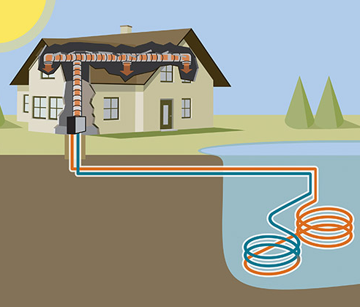
Open Loop System:
Advantages:
Simplicity and stability in Construction
Disadvantages:
Accuracy and Reliability: since these systems do not have a feedback mechanism, so they are very inaccurate in terms of result output and hence they are unreliable too.
Due to the absence of a feedback mechanism, they are unable to remove the disturbances occurring from external sources.

Slide 5
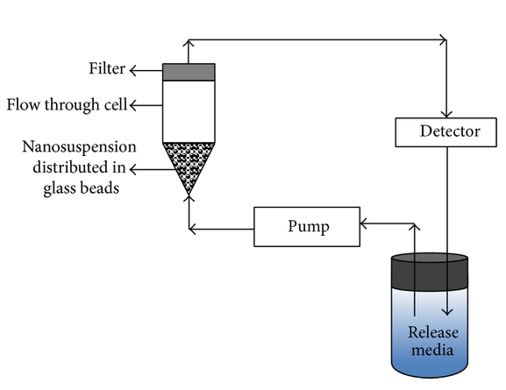
Closed Loop System:
Advantages:
1. Accuracy
2. Noise reduction ability: Since they are composed of a feedback mechanism, so they clear out the errors between input and output signals, and hence remain unaffected to the external noise sources.
Disadvantages:
1. Construction: They are relatively more complex in construction and hence it adds up to the cost making it costlier than open loop system.
2. Since it consists of feedback loop, it may create oscillatory response of the system and it also reduces the overall gain of the system.
3. Stability: It is less stable than open loop system but this disadvantage can be solved since we can make the sensitivity of the system very small so as to make the system as stable as possible.

Slide 6
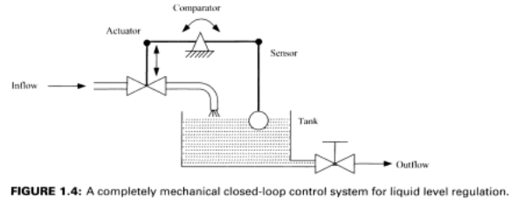
Examples

Slide 7
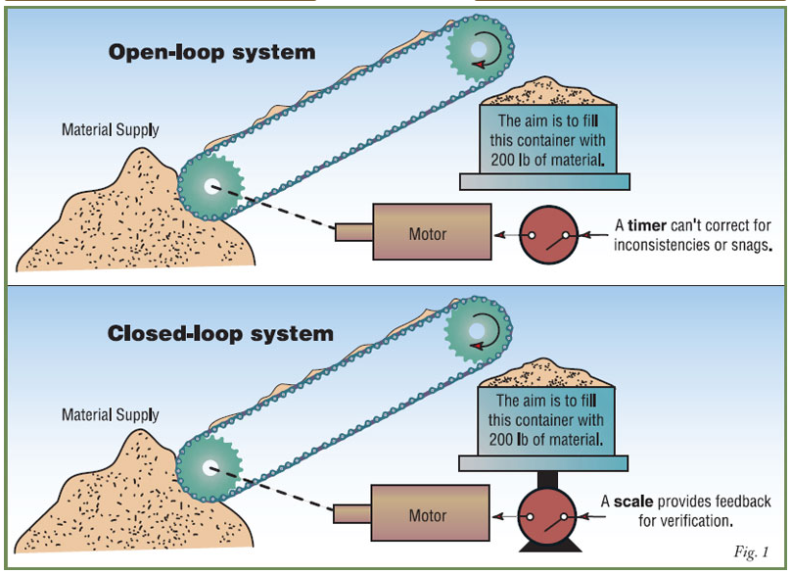

Slide 8
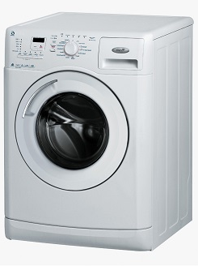
Feed-back vs Feed-forward
Feed-back: the path by which some of the output of a circuit, system, or device is returned to the input.
Feed-forward, sometimes written feedforward, is a term describing an element or pathway within a control system which passes a controlling signal from a source in its external environment
Using timer to fill the drum or using a water
level sensor to check waters level

Slide 9
Examples:
-In the house example, a feed-forward system may measure the fact that the door is opened and automatically turn on the heater before the house can get too cold however, if a window was opened which was not being measured, the feed-forward-controlled thermostat might still let the house cool down.
-Car approaching hill : see how steep the hill is (measurement)
Push on pedal to keep steady speed
-Filling house reservoir during the night for next day

Slide 10
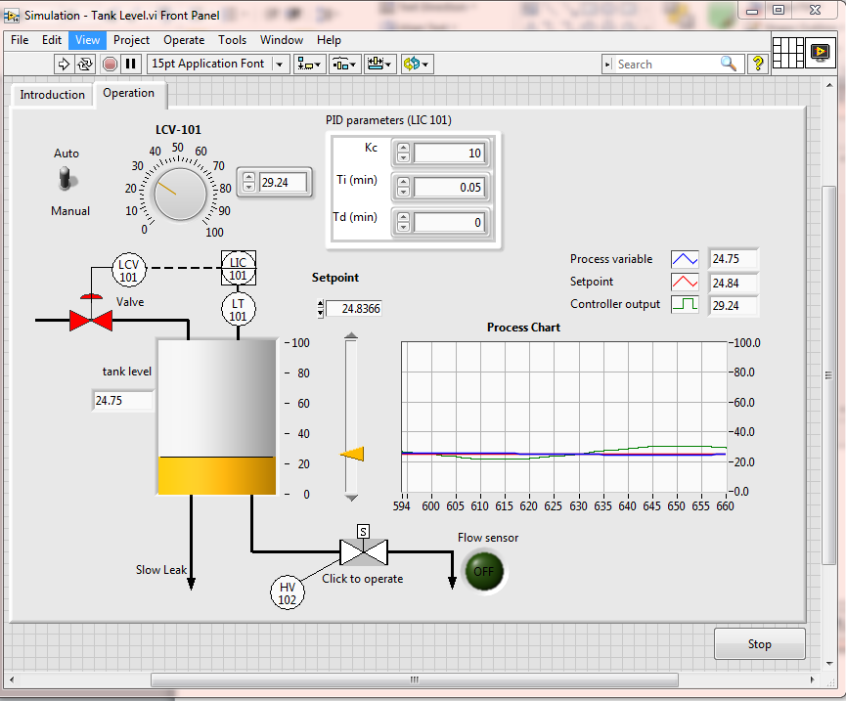

Slide 11
