Slide 1
Principles of Botany
Chapter 2
Plant Cell
Shahla Hosseini

Slide 2
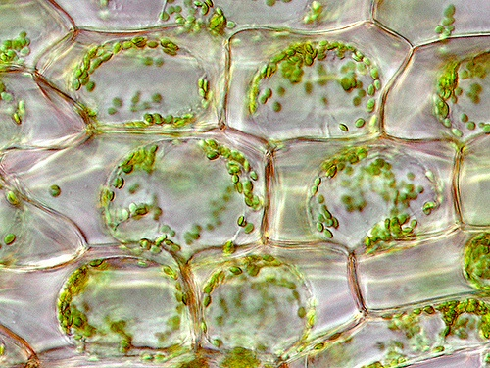
The Plant Cell

Slide 3
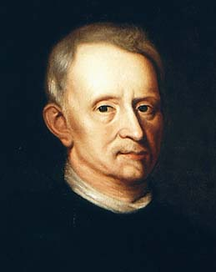
Robert Hooke – first saw cells - 1665

Slide 4
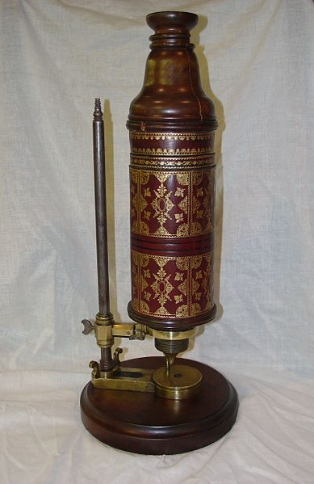
Hooke’s Microscope

Slide 5
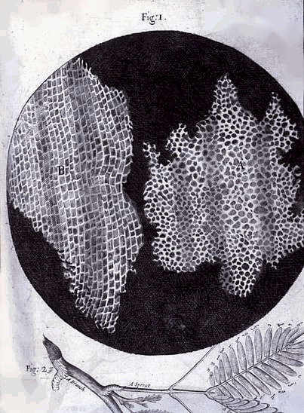
Hooke’s drawing of Cork Cells

Slide 6
Development of Cell Theory of Life
1838 – Matthias Schleiden – stated all plants composed of cells
1839 – Theodor Schwann – stated all animals also composed of cells – thus claimed all living things composed of cells
1858 – Rudolf Virchow – all cells come from preexisting cells

Slide 7
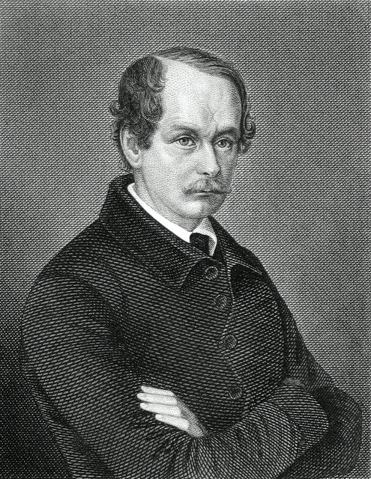
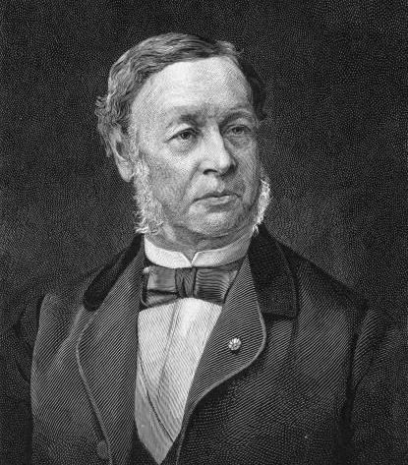
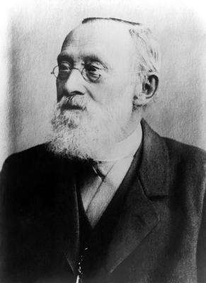
Developers of Cell Theory
Matthias Schleiden Theodor Schwann Rudolf Virchow

Slide 8
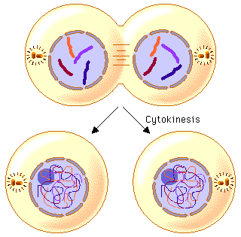
Cell Theory
1. All organisms are made up of cells.
2. Cells are the basic unit of structure and function in all organisms.
3. All cells come from cells that already exist.

Slide 9
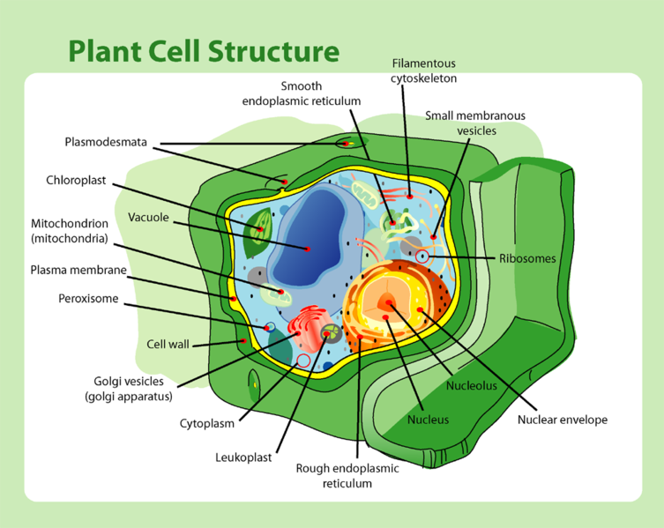

Slide 10
The Plant Cell
The Plant Cell consists of a more or less rigid cell wall and the protoplast - the contents of the cell
The protoplast consists of the cytoplasm and a nucleus
The cytoplasm includes distinct membrane-bound organelles such as plastids and mitochondria; systems of membranes (endoplasmic reticulum and dictyosomes); nonmembranous entities such as ribosomes, actin filaments and microtubules
The rest of the cytoplasm is a liquid matrix in which the nucleus, various entities and membrane systems are suspended - it is typically referred to as the cytosol or ground substance

Slide 11
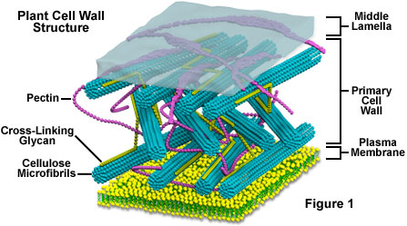
Cell Wall Structure

Slide 12
Cell walls consist of 3 types of layers
  Middle lamella is formed during cell division. It makes up the outer wall of the cell and is shared by adjacent cells. It is composed of pectic compounds and protein.
  Primary wall: This is formed after the middle lamella and consists of a skeleton of cellulose microfibrils embedded in a gel-like matrix of pectic compounds, hemicellulose, and glycoproteins.
  Secondary wall: formed after cell enlargement is completed provides compression strength. It is made of cellulose, hemicellulose and lignin. The secondary wall is often layered.

Slide 13
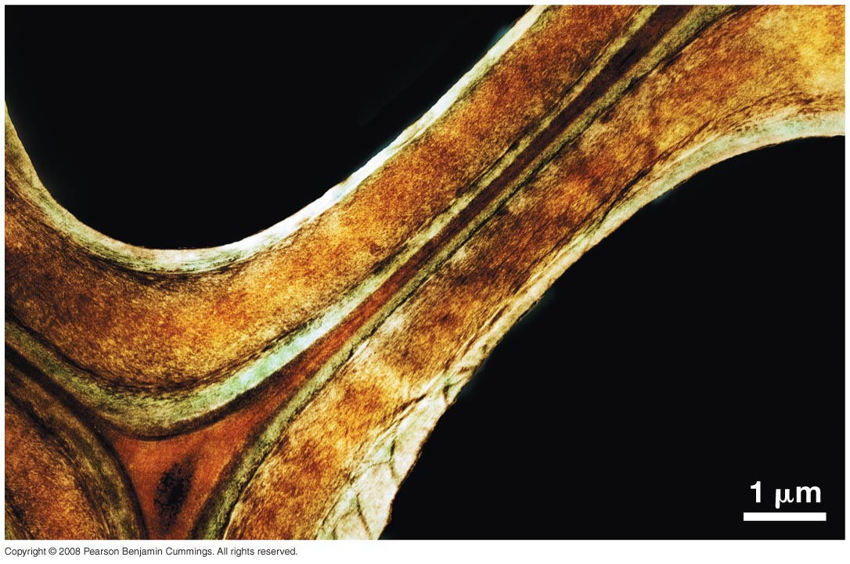
Figure 8-9
Secondary cell wall
Primary cell
walls
Middle lamella

Slide 14
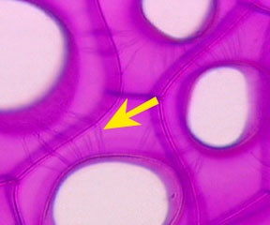
Plasmodesmata
Plasmodesmata allow the transport of substances from one cell to the next
They are cytoplasmic threads which connect the living protoplasts of adjoining cells

Slide 15
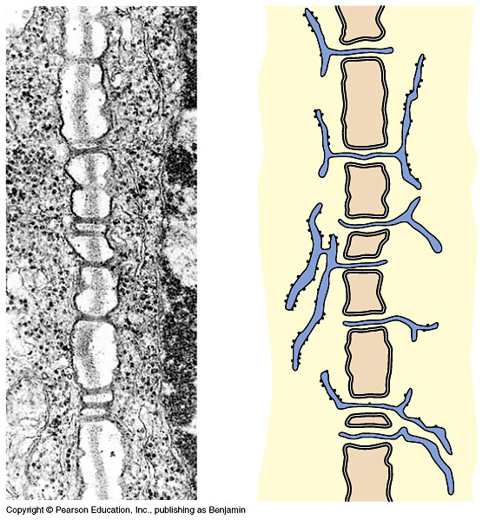
Cell Wall Structure
plasmodesmata

Slide 16
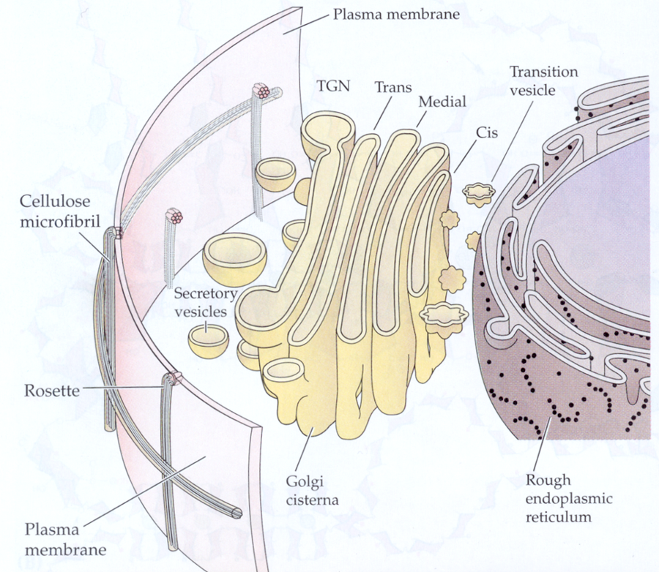
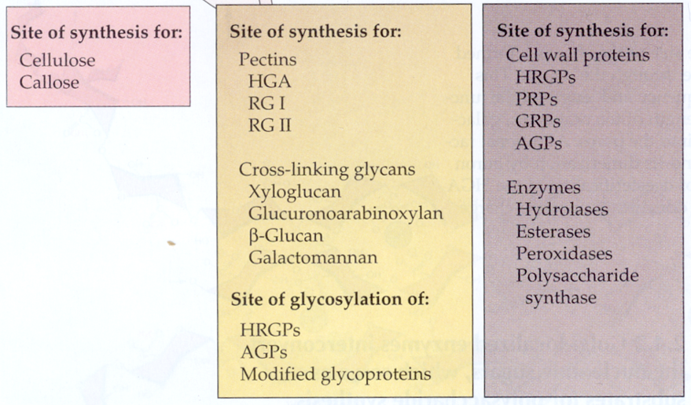

Slide 17
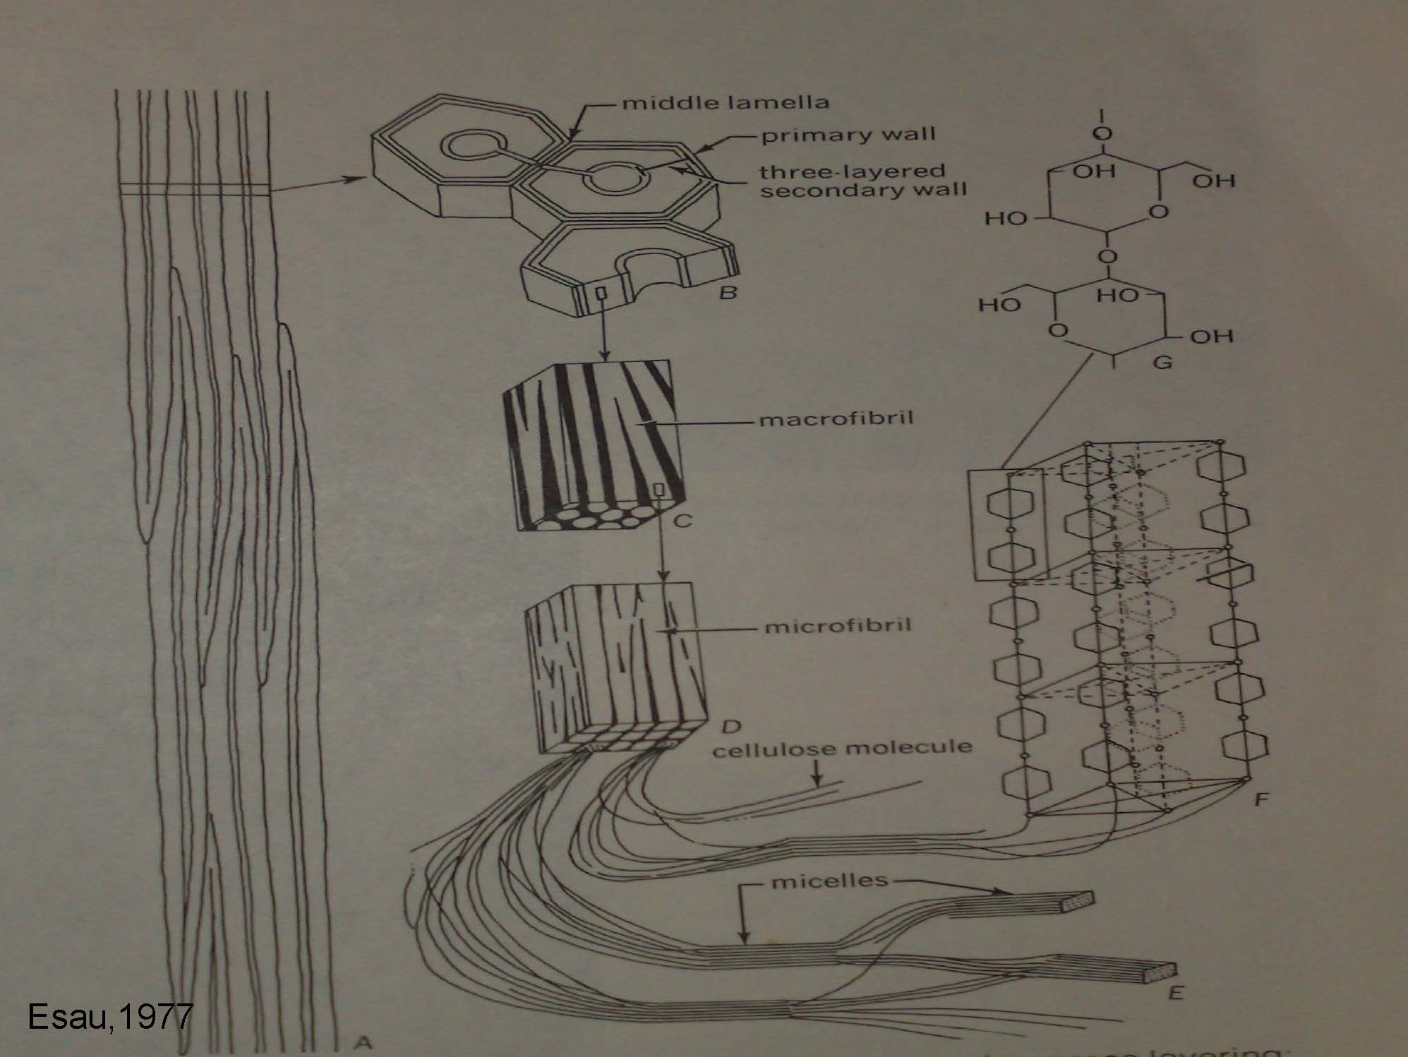

Slide 18
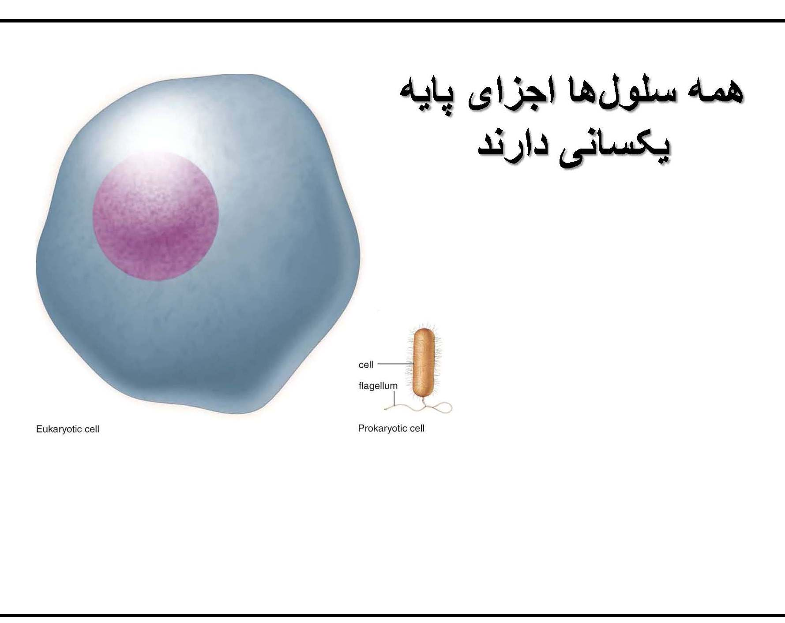

Slide 19
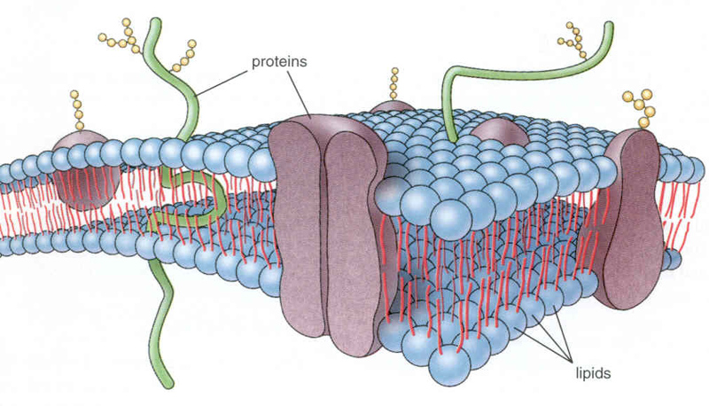
Plasma Membrane
The plasma membrane has several functions
1. it mediates the transport of substances into and out of the protoplasm
2. it coordinates the synthesis and assembly of cellulose microfibrils
3. it relays hormonal and environmental signals involved in the control of cell growth and differentiation

Slide 20
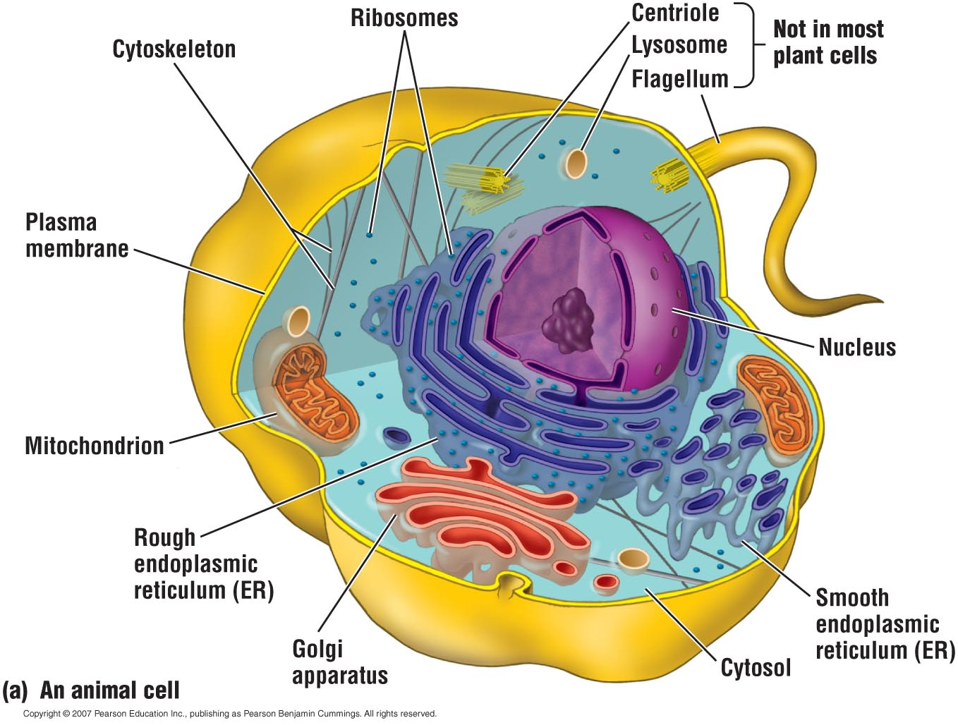
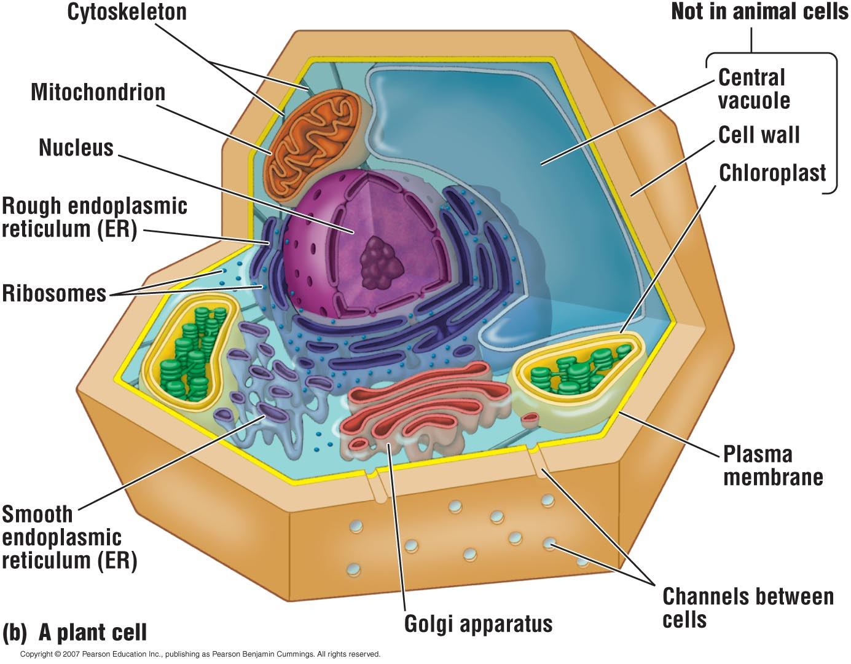
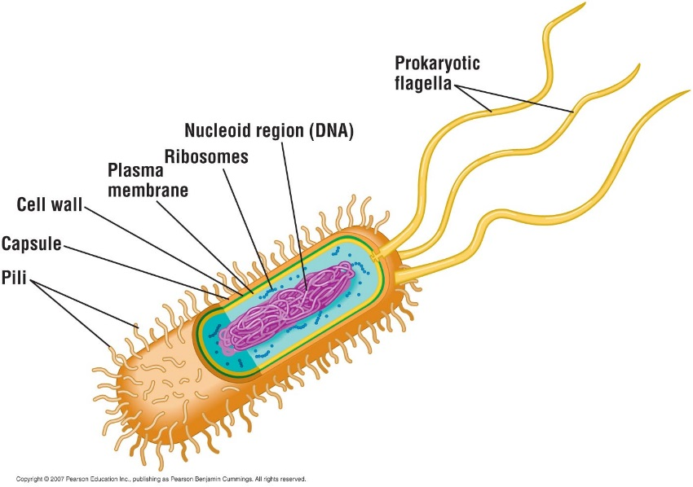
Plasma Membrane
  The plasma membrane separates the living cell from its nonliving surroundings.

Slide 21
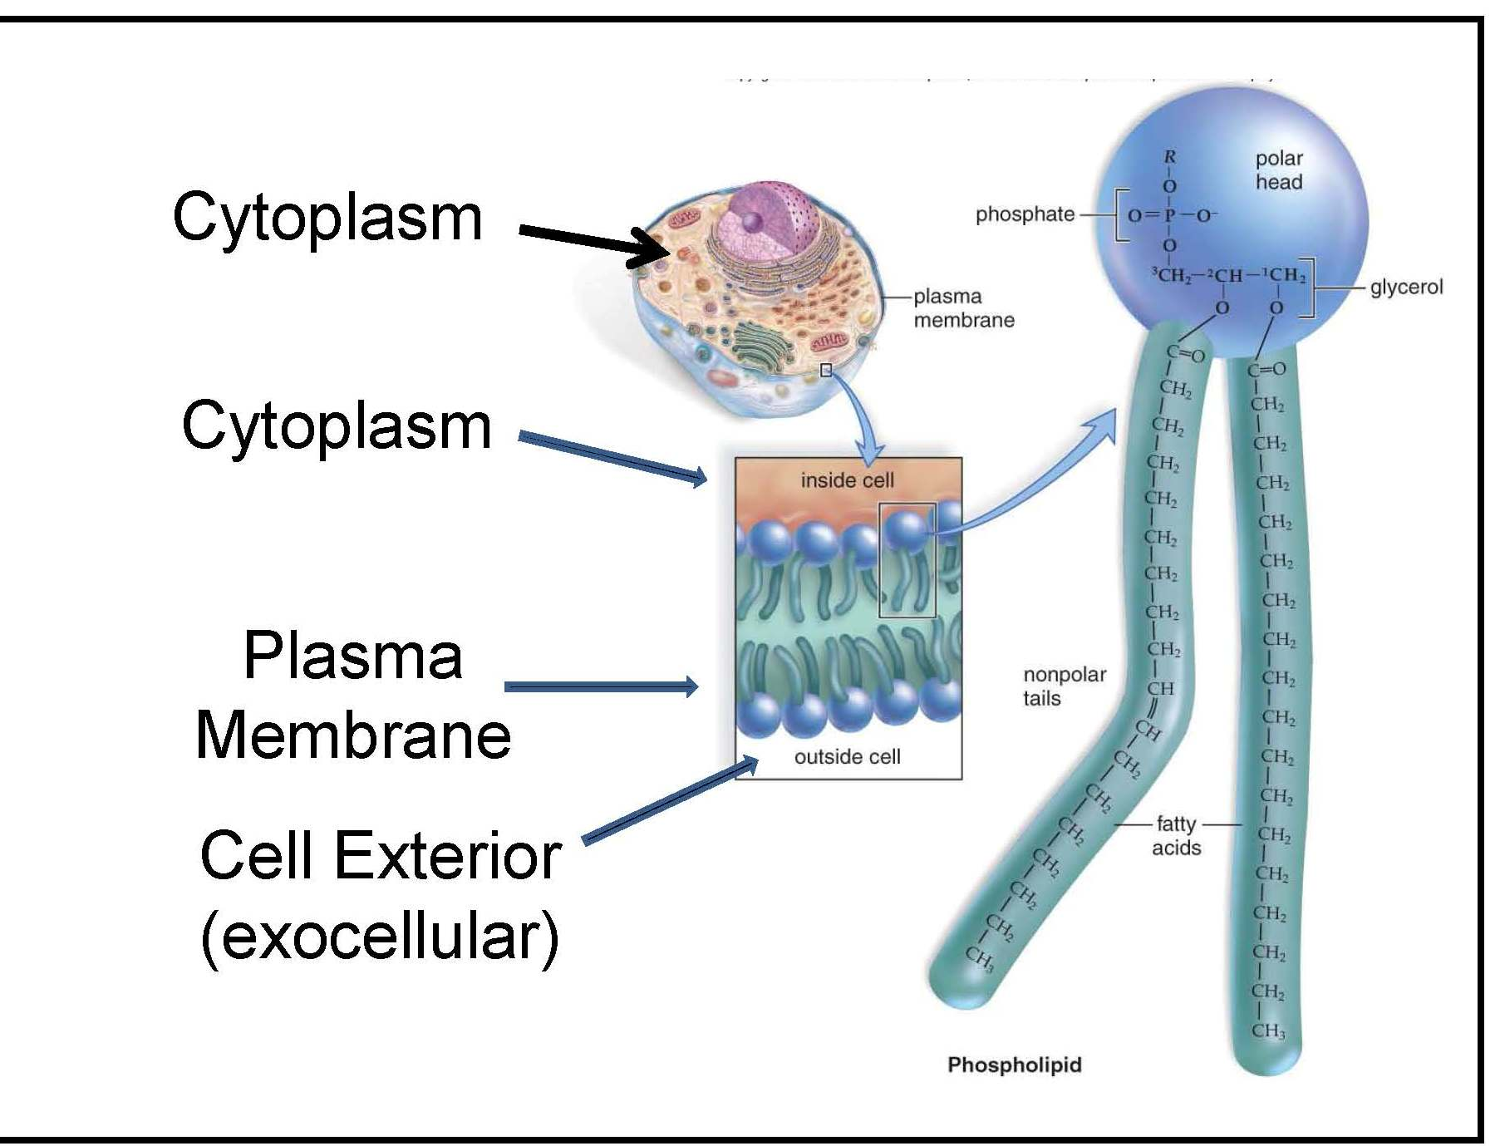

Slide 22
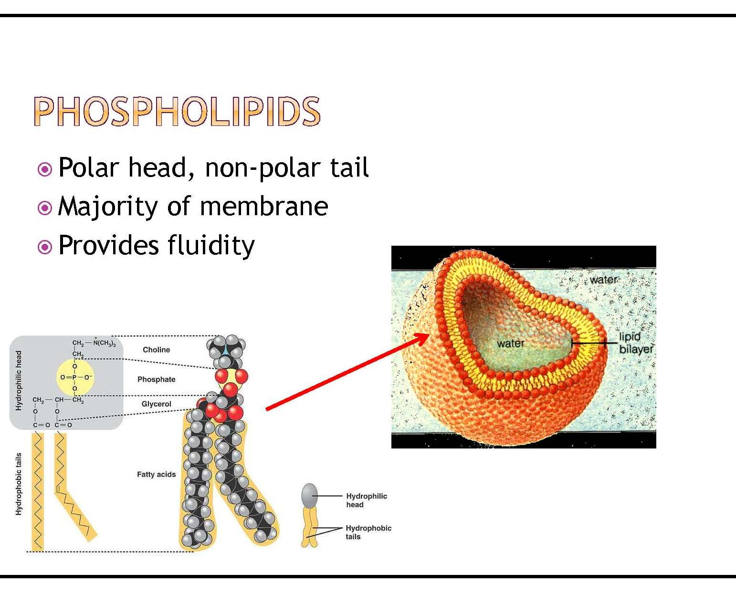

Slide 23
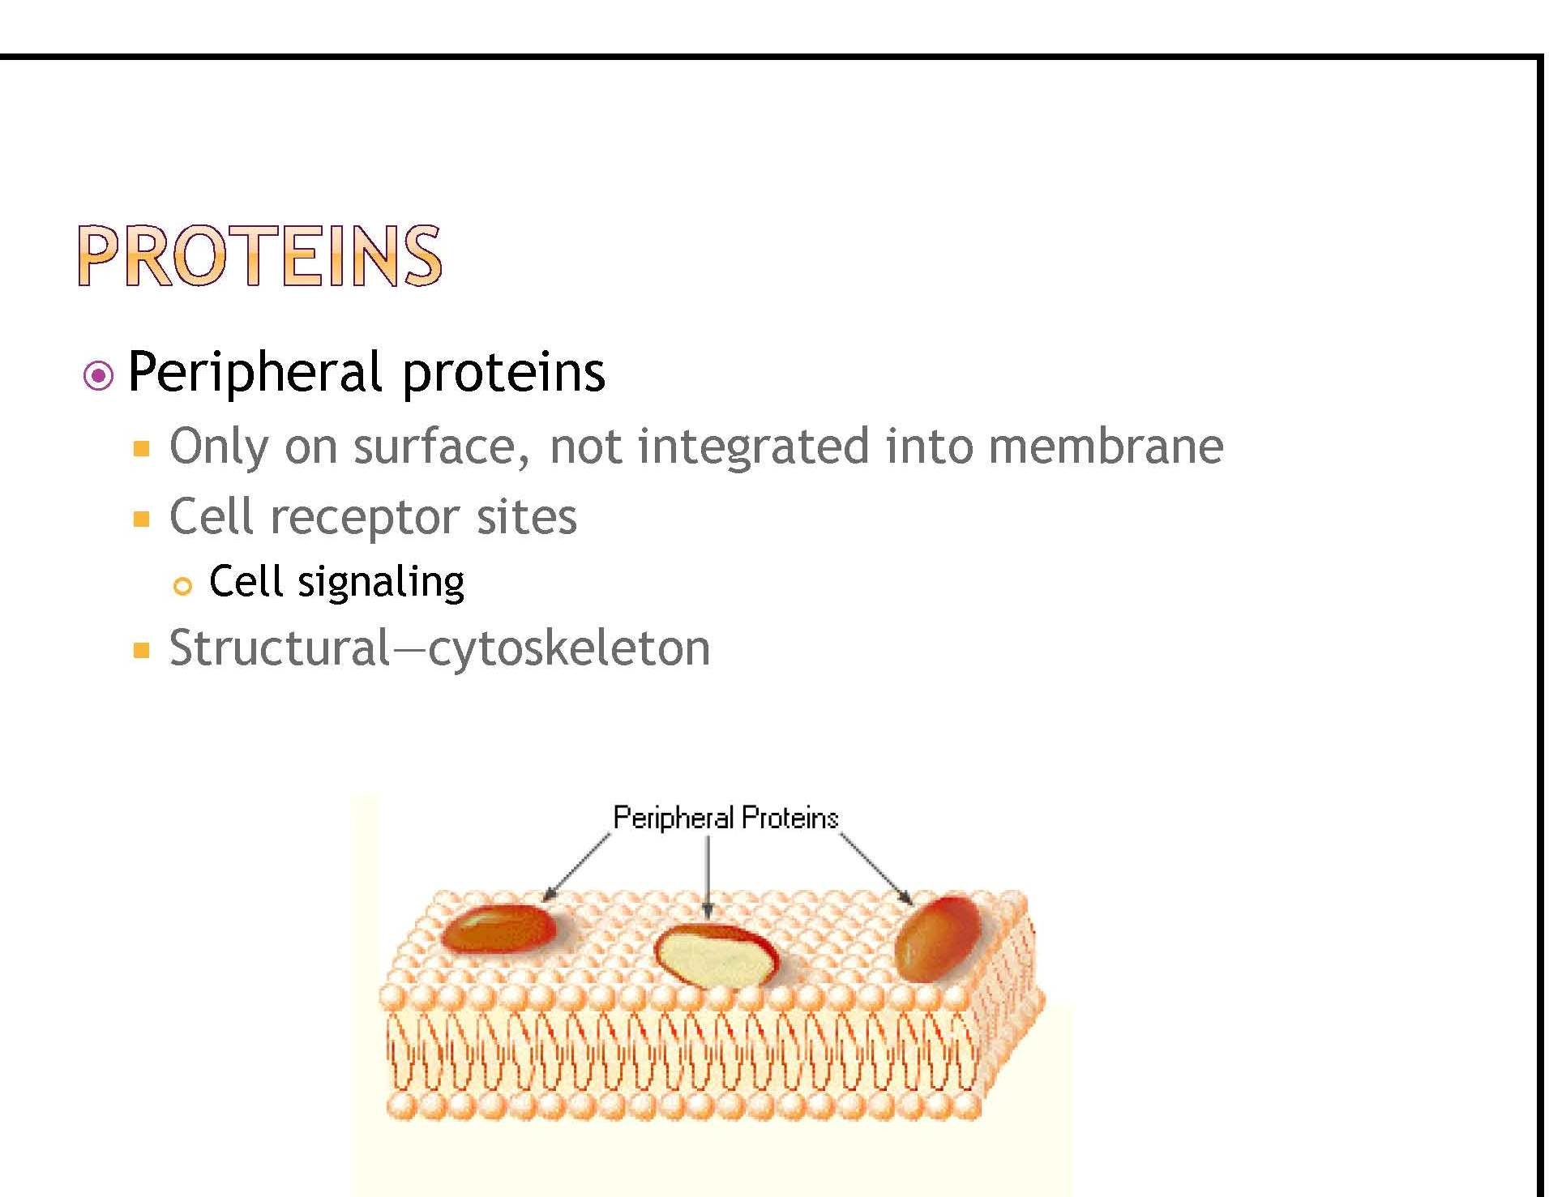

Slide 24
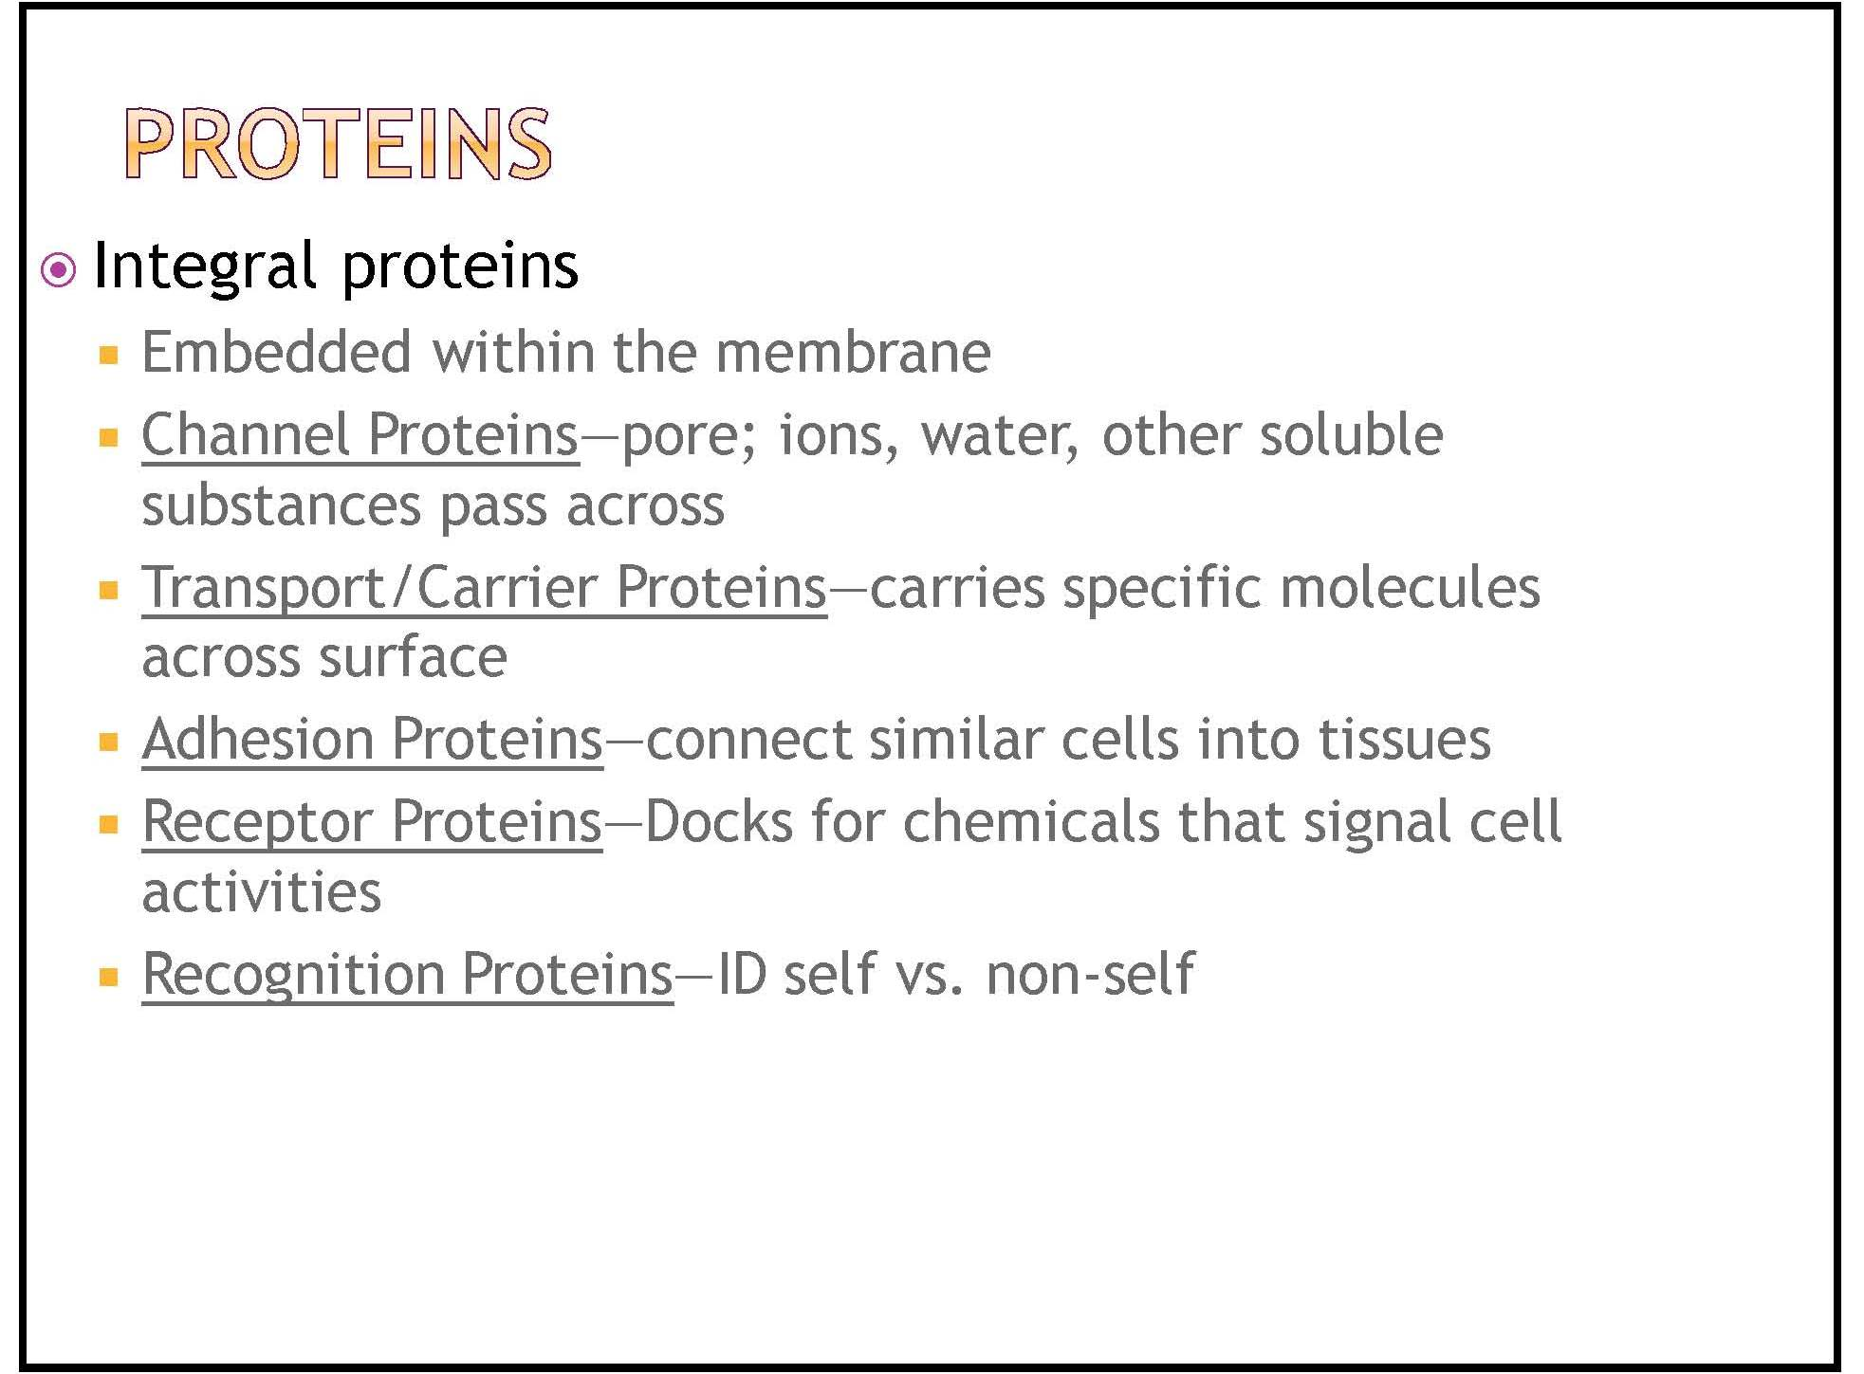

Slide 25
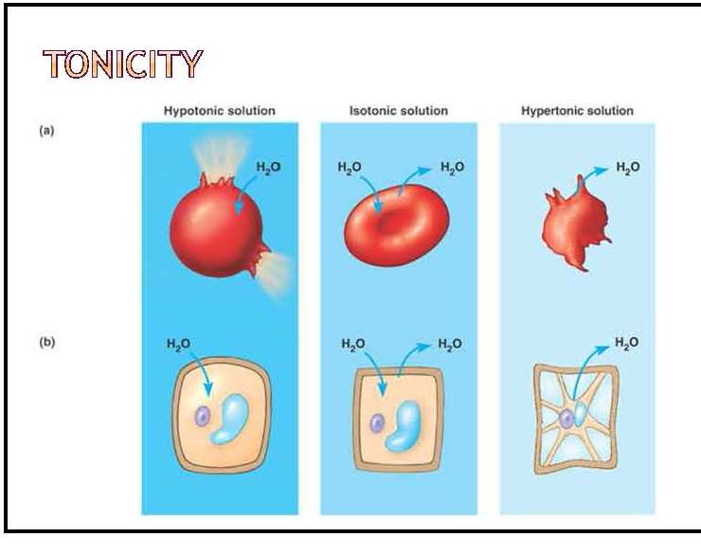

Slide 26
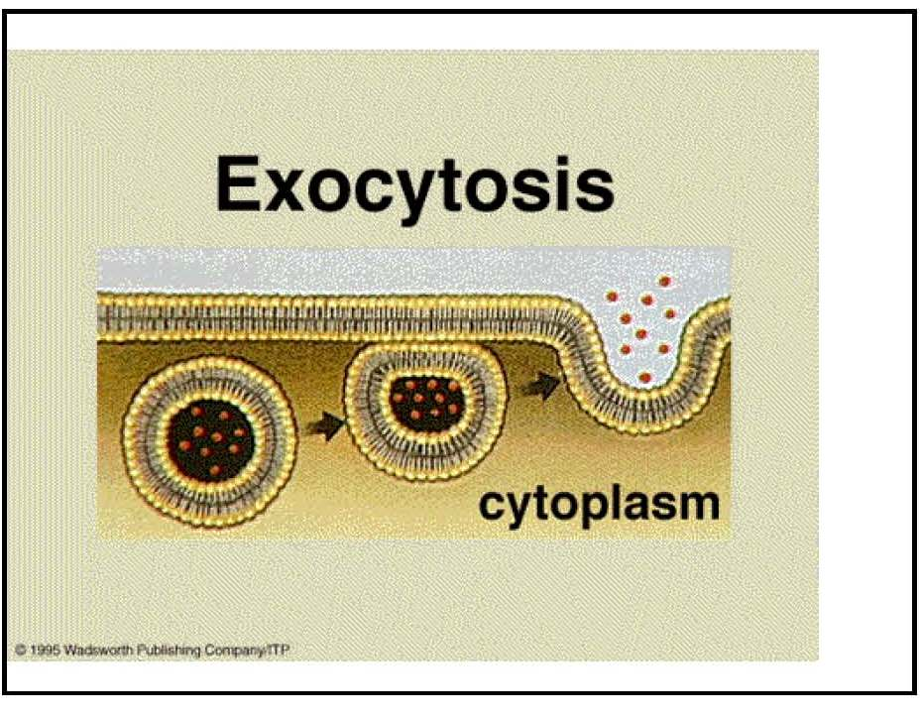

Slide 27
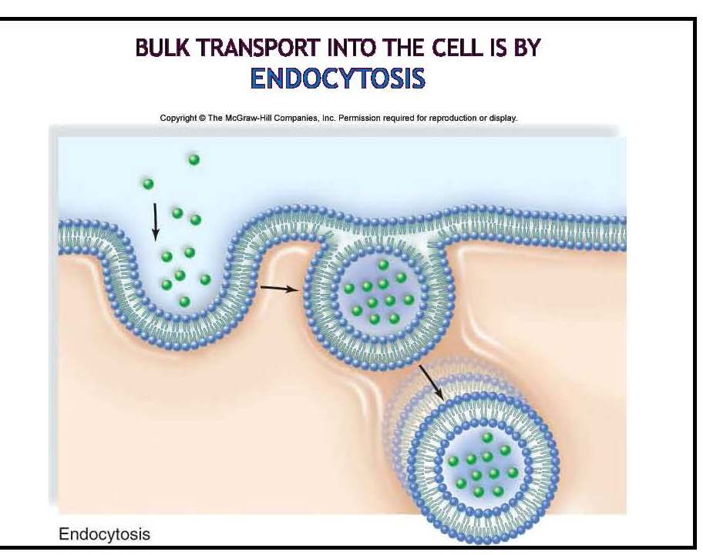

Slide 28
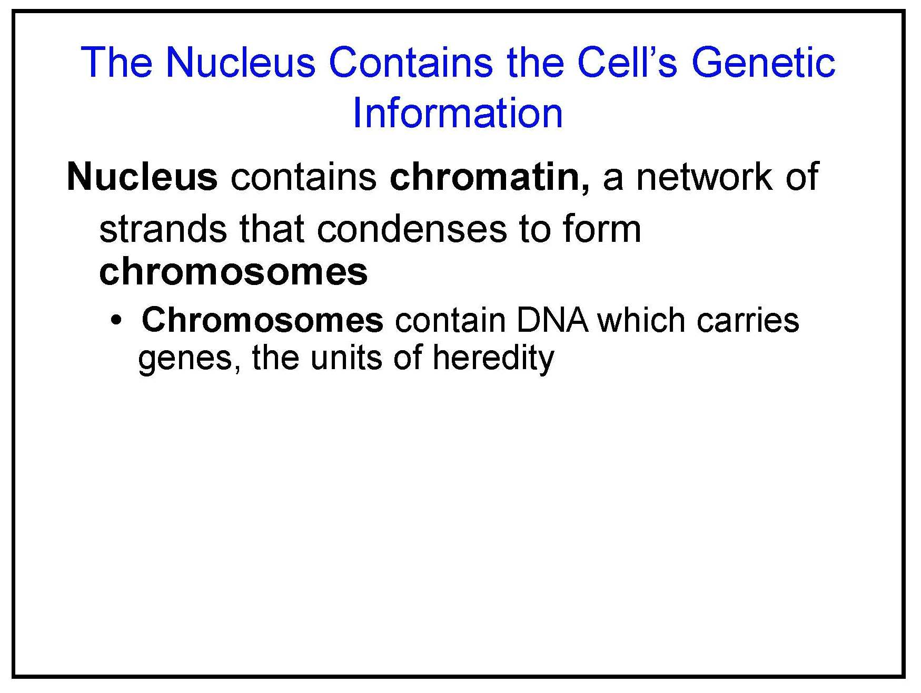

Slide 29
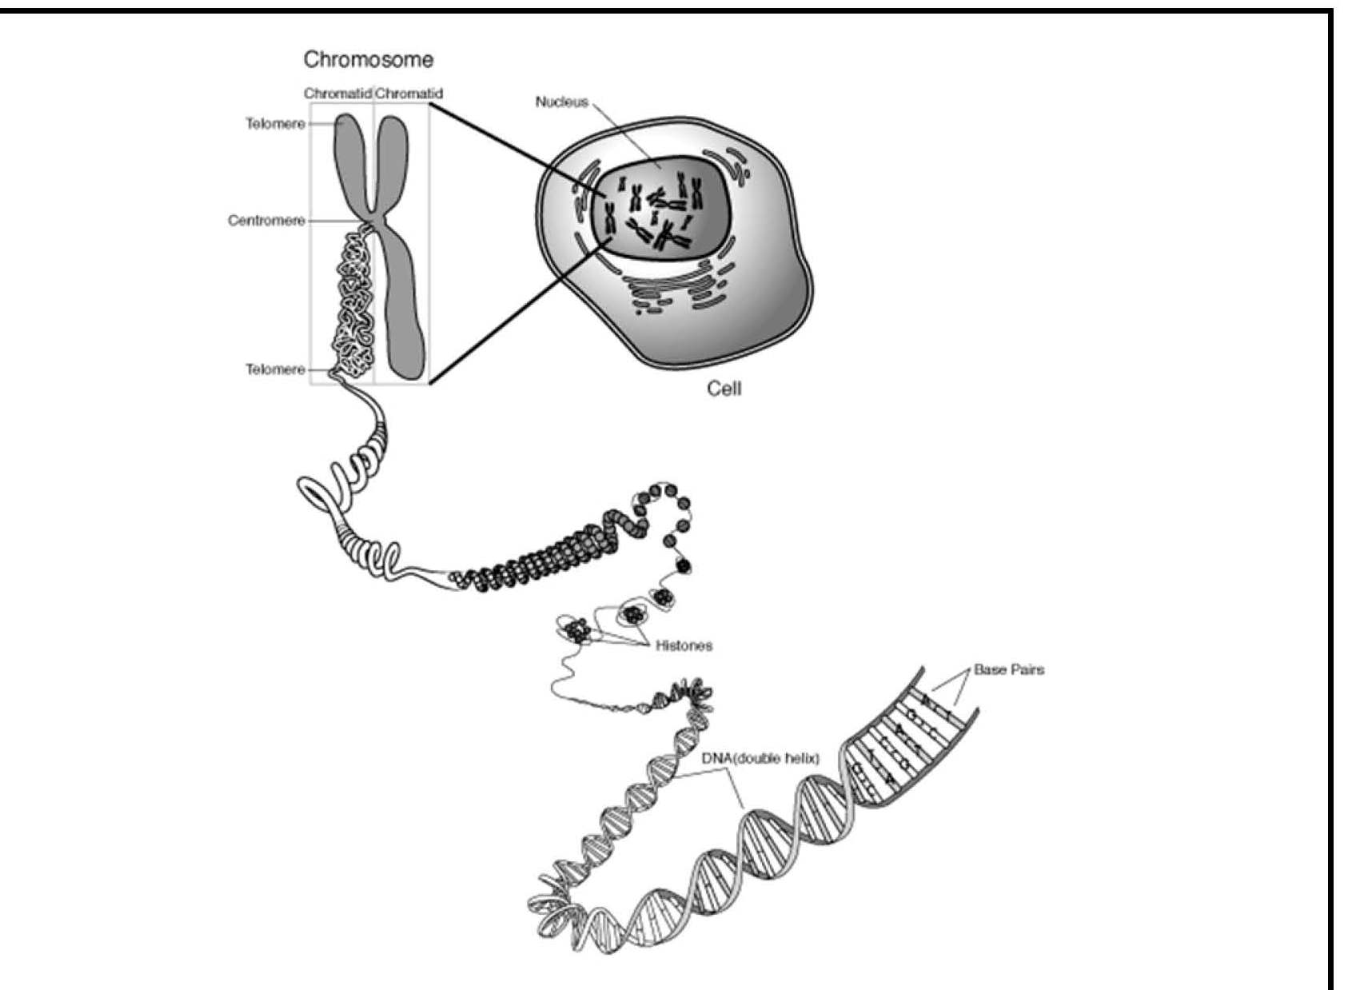

Slide 30
Cell Nucleus
The nucleus is usually the most prominent structure in the protoplast of eukaryote cells
1. it controls the ongoing activities of the cell by determining which protein molecules are produced by the cell and when they are produced
2. it stores genetic information, passing it onto daughter cells during cell division

Slide 31
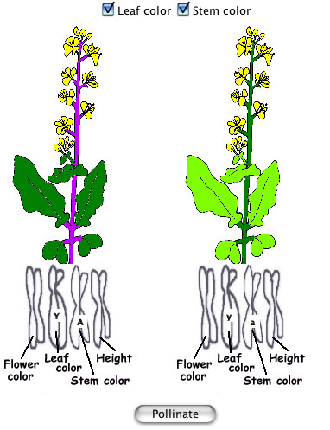
Plant Chromosomes

Slide 32
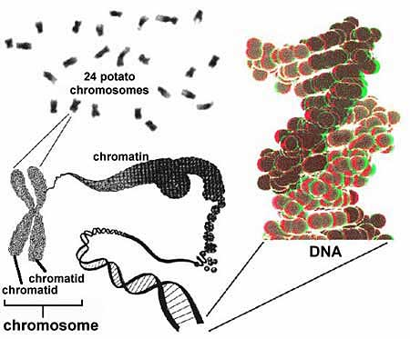
Potato Chromosomes

Slide 33
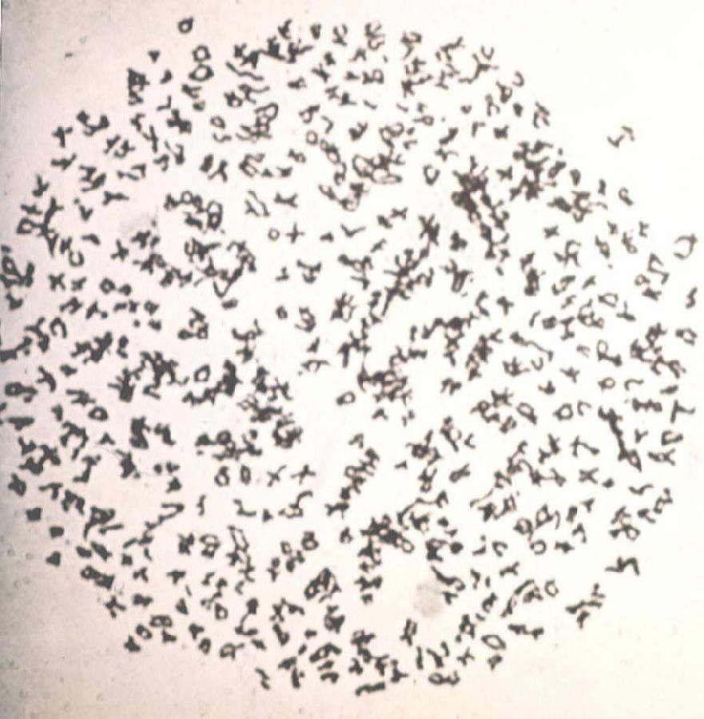
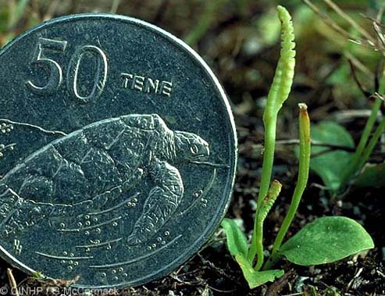
Ophioglossum reticulatum
1252 chromosomes

Slide 34
Structure Meets Function in a Cell
Plasma Membrane and Cell Surface
Nucleus and Ribosomes
Endomembrane System
  Endoplasmic Reticulum (ER)
  Golgi Body
  Lysosomes
  Vacuoles
Energy Conversion: Chloroplasts and Mitochondria

Slide 35
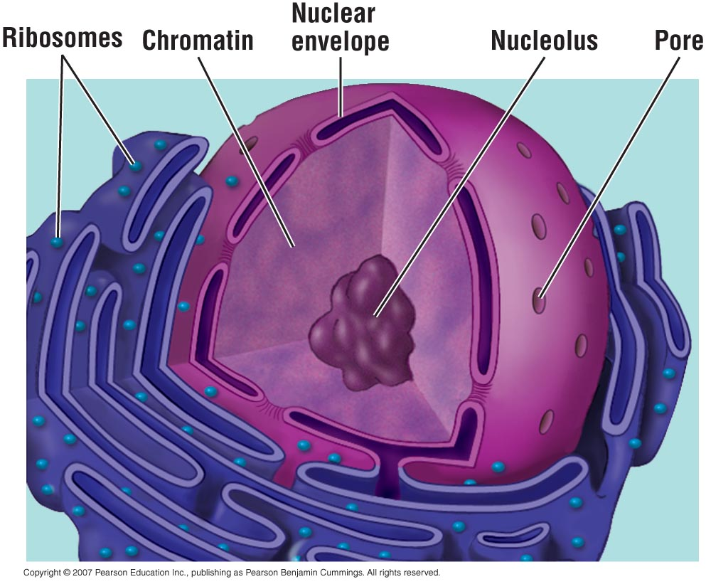
Structure and Function of the Nucleus
  The nucleus is bordered by a double membrane called the nuclear envelope.
    It contains chromatin and a nucleolus.
Chromatin: long strands of DNA and associated proteins. The DNA stores the genetic information (genes).
Nucleolus: assembles ribosomes

Slide 36
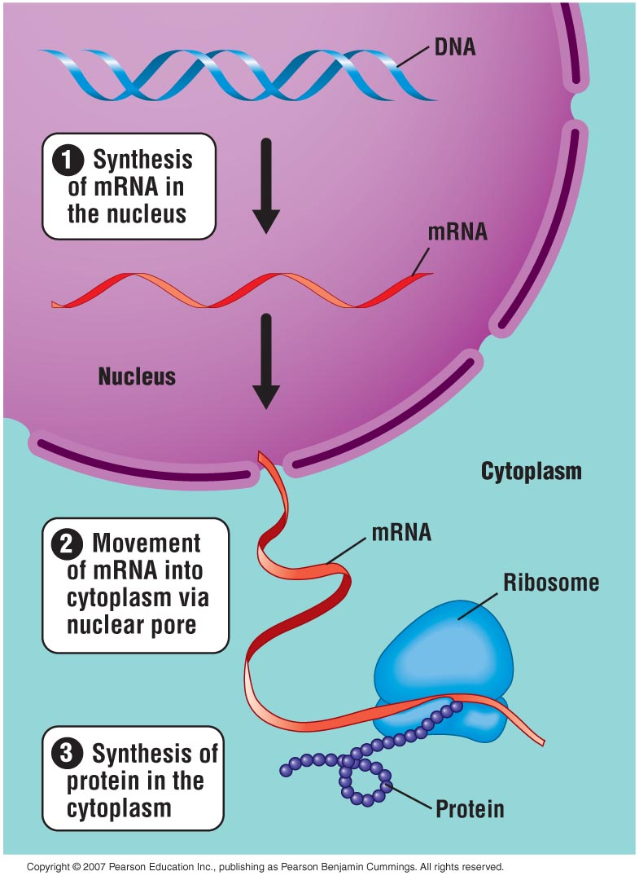
How DNA Controls the Cell
  DNA controls the cell by transferring its coded information into RNA.
    The information in the RNA is used to make proteins.

Slide 37
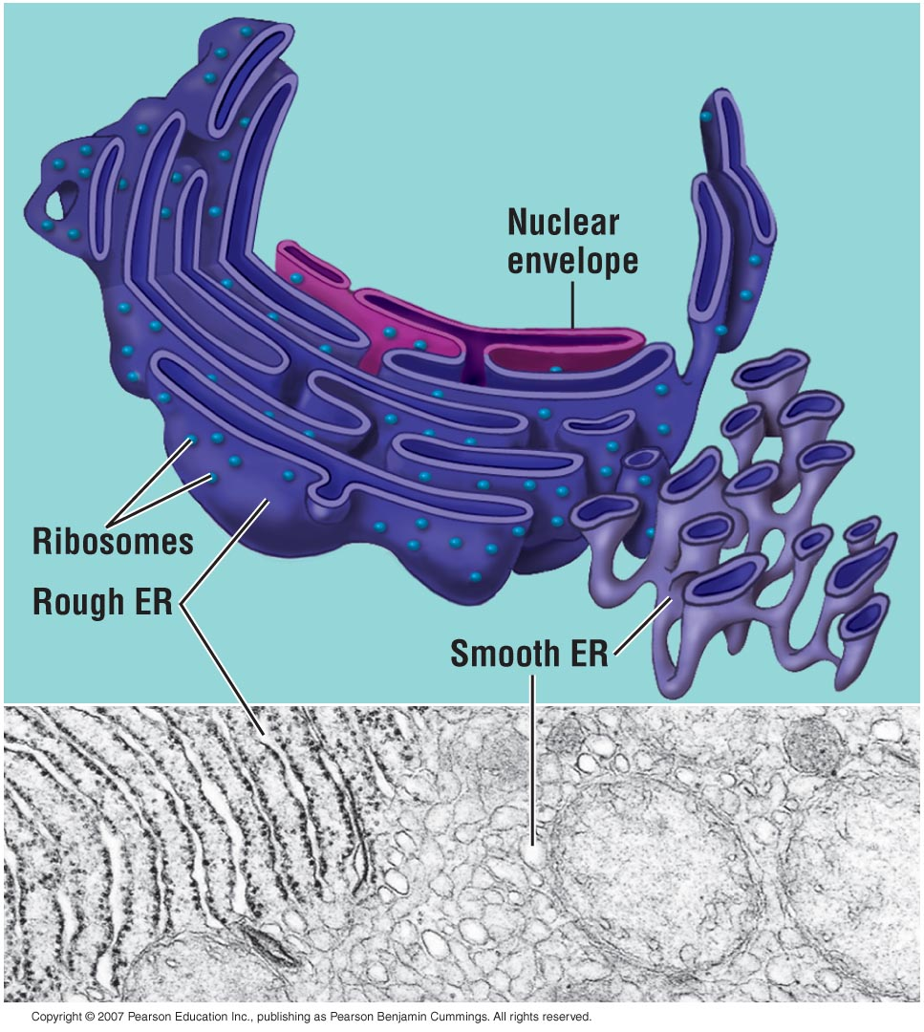
The Endoplasmic Reticulum
  The endoplasmic reticulum (ER)
    Produces an enormous variety of molecules.
    Is composed of smooth and rough ER.

Slide 38
Smooth ER
  The smooth ER lacks the surface ribosomes of rough ER and produces lipids, including steroids.

Slide 39
Rough ER
  The “roughness” of the rough ER is due to ribosomes that stud the outside of the ER membrane.
  The functions of the rough ER include:
    Producing two types of membrane proteins
      Membrane proteins
      Secretory proteins
    Producing new membrane

Slide 40
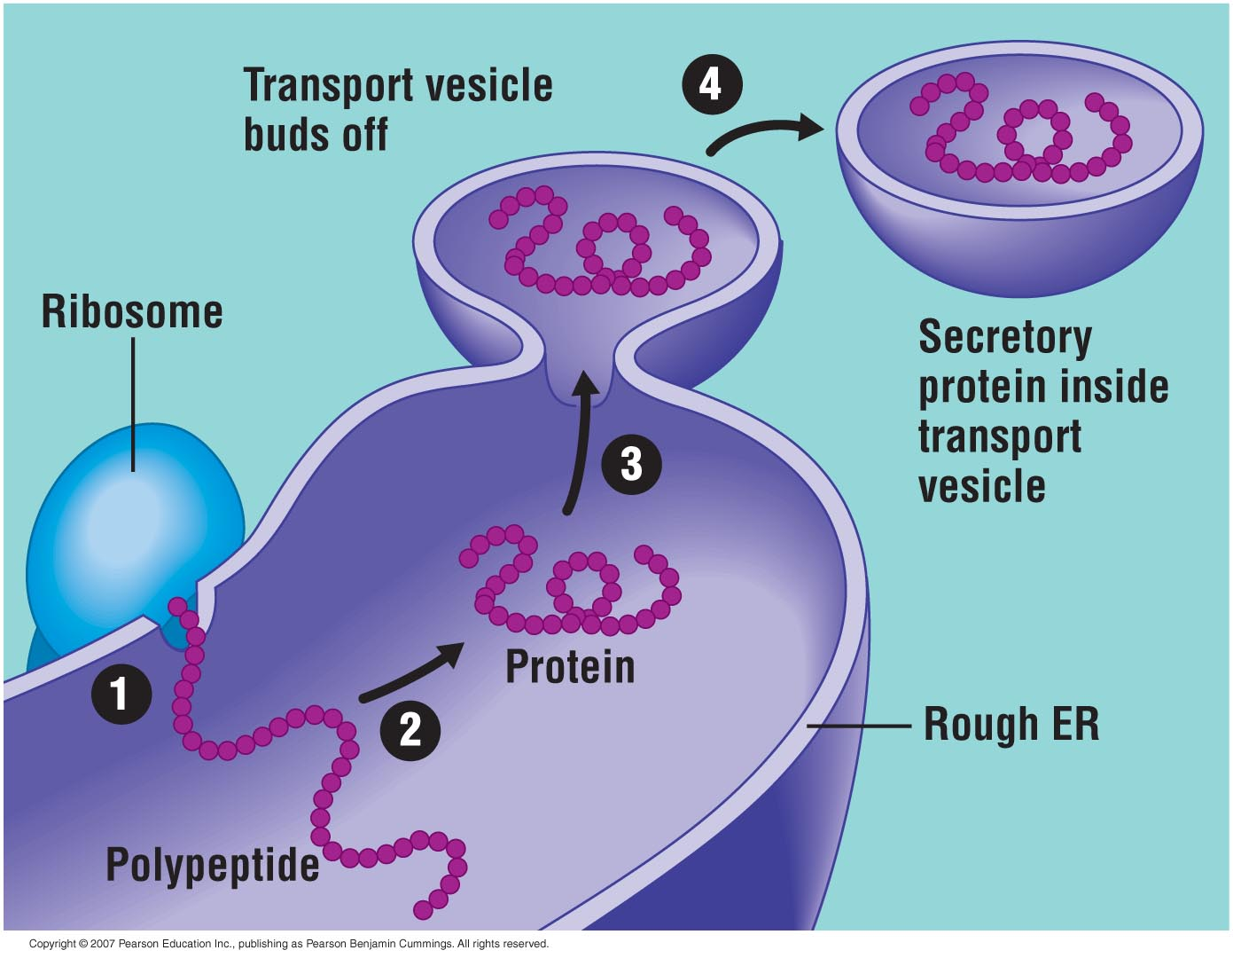
  After the rough ER synthesizes a molecule, it packages the molecule into transport vesicles. These vesicles head off to the Golgi Apparatus…

Slide 41
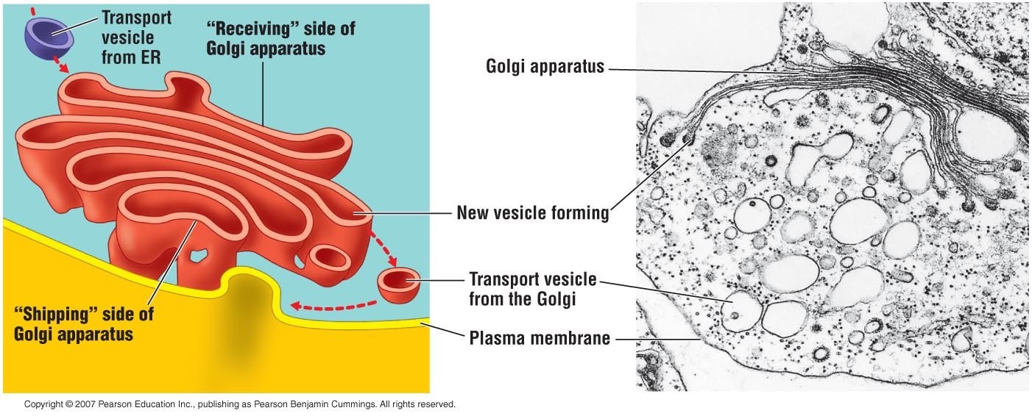
The Golgi Apparatus
  The Golgi apparatus
    Works in partnership with the ER.
    Refines, stores, and distributes the chemical products of cells.

Slide 42
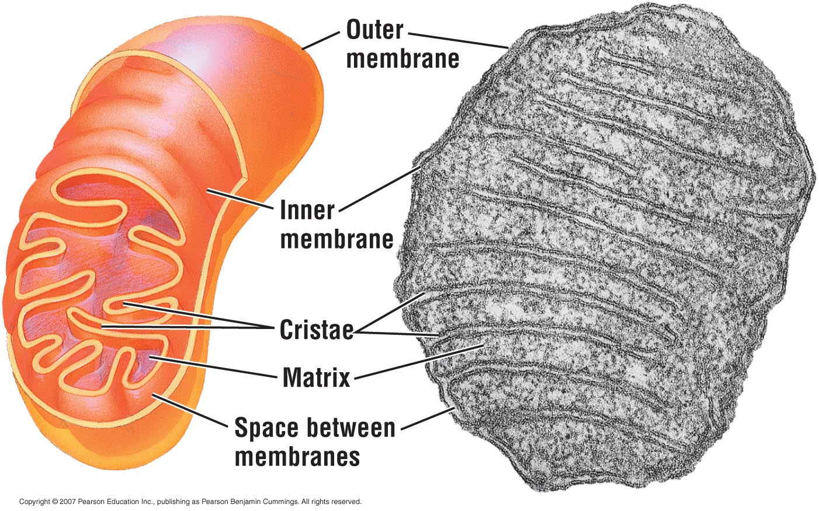
Mitochondria
  Mitochondria are the sites of cellular respiration, which involves the production of ATP from food molecules.

Slide 43
Plastids
Plastids are a characteristic component of plant cells
Plastids are classified and named based on the kinds of pigments they contain
Each plastid is surrounded by two membranes and internally the plastid has a system of membranes which form flattened sacs called thylakoids and a ground (fluid) substance called stroma

Slide 44
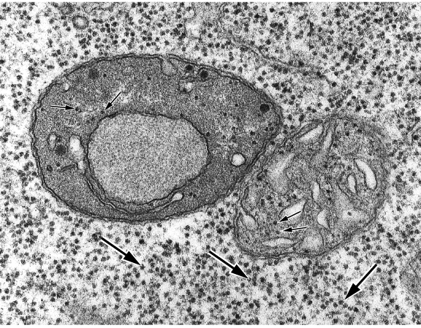
Plastids and Genome Interactions
Types of plastids
proplastids:most simple and least developed form of plastids. Found in least differentiated tissues such as meristem and reproductive cells. Very small (1 um diameter) and primitive suborganelle structure.
TEM picture of
A proplastid next to a Mitochondria
From bean root cell. The dark dots in the cytoplasm are ribosomes. SO are the dots pointed by a small arrows (the organelle ribosomes).

Slide 45
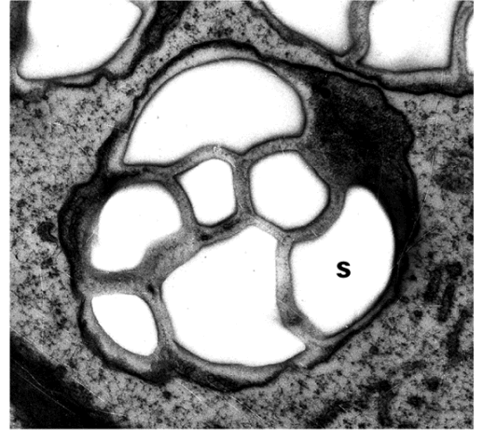
2) Amyloplast: is also rather simple. Non-colored plastids that accumulate and store starch (thus the name). They are found in storage tissues such as potato tuber etc. Amyloplasts in root cap cells also serves as gravity-sensing statoliths during gravity response. Leucoplasts refer to non-pigmented palstids (proplastids and amyloplasts).
TEM picture of a amyloplast from root cap of white clover. This statolith device contain largely starch grains (s) surrounded by the stroma membranes.
IN potato tubers, the starch grains fill the entire organelles with even less stroma.

Slide 46
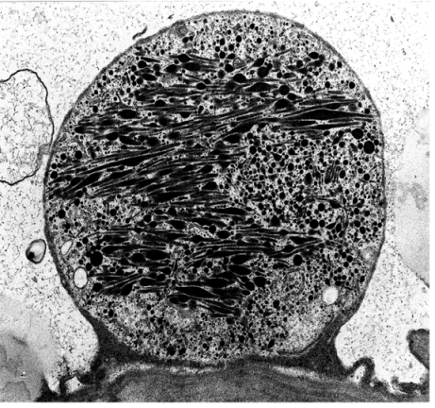
3) Chromoplasts: plastids that are pigmented into red, organge, yellow. Found in fruits, roots/tuber, and flowers. Tomato and pepper, carrots and sweet potatos. Some colorful pigments are also stored in vacuoles such those in flowers.
TEM picture of a chromoplast from a cherry fruit cell. The plastid is filled with carotenoids that are formed by enzymes and carotenes associated with the plastid membranes. Depending on the type of carotenoids and other pigments present in the chromoplast, they display different colors, shapes, and sizes.

Slide 47
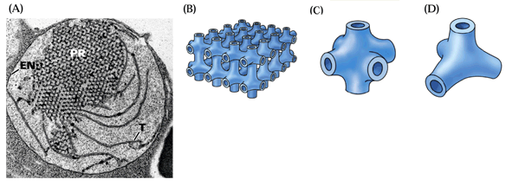
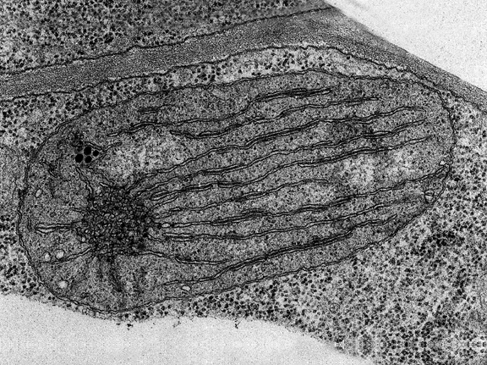
4) Etioplasts: precursor of chloroplasts when plants were grown in the dark. The etioplasts develop into chloroplasts when light becomes available. This happens a lot during early germination.
light
Some prolamellar structure getting ready for further development into thylokoid membrane system inside the chloroplast. As the etiolated (dark grown) plants are illuminated, the thylokoid membrane begin to extend and form more extensive membrane networks.

Slide 48
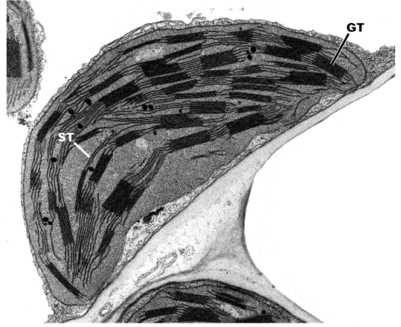
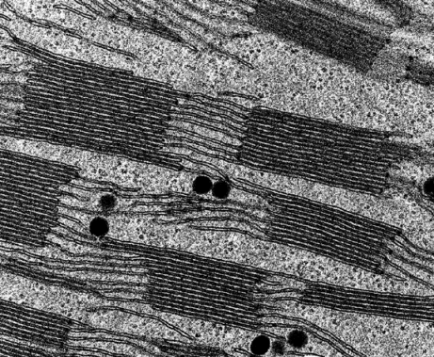
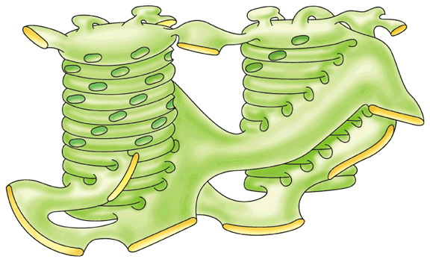
5) Chloroplasts: most important plastid and most complex in suborganelle structure. Green tissues.
Stroma and stacked grana
Form continuous membrane
Network that contain the entire Light reaction machinery to capture light and turn it into chemical energy

Slide 49
Plastid replication and cell division
Plastids, like many other organelles, cannot be synthesized de novo. They come from mother plastids by replication—division.
1. What types of plastids divide? We know meristem cells, but not differentiated cells, divide. Naturally, proplastids divide. But mature plastids divide too—All types of plastids do! Plastid division keeps pace with cell division in meristem cells, but they also respond to cell enlargement after division. E.g, when a leaf expand, mesophyll cell enlarge, chloroplasts inside the mesophyll cell replicate (otherwise, the larger leaves will look pale due to dilution of chloroplast density).

Slide 50
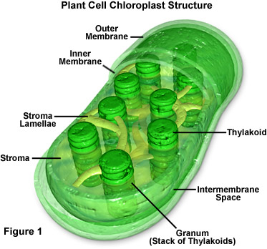
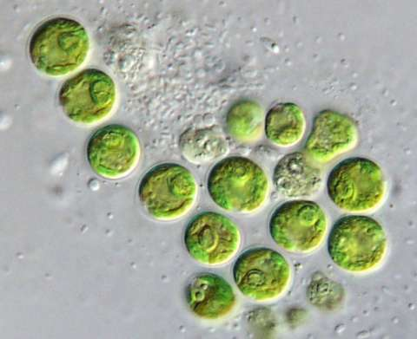
Chloroplasts

Slide 51
Plant Cells with Chloroplasts

Slide 52

Chromoplasts
Chromoplasts lack chlorophyll but synthesize and retain carotenoid pigments which are responsible for the yellow, orange or red colors of many flowers, old leaves, some fruits and some roots

Slide 53

Leucoplasts
Leucoplasts are nonpigmented plastids some of which synthesize starch while others produce oils or proteins
Upon exposure to light they may develop into chloroplasts

Slide 54

Proplastids
Proplastids are small, colorless or pale green undifferentiated plastids that occur in meristematic cells of roots and shoots - they will eventually develop into other, differentiated plastids such as the chloroplasts, chromoplasts or leucoplasts

Slide 55

Vacuoles
Vacuoles are membrane bound organelles filled with cell sap
The membrane is referred to as the tonoplast
Different kinds of vacuoles may have different functions within the same cell
Along with water based cell sap, vacuoles typically contain salts, sugars and some dissolved proteins

Slide 56

Vacuole
Considered “outside” of the cytoplasm.
Structure? The only “structure” concerns the tonoplast—vacuole membrane. Single bilayer of 10 nM thick and resembles plasma membrane.
Most of plant cells have
Large central vacuole.
Bean mesophyll cells
With chloroplasts and
The central vacuole

Slide 57
2. Formation and development
This is the only organelle that is produced de novo (not through inheritance). What is the origin of vacuole?
It is has been difficult to determine because many vesicular compartments in the cell are similar to precursors of vacuole—provacuoles. Most likely the transGolgi network (TGN) and smooth ER produce provacuole that develop into mature vacuole.
TEM and molecular marker labeling.
In the meristem cells, only very small vacuoles or provacuoles exist. As the cell expands, small vacuoles fuse to form larger vacuoles and eventually form the central vacuole. AS the cells differentiate into different types, the vacuole develops into various functional groups as well. Like the plastid development---depending on the cell type…

Slide 58

2. Function of vacuole
As lysosome in animal cells: containing a number of lytic enzymes that can digest the whole cell. Example, xylem vessel formation. Autolysis.
2) Garbage disposal and storage space:
a) chemical weapons and medicines: secondary toxic products for self defense purposes and some of them are medicines. examples: nicotine, caffeine, taxol, opium, …
Antipoisoning Theriak: opium, snake, and wine

Slide 59

3) Homeostatic balancer and osmotic regulation:
Vacuole is less important space in terms of life reactions…
a) Salt balance:K+ as example
K+ uptake into cytoplasm and then into vacuole. Depending on the need in the cytoplasm (priority), K+ distribution is in constant flux.

Slide 60
On the other hand, for toxic Na+, vacuole serve as a detoxifying space---
H+-Na+ antiporter
Found in yeast and plants. Overexpression of this antiporter confer plant tolerance to high salt in the soil.
Na+
Na+
Na+
Na+
Na+
H+
Na+
H+
A big family of H-Na antiporters also exist in the plasma membrane and help remove Na from the cytoplasm. Overexpression of these can also make plants more tolerant to saline soil.

Slide 61
b) PH balancer or buffer
AS mentioned earlier, the H-ATPases in the PM and tonoplast both work to pump out the H+ produced in the cytoplasm that has a rather stable pH around 7. The vacuole pH can be as acidic as 4-5.
c) Osmotic regulation—the most important function for most of plant cells
Turgor pressure---due to the osmotic gradient between outside and inside of the cell and the limited flexibility of cell wall.

Slide 62

Vacuole Growth

Slide 63

Vacuole and Turgor Pressure

Slide 64



Beetroot cell vacuoles

Slide 65



بلورهای واکئولی

