Slide 1


Internet of Things (IoT)
Professor: Dr. Sadoon Azizi s.azizi@uok.ac.ir
Faculty of Engineering
Department of IT and computer engineering

Slide 2
Chapter objectives
* In this chapter the students are expected to get familiar with these objectives:
Fog computing concept
Cloud computing comparison with Fog computing
Synchronization and regulation in fog
Data management in fog

Slide 3
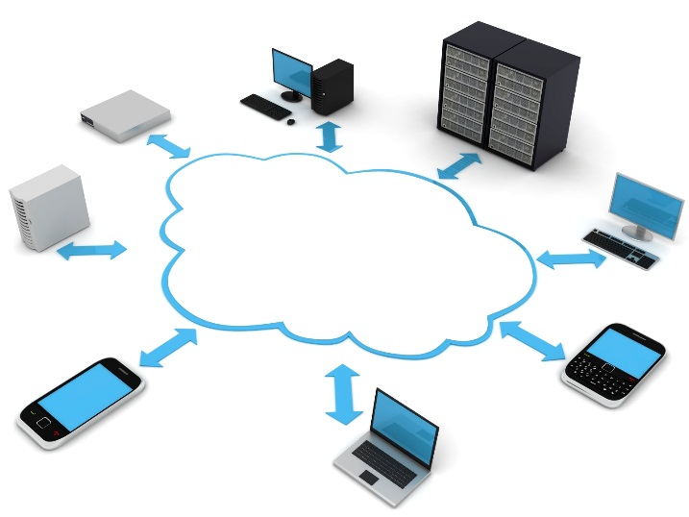
Cloud computing
Cloud computing is referred to a model that enables network-based on-demand service allocation from a pool of resources
Cloud computing services:
  SaaS: Software as a Service
  PaaS: Platform as a Service
  IaaS: Infrastructure as a Service
Cloud
Computing

Slide 4
Cloud computing characteristics
Cloud
Computing
Cost reduction
High speed computing
And big memory
Rapid elasticity
Measured service

Slide 5
Some cloud computing limitations
Connection between cloud and edge devices
  Such connection is an internet-based one which is not best suited for IoT applications. for instance latency-sensitive applications
  Examples of latency-sensitive applications: connected vehicles (CV), fire detection, smart electricity network, content delivery
Some IoT applications include multiple components which may reside on different clouds
  Overhead due to inter-cloud connections (Exacerbation of delay)
Security challenge for some applications
  Privacy issues

Slide 6
Fog Computing
Fog: cloud near earth
Also known as edge computing
Fog computing can be defined as a distributed computing paradigm that brings the cloud services to edge of the network
In fact, fog computing is the bridge between edge devices and cloud computing
Due to being close to edge devices, fog has potential to provide services with low delays
Fog computing is an extend to cloud computing not a replacement
  Immediate computations are done by fog while extreme computations are done by the cloud

Slide 7
The role of fog and cloud’s resources in IoT services

Slide 8
Factors of fog existence
Data flood
  The excess amount of data compared to network bandwidth
  All generated data until the year 2004 was 5 Exabytes. Now every 2 days the exact same amount is generated
Quick mobility
  Too much changes in the network state causes huge reduction of service and connectivity to cloud
Reliable control
  Need for a connection with low delay for immediate and reliable control
Management and data control
  Need support for distributed and hierarchical data management

Slide 9
Characteristics and advantages of fog computing
Network traffic reduction
Reduce the response time by bringing the computation to the edge of network (near edge devices)
  Suitable for immediate and delay-sensitive applications
Service quality
Distributed architecture
Scalability
Security

Slide 10
Fog computing compared to Cloud computing

Slide 11
Virtualization technologies

Slide 12
Orchestration and synchronization in Fog
The process of automating different work flows
  Providing and management of computing, network and storage resources
Dealing with topologies that connect different objects with various requirements (bandwidth, delay and reliability varieties)
Efficient connection establishment between applications and objects
Network functionality assurance

Slide 13
Orchestration and synchronization in Fog

Slide 14
DIKW pyramid
Data: symbols and bits
Information: process on data (answering to “who”, “what”, “when” and “where” questions)
Knowledge: Accumulation and combination of data segments to find patterns (answering the “how” question)
Wisdom: Using knowledge for learning and producing better outputs

Slide 15
Data management in Fog
Most new data that is generated in IoT are the type Immediate
Data value is decreased or even destroyed as time goes on
Inborn challenges in collection, search, sharing, analysis and visualization lead up to the development of parallel programs and frameworks which run on tens, hundreds or even thousands of servers
  Hadoop, Spark, Storm, Flink, Kafka
Data analytics may include one or more of these:
  Aggregation
  Reduction / Filtering
  Classification
  Pattern matching
  …

Slide 16
Data management in Fog

Slide 17
Data search in Fog
Huge amounts of data lead to the need for accurate and effective information searching mechanisms
Search engines and technologies of WWW deal with constant amounts of data which are usually altered slowly
IoT needs a distributed data searching solution that requests are propagated through the whole fog infrastructure
The solution is logically divided into two levels:
  Things plane: Including physical objects, network and computing nodes in fog
  Search plane: A logical view of the fog nodes that have distributed search ability
This solution needs special considerations so that it doesn’t lead to traffic flood
We can guarantee the scalability by limiting the search radius (search domain)

Slide 18
Data search in Fog

Slide 19
Challenges ahead
In cloud computing:
  Network topologies are defined very well
  Infrastructure is secured physically
  Datacenter’s I/O with external networks (such as internet) is handled by firewall nodes
  Network bandwidth is considerably abundant so topology altering is fairly easy
In fog computing:
  Applications may be clustered together but they may not have the same physical configurations in common (the need for Orchestration and synchronization in fog)
  Object and fog node connection challenges
  Fog nodes may be implemented in an environment that could be easy to access physically
  Need for a high-level programming model for ease of development in high-scale, distributed applications

Slide 20
Some articles in the context of fog computing
Mouradian, C., Naboulsi, D., Yangui, S., Glitho, R.H., Morrow, M.J. and Polakos, P.A., A Comprehensive Survey on Fog Computing: State-of-the-art and Research Challenges. IEEE Communications Surveys & Tutorials, 2017.
Bitam, S., Zeadally, S. and Mellouk, A., Fog computing job scheduling optimization based on bees swarm. Enterprise Information Systems, pp.1-25, 2017.
Gupta, H., Vahid Dastjerdi, A., Ghosh, S.K. and Buyya, R., iFogSim: A toolkit for modeling and simulation of resource management techniques in the Internet of Things, Edge and Fog computing environments. Software: Practice and Experience, 47(9), pp.1275-1296, 2017.
Zeng, D., Gu, L., Guo, S., Cheng, Z. and Yu, S., Joint optimization of task scheduling and image placement in fog computing supported software-defined embedded system. IEEE Transactions on Computers, 65(12), pp.3702-3712, 2016.

