Slide 1
Principles of Botany
Chapter 1
Plant Taxonomy
Shahla Hosseini

Slide 2
Bryophyts
Hepaticophyta
Bryophyta

Slide 3
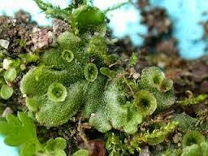
Hepaticophyta

Slide 4
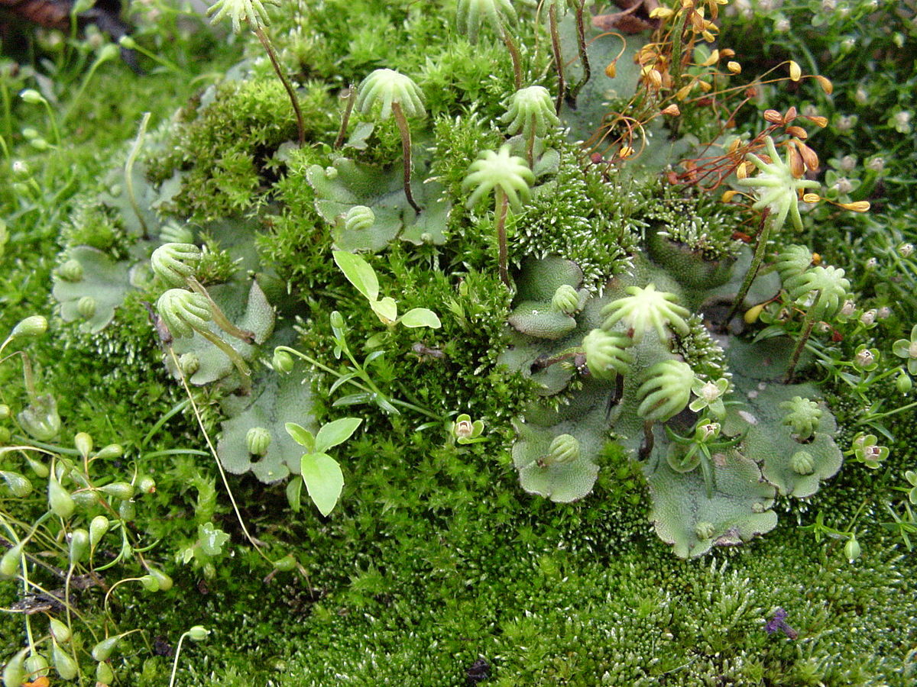

Slide 5
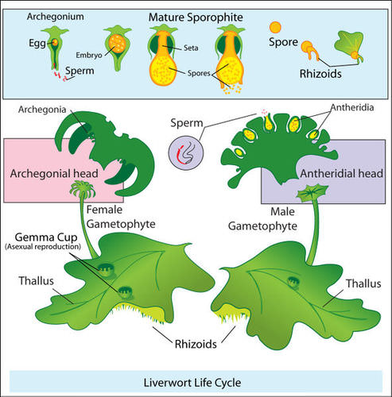

Slide 6
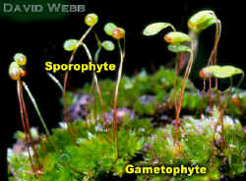
بریوفیت ها

Slide 7
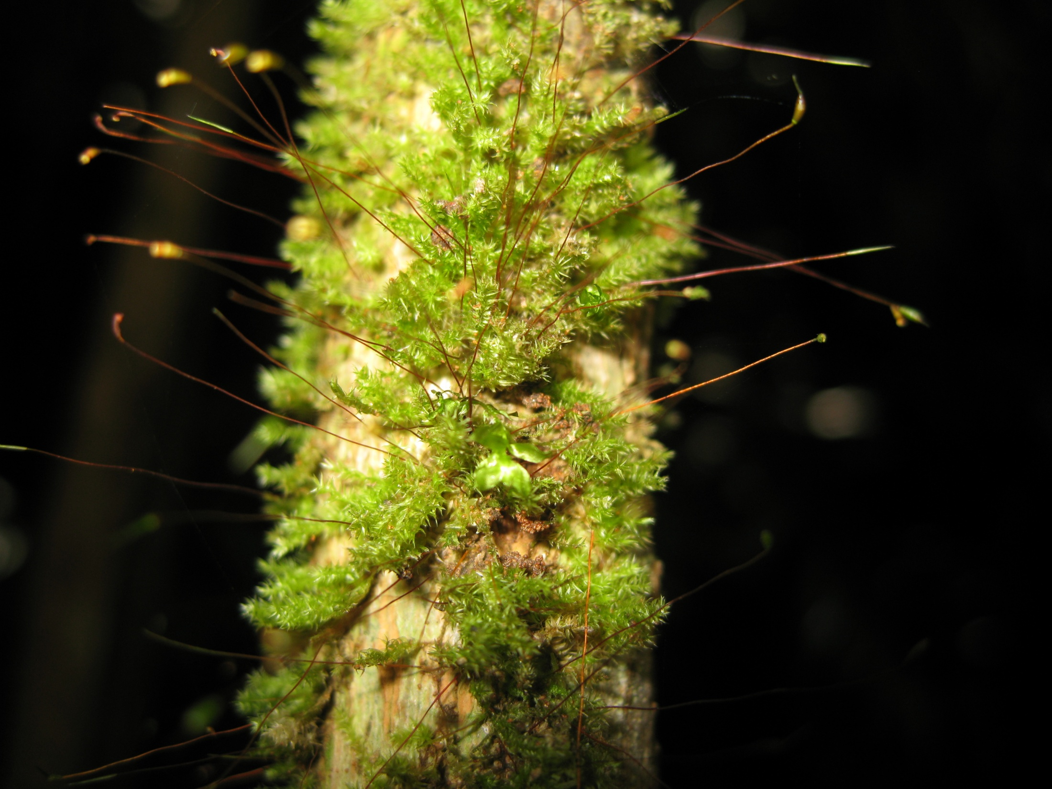

Slide 8
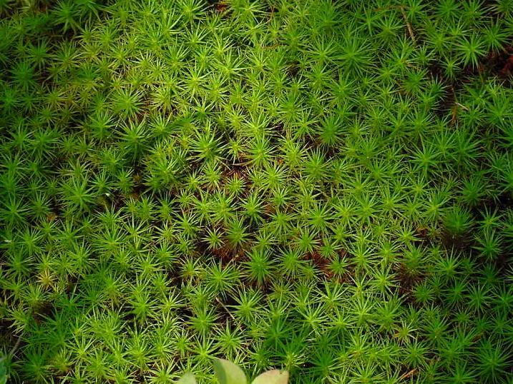
Sphagnum

Slide 9
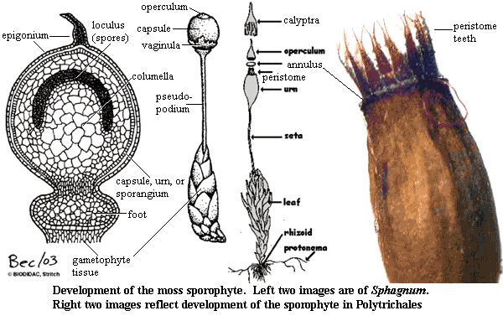

Slide 10
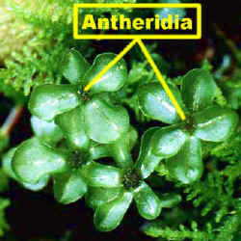

Slide 11
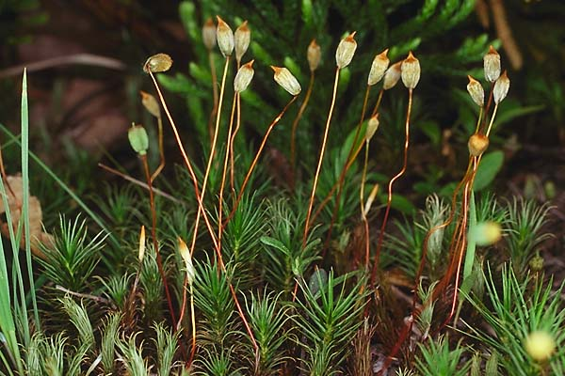
Polytrichum

Slide 12
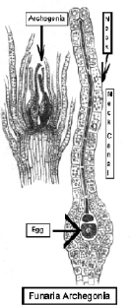
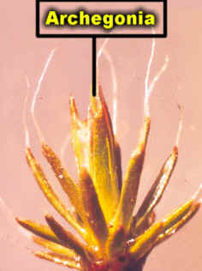

Slide 13
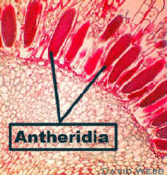

Slide 14
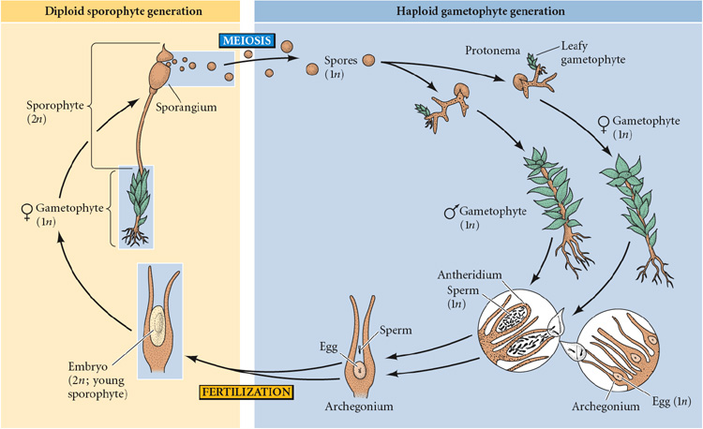

Slide 15
Pteridophyts
- Psilophyta
- Lycopodiophyta
- Equisetophyta
- Polypodiophyta

Slide 16
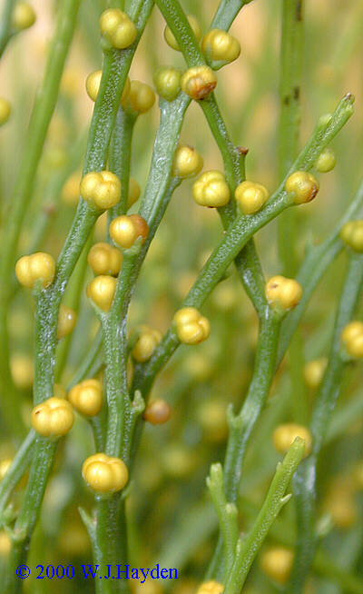
Psilotum

Slide 17
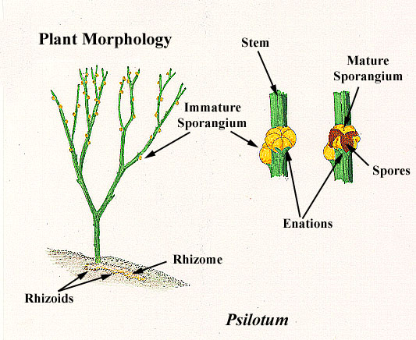

Slide 18
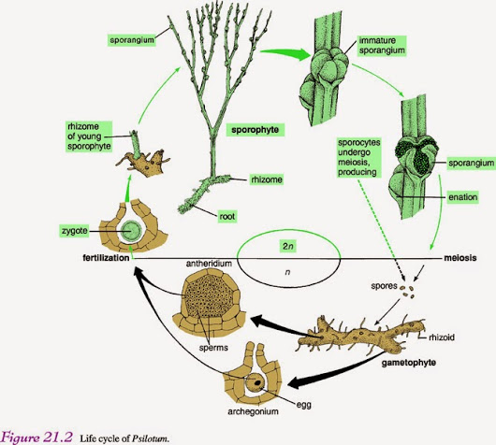

Slide 19
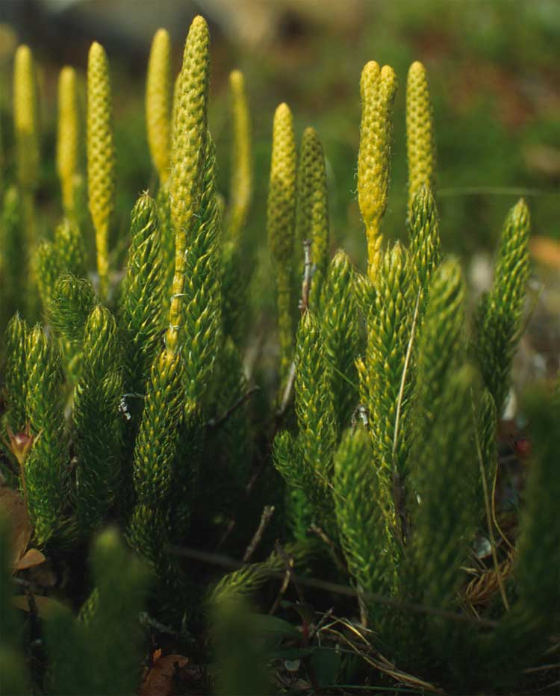
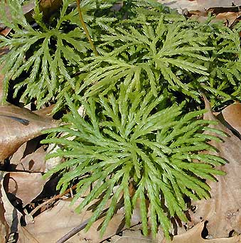
Lycopodium

Slide 20
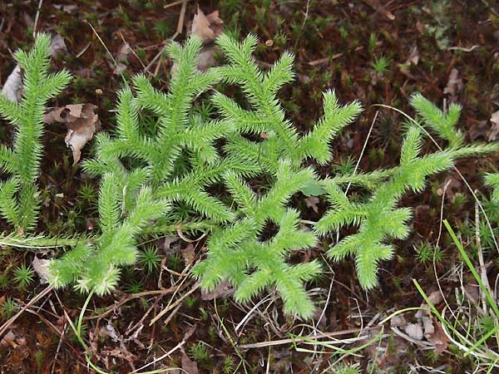
Lycopodium

Slide 21
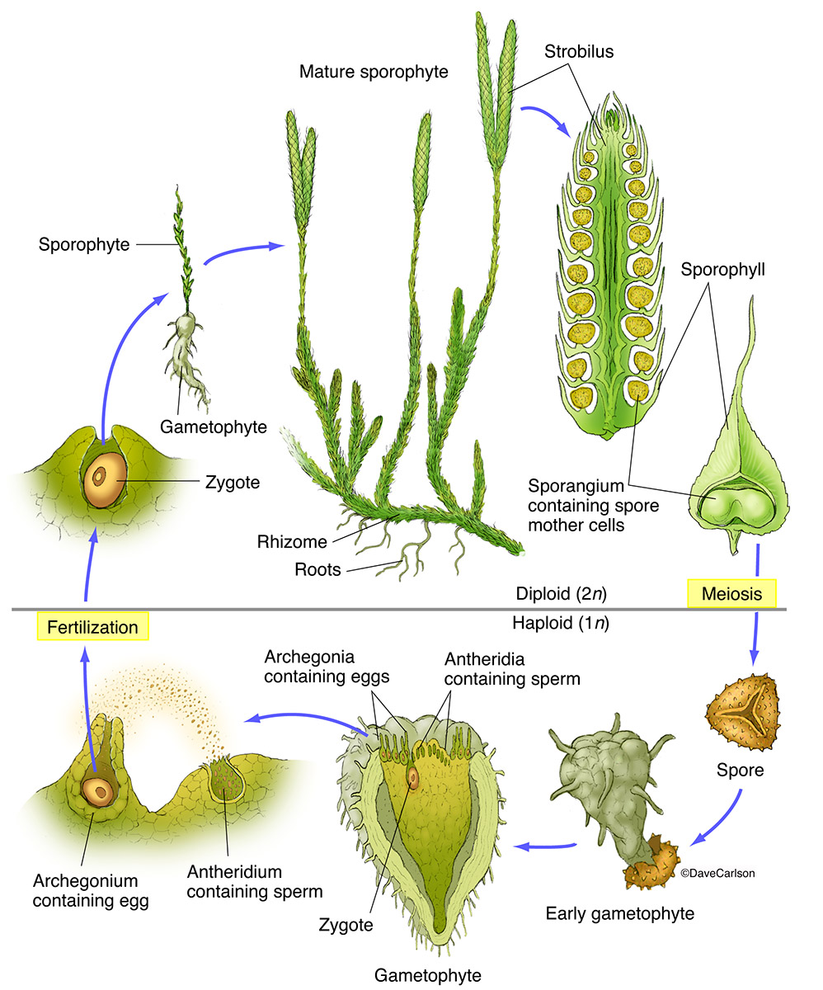
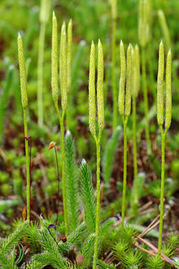
Lycopodium Life cycle

Slide 22
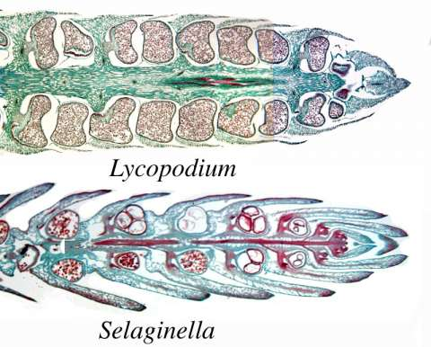

Slide 23
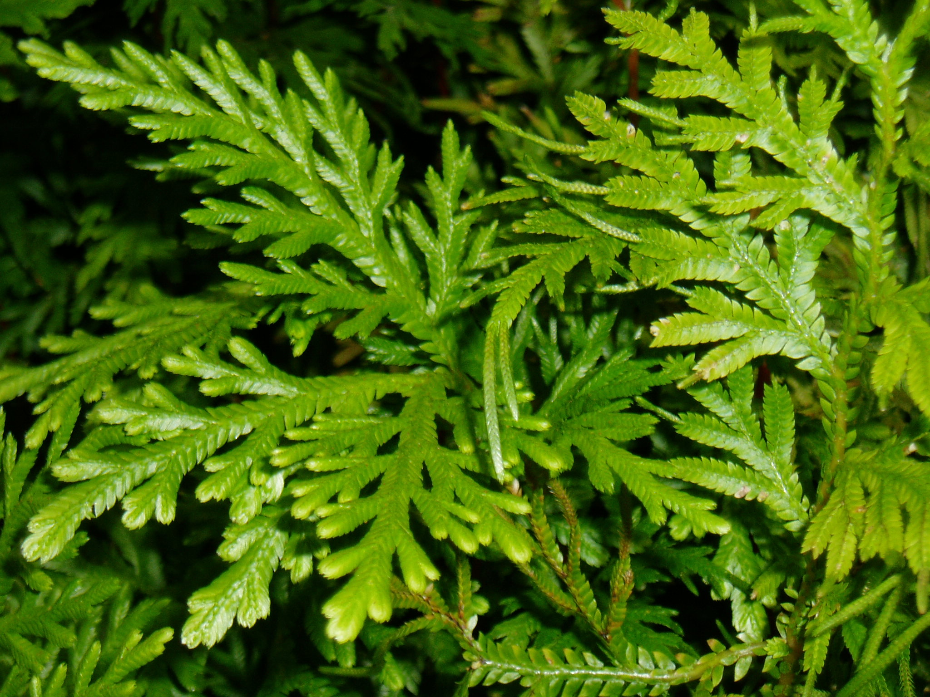
Selaginella

Slide 24
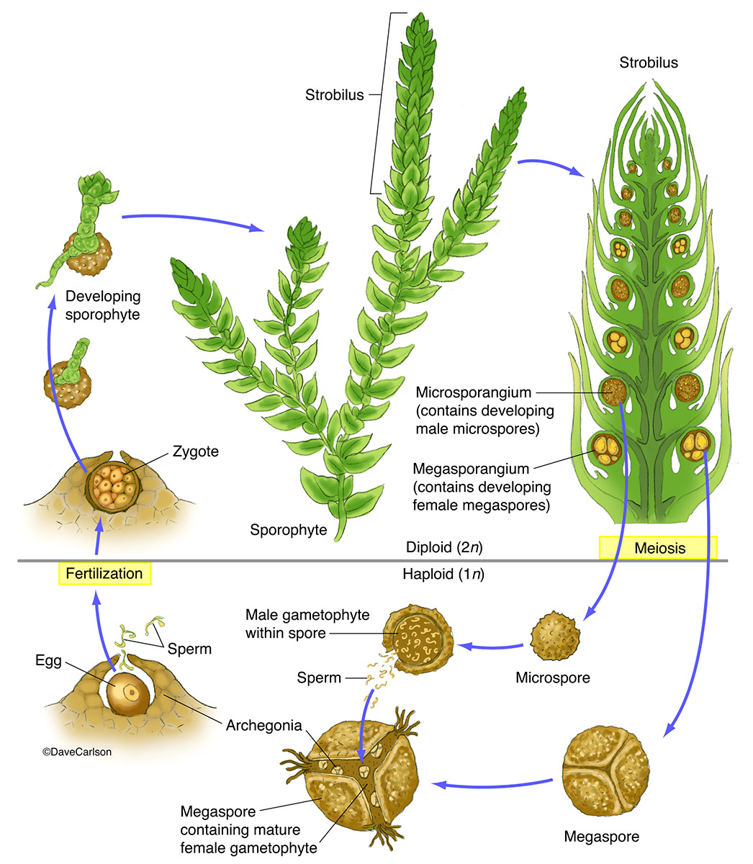
Selaginella Life cycle

Slide 25
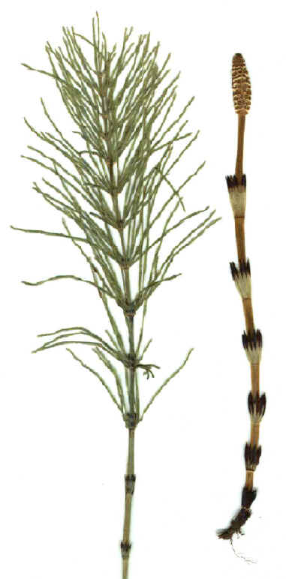
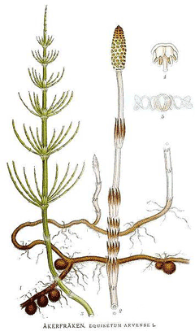
Eqiusteum arvensel

Slide 26
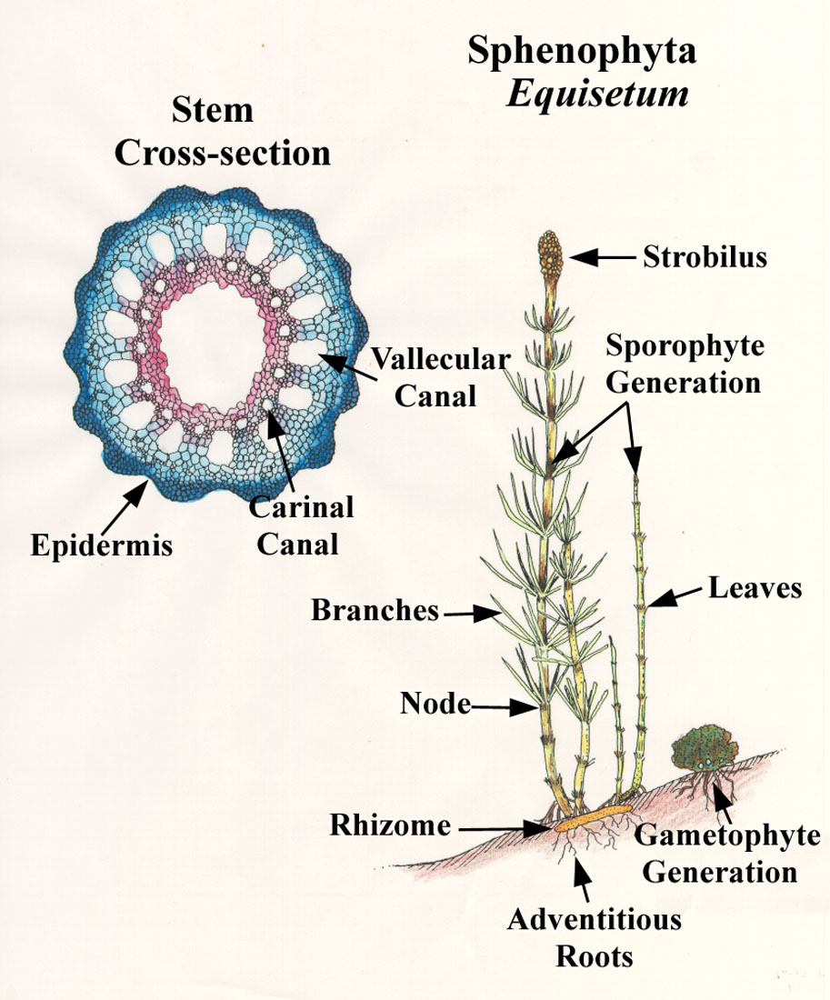

Slide 27
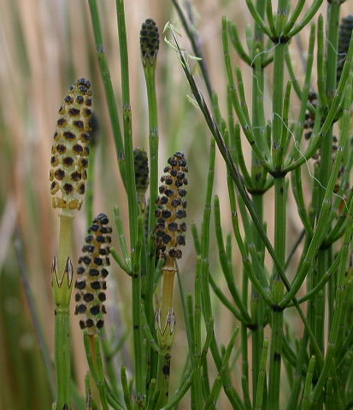
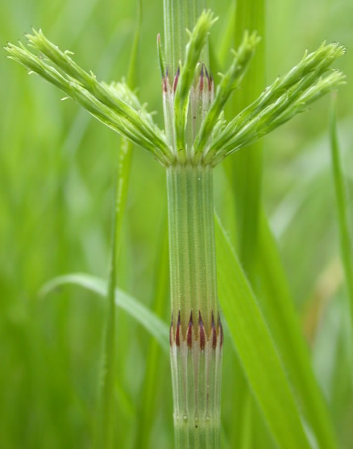
Eqiusteum arvensel

Slide 28
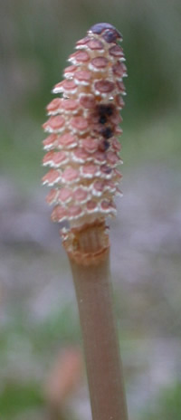
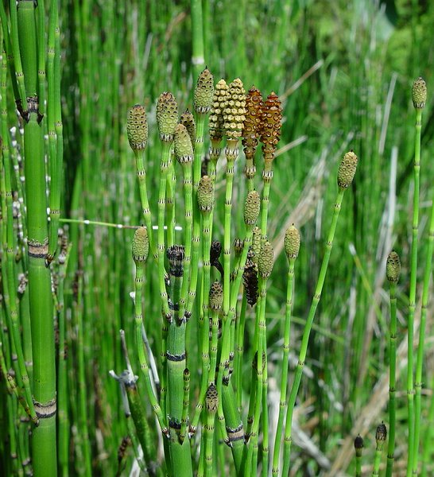
Eqiusteum arvensel

Slide 29
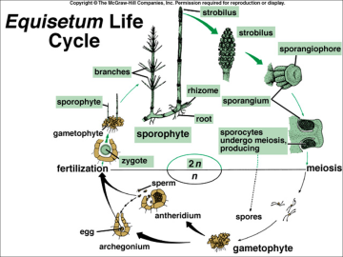

Slide 30
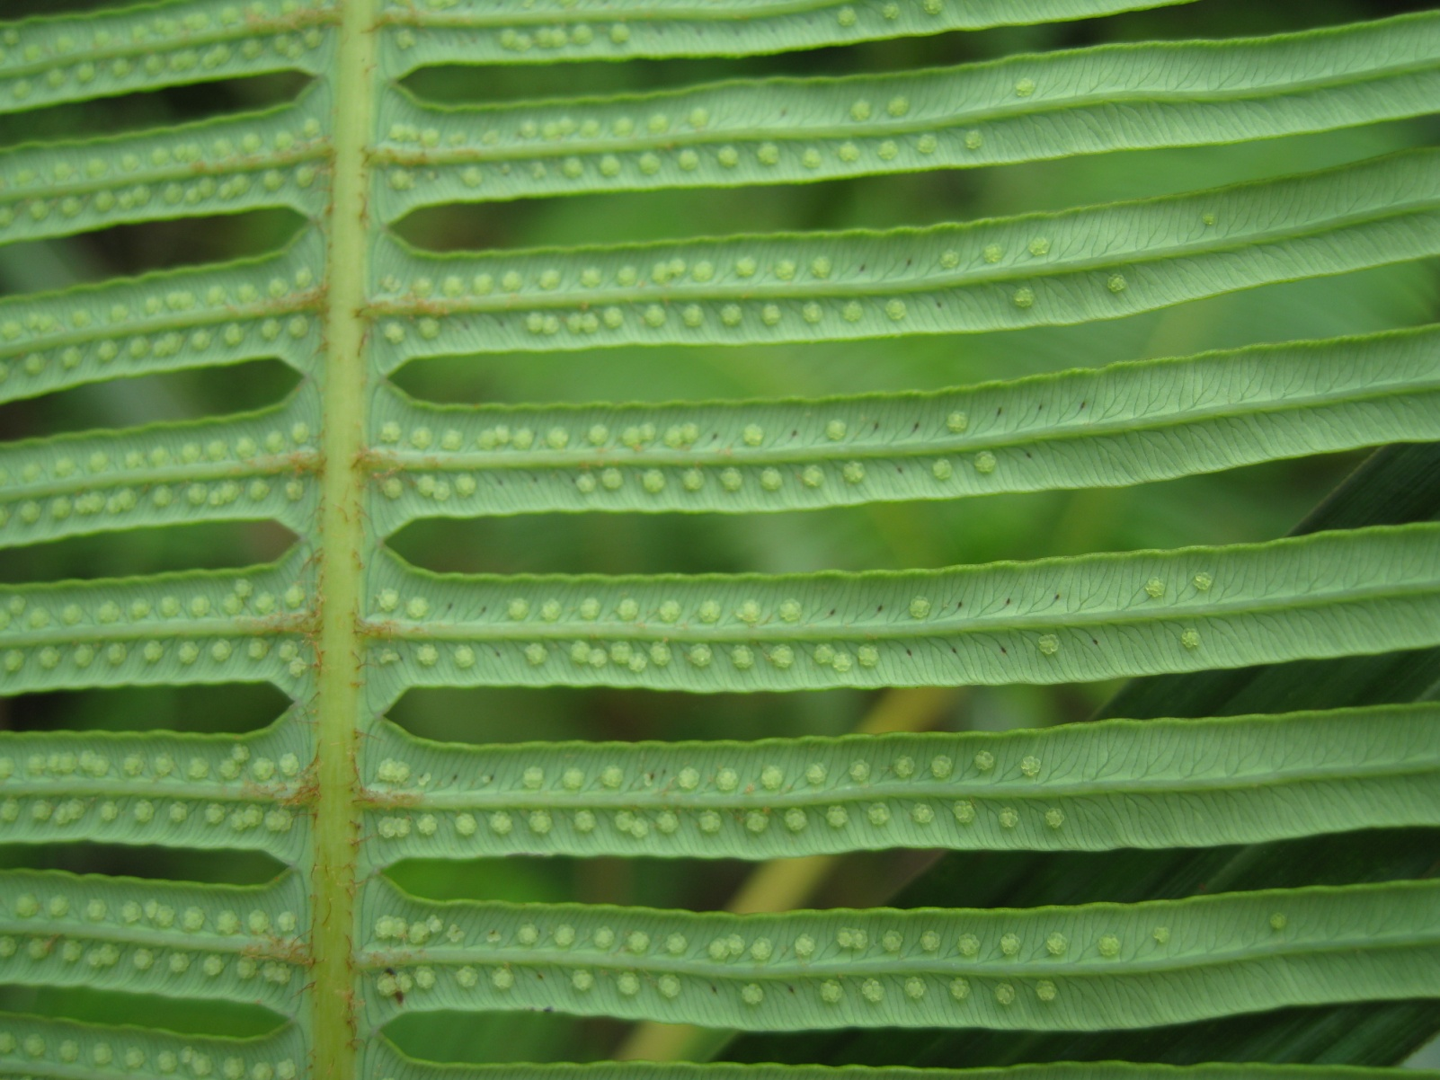
نهانزادان آوندی: سرخسها

Slide 31
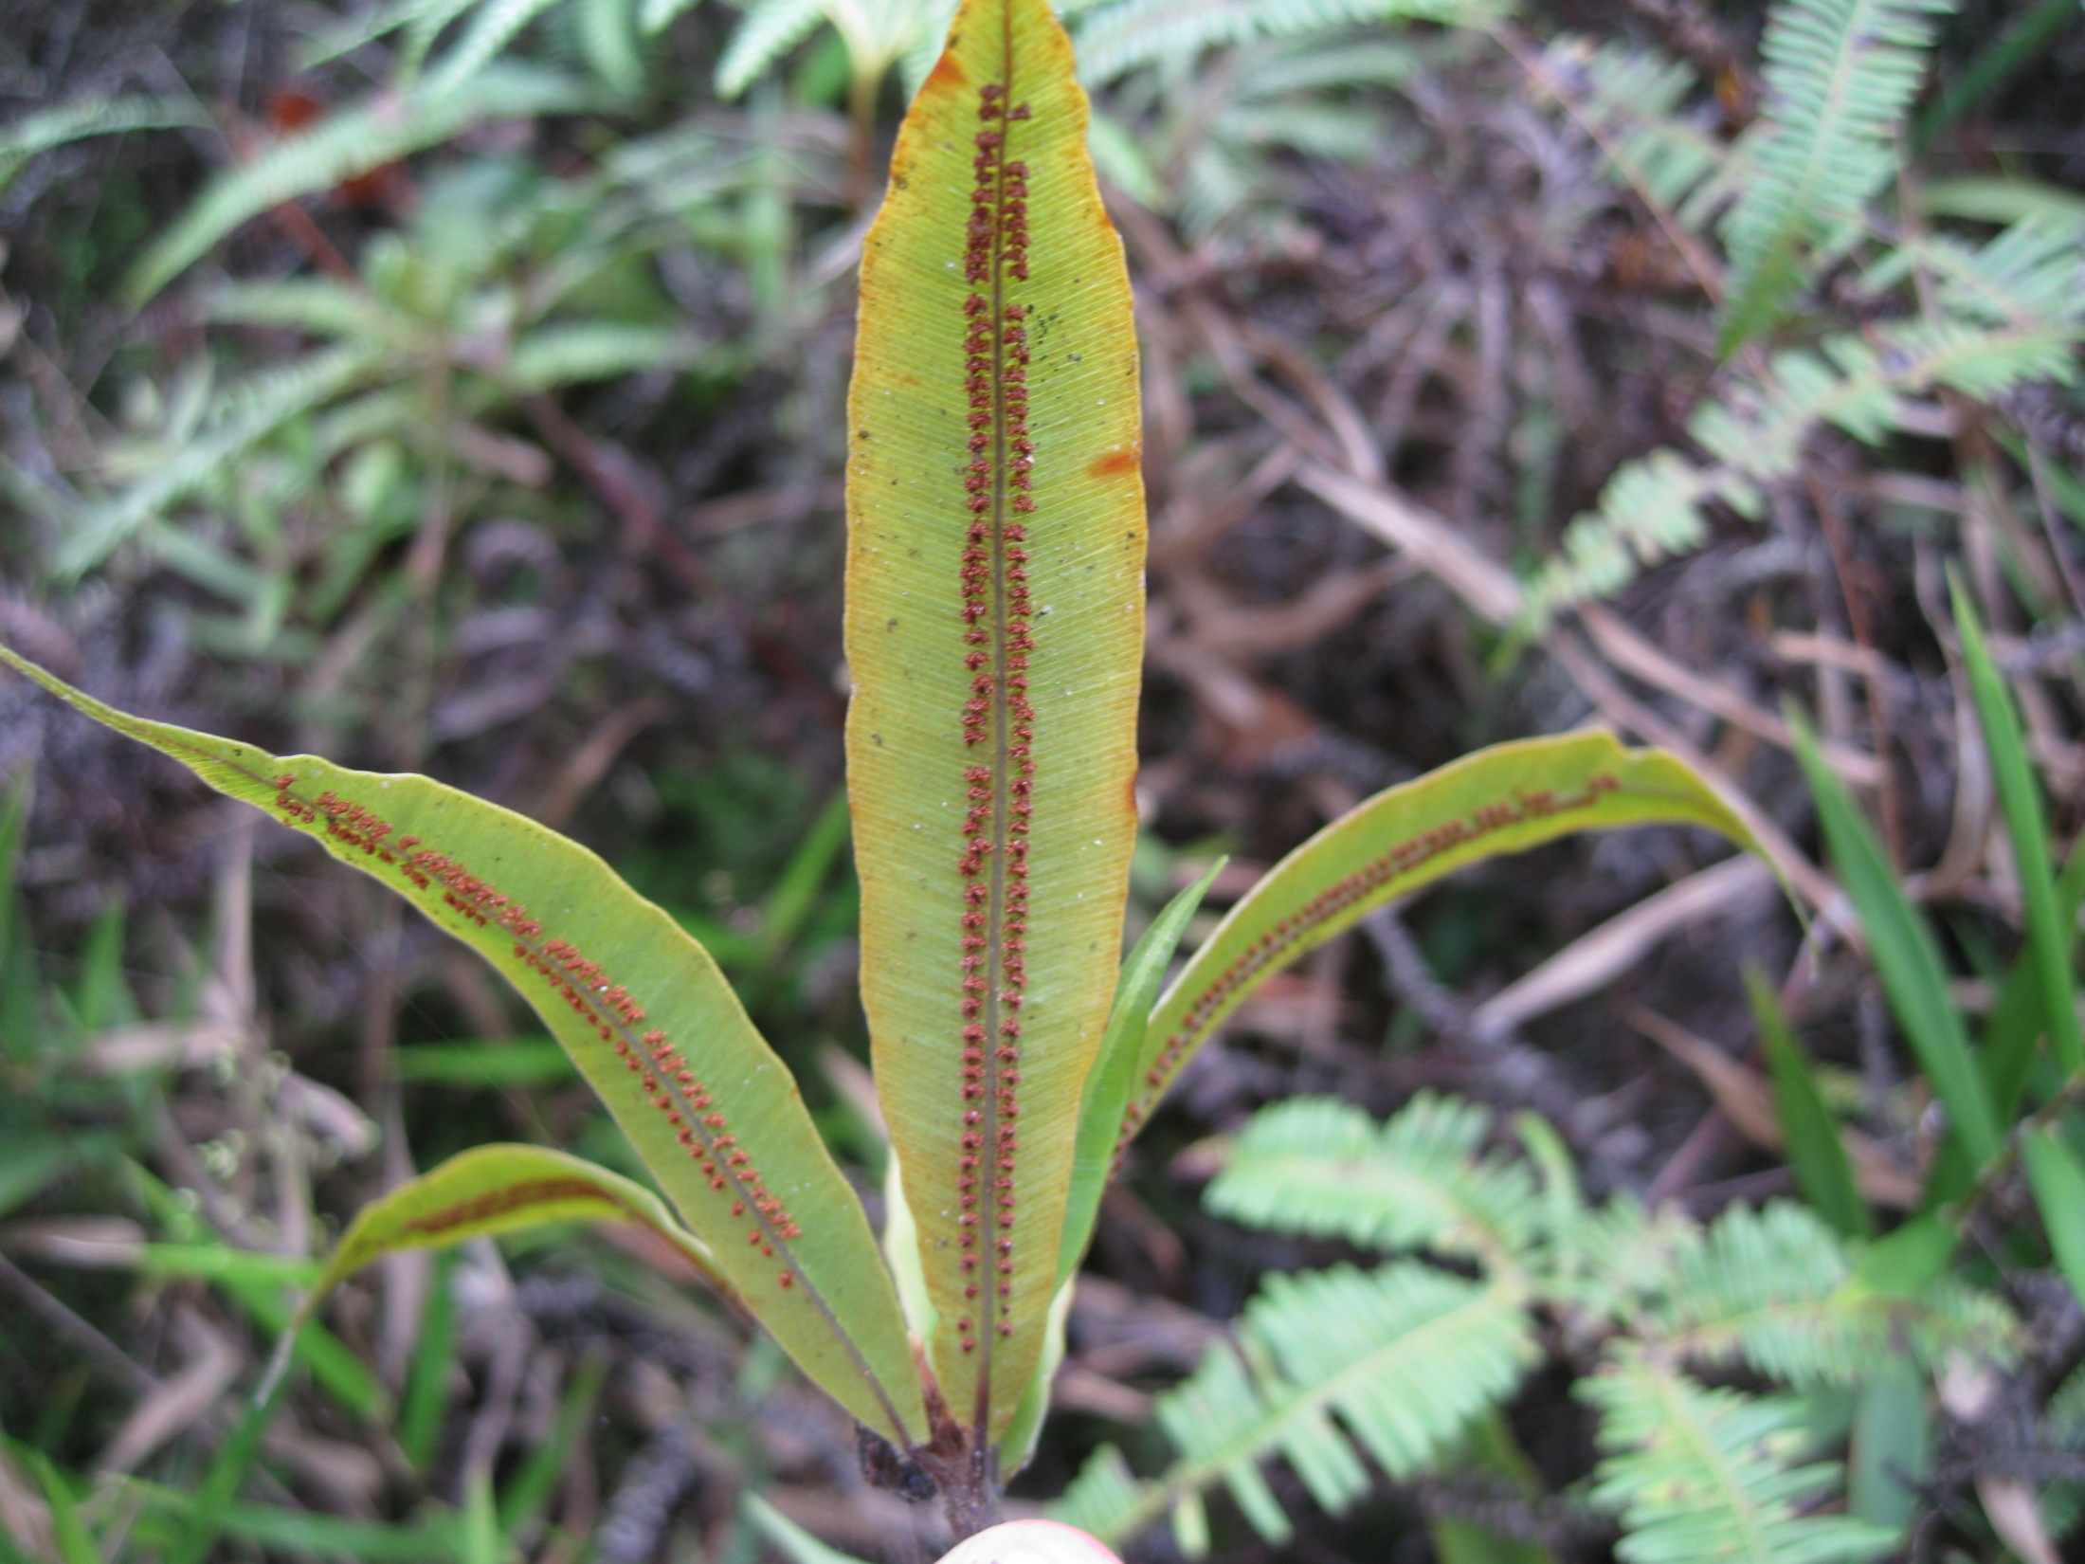

Slide 32
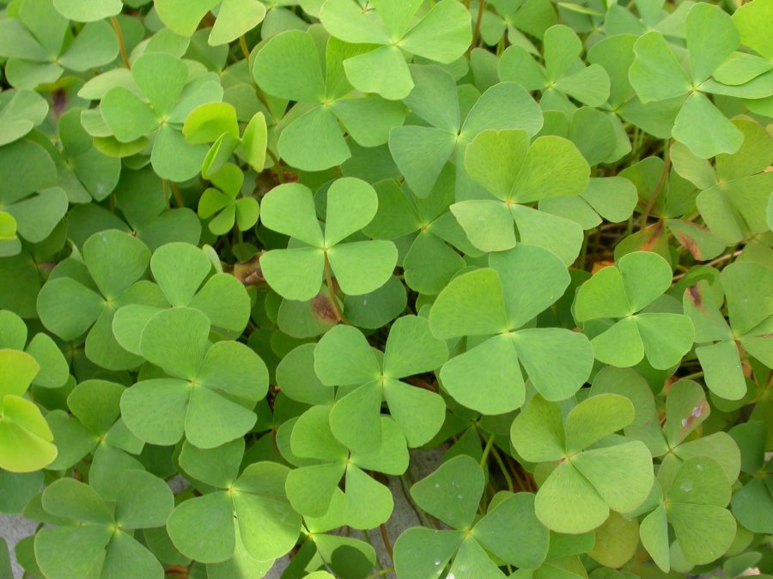
Marsilea quadrifolia

Slide 33
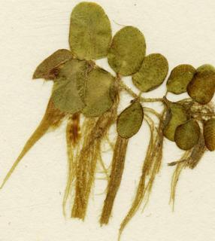
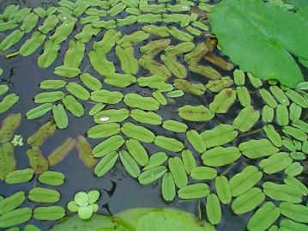
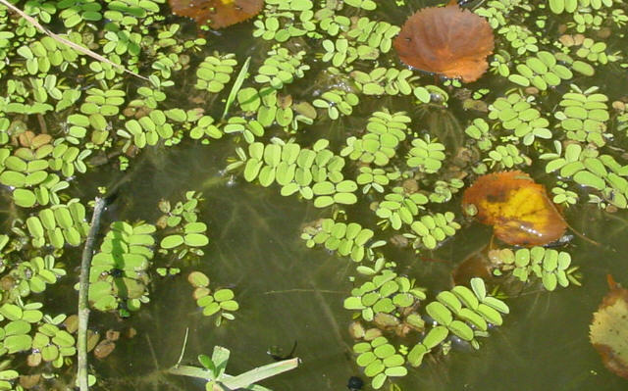
Salvinia natans

Slide 34
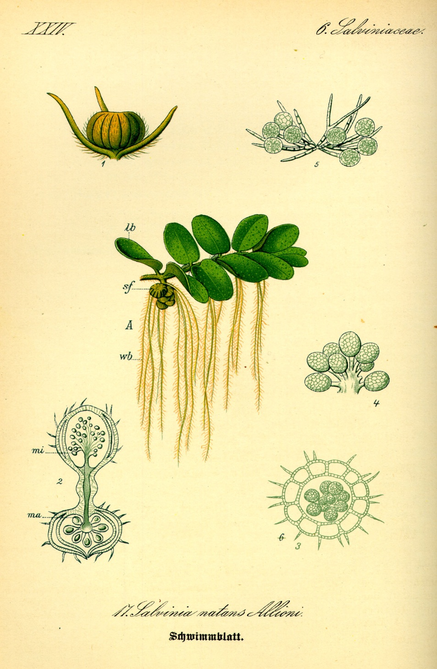
Salvinia natans

Slide 35
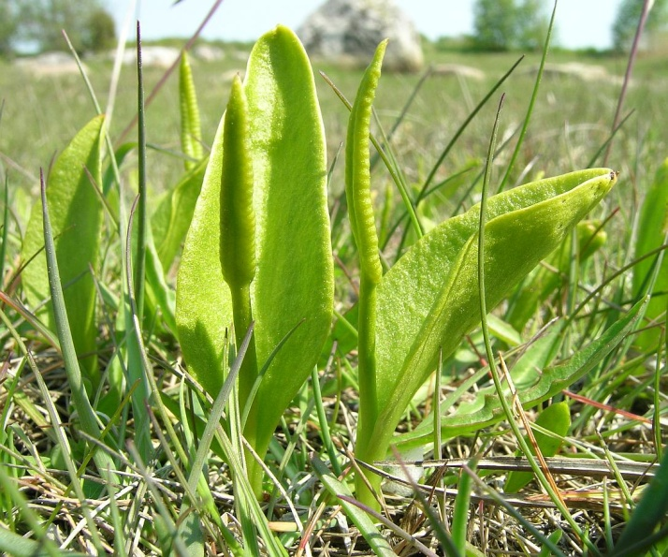
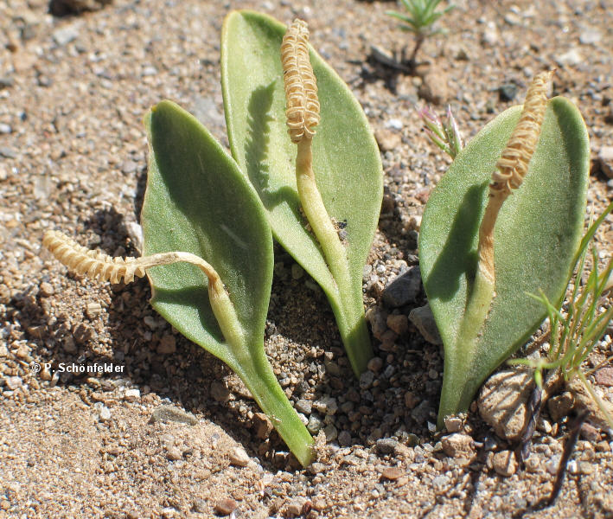
Ophioglusum vulgatum

Slide 36
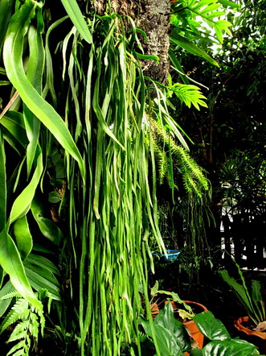
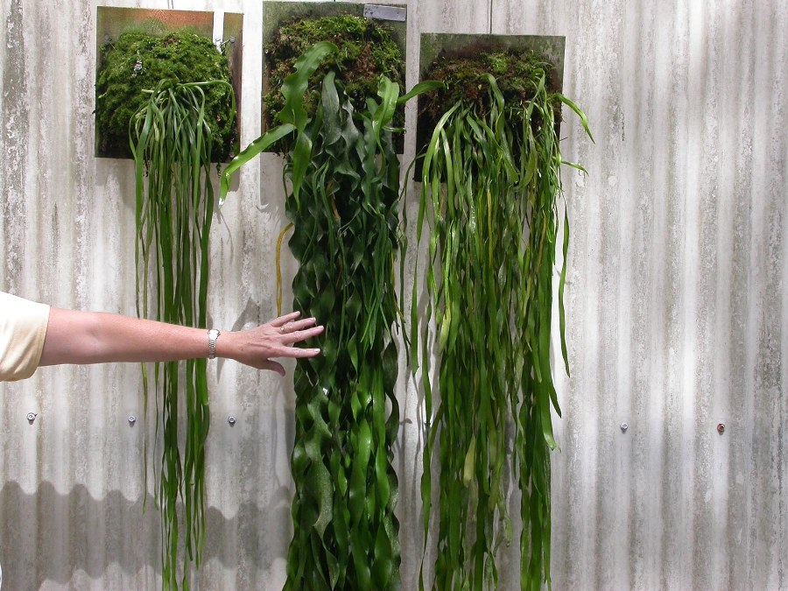
Ohioglusom pendulum

Slide 37
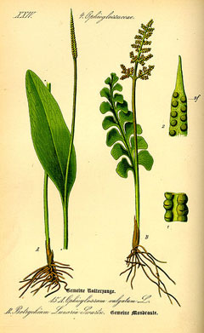
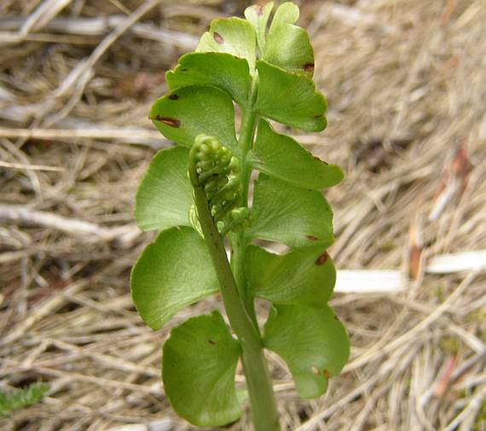
Botrychium lunaria

Slide 38
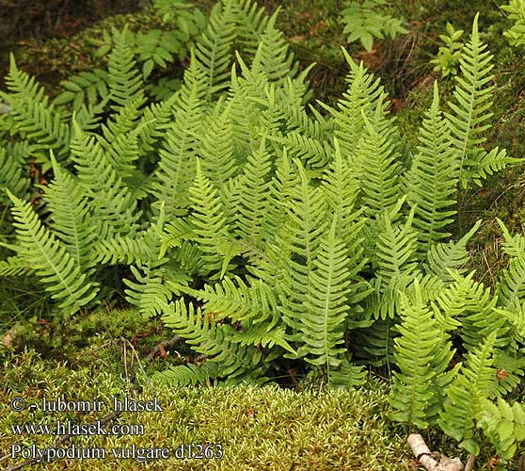
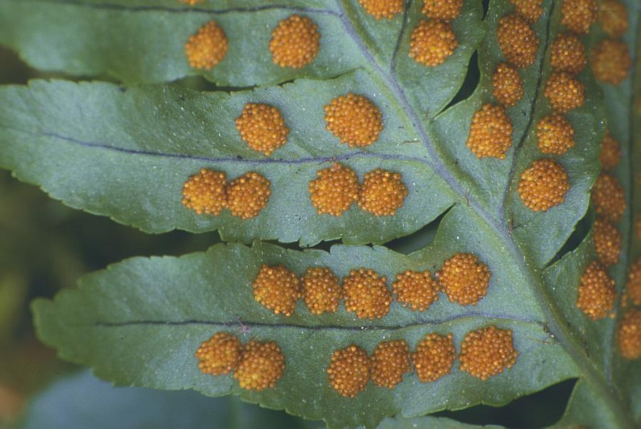
Polypodium vulgare

Slide 39
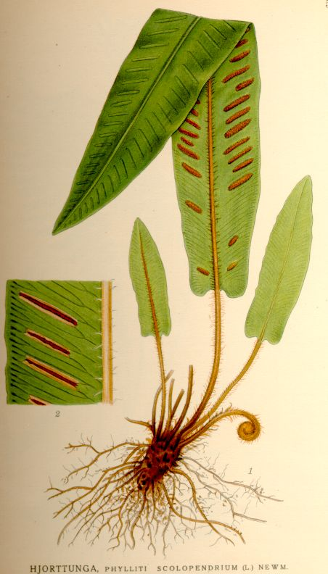
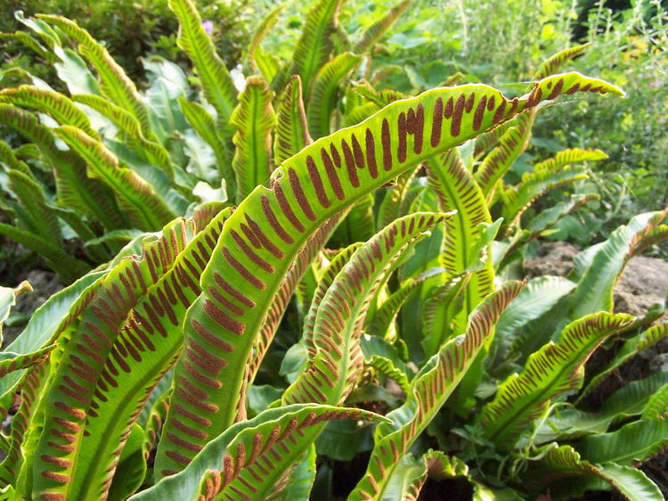
Phylitis scolopendium

Slide 40
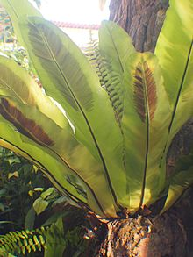

Asplenium nidus

Slide 41

Adianthum caudatum

Slide 42


Adianthum caudatum

Slide 43


Adianthum caudatum

Slide 44

Pteridium aquilinum

Slide 45


Slide 46
Gymnosperms
- Cycadophyta
- Gynkgophyta
- Coniferophyta
- Gnetophyta

Slide 47


Cycadaceae

Slide 48

Cycas orixensis

Slide 49


Cycas circinalis
Cycas male cone

Slide 50

Cycas male cone

Slide 51

Cycas male cone

Slide 52

Cycas revoluta
Female cone

Slide 53


Cycas female cone

Slide 54


Slide 55


Slide 56


Slide 57


Cycadaceae
Zamia

Slide 58


Cycadaceae
Zamia

Slide 59

Ginkgo biloba

Slide 60


Ginkgo biloba

Slide 61

Ginkgo biloba
Male cone

Slide 62

Ginkgo biloba
female cone

Slide 63

Ginkgo biloba

Slide 64

Ginkgo biloba
male cone

Slide 65



Ginkgo biloba
female cone

Slide 66


Pinus eldarica

Slide 67


Pinaceae
Larix

Slide 68


Pinus

Slide 69


Pinaceae
Picea

Slide 70


Pinaceae
Abies

Slide 71

Cupressaceae
cupressus

Slide 72

Cupressaceae
Thuja

Slide 73

Cupressaceae
Thuja

Slide 74

Taxaceae
Taxus bacata

Slide 75

Taxaceae
Taxus bacata

Slide 76


Slide 77


Slide 78


Slide 79

Efedra
Female cone

Slide 80

Efedra
Male and female cone

Slide 81

Gnetum
Male and Female cone

Slide 82



Slide 83


Slide 84


Slide 85


Slide 86
Angiosperms
Monocotes
Eudicots

Slide 87


Slide 88


Slide 89

Salix acmophylla زرد بید

Slide 90

Salix aegyptica بید مشک

Slide 91

Populus male flower

Slide 92

Corylus avellana

Slide 93

Corylus avellana
fruit

Slide 94

Corylus avellana
Male flower

Slide 95

Juglans regia
Female flower became fruit

Slide 96

Juglans regia

Slide 97

Morus male flower

Slide 98


Slide 99

Morus female flower

Slide 100

Solanaceae

Slide 101

Rosaceae
Fragaria

Slide 102

Allium
Amaryllidaceae
Monocots

Slide 103


