Slide 1
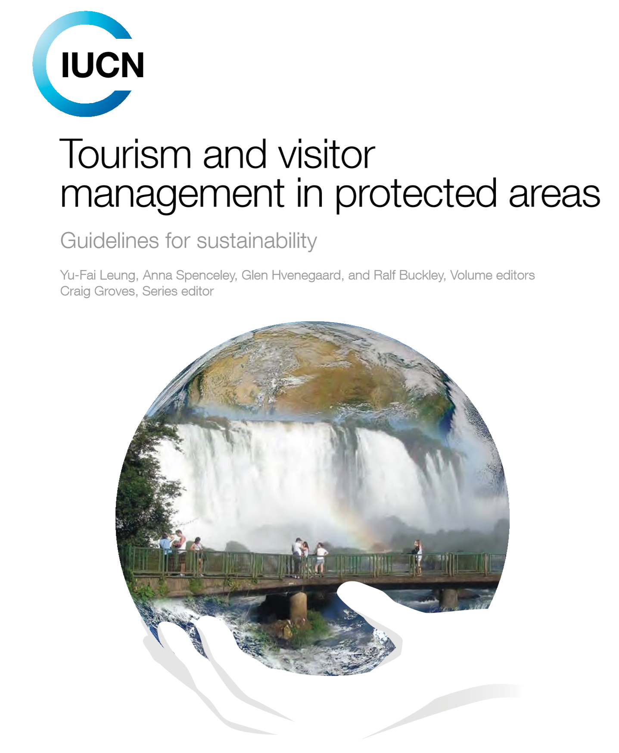
Adaptive management for sustainable tourism

Slide 2
Monitoring is essential to professional management
An essential component of any tourism management strategy is a commitment to sustained monitoring that tracks current conditions, evaluates the efficacy of management actions, and provides the basis for taking appropriate remedial action and any needed adjustments to management plans.
To design an effective monitoring programme with useful outputs, managers should consider the following basic questions:
Why monitor
What to monitor
Where and when to monitor

Slide 3
Basic questions to answer
1.Why monitor: Is monitoring intended to detect long-term resource or use trends (often called ‘ambient monitoring’), support a management framework, or provide short-term efficacy evaluation of a management strategy (often called ‘effectiveness monitoring’)?
2. What to monitor: What indicators are clearly linked to protected area values or directly relevant to management decision making? What type of impact (e.g. environmental, economic, social, cultural) is most important? Comparing input (e.g. number of visitors, tourist behaviour) and output/outcome indicators (e.g. economic benefit, visitor experience or ecological impact), what is most critical for managers to track if monitoring for both types of indicators is not feasible?
3. Where and when to monitor: Should monitoring take place in the most sensitive habitats or in areas that show signs of rapid change? Should monitoring take place
Source

Slide 4
4. Who should monitor: Should data be collected by managers such as wardens or rangers, by academic researchers, or by volunteers? Can some or all parts of a monitoring programme be run by a local community? What agency and community capacity can a protected area leverage to support a sustained monitoring programme? What level of training is needed to ensure data quality? Can the data be collected by tour or concession operators?
5. Who will analyse the data: Will monitoring results be analysed by protected area managers, academic researchers, or a combination of the two?
6. How will the data be used: How will the results be incorporated and used by managers?

Slide 5

Community-based monitoring
Monitoring tourism and visitor use can be an expensive undertaking, one that overwhelms the capacity of protected areas with a limited budget or staff. However, depending on the indicators to be monitored, some programmes can be relatively simple and cost effective. The cost can be further reduced through the participation of community volunteers, visitors or tour/concession operators in data collection

Slide 6
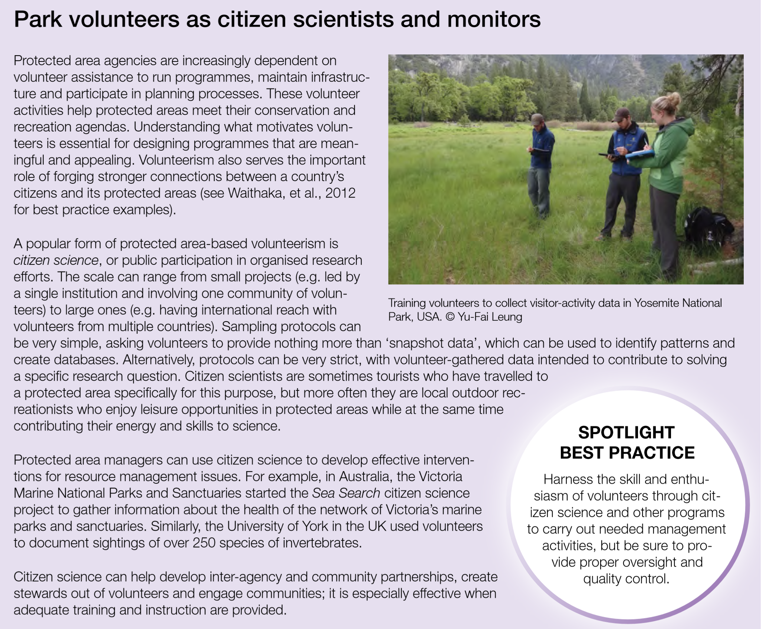

Slide 7
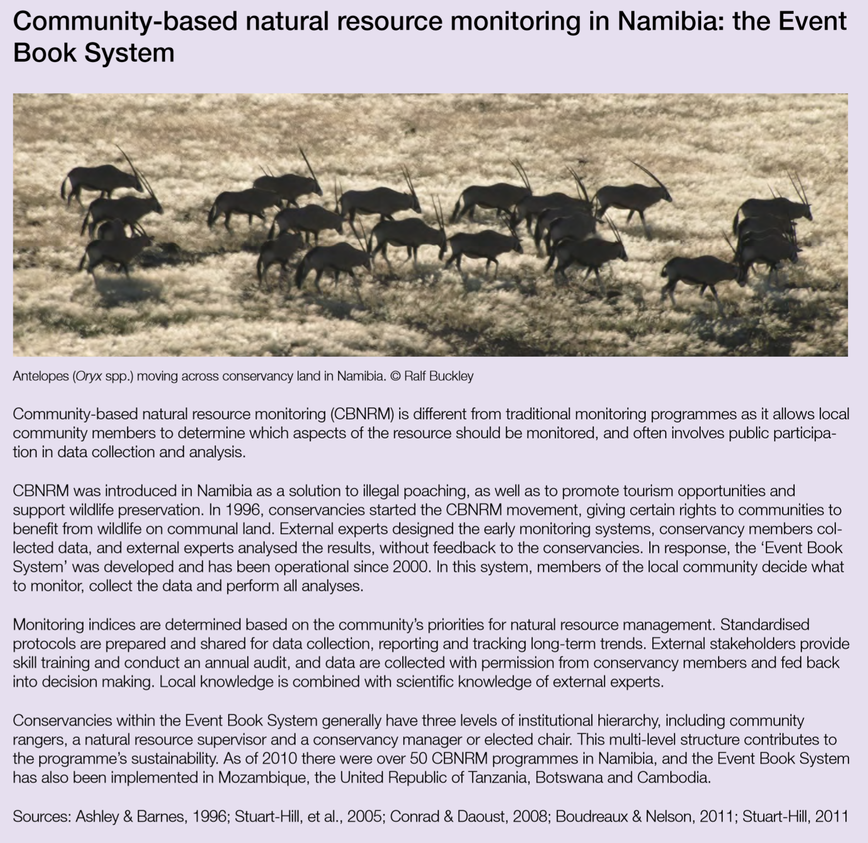
Community members can also be engaged to monitor tourism’s impact on natural resources

Slide 8
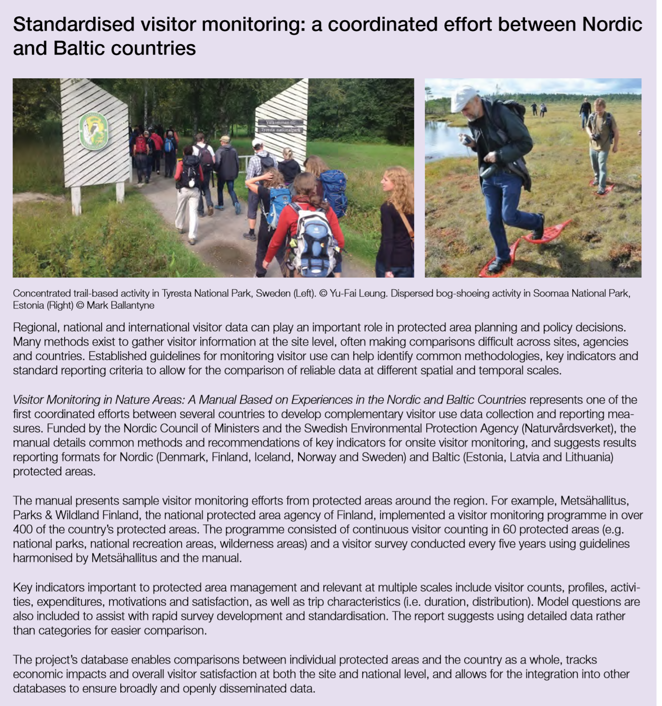

Slide 9
Visitor impact monitoring
Indicators for monitoring visitor impacts have been developed for a wide variety of settings, ranging from whole ecosystems to individual facilities.
Monitoring can be focused on the condition of recreation infrastructure, which should be able to sustain visitor impacts through its design and management. Ecological resources can also be the focus, especially for sensitive landscapes, habitats or species. Visitor use and behaviour can be monitored to evaluate impact-causing behaviour, such as littering and off-trail walking. The selection of a monitoring focus and specific indicators is largely dependent on the management objectives.

Slide 10
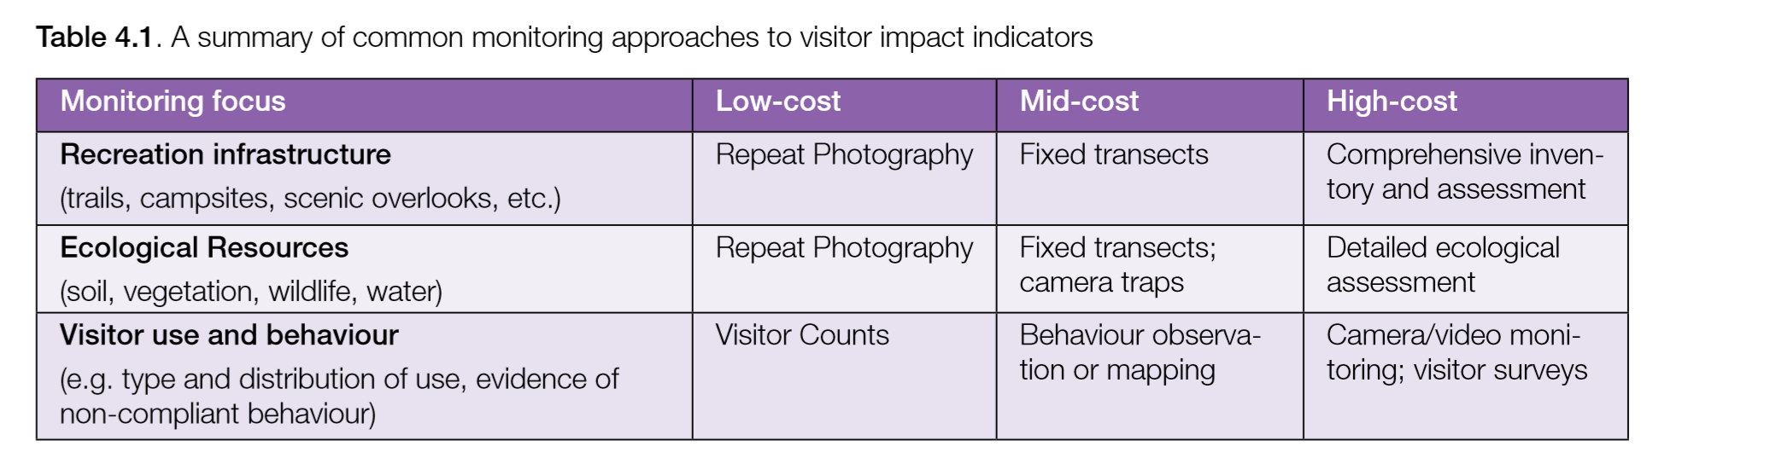

Slide 11
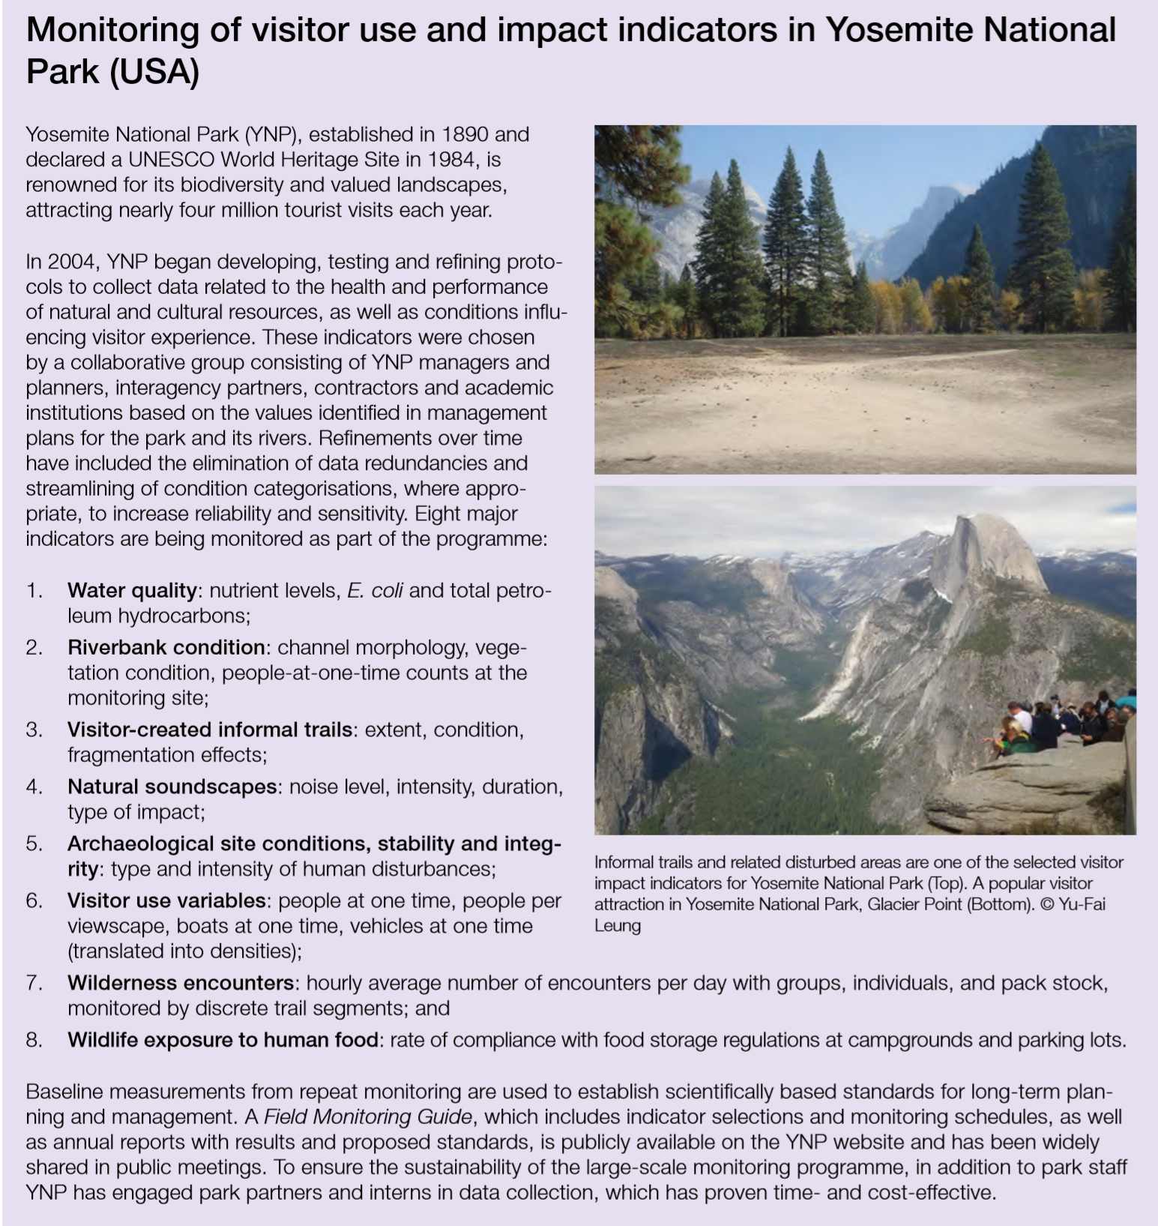

Slide 12
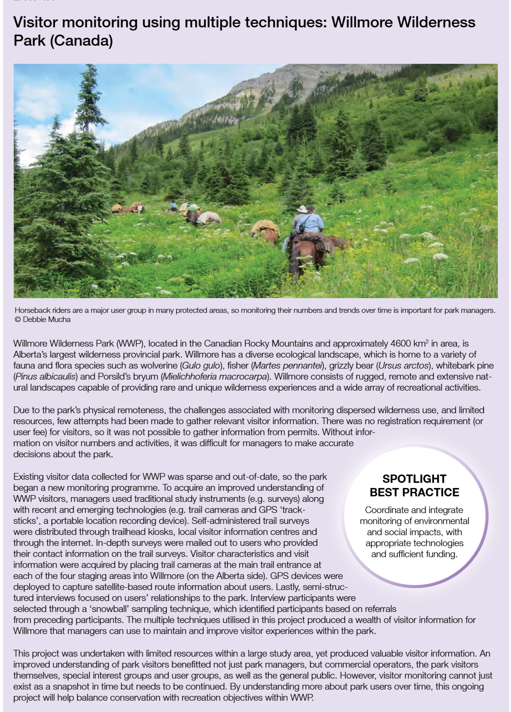

Slide 13
Participatory planning and community engagement
Sustainable tourism and visitor management entails a planning process with numerous steps and can engage many rightsholders and stakeholders, including Indigenous Peoples and local communities.
Collaborative planning can be a proactive approach to build community consensus, engagement and capacity for managing the positive and negative impacts of tourism.

Slide 14
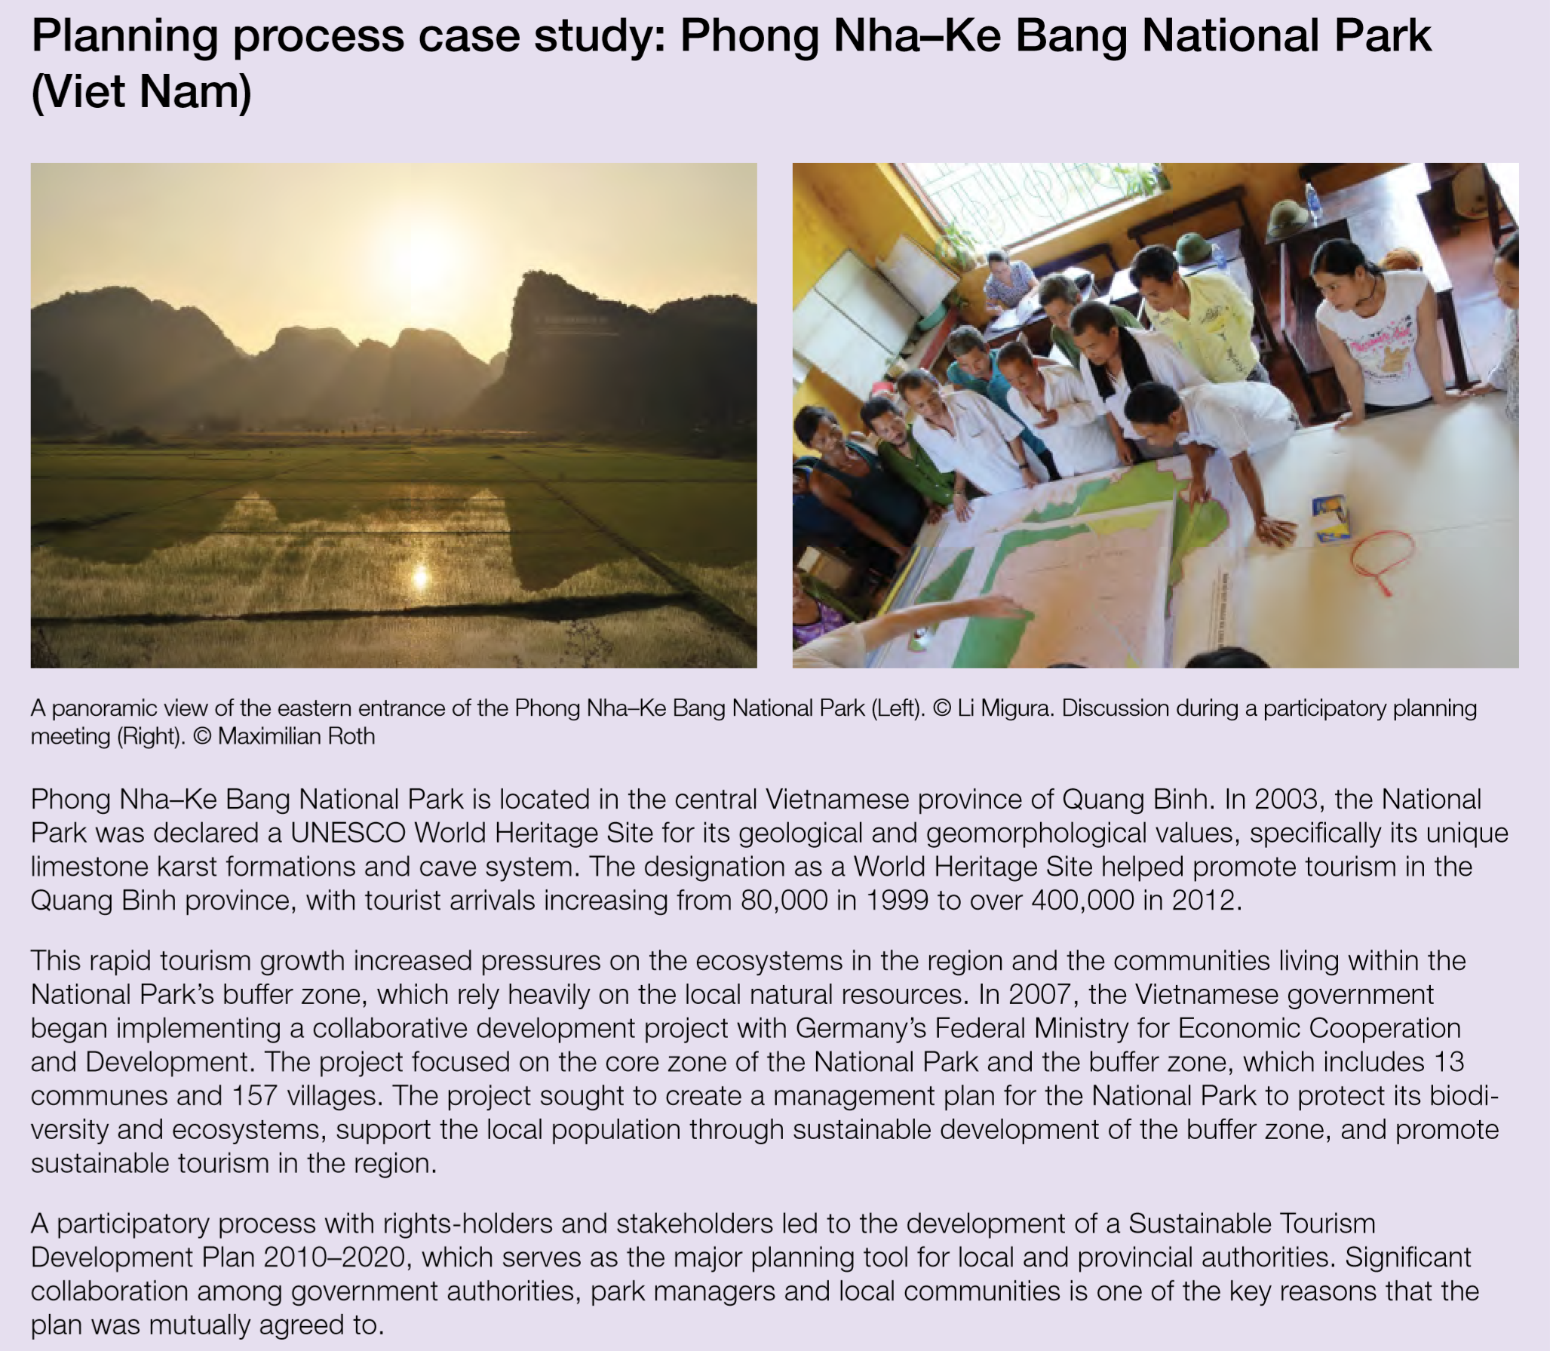

Slide 15


