Slide 1


Internet of Things (IoT)
Professor: Dr. Sadoon Azizi s.azizi@uok.ac.ir
Faculty of Engineering
Department of IT and computer Engineering

Slide 2
Chapter Objectives
* In this chapter students are supposed to get familiar with these objectives:
Sensors and their types
RFID
Actuators and their types

Slide 3
This chapter’s focus

Slide 4
This chapter’s focus

Slide 5
Things in the Internet of Things
Sensing: In order to detect and gather key parameters for analysis
Addressing: To detect things in a unique fashion through internet
Actuate: To do the desired action

Slide 6
Sensors in the Internet of Things
Sensor definition:
  A sensor is a device (mostly electronic) that detects events or changes in it’s environment (such as temperature, sound, pressure, flow, motion, chemical parameters, etc.) and generates the according outputs
Most sensors receive input as analog signals and produce output as digital signals
Sensors are comparable to human biological senses
Sensors are the bridge between physical and virtual worlds
A sensor can be very simple (only sensing the environment) or very intelligent (sensing the environment and computing the collected data)

Slide 7
Intelligent Sensor Components

Slide 8
Sensor types
Temperature sensors
Pressure sensors
Flow sensors
Level sensors
Imaging sensors
Noise sensors
Pollution sensors
Proximity and displacement sensors
Infrared sensors
Moisture sensors
Velocity sensors

Slide 9
Temperature sensors
Temperature is the most common quantity to measure; because most physical, electronic, chemical, mechanical and biological systems are affected by temperature
  Measuring room temperature, human body temperature, water temperature

Slide 10
Pressure sensors
These sensors are used to measure gas and liquids
  For example, water pressure, air pressure in heights, pressure on the touchscreen smartphones

Slide 11
Flow sensors
These sensors are used to detect and record the fluid’s flow rate in a pipe or system; these are also used to measure flow / heat transfer caused by an animated medium
  Example: Water boilers, flow supervision for high purity acids

Slide 12
Level sensors
These sensors are used to measure fluid levels continuously or in special places
Example: Sea level supervision and tsunami warnings

Slide 13
Imaging sensors
These are devices to convert visual images to electric signals
  Example: Digital cameras, medical imaging devices and night vision accessories

Slide 14
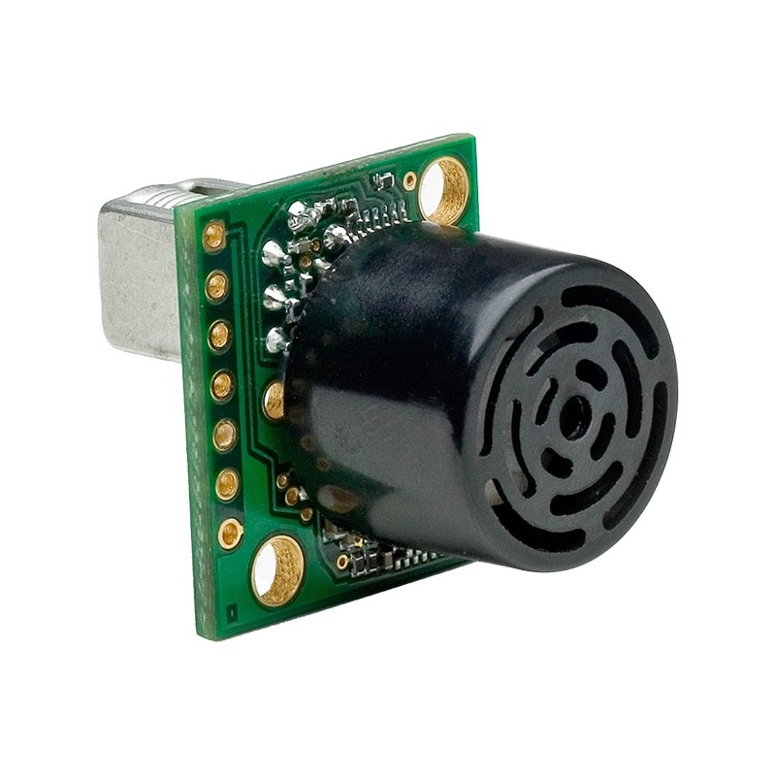
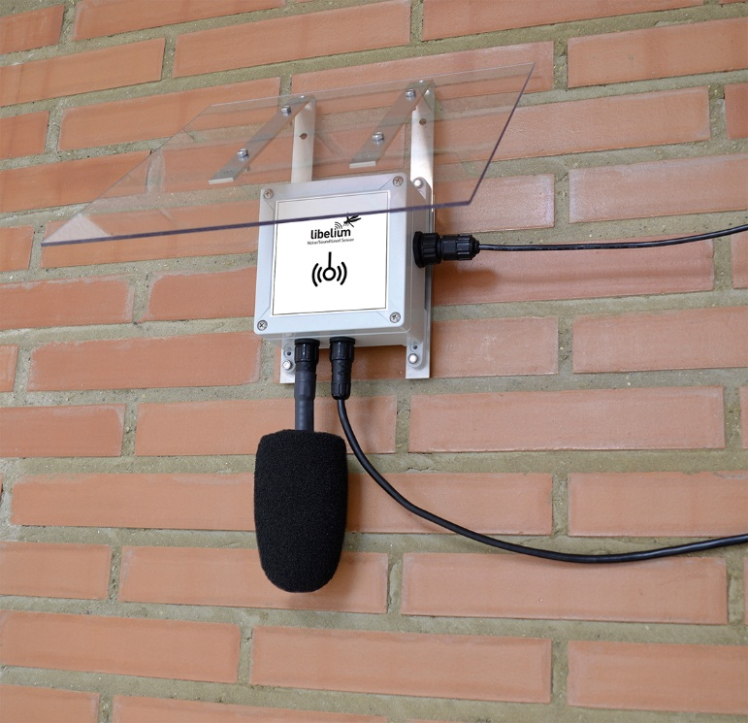
Noise sensors
High noise can affect humans (Heart diseases) and animals (Losing hearing abilities) in bad ways
Environmental noise sensors continuously control the noise level around them
  Example: music sound tuning, presence detection

Slide 15
Practical requirements of IoT (focusing on sensors)
Very small sizes
More data collection
Low power consuming processors
Longer battery life
Quicker response time
Less time to enter market

Slide 16
Sensor specifications
Filtering the data
  Removing repetitive and unwanted data or noise before data transmission
Minimum power consumption
  Sometimes replacing sensor batteries is a difficult or even impossible task
Compression
  Compressing the sensor sizes to fit small spaces
Smart detection
  Remote sensing (getting information about a thing without physical contact)
High sensitivity
  Devices output must change with a small variation in it’s input (physical)
Linearity
  Output must change on a linear basis according to input

Slide 17
Sensor specifications
Dynamic range
  Signal input ranges which can be converted to electric signals by the sensor
Accuracy
  Maximum difference between the actual measured signals and the ideal output signals
Hysteresis
  Expected error range based on the measured component
Limited noise
  Sensor noise must be limited so that it won’t affect IoT system’s performance
Broad bandwidth
  Response time must be low in case of momentary changes in the physical signal

Slide 18
Sensor Specifications
High clarity
  Smallest recognizable signal oscillation
Minimum Interruption
  Sensors must work normally in all times (without or with very small interruptions)
High reliability
  Accuracy and precision assurance of the measured data
Ease of usage
  Sensors must be designed well so that their usage would be easy enough

Slide 19
Radio Frequency Identification (RFID)
Another way to receive information from things is to use RFID
RFID is not a sensor but a mechanism to retrieve information in the pre-installed sticker that can be on the things
Information in the sticker are read with radio frequencies
RFID is consisted of two parts:
  Tag: including a microchip to store and process the antenna information to send and receive information
  Reader: to read the coded information on the sticker by sending and receiving radio frequencies
At last it sends the final information to an application

Slide 20
Radio Frequency Identification (RFID)

Slide 21
RFID advantages compared to Barcode
RFID tags don’t need to get inline with the reader
  Tag information can be read from 12 meter distance (for UHF disabled systems) or even 100 meters (battery included tags)
RFID’s data on the tag can be changed based on needs
RFID tags are durable
RFID’s data can be encrypted
RFID systems can read hundreds of tags concurrently

Slide 22
RFID disadvantages
Tags are likely to be blocked
  Example: wrapping the tags with metals (such as aluminum)
Reading conflicts can occur if the system is not configured well
  Each RFID reader will scan all the tags that fall in it’s region (Consequences?)

Slide 23
RFID main usages
Accessibility management and control
Passport
Medical care
Logistic and tracing supply chain
Athlete scheduling
Animal tracing
Other usages
  Tracing conference participants
  Interactive marketing
  Library systems
  Immediate location systems

Slide 24
Video tracing
Video tracing is the process of analyzing the captured video of an object frame by frame in a short period of time
It is used to measure and analyze movements and behavior
Using video tracing along with sensors and/or RFID one can achieve much more comprehensive solutions
The main flaw of this solution is that it’s time consuming
  Needs enormous video analysis traffic
Another flaw is the need for complicated methods of object/picture detection

Slide 25
Video tracing usage
retail
  User behavior and eye movements tracing to increase the sales
Banking
  Detecting high priority clients (for instance those with higher account balances) in order to provide them better services
Security and physical supervision
  Detecting unfamiliar people or those who intend to rob the bank
Traffic management and control
  Detecting the number of vehicles behind the traffic lights

Slide 26
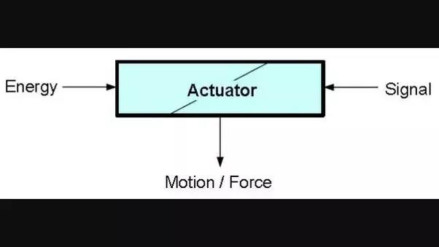
IoT actuators
An actuator is an engine that is responsible for doing an action or controlling something in a system
Actuators use the data analyzed by the sensors to control the IoT system

Slide 27
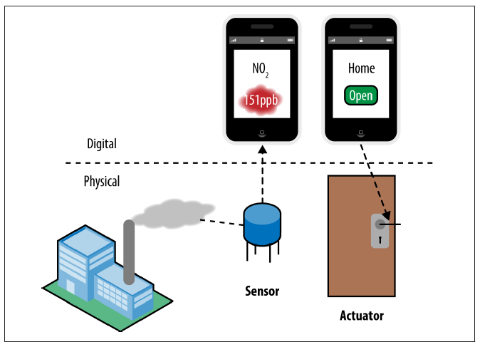
IoT Actuators

Slide 28
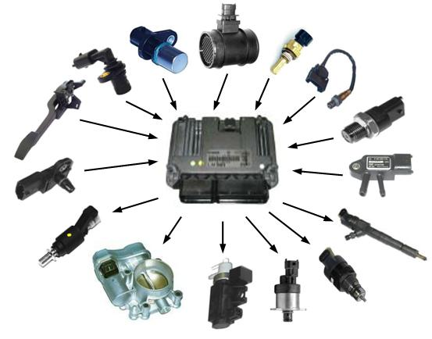
IoT Actuators

Slide 29
How things are identified in IoT?
The easiest way to identify each device in IoT is to assign a unique IP to each sensor and actuator
IPv4 address range is all taken
IPv6 addresses are still to be implemented
Most of the sensors and actuators are not capable of having an IP
Solution: assigning an IP address to the gateway and identifying sensors and actuators based on their corresponding gateways

