Slide 1


Internet of Things (IoT)
Professor: Dr. Sadoon Azizi s.azizi@uok.ac.ir
Faculty of Engineering
Department of Computer and IT Engineering

Slide 2
This chapter’s objectives
* In this chapter students are expected to get familiar with these objectives:
A general understanding of IoT’s protocol stack
Datalink layer (such as IEEE 802.15.4, Zigbee)
Network layer protocols (such as 6LoWPAN, RPL)
Application layer protocols (such as COAP, MQTT)

Slide 3
IoT’s protocol stack
CoAP
Application layer
UDP
Transport layer
IPv6, RPL
Network layer / Routing
6LoWPAN
Adaptation layer
MAC 802.15.4
Datalink layer
PHY 802.15.4
Physical layer

Slide 4
Datalink layer challenges
Device specifications
  Broad spectrum of objects from computing nodes with all capabilities to devices with high limitations
  Communicating technologies must be optimized to support low powered devices
Traffic specifications
  Some applications have relaxing dependencies to resolve packet loss, delay and jitter (such as weather forecast applications) and some have hardened dependencies (such as jet’s engine control application)
  Both applications use the same sensors (temperature sensor, pressure sensor)
Accessibility specifications
  Wired or wireless technologies, short range or long range, static or dynamic device state
Scalability
  Great number of edge devices
  Delay challenges, slow convergence

Slide 5
Datalink layer challenges

Slide 6
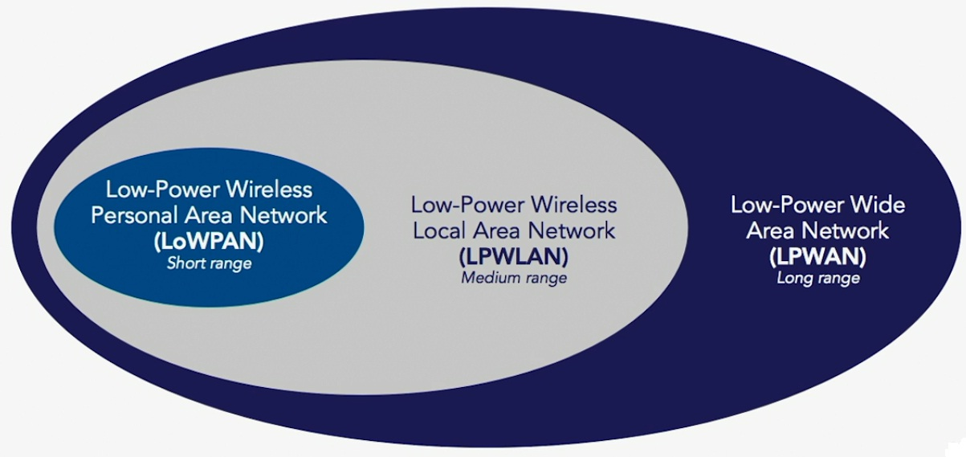
Different low powered wireless networks

Slide 7
Low powered short range wireless networks
IEEE 802.15.4
Zigbee
Z-Wave
Wireless HART
ISA 100
NRF
Bluetooth Low Energy (BLE) یا Smart Bluetooth
NFC
RFID

Slide 8
Low powered long range wireless networks
GSM
LTE-A
LoRa
SigFox
NB-IoT

Slide 9
Dominating wireless technologies in IoT

Slide 10
IEEE 802.15.4
This groups’ purpose:
  Finding an optimal solution for wireless connection with low data rate with focus on simplicity and battery life extension (from months to years)
  Focus on personal low powered networks
Some applications: home automation, remote control
Supporting data rates: 20, 40, 100, 250, 850 kbps, 1Mbps
Reliable transport
Frame size is 127 Bytes in the original version
In the IEEE 802.15.4g version the maximum frame size is grown to 2047 Bytes
Zigbee, Wireless HART, ISA 100 and RPL protocols are based on this standard

Slide 11
Topology varieties in IEEE 802.15.4

Slide 12
IEEE 802.11ah
WiFi technologies (IEEE 802.11) cannot satisfy requirements of IoT for two reasons:
  High energy consumption
  Inappropriate frequency bands (2.4-5 GHz)
IEEE 802.11ah
  Supporting lots of devices with resource limitations (more than 8,191)
  Use of sub-1 GHz bands (wider range as it can bypass hard obstacles like walls)
  More than 1 KM supporting range – best suited for outdoors
  Transmission rate from 150 Kbps to 340 Mbps

Slide 13
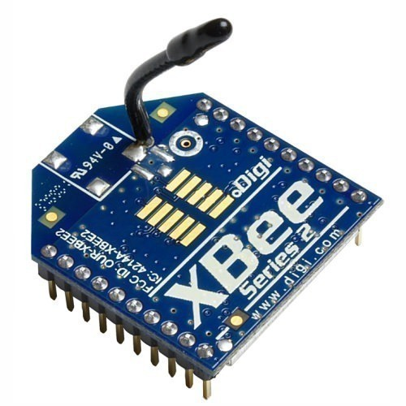
Zigbee
This protocol is specially for WPANs (Wireless Personal networks)
It is based on the IEEE 802.15.4 standard
It operates in 868 MHz, 915 MHz and 2.4 GHz bands
Maximum data rates reaches up to 250 Kbps
Environmental range is between 10 to 100 meters
It can connect more than 64000 devices through network
Low energy consumption and long battery life

Slide 14
Time sensitive networks
These networks indicate applications that need immediate response time (such as industrial automation and vehicle networks)
Industrial automation:
  Network range is quite large (from one to couple of Kilometers)
  It may include more than 64 hop for a factory or more than 5 hop for a working station (such as a robot)
In addition to immediate traffic, these networks require long-tail traffics too (such as video or large file transfer)
  A requirement for these networks is that the delay must be deterministic and predictable
  In industrial automation, a cell’s delay must not exceed 5 us and for a factory region this delay must be smaller than 125 us

Slide 15
IEEE 802.11Qbv

Slide 16
Network layer (Internet layer)
Most IoT systems are created based on low-powered and Lossy networks
  Low-power and Lossy Networks (LLNs)
Networks including numerous (usually couple of thousands) number of embedded devices with resource constraints such as power, memory and computation
In this kind of networks, devices will be connected by technologies such as IEEE 802.15.4, Bluetooth WiFi and PLC
Some applications that operate based on these networks:
  Industrial supervision
  House/building automation
  Medical health/care
  Environment supervision
  Smart energy network

Slide 17
Network layer challenges
Nodes in LLNs have very limited memory to keep the topology states or routing tables
Optimizing energy consumption in LLNs
Traffic patterns in LLNs
  point-to-point
  multipoint-to-point
  point-to-multipoint
Datalink layer technologies in LLNs usually have limited frame size
Link reliability in LLNs is variable in time
  Bit Error Rate (BER)
  Dropping packets for various reasons (Collision)

Slide 18
Packet delivery rate for two IEEE 802.15.4 links

Slide 19
IoT’s network layer challenges

Slide 20
6LoWPAN protocol
Abbreviated from: IPv6 over Low-Power Wireless Personal Area Networks
RFC 6282
6LoWPAN is an adaptation layer for exploiting IPv6 on IEEE 802.15.4 networks
Maximum Transmission Unit –MTU for Ethernet is 1500 Bytes while for IEEE 802.15.4 it equals 127 Bytes
These 127 Bytes include 25 header Bytes and 21 Datalink layer security additions

Slide 21
6LoWPAN protocol

Slide 22
6LoWPAN protocol
Two major problems of IPv6 in IoT:
  IPv6’s header is 40 Bytes long
  IPv6 does not do fragmentation and reassembly of the packets
Three major tasks of 6LoWPAN protocol:
  IPv6 header compression
  IPv6 packet fragmentation and reassembly
  Layer 2 forwarding – also known as mesh under

Slide 23
6LoWPAN protocol

Slide 24
Routing requirements for network layer
Support for unicast / anycast / multicast
Comparative routing
  Considering network conditions
Limitation-based routing
  Taking node and link limitations into account (such as energy, computing power, memory, link quality)
Traffic specification
  MP2P، P2MP، P2P
  Supporting parallel routes
Scalability
  Supporting networks with more than couples of thousands of nodes

Slide 25
Routing requirements for network layer (Cnt’d)
Automatic management and configuration
  Adding more nodes to the network
  Separating nodes with unnatural behavior
Node characteristic
  Supporting nodes in sleeping mode
Performance
  Quick convergence in case of path breakage
  Supporting node mobility and quick convergence
Security
  Authentication, Encryption

Slide 26
RPL routing protocol
It is abbreviated from IPv6 Routing Protocol for Low-Power and Lossy Networks
RFC 6550
RPL is a distance vector routing protocol
  Support for memory limitations in LLNs
RPL creates a directed acyclic graph based on an objective function and a set of criterions and constraints
  Objective Function (OF)
  Destination Oriented Directed Acyclic Graph (DODAG)
DODAG is a logical topology which is created on the physical network to satisfy the required needs
  DODAG is created based on OF

Slide 27
Destination Oriented Directed Acyclic Graph (DODAG)
1
DIO
DIO
2
DIO
DIO
DIO
3
2
DIO
DIO
2
DIO
DIO
3
DIO
DIO
DIO
3
3
4
3
DIO
DIO
4
4
4
4

Slide 28
Metric VS Constraint
Metric: Scalar values that are passed to the OF as input parameters so that the best route is chosen
  Link delay
  Node energy level
Constraint: Omitting nodes that do not satisfy the required conditions
  A link that does not provide datalink layer encryption
  A node that operates with battery

Slide 29
Routing metrics in LLNs
Aggregation VS Recorded
  Example: suppose that all network nodes have a cost label (cost can be any metric), now in case of route calculation from source to destination:
  Aggregated: Sum of all links that fall into the route
  Recorded: Recording every link’s cost which fall into the route
Local VS Global
  A metric is local if it’s information do not propagate along DODAG
Attribute or node state
  Node’s computing power, accessible memory
Node’s energy level
  Node’s power state ( main-powered, battery-powered, energy harvesting)
  Remaining battery life estimation

Slide 30
Routing metrics in LLNs
Hop count
  Hops remaining to reach the destination
Throughput
  Data transfer rate on a link
Delay
  Needed time to send a packet on a link
Link reliability
  Example: sending attempts for a successful packet transmission (ETX)
  ETX=1/(D_{r}*D_{f})
  Dr: Probability that a packet is received by neighbor Df: Probability that the ACK will be received successfully
Link color attribute
  Example: Blue color to indicate that a link has data link encryption

Slide 31
Objective Function
Objective function in RIP routing protocol: Choosing the path with least hops
Objective function in OSPF routing protocol: Choosing the path with least cost (assigning a static cost to each link)
Objective function in MPLS routing protocol: Choosing the path with desired bandwidth available to reserve
In LLNs, it’s possible that not only the links and the nodes have different characteristics but also different applications with various requirements run on them
  High and low bandwidth links
  Main-powered nodes and battery-powered nodes
  Time sensitive applications and normal applications

Slide 32
Objective Function

Slide 33
Objective Function
OF1: link quality (metric) and not encrypted link (limitation)
OF2: delay (metric) and low quality links and battery powered nodes (limitation)

Slide 34
Objective Function
Source: Kim, H.S., Kim, H., Paek, J. and Bahk, S., 2017. Load balancing under heavy traffic in RPL routing protocol for low power and lossy networks. IEEE Transactions on Mobile Computing, 16(4), pp.964-979.

Slide 35
Some notes
DODAG’s root is usually an edge router which connects LLN to the backbone netwrok
Rank 1 is assigned to the DODAG’s root
Node ranks are defined based on the objective function
Node rank is increased when moving toward the leaves
RPL is a proactive protocol
  Alternative routes are taken into account as a part of the topology
RPL prefers local repair to global ones
  Finding backup route with local methods

Slide 36
Application Layer
Application protocols are responsible for endpoint connections
  Things or gateways and applications
Main challenges of these protocols:
  Ability to implement on resource-limited devices
  Mappings between formats used in resource-limited devices and WWW applications

Slide 37
Request/Response Paradigm

Slide 38
Request/Response Paradigm
Connection establishment between endpoints
This paradigm is best suited for applications that have one or more of these characteristics:
  Client / Server architecture
  Both endpoints tend to send to the other (interactive communication)
  Receiver requires acknowledgement information (for reliability)

Slide 39
Publish/Subscribe paradigm

Slide 40
Publish/Subscribe paradigm
Mostly known as Pub/Sub
Best suited for unidirectional connection
  from a publisher to one or more subscribers
Subscribers declare their interest in a concept; when the publisher has a new data in that class, it notifies it’s subscribers about the publish
This paradigm is most suitable for applications with these characteristics:
  Unidirectional connection between endpoints
  Better scalability using parallel and multi-part transport infrastructure

Slide 41
Application layer protocols
CoAP
MQTT
AMQP
XMPP
SIP
DDS
IEEE 1888
WebSocket

Slide 42
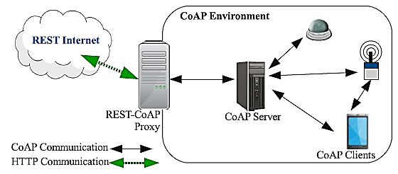
CoAP protocol
CoAP is abbreviation for Constraint Application Protocol
RFC 7252
Lightened version of HTTP protocol
Unlinke HTTP, CoAP protocol runs on UDP

Slide 43
Message format in CoAP protocol
Ver: protocol version
T: message type (ACK, RESET, NON, CON)
OC: Token field’s size
Code: message class (request, response, etc.)
Message ID: self explanatory

Slide 44
Message types in CoAP
Confirmable
Non-Confirmable
Acknowledgement
Reset
Separate response
Piggybacked response

Slide 45
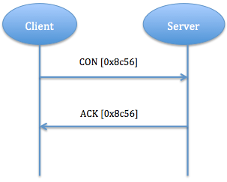
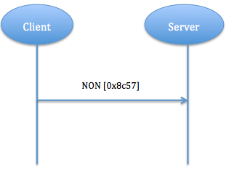
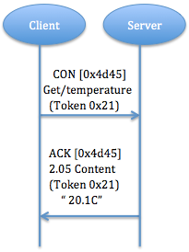
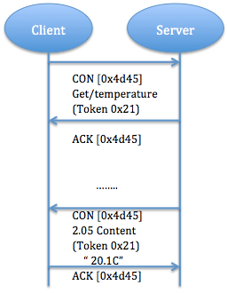
Message types in CoAP

Slide 46
HTTP and CoAP stack comparison

Slide 47
MQTT protocol
Abbreviated from Message Queue Telemetry Transport
Based on Pub/Sub paradigm
Based on Client/Server architecture
This protocol runs on TCP
Best suited for devices with low resources which use unreliable low-bandwidth links
Client subscribes for some topics and gets their updates

Slide 48
Pub/Sub procedure in MQTT protocol

Slide 49
MQTT architecture

Slide 50
AMQP architecture

Slide 51
AMQP architecture
Source: Al-Fuqaha et al., Internet of Things: A Survey on Enabling Technologies, Protocols, and Applications, IEEE Communication Surveys and Tutorials, 2015

