Slide 1
Presentation No. 3

Slide 2
A mechanism is a system of mechanical elements arranged to transmit motion from one form to another form

Slide 3
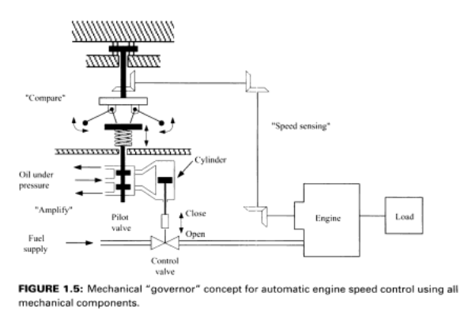

Slide 4
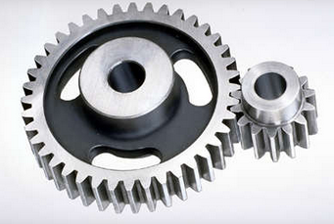
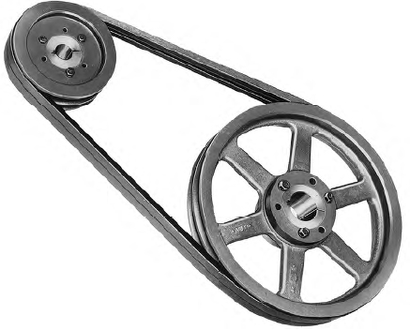
Chapter 3 (Sabri Cetinkunt)
Mechatronics For Motion Transmission
The most common motion transmission mechanism fit into one of three major categories:
Rotary-to-rotary motion transmission mechanisms
  (gears, belts & pulleys)

Slide 5
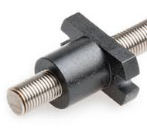
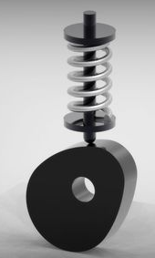
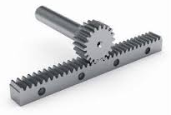
  2. Rotary-to-translational motion transmission mechanisms (Lead screw, rack & pinions, belt 7 Pulleys)

Slide 6
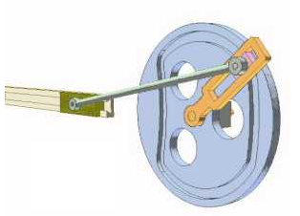
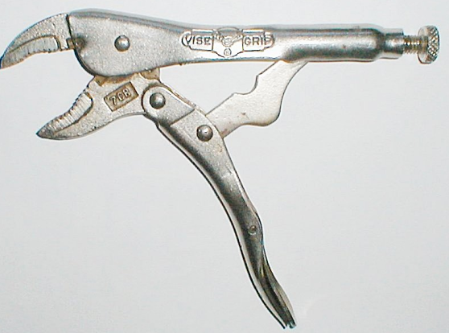
3. Cyclic motion transmission mechanisms (Linkage & arms)

Slide 7
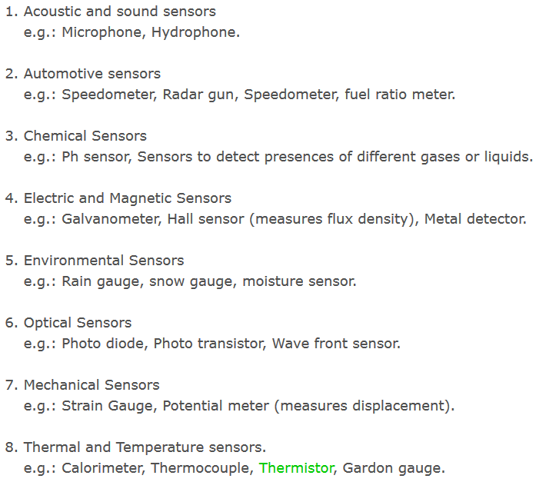
Types of Sensors
Sensors are classified based on the nature of quantity they measure. Following are the types of sensors with few examples.

Slide 8
Sensors
Air flow meter
Air–fuel ratio meter
Blind spot monitor
Engine coolant temperature sensor,
Knock sensor, used to detect detonation in internal combustion engines
MAP sensor, Manifold Absolute Pressure, used in regulating fuel metering.
Mass flow sensor, used to tell the ECU the mass of air entering the engine
Oxygen sensor, used to monitor the amount of oxygen in the exhaust
Parking sensors, used to alert the driver of unseen obstacles during parking maneuvers
Radar gun, used to detect the speed of other objects
Speed sensor, used to detect the speed of an object
Tire-pressure monitoring sensor, used to monitor the air pressure inside the tires
Transmission fluid temperature sensor,
Vehicle speed sensor (VSS), used to measure the speed of the vehicle
Water sensor or water-in-fuel sensor, used to indicate the presence of water in fuel
Wheel speed sensor, used for reading the speed of a vehicle's wheel rotation
Etc.

Slide 9
Sensors
Current sensor
Galvanometer
Magnetometer
MEMS magnetic field sensor
Metal detector
Radio direction finder
Voltage detector
Air flow meter
Anemometer
Flow sensor
Gas meter
Mass flow sensor
Water meter

Slide 10
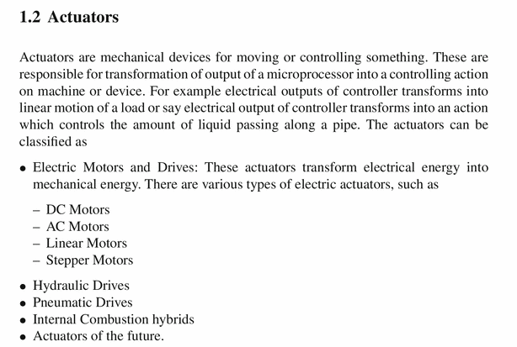

Slide 11
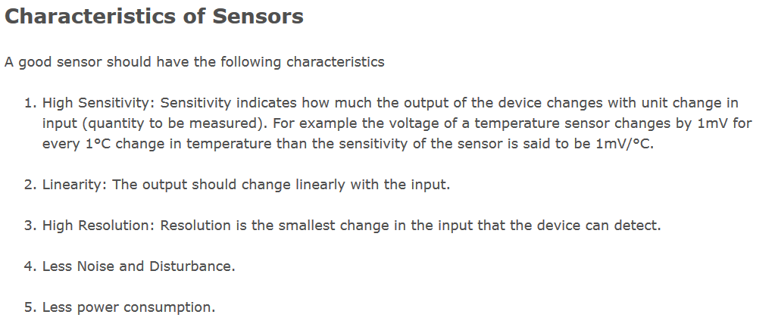

Slide 12
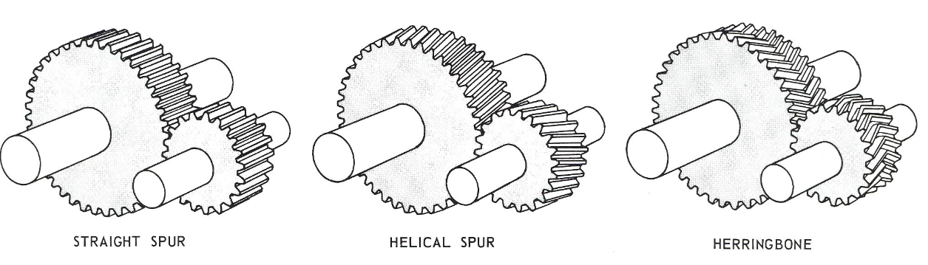
2. Physics & Mathematics
2.1. Mechanical Component
2.1.1. Gears

Slide 13
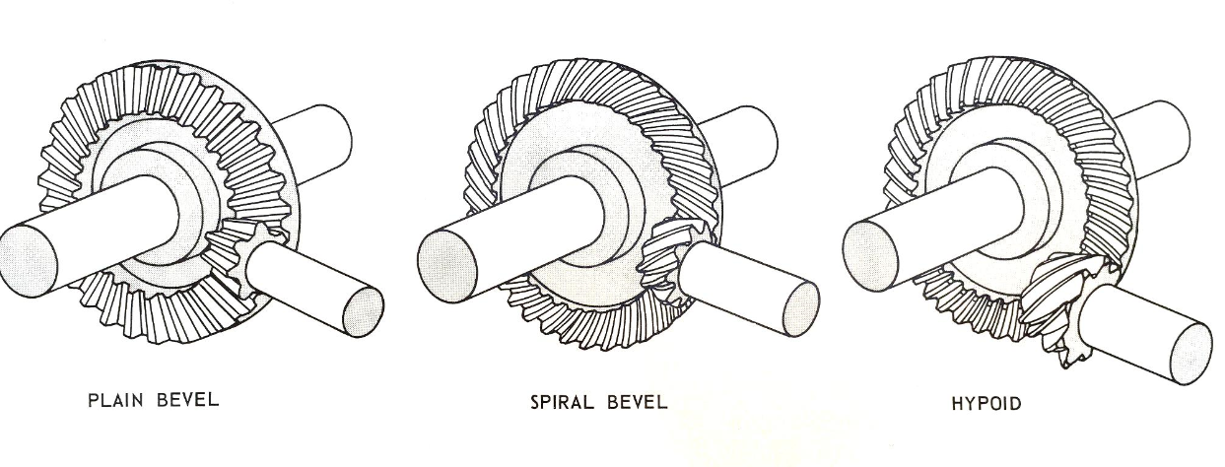
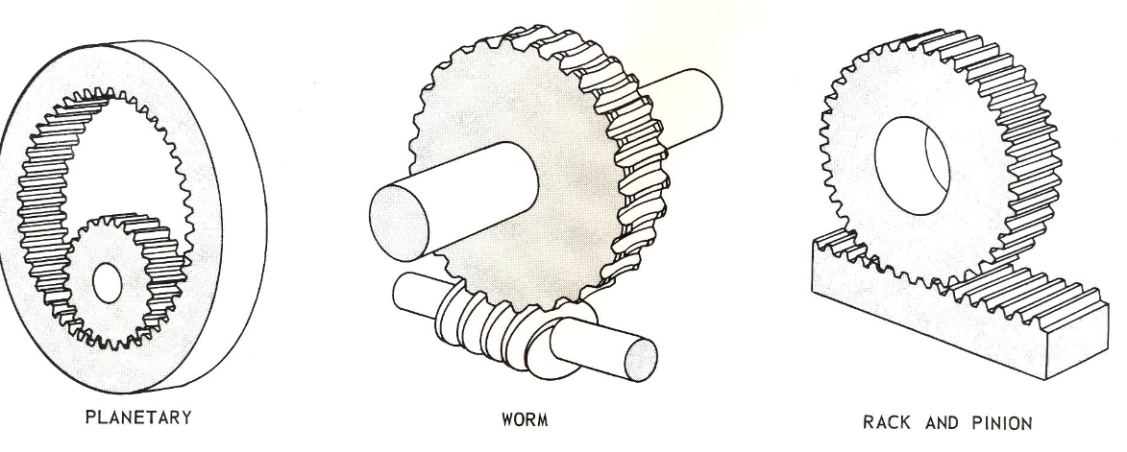

Slide 14
2.1.2. Chain Drive or Chain & Sprockets
High power transmission
No slip
Use in timing systems
No adjustment in cold and hot environment
Need of lubrication
Noisy
V=NPn/(60)
V: chin speed
N: No. of sprocket teeth
N: Speed of sprocket (rev/min)

Slide 15
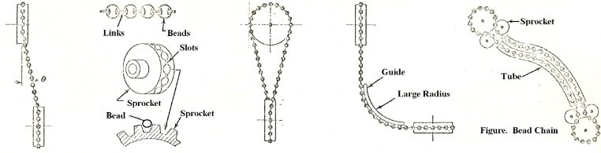
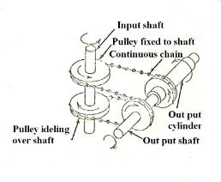
Bead Chain

Slide 16
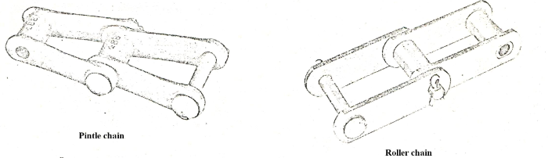
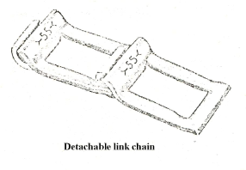
Roller chain
Pintle chain
Detachable chain

Slide 17
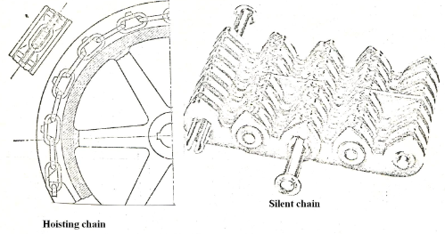
Silent chain
Hosting Chain

Slide 18
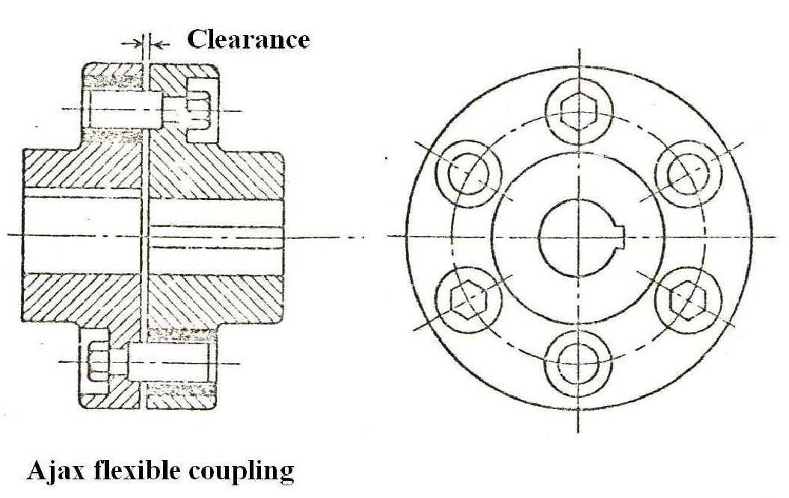
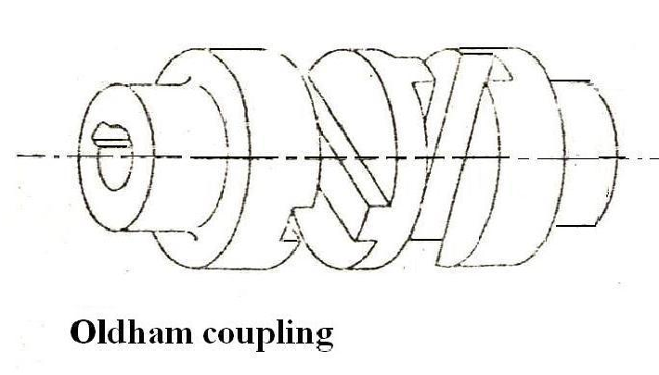
2.1.3. Couplings
Ajax flexible coupling
Oldham coupling

Slide 19
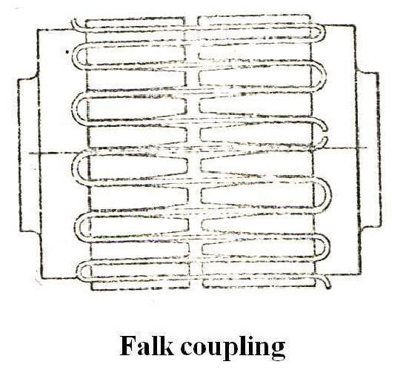
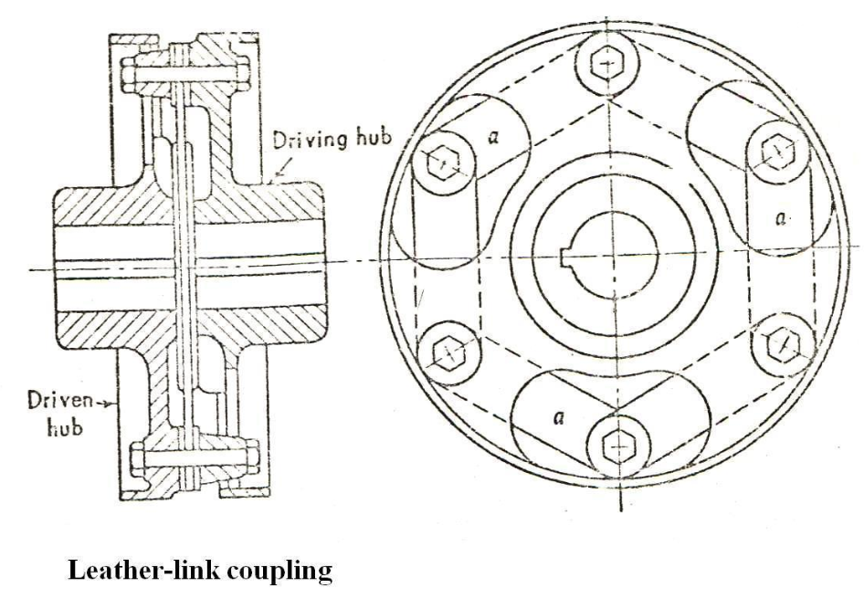
Falk coupling
Leather-link coupling

Slide 20
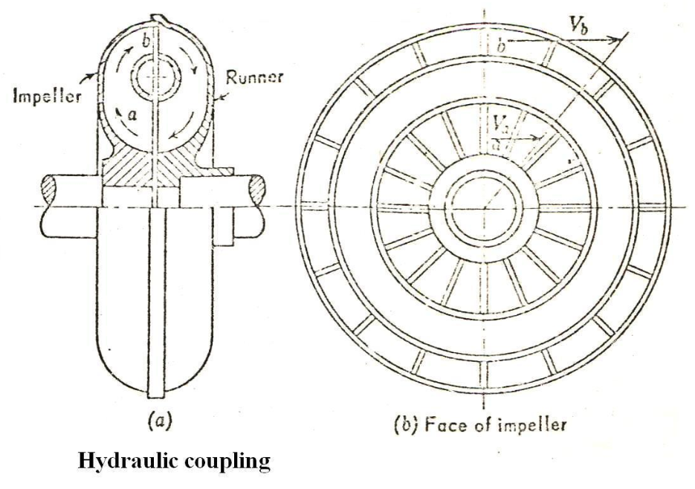
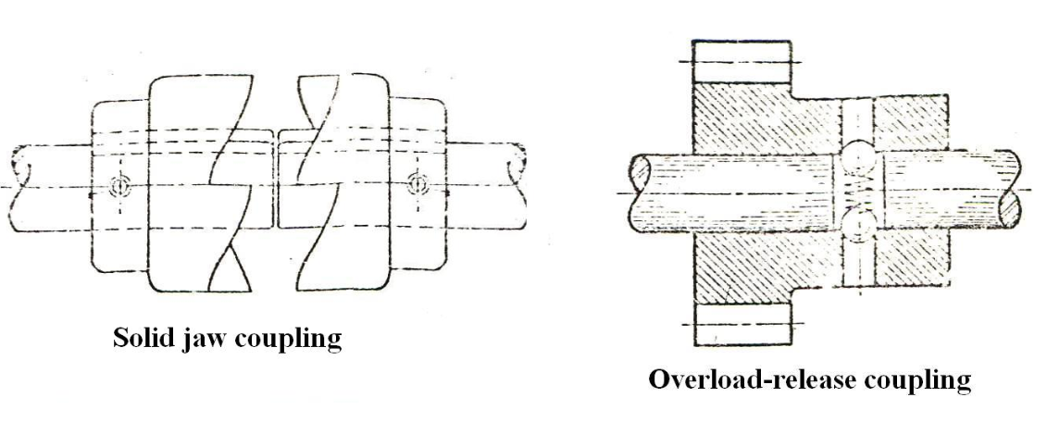
Hydraulic coupling
Solid jaw coupling
Overload-release coupling

Slide 21
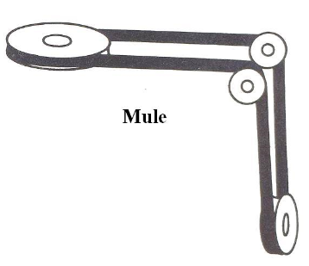
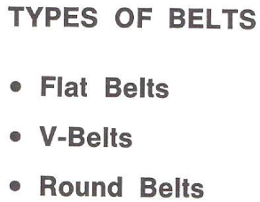
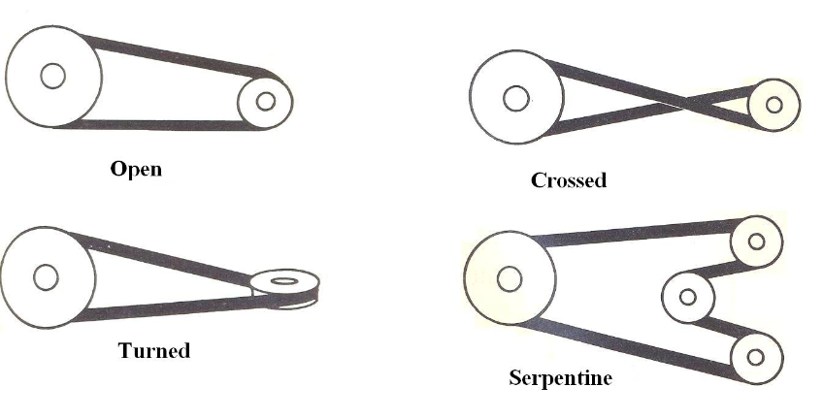
2.1.4. Belt & Pulley

Slide 22
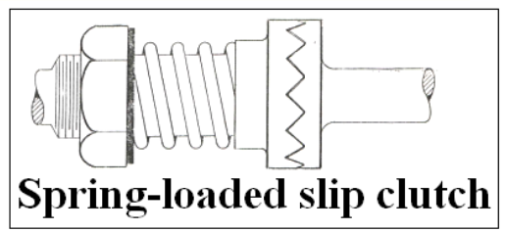
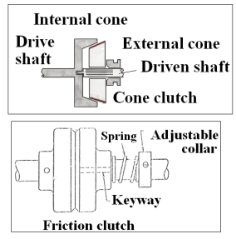
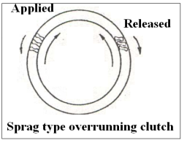
2.1.5. Clutch

Slide 23
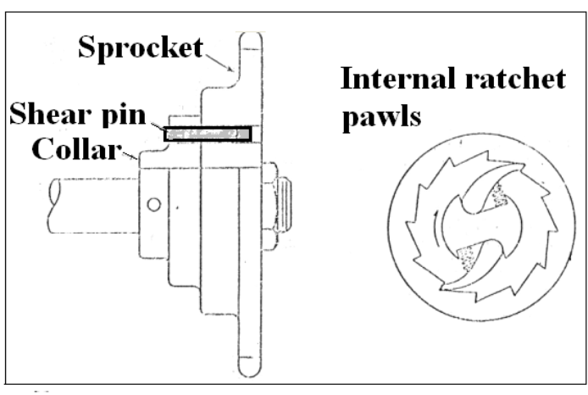
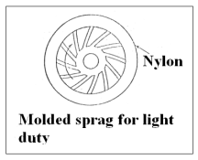
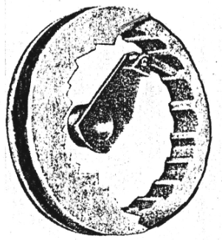
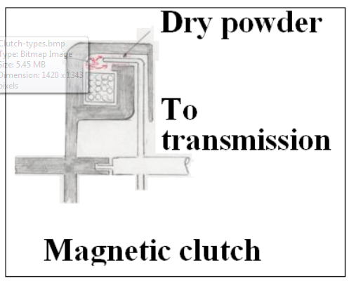
Overrunning clutch

Slide 24
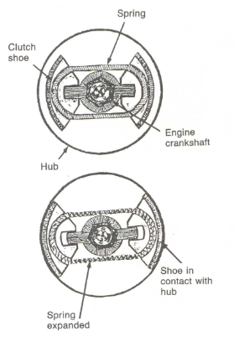
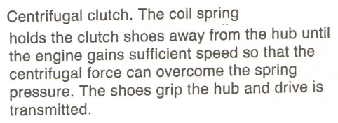

Slide 25
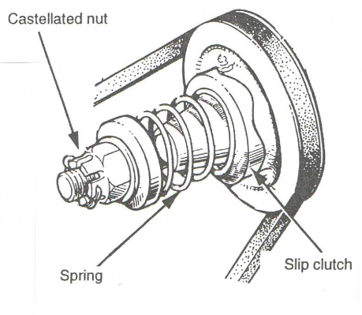
Serrated face slip clutch

Slide 26
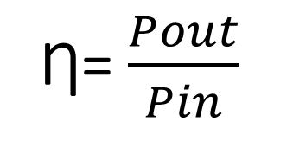
The similarity of all is that having an input shaft and an output shaft
Ƞ=$\frac{Pout}{Pin}$

