Slide 1
Immobilization of whole cells
and enzymes

Slide 2
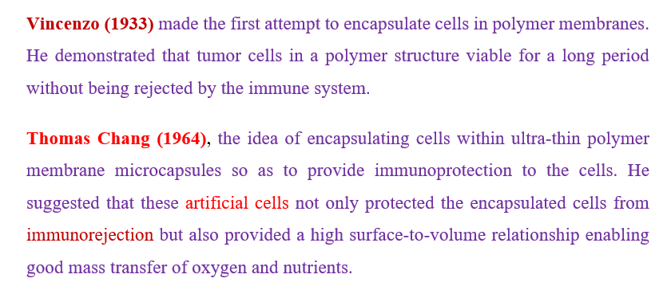
Immobilization
History

Slide 3
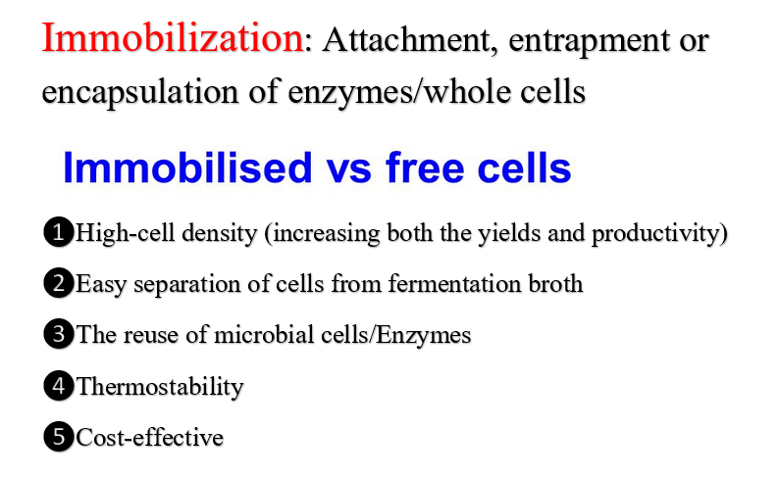

Slide 4
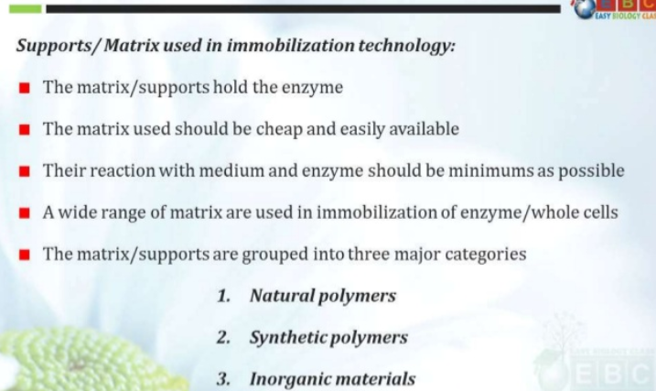

Slide 5
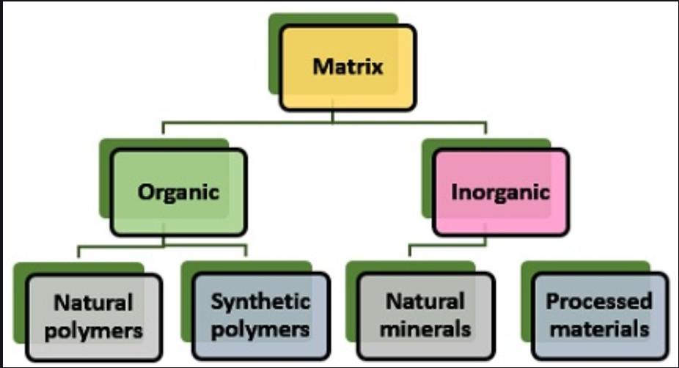

Slide 6
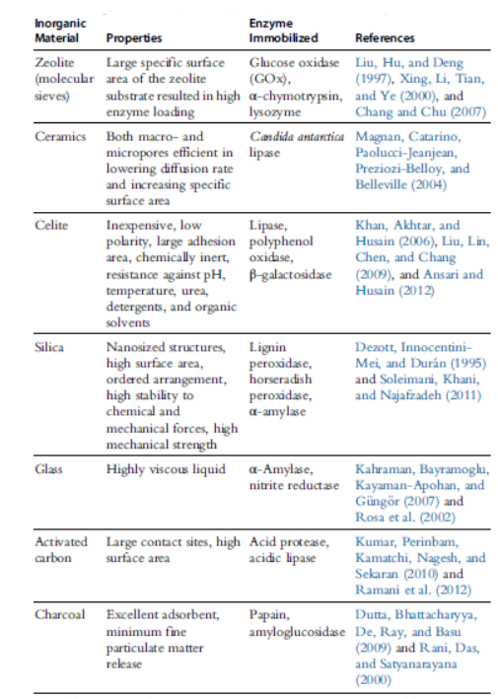

Slide 7
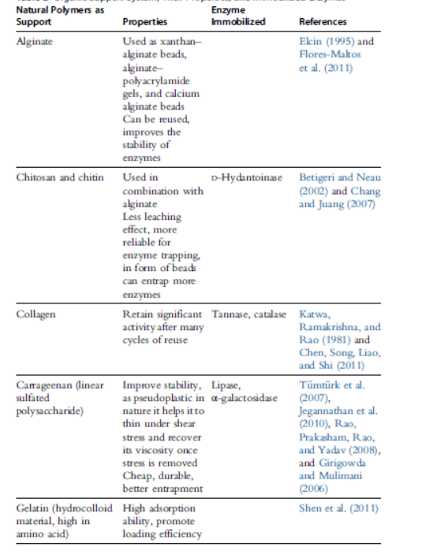
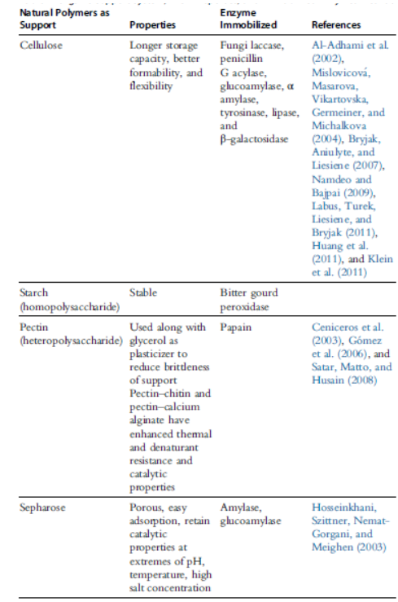

Slide 8
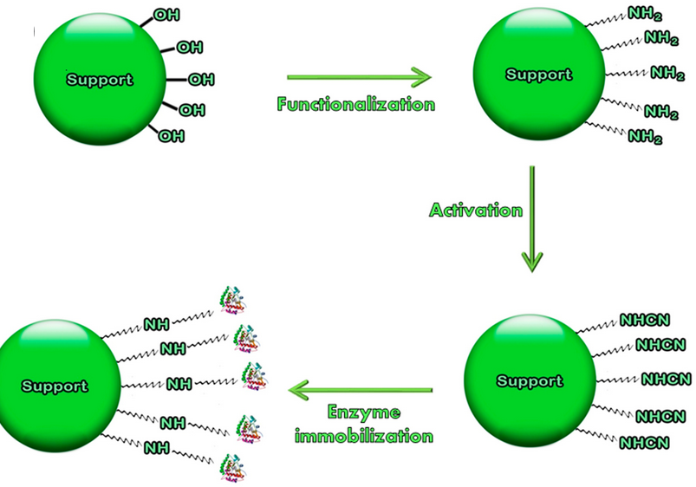

Slide 9
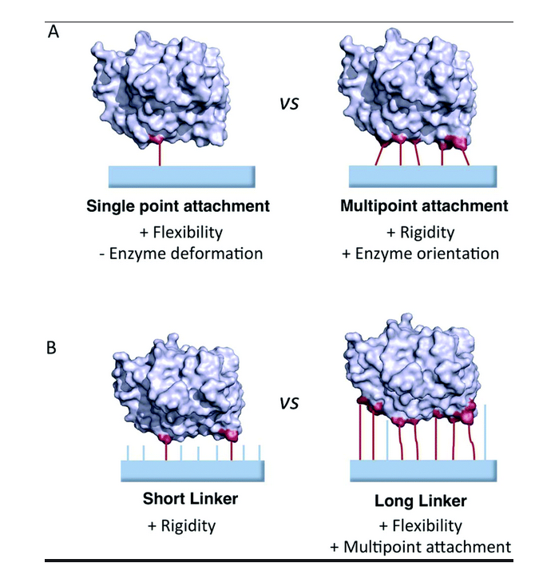

Slide 10
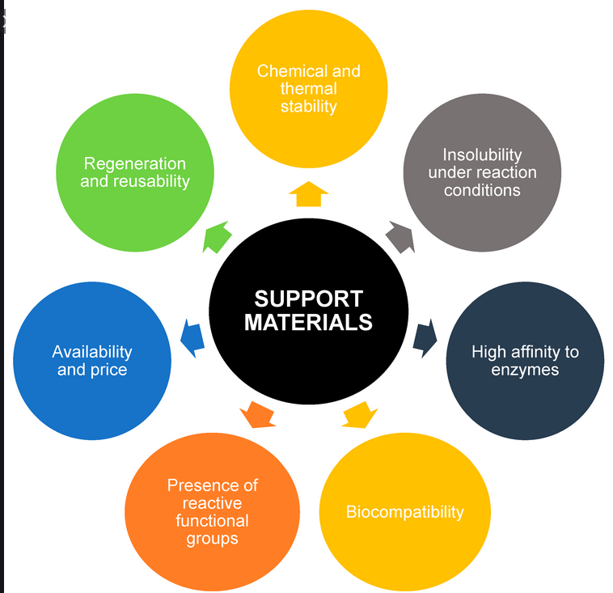

Slide 11
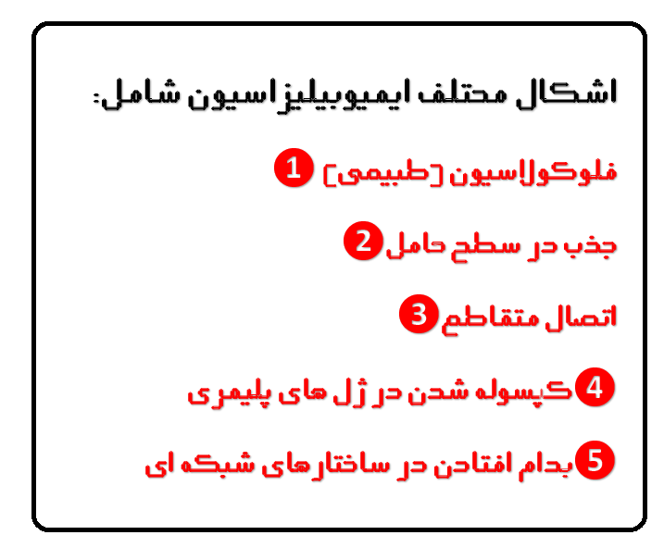

Slide 12
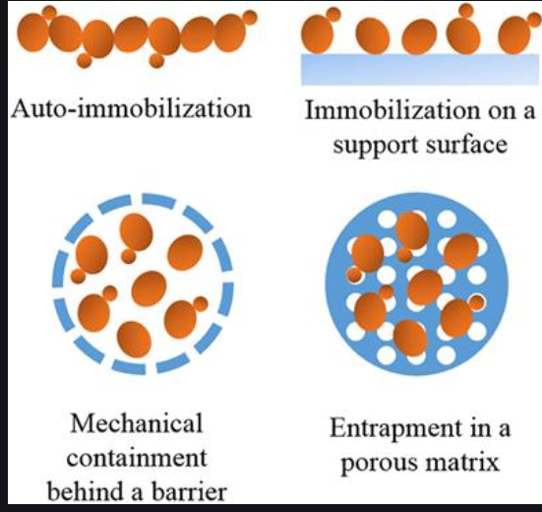
The different methods are:
Carrier-Binding: the binding of enzymes to water-insoluble carriers
Cross-linking: intermolecular cross-linking of enzymes by bi-functional or multi-functional reagents.
Entrapping: incorporating enzymes into the lattices of a semi-permeable gel or enclosing the enzymes in a semi-permeable polymer membrane

Slide 13
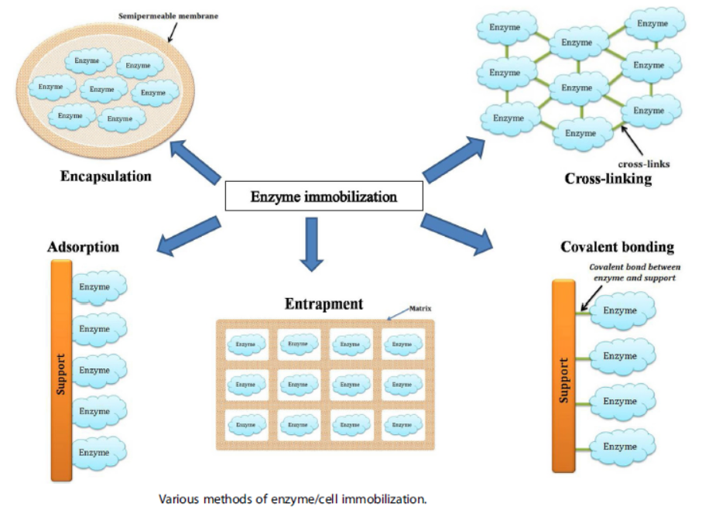

Slide 14
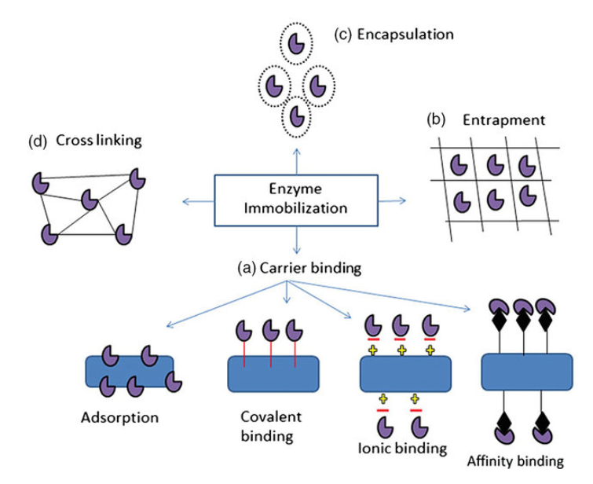

Slide 15
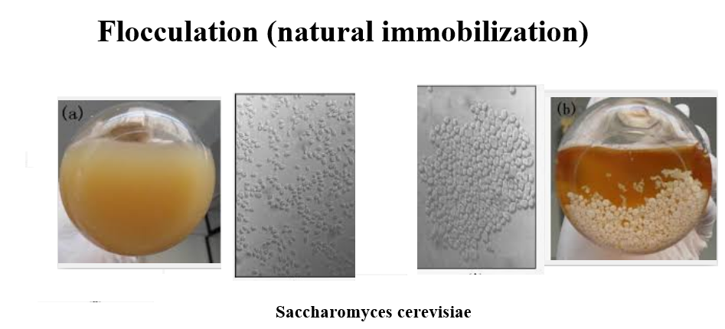

Slide 16
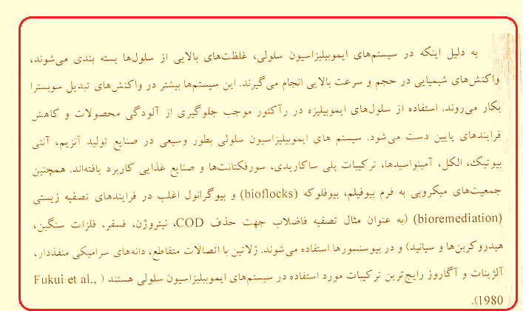

Slide 17
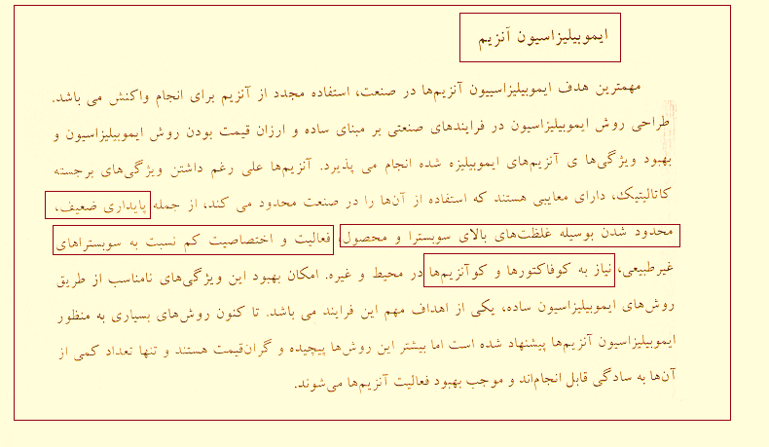

Slide 18
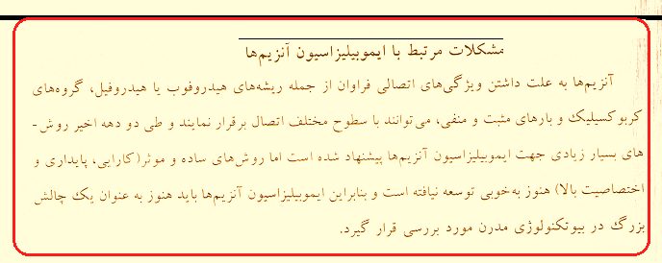

Slide 19
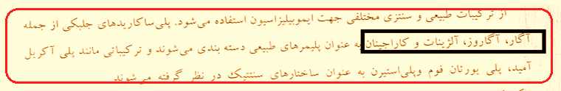
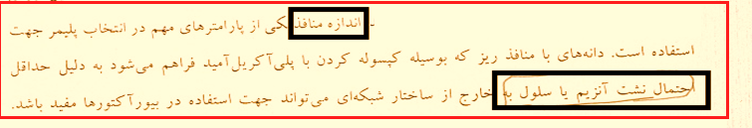


Slide 20
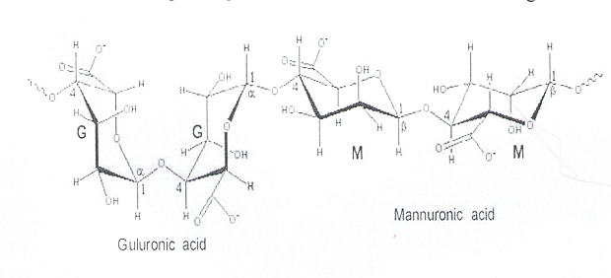
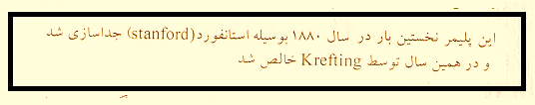
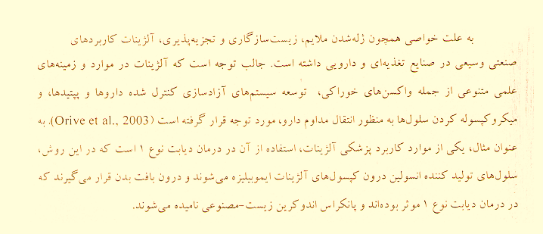



Slide 21
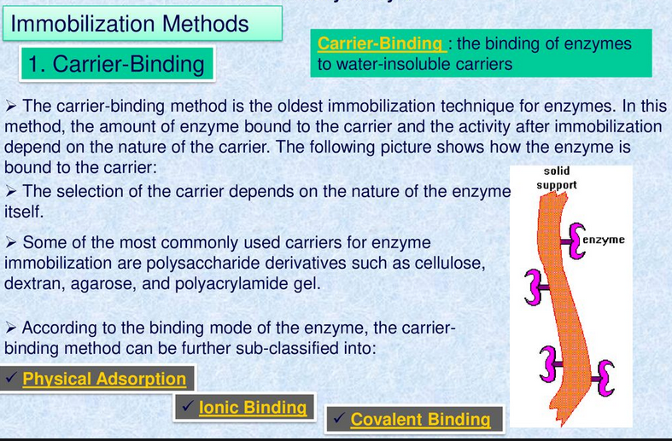
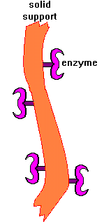
❶ Carrier-Binding

Slide 22
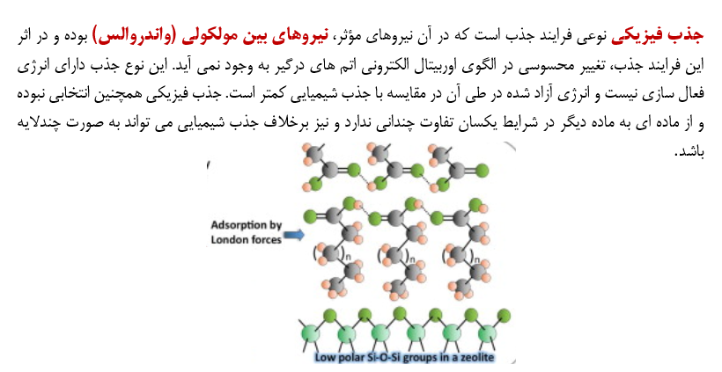

Slide 23
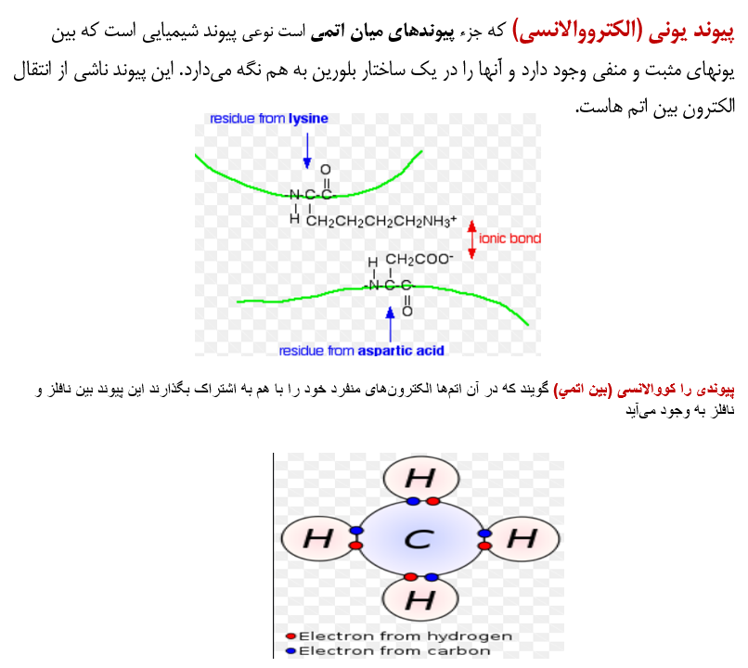

Slide 24
1-1 : Physical Adsorption
Of enzyme protein on the surface of water-insoluble carriers.
Advantages : no reagents and only a minimum of activation steps are required
Disadvantages : the adsorbed enzyme may leak from the carrier during use due to a weak binding force between the enzyme and the carrier. Moreover, the adsorption is non-specific, further adsorption of other proteins or other substances

Slide 25
1-2 : Covalent Binding
Based on the binding of enzymes and water-insoluble carriers by covalent bonds
The functional groups that may take part in this binding are Amino group, Carboxyl group, Sulfhydryl group, Hydroxyl group, Imidazole group, Phenolic group, Thiol group, Threonine group, Indole group
Disadvantages : covalent binding may alter the conformational structure and active center of the enzyme, resulting in major loss of activity and/or changes of the substrate
Advantages : the binding force between enzyme and carrier is so strong that no leakage of the enzymes occurs, even in the presence of substrate or solution of high ionic strength.

Slide 26
1-3 : Ionic Binding
Of the enzyme protein to water-insoluble carriers containing ion-exchange residues
Polysaccharides and synthetic polymers having ion-exchange centers are usually used as carriers
Advantages : the enzyme to carrier linkages is much stronger for ionic binding
Disadvantages : the binding forces between enzyme proteins and carriers are weaker than those in covalent binding

Slide 27
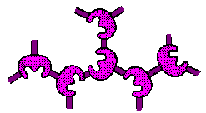
❷ Cross-Linking
Either to other protein molecules or to functional groups on an insoluble support matrix
It is used mostly as a means of stabilizing adsorbed enzymes and also for preventing leakage from polyacrylamide gels
The most common reagent used for cross-linking is glutaraldehyde
Disadvantages : Cross-linking reactions are carried out under relatively severe conditions. These harsh conditions can change the conformation of active center of the enzyme; and so may lead to significant loss of activity.

Slide 28
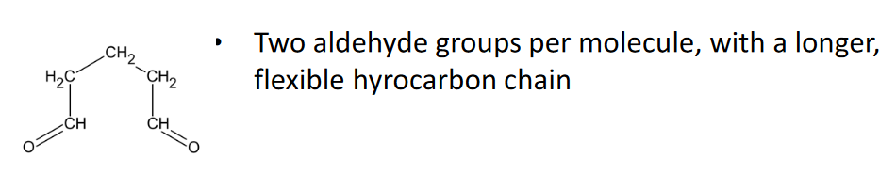
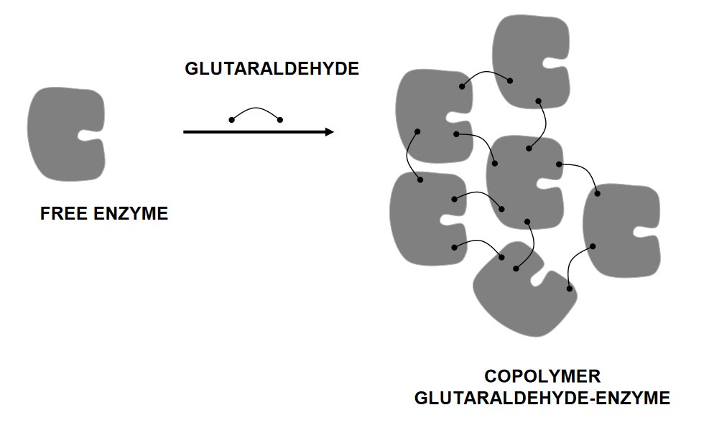

Slide 29
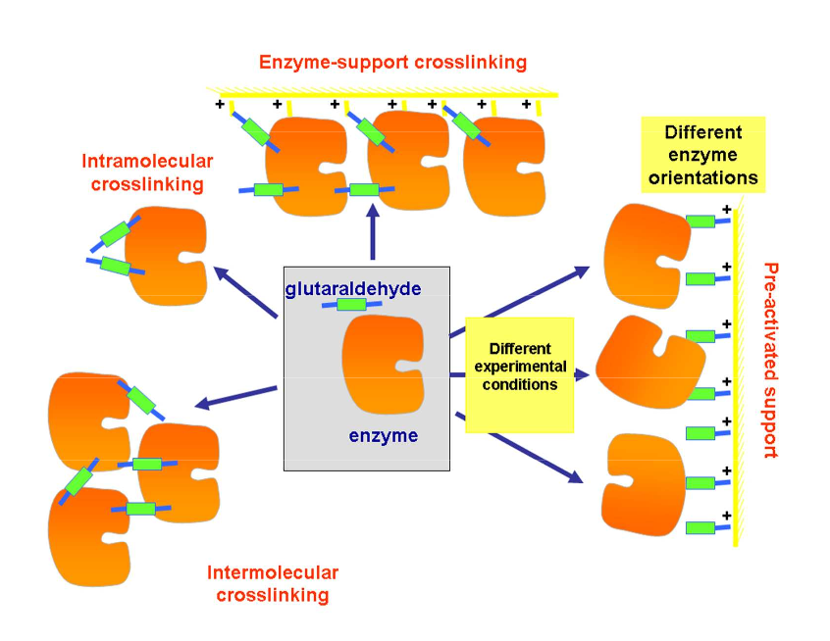

Slide 30
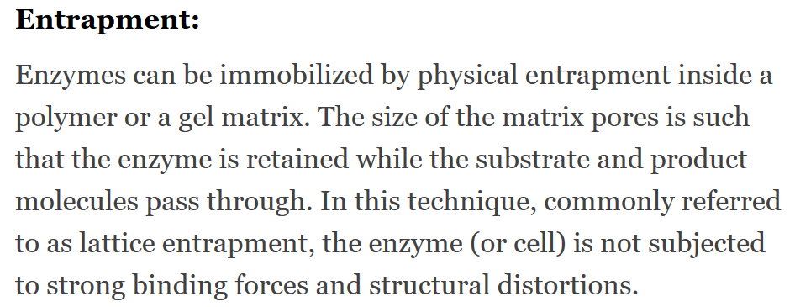
This method differs from the covalent binding and cross linking in that the enzyme itself does not bind to the gel matrix or membrane. This results in a wide applicability

Slide 31
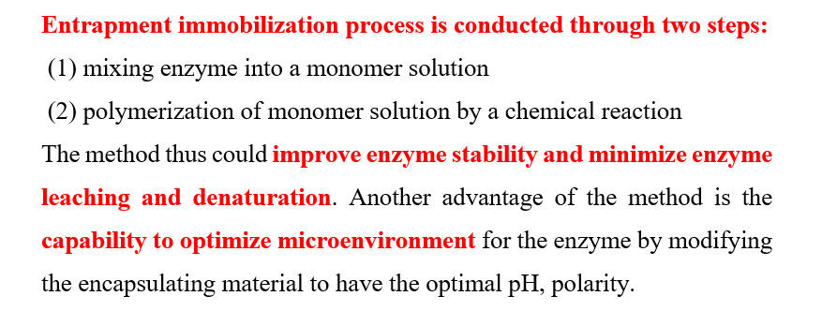
Entrapping Enzymes/cells

Slide 32
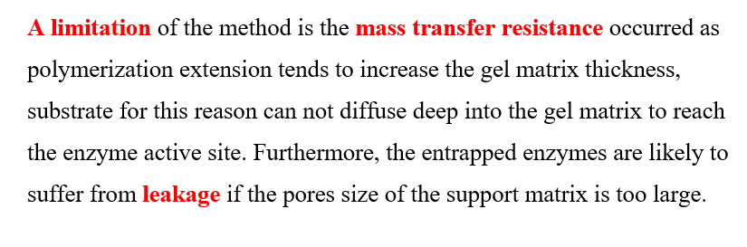
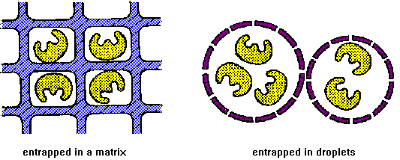

Slide 33
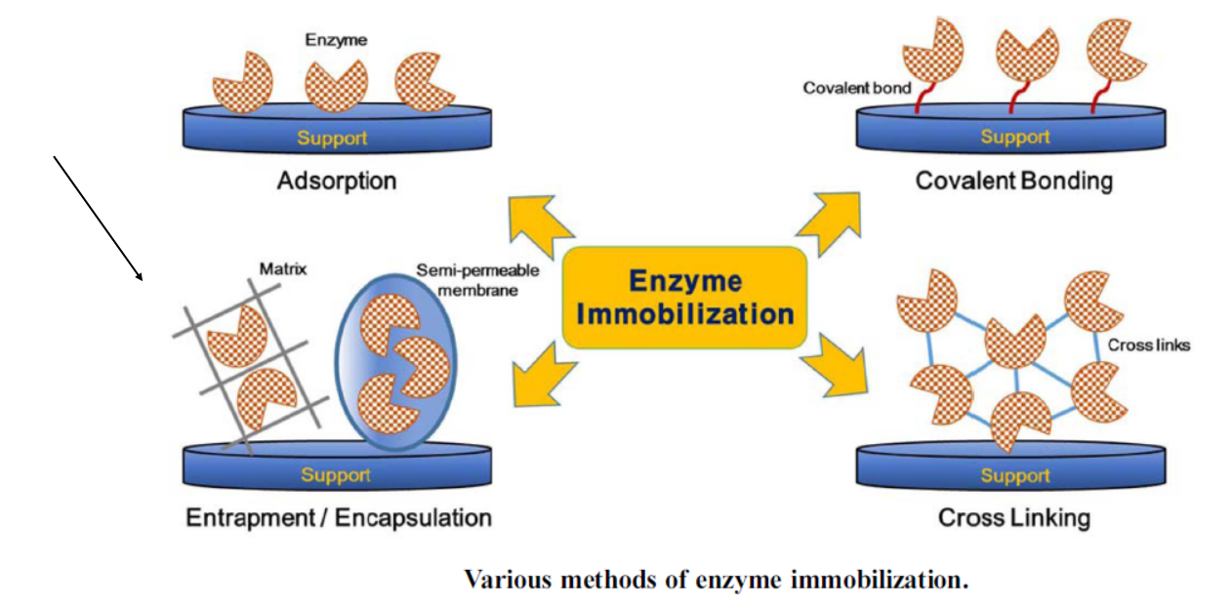

Slide 34
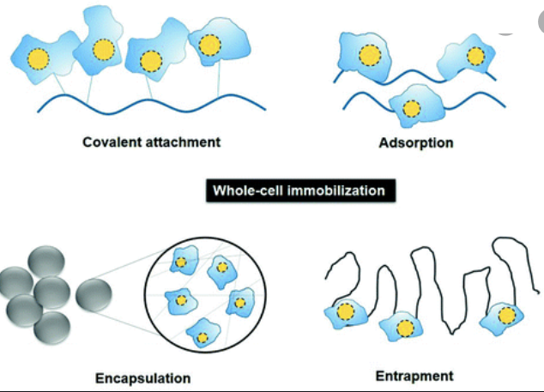

Slide 35
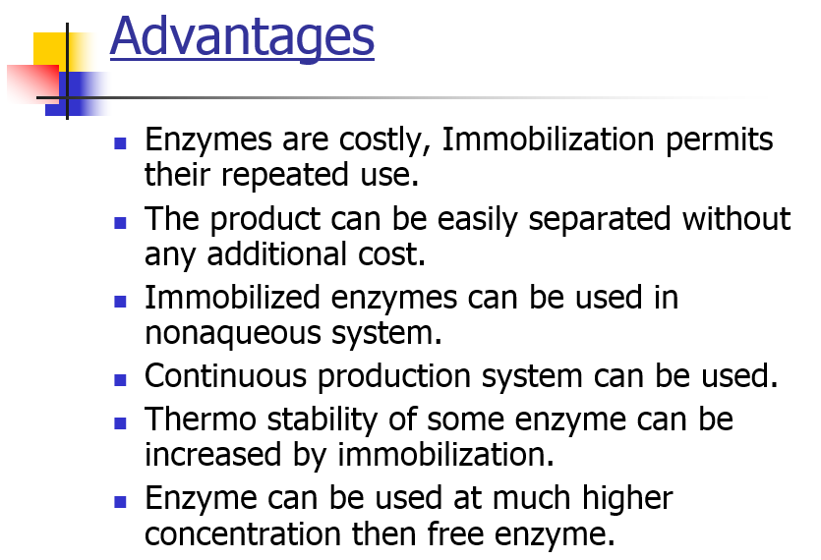

Slide 36
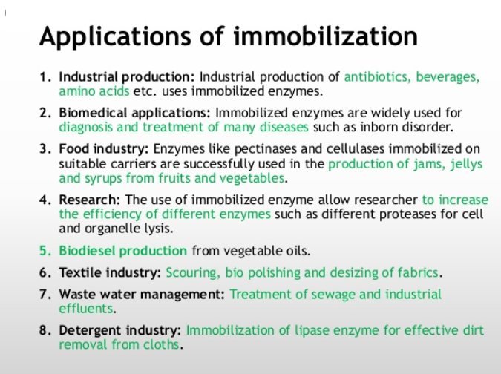
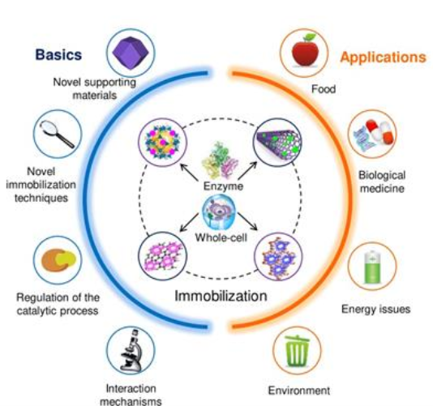

Slide 37
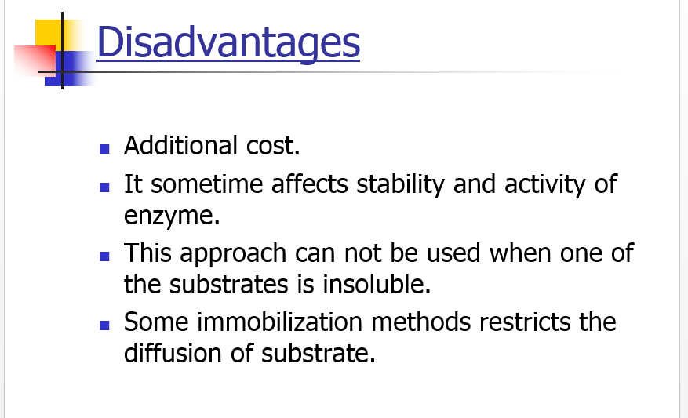

Slide 38
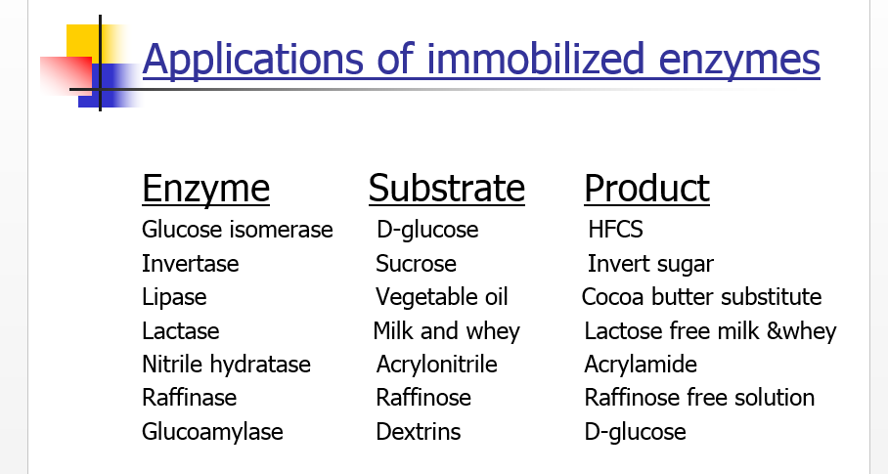

Slide 39
