Slide 1
Presentation No. 1

Slide 2
To learn Mechatronics it is necessary:
Understanding Documentation
Physics & Mathematics
Programming & Trouble Correction
Critical Thinking Skills

Slide 3
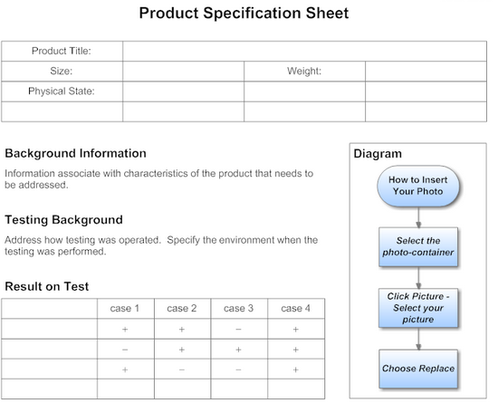
Understanding Documentation
1-1. specification Sheet (Spec. Sheet)
prepared by factory to customer or another factory

Slide 4
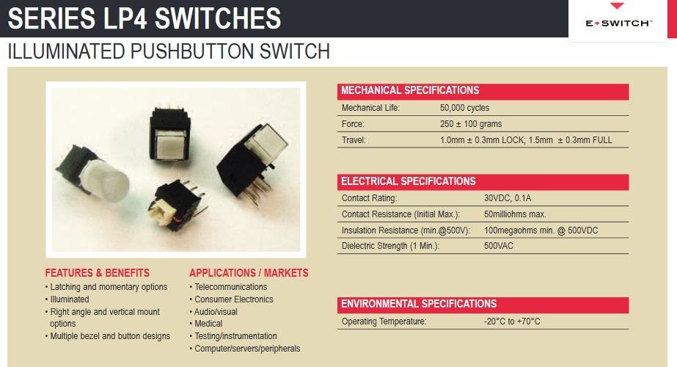

Slide 5
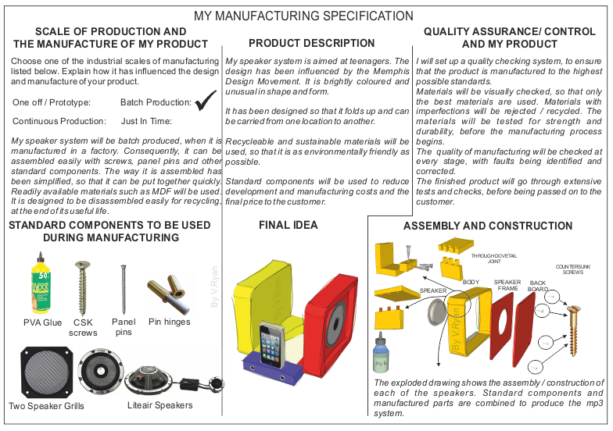

Slide 6
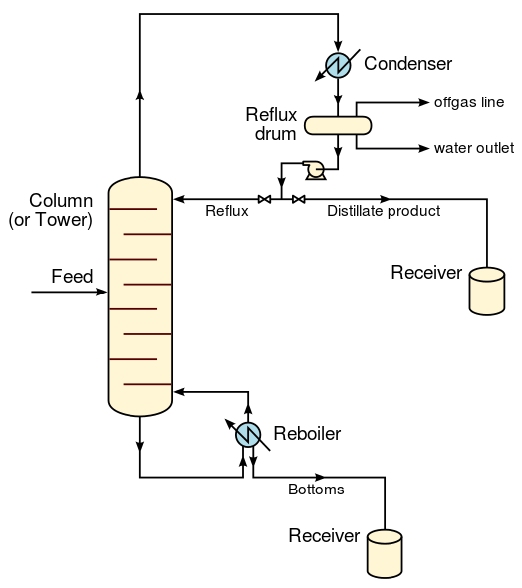
1-2. Schematics
Chemical engineering schematic

Slide 7
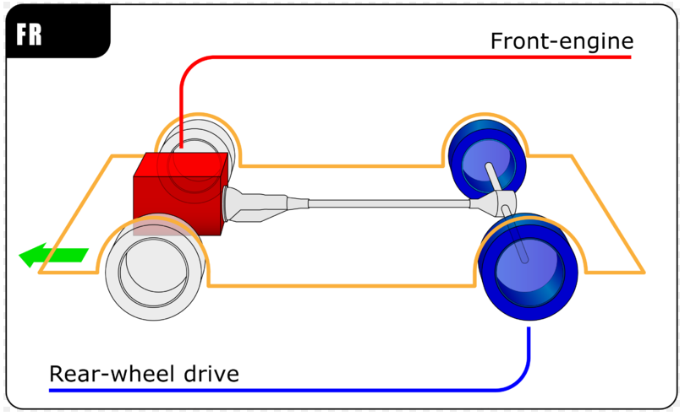
Schematic of a drive train

Slide 8
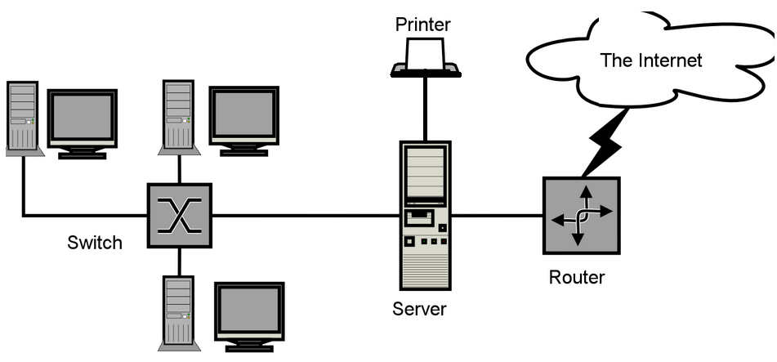

Slide 9
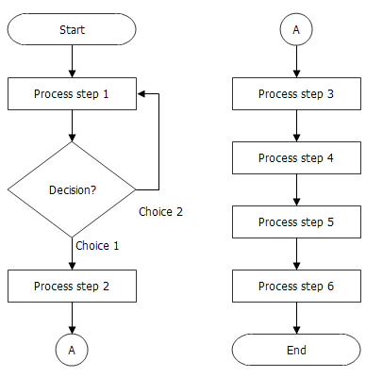
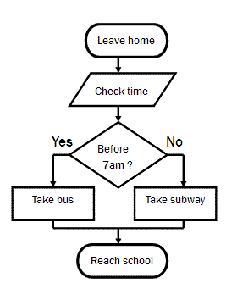
1-3. Flowcharts
Process Flowchart
Flowchart

Slide 10
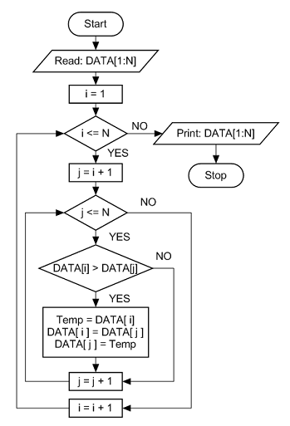
Programming Flowchart

Slide 11
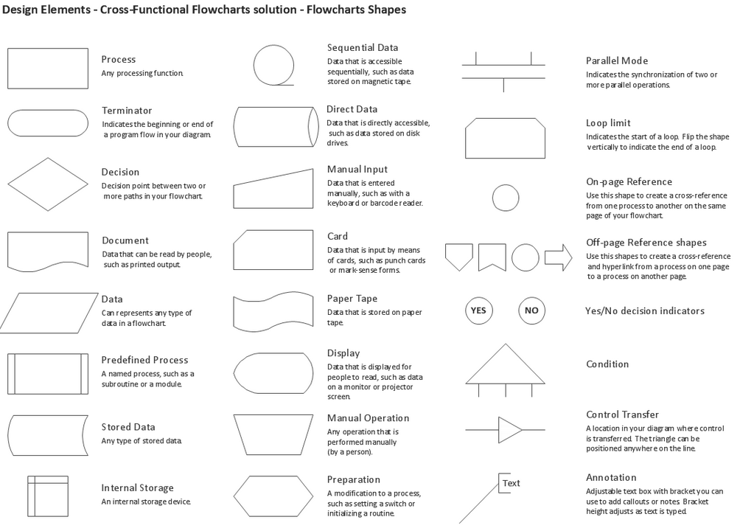

Slide 12
HW1: Draw the flowchart of your time table in a week
HW2: Draw the flowchart of “summation of numbers which can be divided by 3
from 0 to 10000

Slide 13
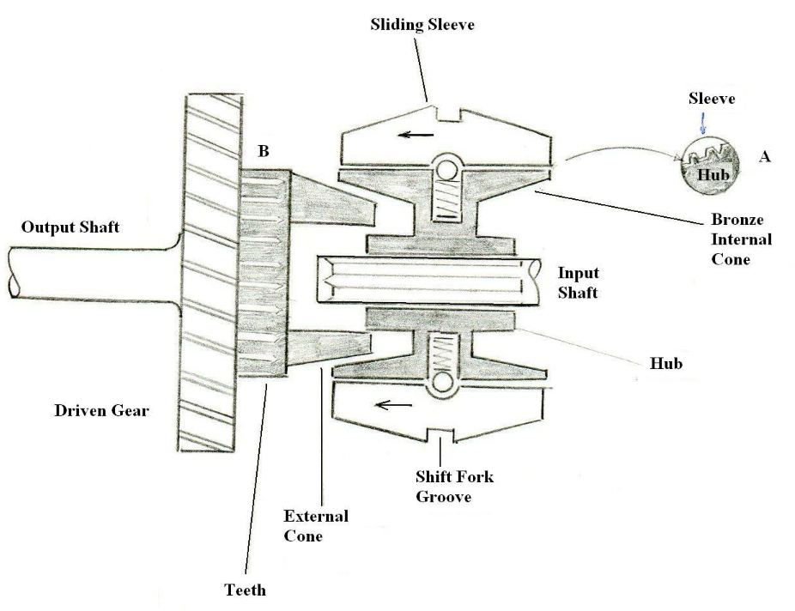
1-4. Drawing

Slide 14
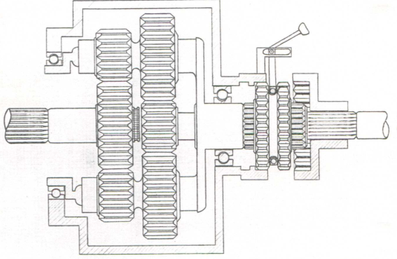

Slide 15
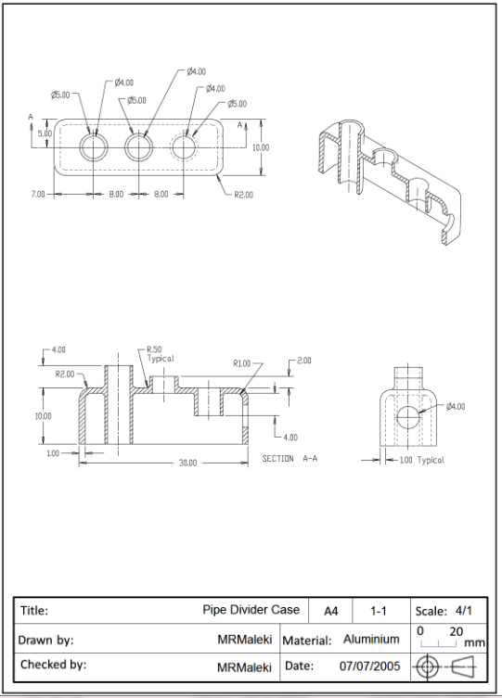

Slide 16
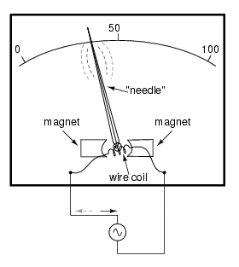
1-5. System Representation
Torque
Analog
Scale
K1
K2
K3
I
T
Ɵ
x
Input
I x K1= T k1= T/I N.M/A
T x K2= Ɵ K2= Ɵ/T Rad/N.m
Ɵ x k3= x k3= x/Ɵ m/Rad
I (K1K2K3)= x dx/dI = k1 k2 K3

Slide 17
Example:
A piezoelectric pressure transducer sensitivity is 0.9 pico coulomb/bar and charge sensitivity is 0.005 Volt/ pico coulomb/bar if ultr violet recporder sensitivity is 20 mm/volt
It is desire to draw block diagram and overall sensitivity.
For 35 bar calculate δx
δp
δc
δv
δx
9.0
p.c./bar
0.005
v/p.c.
20
mm/volt
Bar
p.c
mm
volts
δx/δp =?
δx =δp (9.0 p.c./bar)(0.005 v/p.c.) (20 mm/v)
Δx/δp = 0.9 mm/bar
δx =0.9 δp =0.9 (35)=31.5 mm

