Slide 1


Internet of Things (IoT)
Professor: Dr. Sadoon Azizi s.azizi@uok.ac.ir
Faculty of Engineering
Department of Computer and IT Engineering

Slide 2
Chapter Objectives
* In this chapter students must learn:
The Concept of Internet of Things
Internet of Things’ definition
Internet of Things’ architecture
Some practical usecases
IoT’s use in Universities, Research centers, Industry and Business.

Slide 3
The Concept of Internet of Things
There are two fundamental pieces that make up the concept:
Things: Including a set of end devices with abilities like Sensing the environment (using the sensors), Computing intelligence (microcontrollers and electronic boards) and Network connectivity (mostly wireless technologies).
  Note: a thing (object) might perform an action on the environment (using the actuators) instead of sensing it.
Internet: The traditional internet infrastructure.

Slide 4
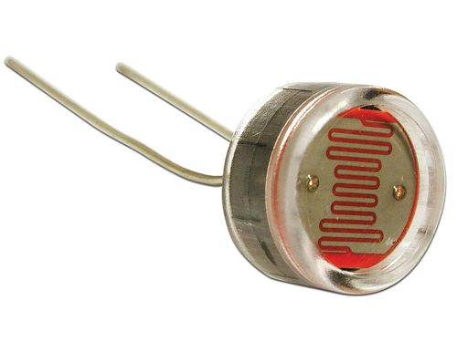
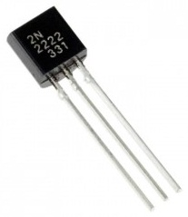
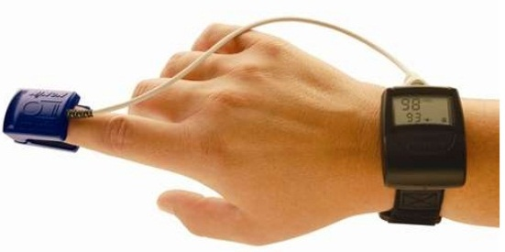
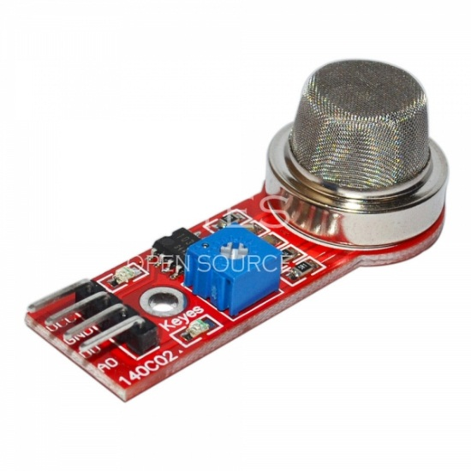
The Concept of IoT: Sensing the environment
Light sensor
Temperature sensor
Blood pressure sensor
Air pollution sensor

Slide 5
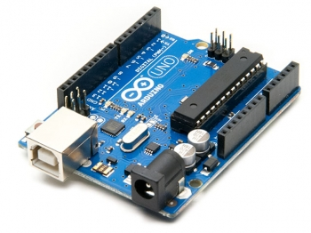
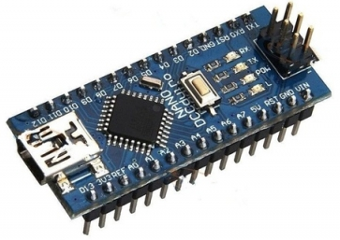
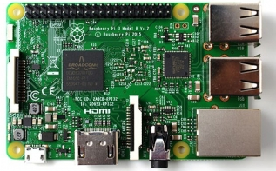
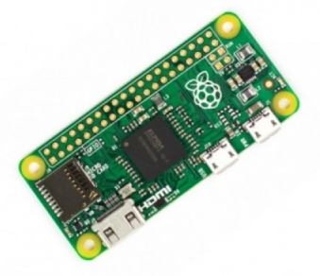
The Concept of IoT: Computing intelligence
Arduino UNO
Arduino NANO
Raspberry Pi 3 Model B
Raspberry Pi Zero

Slide 6
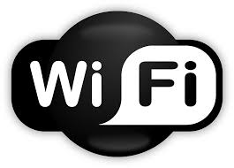
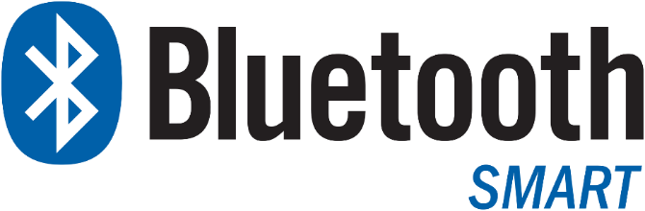

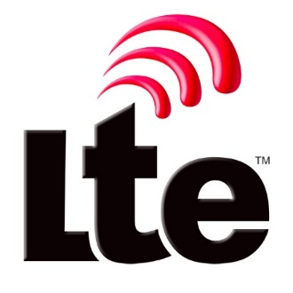
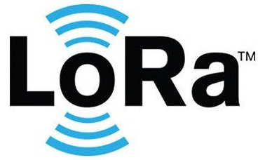
The Concept of IoT: Network Connectivity

Slide 7
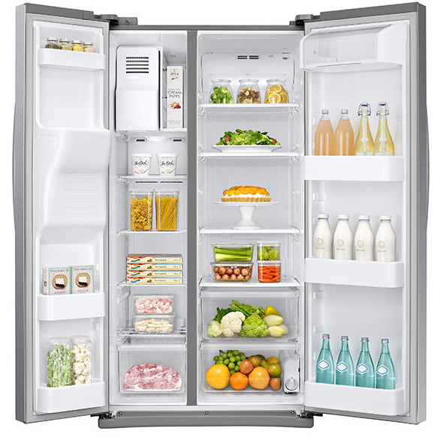


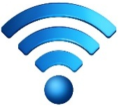

Intelligent Refrigrator

Slide 8
The ultimate goal of IoT
The ultimate purpose of IoT is that all things around us will be able to sense the environment and through the connectivity among themselves and with us provide a better environment.
Examples:
  Remote plants irrigation
  Automatic light adjustment
  Intelligent parking
  Taking care of the elderly
  Water management for agricultural use
  ...

Slide 9
What is Internet of Things?
There are various definitions for Internet of Things:
Wikipedia
International Telecommunication Union - ITU
Course’s reference book

Slide 10
What is IoT? (Wikipeida)
The Internet of things (IoT) is the network of physical devices, vehicles, home appliances and other items embedded with electronics, software, sensors, actuators, and network connectivity which enables these objects to connect and exchange data.
Each thing is uniquely identifiable through its embedded computing system but is able to inter-operate within the existing Internet infrastructure.

Slide 11
What is IoT? (ITU)
ITU-T Y.2060 (06/2012)
A global infrastructure for the information society, enabling advanced services by interconnecting (physical and virtual) things based on existing and evolving interoperable information and communication technologies.
NOTE – Through the exploitation of identification, data capture, processing and communication capabilities, the IoT makes full use of things to offer services to all kinds of applications, whilst ensuring that security and privacy requirements are fulfilled.

Slide 12
What is IoT? (reference book)
Internet of Things can be considered a network of physical resources that are powered by:
  Sensors: to collect information
  IDs: to authorize the data source
  Software: to analyze the data
  Internet connectivity: for collaboration and notification
Gathering all these:
IoT is the network of things, with clear element identification, embedded with software intelligence, sensors, and ubiquitous connectivity to the Internet.

Slide 13
What is IoT? (reference book)
* Things can be anything: Sensors, devices, machines, people, animals, trees, etc.

Slide 14
A better definition (reference book)
* Data transmission according to the standards that guarantee the collaboration and enable useful procedures (mostly automatic).

Slide 15
A better definition (reference book)
A more generalized definition of IoT:
IoT is the network of things, with device identification, embedded with software intelligence, and sensing and acting capabilities, connecting people and things over the Internet.
Internet of Things
Internet of People
Internet of Everything (IoE)

Slide 16
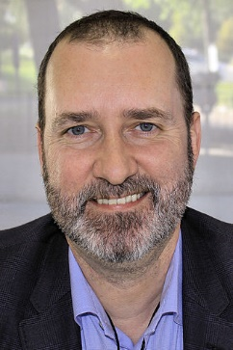
Introduction history of IoT:
The Concept of IoT was first used by Kevin Ashton in 1999. He described a universe in which, everything (including inanimate objects) has a digital identity so that they can be managed by computers.
“Internet of Things has the potential to change the world, just as the internet did. Maybe even more so.” Said Kevin Ashton
MIT Auto-ID Center presented their viewpoint about the IoT in 2001.
Finally, Internet of Things was officially introduced by ITU in 2005.

Slide 17
Fundamental requirements for an IoT-based solution.

Slide 18
Why do we want to manage and supervise things?
Object management for specialists (blood pressure and heartbeat control)
Searching for Things (Where is my key?)
Optimal object management in a smart city (traffic lights)
Privacy and Security (Home management)
...

Slide 19
How is security guaranteed in IoT?
Data access when transferring (network security)
Controlling the IoT devices (such as APIs)
Accessing the IoT data (stored in databases (usually in cloud))
Accessing the user/network credentials (such as username and password)
* IoT security is discussed in detail in chapter 8.

Slide 20
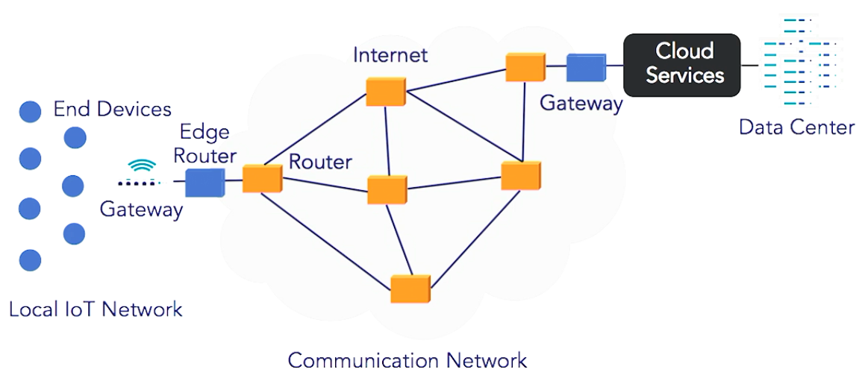
IoT’s architecture (Lynda Corporation)

Slide 21
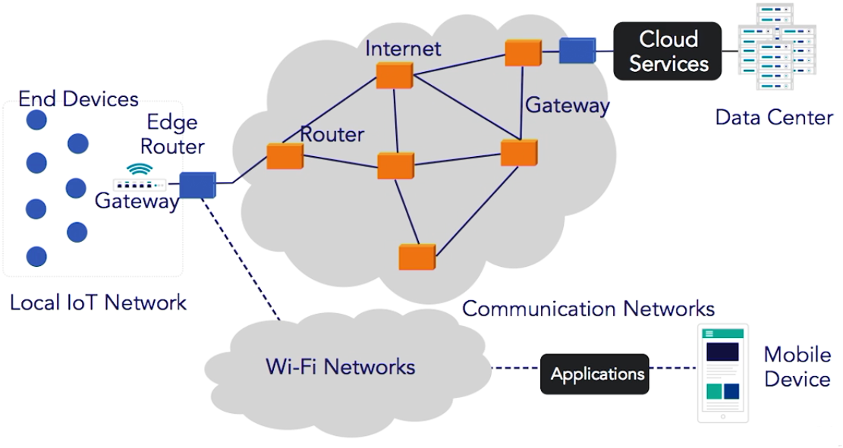
IoT’s architecture (Lynda Corporation)

Slide 22
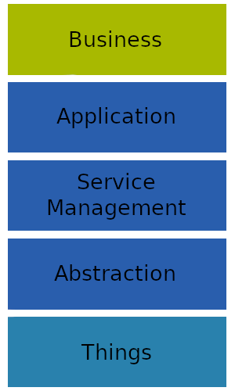
IoT’s 5 layer architecture
)Internet of Things: A Survey on Enabling Technologies, Protocols, and Applications(
Things Layer
  Including Sensors and Actuators
  Gathering data and preprocessing (such as converting analog signal to digital)
Abstraction Layer
  Transferring the generated data produced in the things layer to the service management layer using safe channels
Service Management Layer
  Enables developers to work with heterogeneous things regardless of their hardware platform
Application Layer
  Providing service to the user (client) requests
Business Layer
  Overall services and activities of IoT is managed by this layer; hence it’s called the management layer

Slide 23
IoT architecture – Key elements
End devices
Gateway
Edge router
Communication network
Cloud service
Application
A cloud service may include:
  Data storage
  Data analysis ( Big data)
  Graphical representation of results
  IoT device management

Slide 24
IoT architecture (reference book)

Slide 25
IoT architecture (4 main levels)
IoT devices
  Including sensors, actuators, RFIDs (chapter 3)
IoT network
  Including all networking components like gateways, routers, switches (chapter 4)
Platform services of applications in IoT
  Overall device and network management is done in this level. In fact this level provides the connectivity infrastructure between devices and network with the applications (chapter 7)
IoT applications
  Practical applications are designed and implemented in this level.

Slide 26
Trends in the Adoption of IoT
(The University of California, Irvine - UCI)
Hardware cost reduction (ENIAC 1945: $500,000 vs Today’s laptops: $500)
Hardware size reduction (ENIAC 1945: 1,800 square feet vs Today’s laptops: 0.05 square feet)
Computational power (ENIAC 1945: 5,000 ips vs Today’s laptops: 18 billion ips)
Internet accessibility (Universal, Wireless technology, Inexpensive, High bandwidth)
Existence of cloud computing (and lately fog computing)
Dominance of the IoT devices (such as sensors and RFIDs)

Slide 27
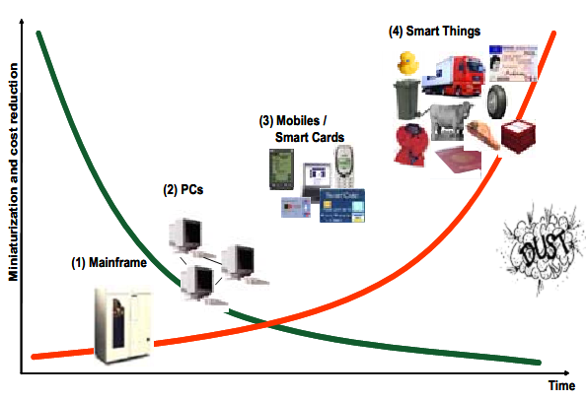

Miniaturization and cost reduction

Slide 28
Effective factors in IoT’s expansion (reference book)
Convergence of IT and Operational Technology (OT)
  OT: Automatic equipment including controllers, sensors and actuators
  IT: End to end informational systems concentrated on computing, storage and networking
Creative businesses based on internet
  Uber، Airbnb، Square، Amazon، Tesla، Self-driving Cars
Expansion of mobile devices
Analysis in edge (fog computing)
Virtualization and cloud computing
Expansion of technology (IoT hardware – affordable sensors, small and inexpensive microcontrollers and computers)
Digitization convergence
Improved User Interfaces (such as HTML5)
...

Slide 29
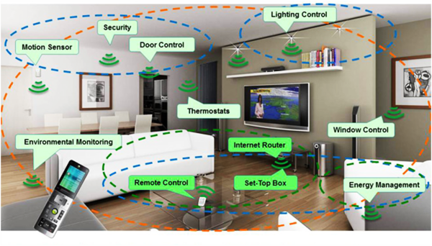
IoT applications: smart home

Slide 30
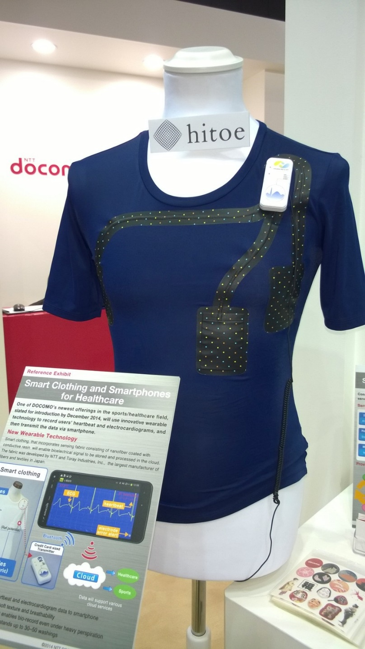
IoT applications: health and medical uses
Toray corporation produced smart outfits (Hitoe) that can measure biological symptoms using conductor Nanofiber. It can monitor heartbeat, breath interval, muscle activity using Electrocardiography (ECG) and Electromyogram (EMG).

Slide 31
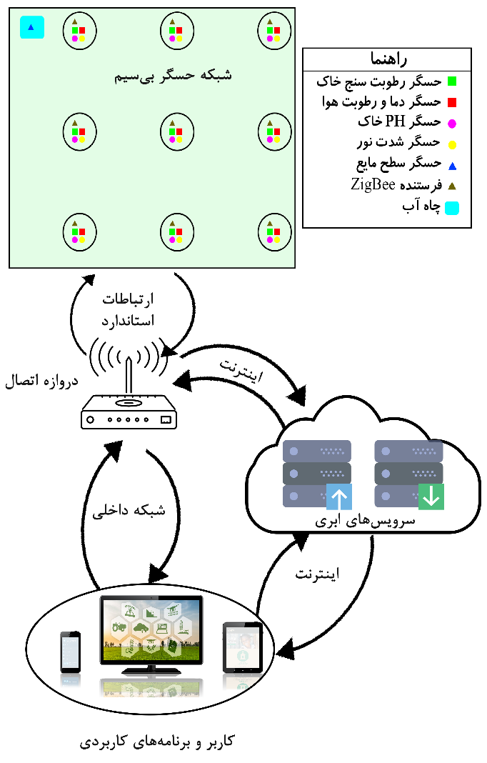
IoT applications: smart agriculture

