Slide 1
Cryopreservation

Slide 2
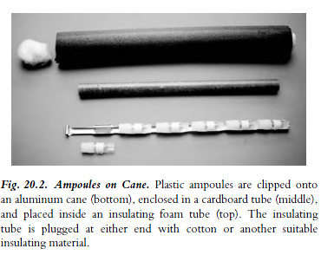

Slide 3
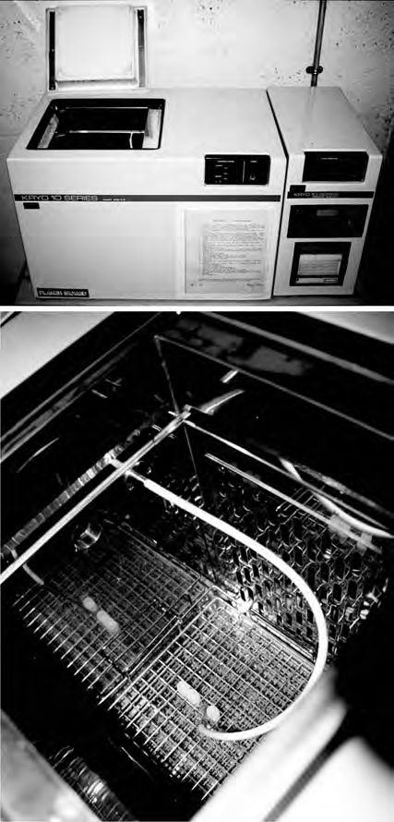
Programmable Freezer.
Ampoules are placed in an insulated chamber, and the cooling rate is regulated by injecting liquid nitrogen into the chamber at a rate determined by a sensor on the rack with the ampoules and a preset program in the console unit (Planer Biomed).
(a) Control unit and freezing chamber (lid open).
(b) Close-up of a freezing chamber with four ampoules, one with a probe in it.

Slide 4
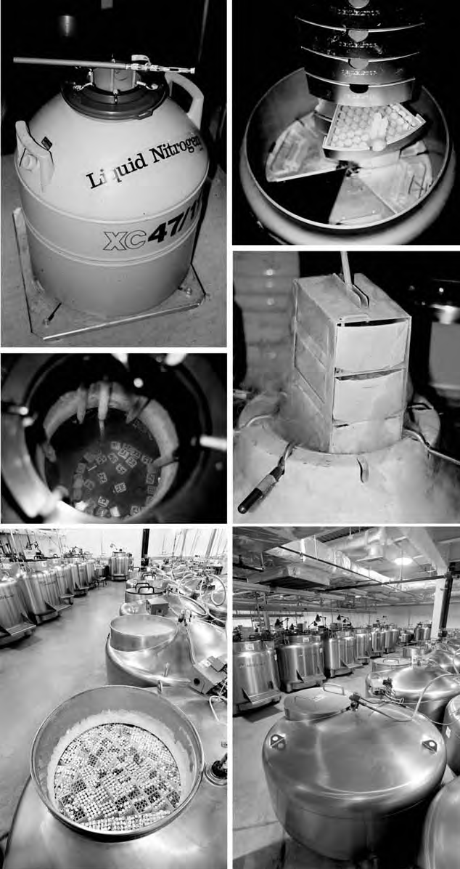

Slide 5
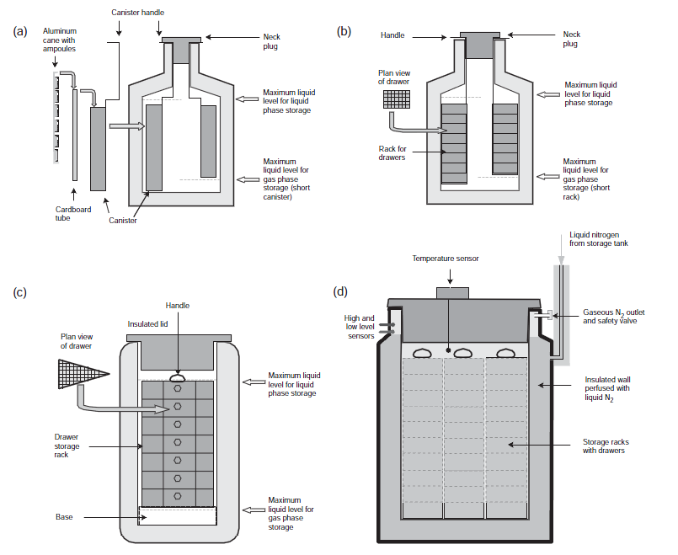

Slide 6
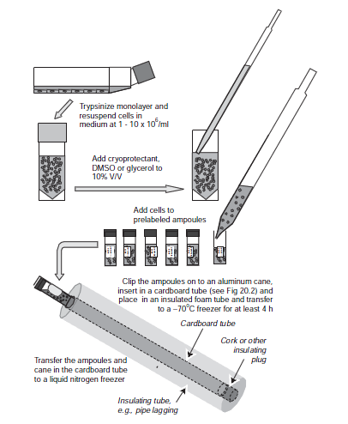

Slide 7
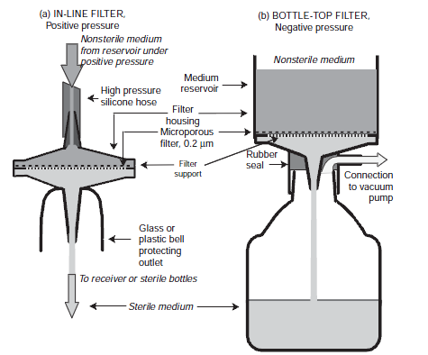
Sterile Filtration

Slide 8
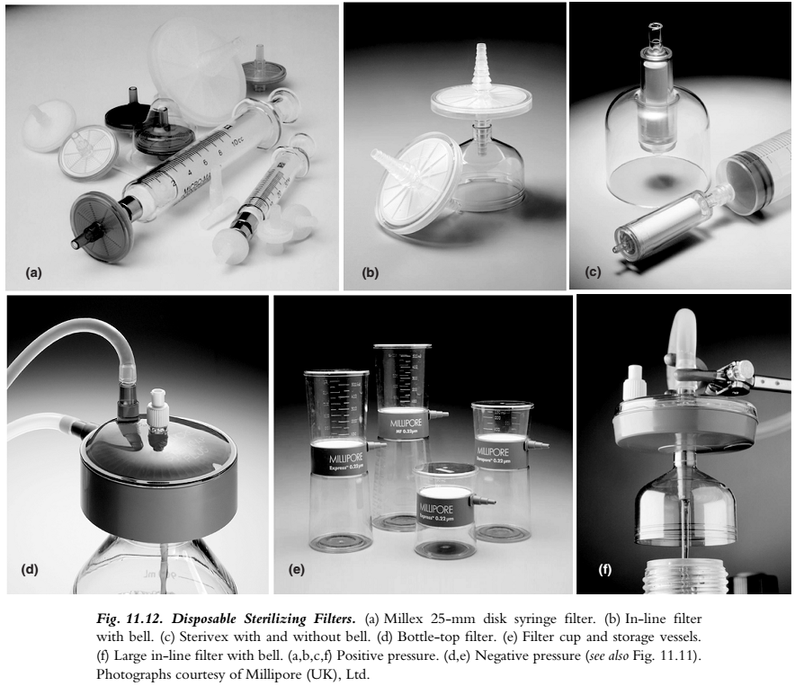

Slide 9
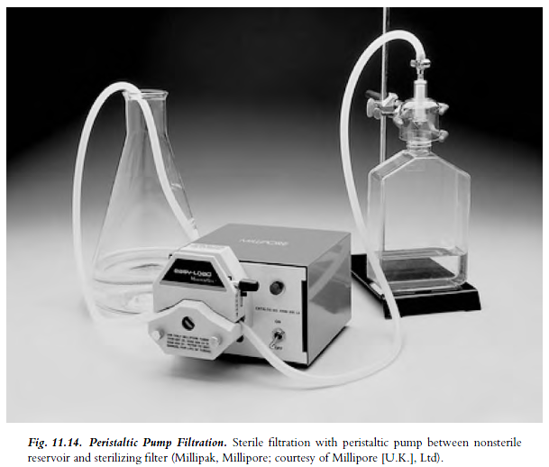

Slide 10
