Slide 1


Internet of Things (IoT)
Professor: Dr. Sadoon Azizi s.azizi@uok.ac.ir
Faculty of Engineering
Department of Computer and IT Engineering

Slide 2
Chapter Objectives
* In this chapter students are expected to get familiar with these concepts:
Internet of Things dependencies for networking protocols
Dependencies’ effects on each of the protocol stack layers

Slide 3
Inspired by the traditional internet protocol stack
The main reason of major growth of the traditional internet protocol stack is that it encapsulates each layer from it’s neighbors
Such a model, provides easier development of the layers
Researchers are inspired by this model for the world of IoT
Two methods ahead:
  Using the traditional internet protocol stack for IoT
  Need for a new protocol stack
At the late 1990s and the first decade of 2000 researchers declared that the traditional internet protocol stack is not suitable for such tasks

Slide 4
Support for the device limitations
IoT devices include wide variety of features and specifications:
  Computation power
  Mobility
  Size
  Complexity
  Scattering
  Energy sources
  Placement
  Connectivity patterns
Such characteristics force a set of dependencies and limitations on the network infrastructure (based on IP) for devices to connect to each other
  Specially computation power and energy resource limitations

Slide 5
Heterogeneous devices in IoT
In traditional internet, devices are homogeneous; meaning that they usually have high computation power and limitless energy resource (direct outlet connectivity or rechargeable batteries)
  Servers, desktop computers, laptops, printers
In IoT such a homogeneous structure isn’t present; on one end devices have limited computational power and energy source (such as pressure sensors) and on the other end devices with powerful processors and rechargeable batteries are present (such as smartphones)

Slide 6
Resource-constrained devices
In general, a resource-constrained device has limitation in at least one of these aspects:
  Maximum code complexity (ROM/Flash)
  Amount of RAM
  Computational power (amount of computations done in a slice of time)
  Available energy resource
  User interface management and placement accessibility (security key settings, updating software, etc.)
Definition
Small, low computational powered, limited energy devices with small memory are known as resource-constrained devices

Slide 7
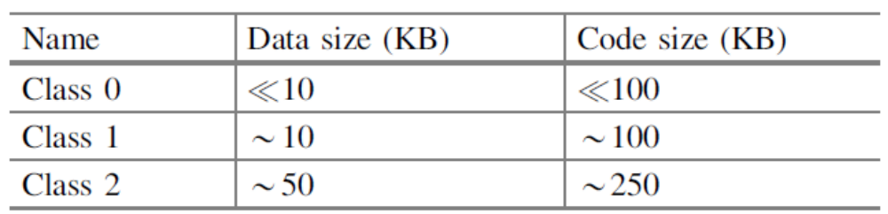
Categories of resource-constrained devices
Class 0 devices are extremely limited in memory and computation power. Such devices do not have enough resources to connect to and IP based network
Class 1 devices are a bit less limited compared to class 0 ones. These are able to connect to IP based networks directly; but they do face challenges for certain protocols like OSPF, HTTP and TLS.
Class 2 devices are the least limited in this category; these are able to run the traditional internet protocol stack but they demand efficient protocol implementations

Slide 8
Energy resource limitation
Factors that are effective on the energy limitation:
  Device size
  Main use state
  Cost
  Operational environment
Device categories based on energy resource limitation
  Energy harvesting (collecting energy from the environment)
  Battery included devices (rechargeable and replaceable)
  Battery included devices (non-rechargeable and non-replaceable)
  Main power (devices without energy constraints)

Slide 9
Resource-constrained devices’ requirements
Energy consumption is the main challenge for the IoT devices
  Data transfer is 3 times costly compared to local computations (energy cost)
  A common strategy is to put the devices on sleep when the devices are idle
Designing light, energy efficient, bandwidth-aware communication protocols

Slide 10
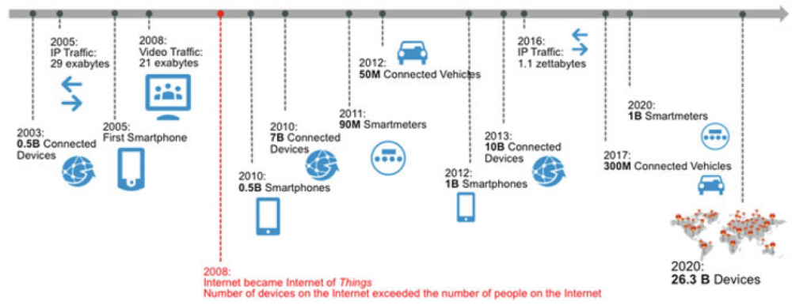
Broad scalablility
Based on the estimations done by Cisco, about 99.4% of the physical objects in the world which have the potential to be connected to the internet are not connected to internet yet!
Devices connected to internet will be more than 26 billion by the year 2020 (Cisco’s forecast)

Slide 11
Broad Scalability
This broad scalability forces different dependencies to the IoT protocol stack:
  Device detection and addressing
  Security
  Routing protocols
  Data transmission
  Management

Slide 12
Device addressing
IoT devices must be individually addressable so that it would be possible to connect to them remotely using the internet
If the device connections are made through proxy or gateway, they are called second class citizens
IoT’s broad scalability accelerates the migration to IPv6

Slide 13
Authentication management
Authentication security (such as shared key and certification management) forces a significant challenge to the internet
Adding billions of devices to internet using IoT complicates this issue even more
Manual mechanism that are used nowadays will not continue to be dominant for two reasons:
  Enormous number of devices
  The shortage (or even lack) of user interfaces on devices with limited resources
Thus, there is need for automatic and light mechanism for authentication

Slide 14
Control plane
IoT protocols are distributed and are implemented using message exchange between nodes
These protocols function based on two models:
  Hierarchical (Client-Server model)
  Flat (Peer-To-Peer)
Controlling functions’ behavior alongside with syntax and semantics of the exchanged messages define specific characteristics of the controlling protocols
As the number of active nodes in a protocol increase, challenges related to the internal resources of each node (storage and compute) arise

Slide 15
Wireless spectrum
Things (Objects) mostly use wireless access to connect to the internet
Wireless spectrum is a limited resource
Radio frequencies can only be used with expensive licenses (which are also rarely to be found)
By connecting billions of things to internet, the competition for these waves will be more intensive
Most IoT systems work in unlicensed frequencies (ISM)
For licensed frequencies (such as GSM) there is spectrum crisis issue
There are two reasons for this spectrum crisis:
  Impressive increase in number of the edge nodes
  Impressive increase in the traffic of each edge node

Slide 16
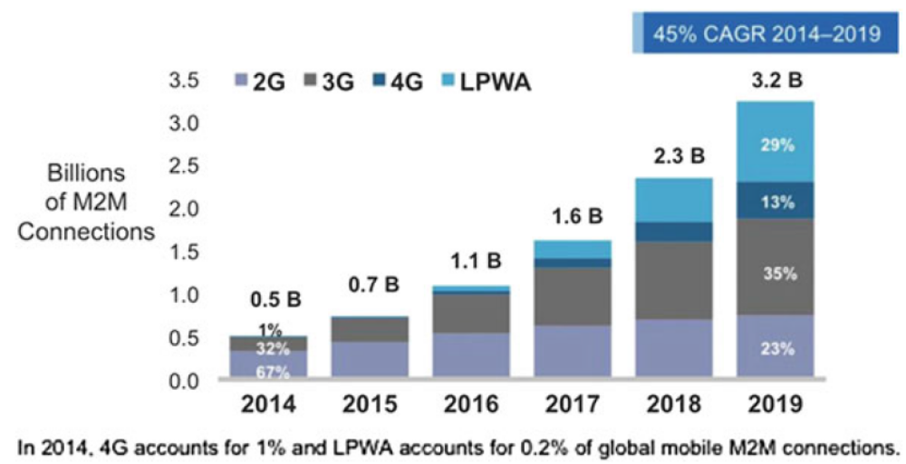
The growth of machine to machine connection

Slide 17
Immediate response time
In most IoT applications, the time it takes for a packet to travel the distance between source and destination must be specified (Timeliness)
An IoT system is working accurately only when it can guarantee the timeliness
Imagine what happens if the network delivers the controlling packet for a jet’s engine with a long delay
If delay and jitter of a network can be predicted for it’s worst case then that network is a deterministic network

Slide 18
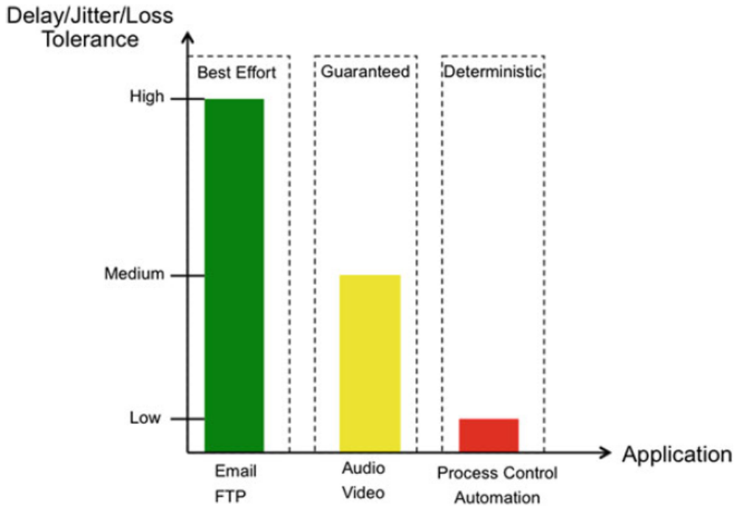
Traffic of best effort, guaranteed, deterministic

Slide 19
Collaborativeness of an application
Development complexity, placement and management of IoT applications is key challenge for industry
Current IoT solutions will not only take costly implementations but also it is difficult and costly to maintain and to evolve through time
Understanding IoT’s vision will be difficult unless APIs which control the devices’ behaviors follow certain standards somehow to enable and guarantee the collaborativeness
Having standard APIs, abstraction for these operations would be introducable:
  Device management (setup, authenticate, update software/middleware)
  Data management (read, write, share)
  Application management (start, stop, debug, upgrade)

Slide 20
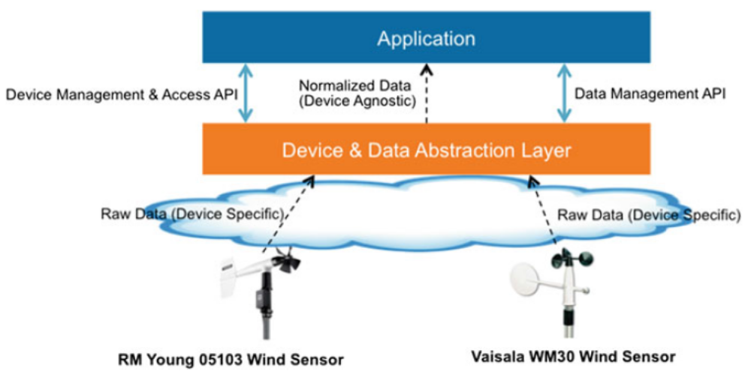
Abstraction and standard APIs

