Slide 1
Adaptive Dynamic Programing (ADP) for continuous-time systems: A literature review
Yazdan Batmani

Slide 2
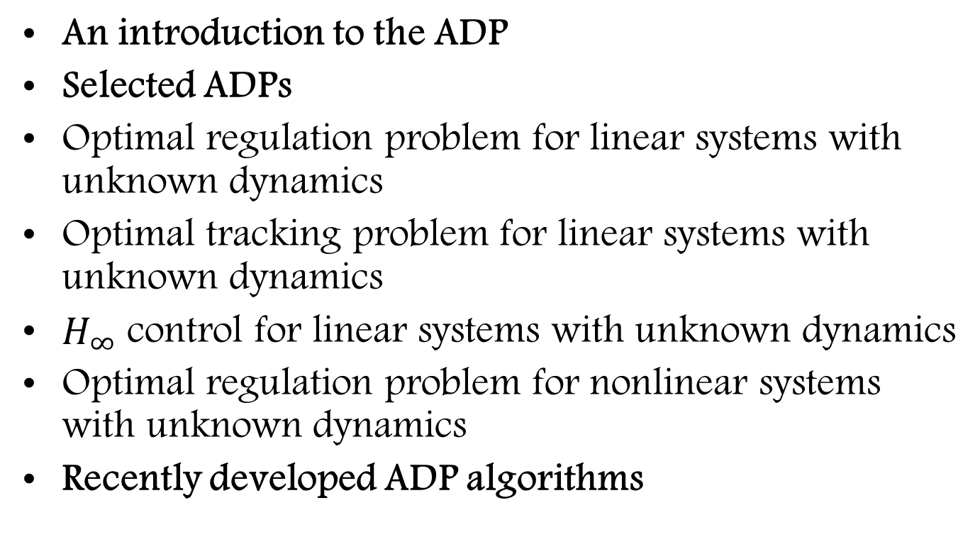
Outline
An introduction to the ADP
Selected ADPs
Optimal regulation problem for linear systems with unknown dynamics
Optimal tracking problem for linear systems with unknown dynamics
$H_{∞}$ control for linear systems with unknown dynamics
Optimal regulation problem for nonlinear systems with unknown dynamics
Recently developed ADP algorithms

Slide 3
An introduction to the ADP
A class of reinforcement learning (RL) algorithms
Solve online optimal control problems
ADP, RL, neuro-dynamic programing

Slide 4
Why ADP?
Difficulties of optimal control methods:
Necessity to know complete knowledge of the system dynamics
Complexity of the related HJB equation
ADP algorithms usually learn the optimal solution using approximate structure for the solution of the HJB equation.

Slide 5
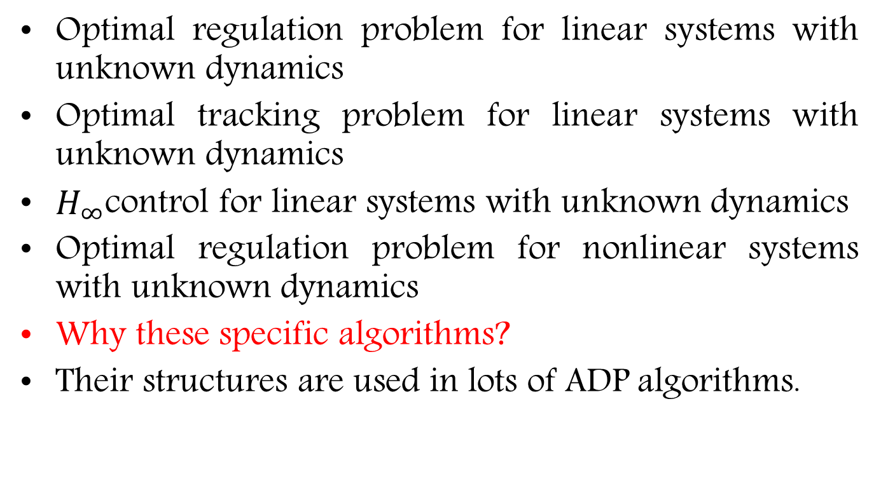
Selected ADPs
Optimal regulation problem for linear systems with unknown dynamics
Optimal tracking problem for linear systems with unknown dynamics
$H_{∞}$control for linear systems with unknown dynamics
Optimal regulation problem for nonlinear systems with unknown dynamics
Why these specific algorithms?
Their structures are used in lots of ADP algorithms.

Slide 6
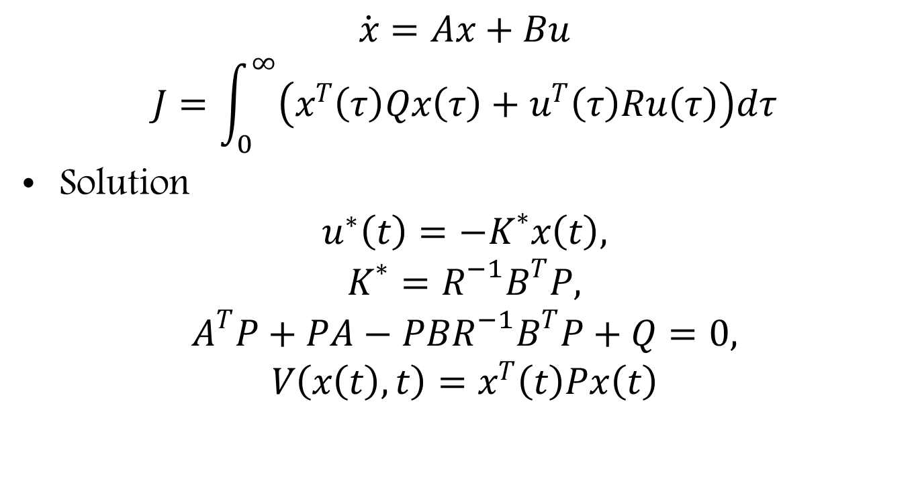
Optimal regulation problem for linear systems with unknown dynamics
$$\dot{x}=Ax+Bu$$
$$J=\int_{0}^{∞}{\left(x^{T}\left(τ\right)Qx\left(τ\right)+u^{T}\left(τ\right)Ru\left(τ\right)\right)dτ}$$
Solution
$$u^{∗}\left(t\right)=−K^{∗}x\left(t\right),$$
$$K^{∗}=R^{−1}B^{T}P,$$
$$A^{T}P+PA−PBR^{−1}B^{T}P+Q=0,$$
$$V\left(x\left(t\right),t\right)=x^{T}\left(t\right)Px\left(t\right)$$

Slide 7
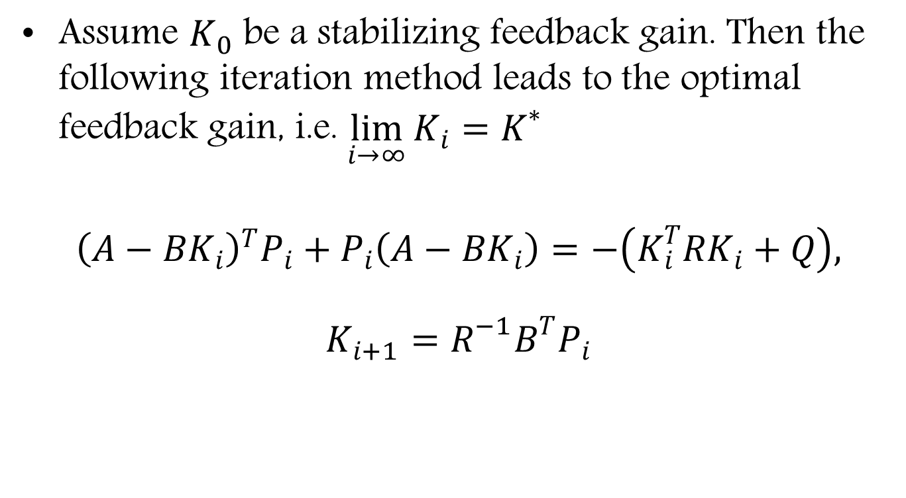
Kleinman iteration method
Assume $K_{0}$ be a stabilizing feedback gain. Then the following iteration method leads to the optimal feedback gain, i.e. $\lim_{i→∞}{K_{i}}=K^{∗}$
$${\left(A−BK_{i}\right)}^{T}P_{i}+P_{i}\left(A−BK_{i}\right)=−\left(K_{i}^{T}RK_{i}+Q\right),$$
$$K_{i+1}=R^{−1}B^{T}P_{i}$$

Slide 8
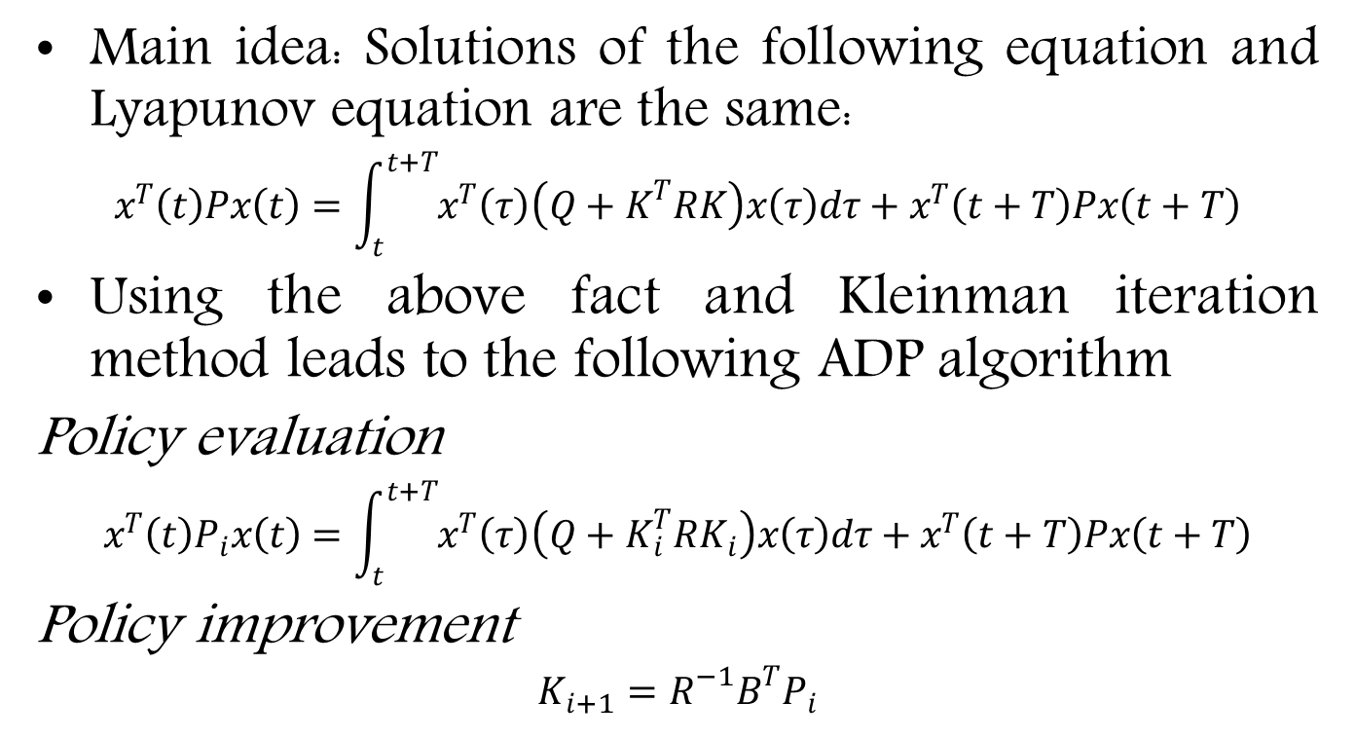
Vrabie, Pastravanu, Abu-Khalaf, & Lewis (2009)
Main idea: Solutions of the following equation and Lyapunov equation are the same:
$$x^{T}\left(t\right)Px\left(t\right)=\int_{t}^{t+T}{x^{T}\left(τ\right)\left(Q+K^{T}RK\right)x\left(τ\right)dτ}+x^{T}\left(t+T\right)Px\left(t+T\right)$$
Using the above fact and Kleinman iteration method leads to the following ADP algorithm
Policy evaluation
$$x^{T}\left(t\right)P_{i}x\left(t\right)=\int_{t}^{t+T}{x^{T}\left(τ\right)\left(Q+K_{i}^{T}RK_{i}\right)x\left(τ\right)dτ}+x^{T}\left(t+T\right)Px\left(t+T\right)$$
Policy improvement
$$K_{i+1}=R^{−1}B^{T}P_{i}$$

Slide 9
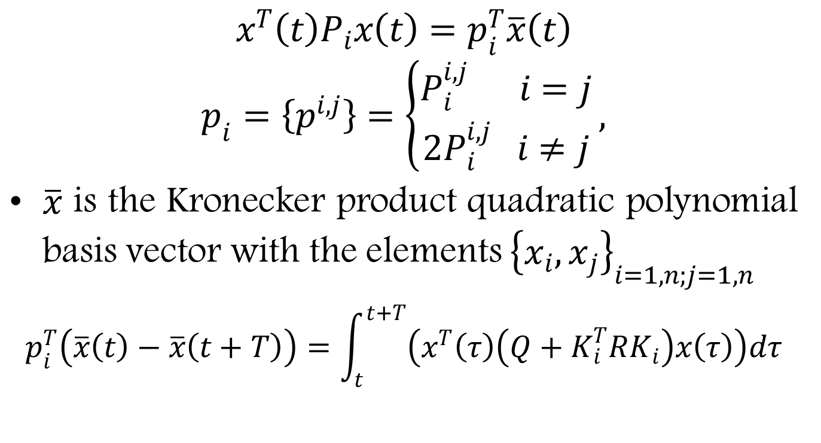
Online implementation
$$x^{T}\left(t\right)P_{i}x\left(t\right)=p_{i}^{T}\overline{x}\left(t\right)$$
$$p_{i}=\left\{p^{i,j}\right\}=\left\{\begin{aligned}P_{i}^{i,j} i=j \\ 2P_{i}^{i,j} i≠j\end{aligned}\right.,$$
$\overline{x}$ is the Kronecker product quadratic polynomial basis vector with the elements ${\left\{x_{i},x_{j}\right\}}_{i=1,n;j=1,n}$
$$p_{i}^{T}\left(\overline{x}\left(t\right)−\overline{x}\left(t+T\right)\right)=\int_{t}^{t+T}{\left(x^{T}\left(τ\right)\left(Q+K_{i}^{T}RK_{i}\right)x\left(τ\right)\right)dτ}$$

Slide 10
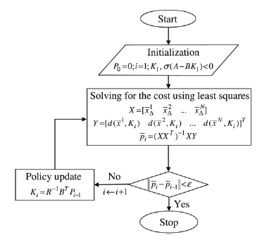

Slide 11

Example
$$\dot{x_{1}}=x_{1}−x_{2}+u, \dot{x_{2}}=2x_{1}−4x_{2}$$
$K_{0}=\left[\begin{matrix}5 & −5\end{matrix}\right],$ $R=1, Q=I, T=0.05$

Slide 14

Optimal tracking problem for linear systems with unknown dynamics
$$\dot{x}\left(t\right)=Ax\left(t\right)+Bu\left(t\right),$$
$$y\left(t\right)=Cx\left(t\right)$$
$${\dot{y}}_{d}=Fy_{d}$$
$$J=\int_{0}^{∞}{e^{−2γt}\left({\left(y−y_{d}\right)}^{T}Q\left(y−y_{d}\right)+u^{T}Ru\right)dt}$$
New state variables and control input:
$$X=e^{−γt}{\left[x^{T} y_{d}^{T}\right]}^{T}, U=e^{−γt}u$$

Slide 15
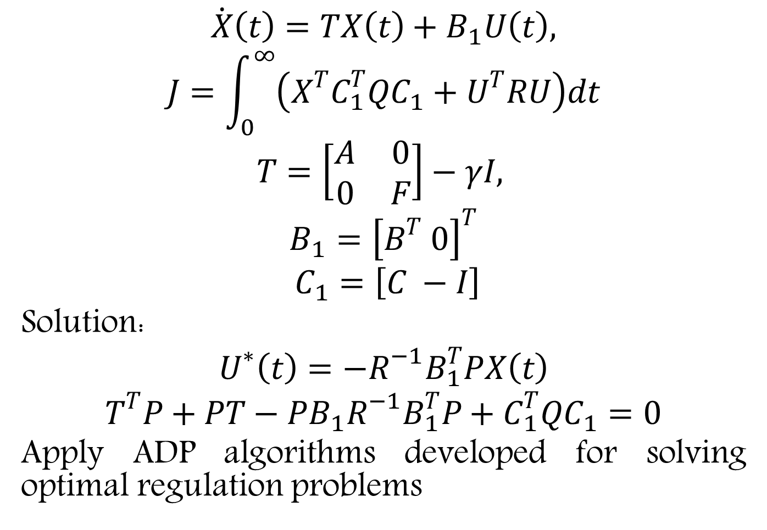
$$\dot{X}\left(t\right)=TX\left(t\right)+B_{1}U\left(t\right),$$
$$J=\int_{0}^{∞}{\left(X^{T}C_{1}^{T}QC_{1}+U^{T}RU\right)dt}$$
$$T=\left[\begin{matrix}A & 0 \\ 0 & F\end{matrix}\right]−γI,$$
$$B_{1}={\left[B^{T} 0\right]}^{T}$$
$$C_{1}=\left[C −I\right]$$
Solution:
$$U^{∗}\left(t\right)=−R^{−1}B_{1}^{T}PX\left(t\right)$$
$$T^{T}P+PT−PB_{1}R^{−1}B_{1}^{T}P+C_{1}^{T}QC_{1}=0$$
Apply ADP algorithms developed for solving optimal regulation problems

Slide 16

Example
$$\dot{x_{1}}=0.5x_{1}+1.5x_{2}+5u, \dot{x_{2}}=2x_{1}−2x_{2}+u$$
$y_{d}=3, K_{0}=\left[0 0 0\right],$ $R=1, Q=10, T=0.05$

Slide 19
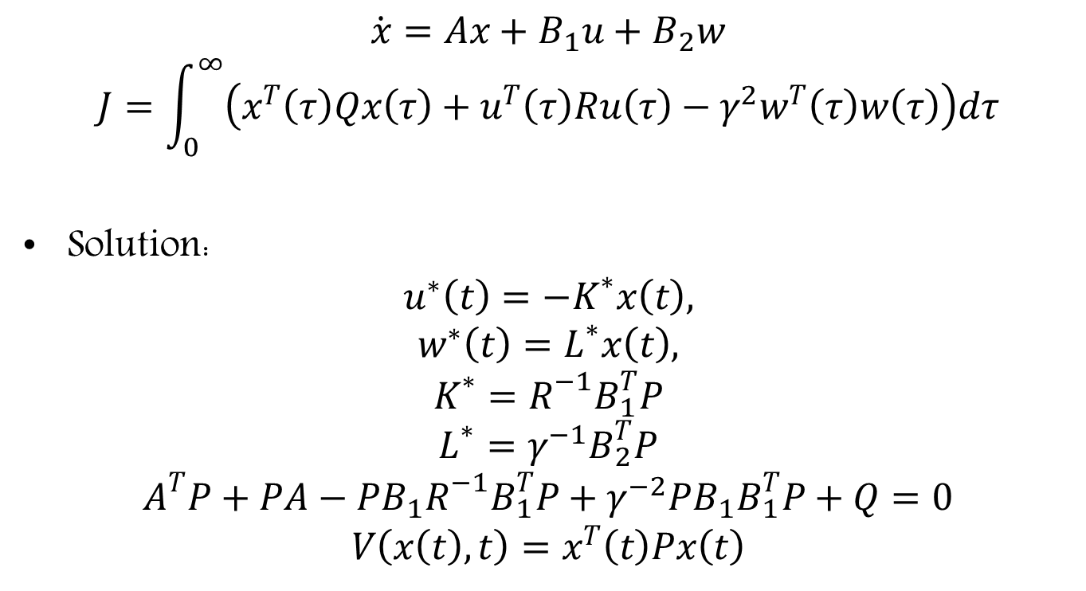
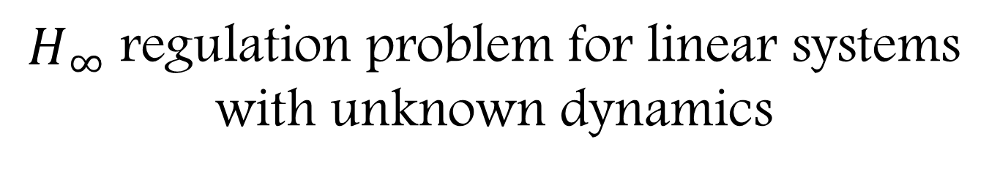
$H_{∞}$ regulation problem for linear systems with unknown dynamics
$$\dot{x}=Ax+B_{1}u+B_{2}w$$
$$J=\int_{0}^{∞}{\left(x^{T}\left(τ\right)Qx\left(τ\right)+u^{T}\left(τ\right)Ru\left(τ\right)−γ^{2}w^{T}\left(τ\right)w\left(τ\right)\right)dτ}$$
Solution:
$$u^{∗}\left(t\right)=−K^{∗}x\left(t\right),$$
$$w^{∗}\left(t\right)=L^{∗}x\left(t\right),$$
$$K^{∗}=R^{−1}B_{1}^{T}P$$
$$L^{∗}=γ^{−1}B_{2}^{T}P$$
$$A^{T}P+PA−PB_{1}R^{−1}B_{1}^{T}P+γ^{−2}PB_{1}B_{1}^{T}P+Q=0$$
$$V\left(x\left(t\right),t\right)=x^{T}\left(t\right)Px\left(t\right)$$

Slide 20
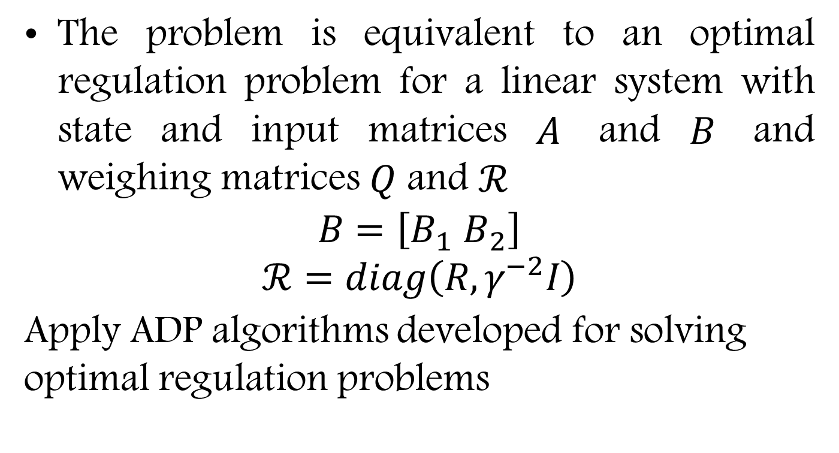
The problem is equivalent to an optimal regulation problem for a linear system with state and input matrices $A$ and $B$ and weighing matrices $Q$ and $ℛ$
$$B=\left[B_{1} B_{2}\right]$$
$$ℛ=diag\left(R,γ^{−2}I\right)$$
Apply ADP algorithms developed for solving optimal regulation problems

Slide 21

Example
$$\dot{x_{1}}=−1.01887x_{1}+0.90506x_{2}−0.00215x_{3}+u,$$
$$\dot{x_{2}}=0.82225x_{1}−1.07741x_{2}−0.17555x_{3},$$
$$\dot{x_{3}}=−x_{3}+w$$
$K_{0}=\left[0 0 0\right]$
$R=1,$
$Q=I,$
$T=0.05$
$γ=5$

Slide 24

Optimal regulation problem for nonlinear systems with unknown dynamics
$$\dot{x}=f\left(x\right)+B\left(x\right)u$$
$$J=\int_{0}^{∞}{\left(x^{T}\left(τ\right)Qx\left(τ\right)+u^{T}\left(τ\right)Ru\left(τ\right)\right)dτ}$$
Solution:
$$u^{∗}\left(t\right)=−\frac{1}{2}R^{−1}B^{T}\left(x\right)\frac{∂V}{∂x},$$
$${\left(\frac{∂V}{∂x}\right)}^{T}f\left(x\right)−\frac{1}{4}{\left(\frac{∂V}{∂x}\right)}^{T}B\left(x\right)R^{−1}\left(x\right)B^{T}\left(x\right)\frac{∂V}{∂x}+Q\left(x\right)=0,$$
$$V\left(0\right)=0$$

Slide 25
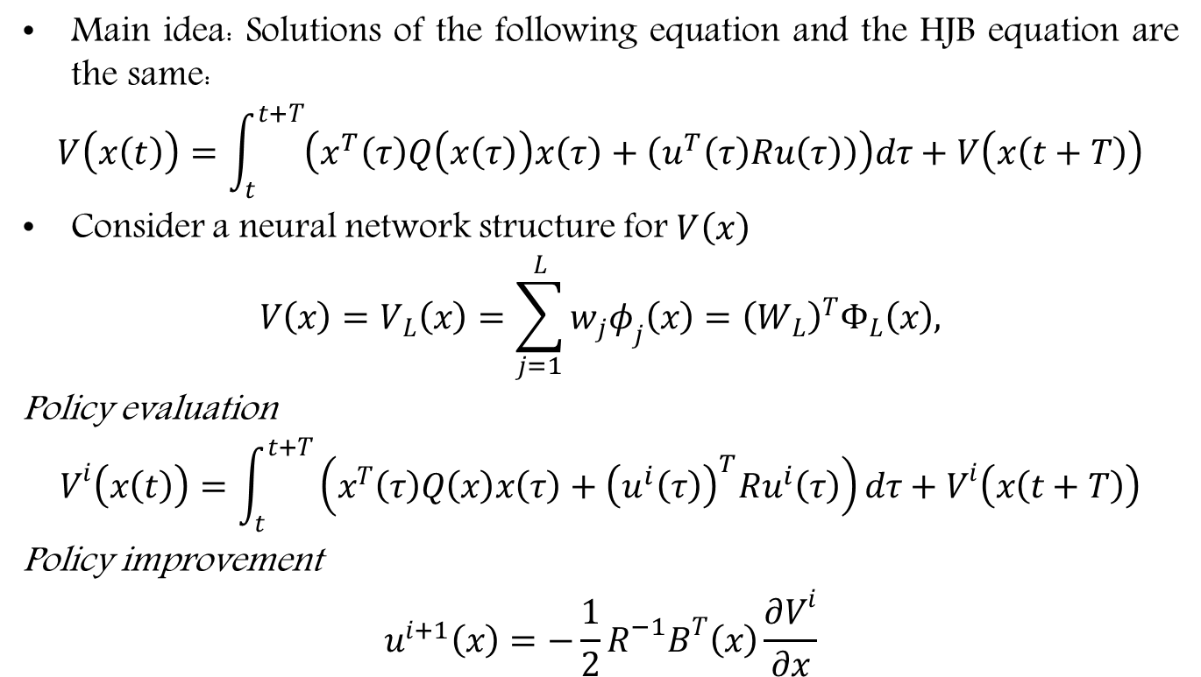
Vrabie & Lewis (2009)
Main idea: Solutions of the following equation and the HJB equation are the same:
$$V\left(x\left(t\right)\right)=\int_{t}^{t+T}{\left(x^{T}\left(τ\right)Q\left(x\left(τ\right)\right)x\left(τ\right)+\left(u^{T}\left(τ\right)Ru\left(τ\right)\right)\right)dτ}+V\left(x\left(t+T\right)\right)$$
Consider a neural network structure for $V\left(x\right)$
$$V\left(x\right)=V_{L}\left(x\right)=\sum_{j=1}^{L}{w_{j}φ_{j}\left(x\right)}={\left(W_{L}\right)}^{T}Φ_{L}\left(x\right),$$
Policy evaluation
$$V^{i}\left(x\left(t\right)\right)=\int_{t}^{t+T}{\left(x^{T}\left(τ\right)Q\left(x\right)x\left(τ\right)+{\left(u^{i}\left(τ\right)\right)}^{T}Ru^{i}\left(τ\right)\right)dτ}+V^{i}\left(x\left(t+T\right)\right)$$
Policy improvement
$$u^{i+1}\left(x\right)=−\frac{1}{2}R^{−1}B^{T}\left(x\right)\frac{∂V^{i}}{∂x}$$

Slide 26
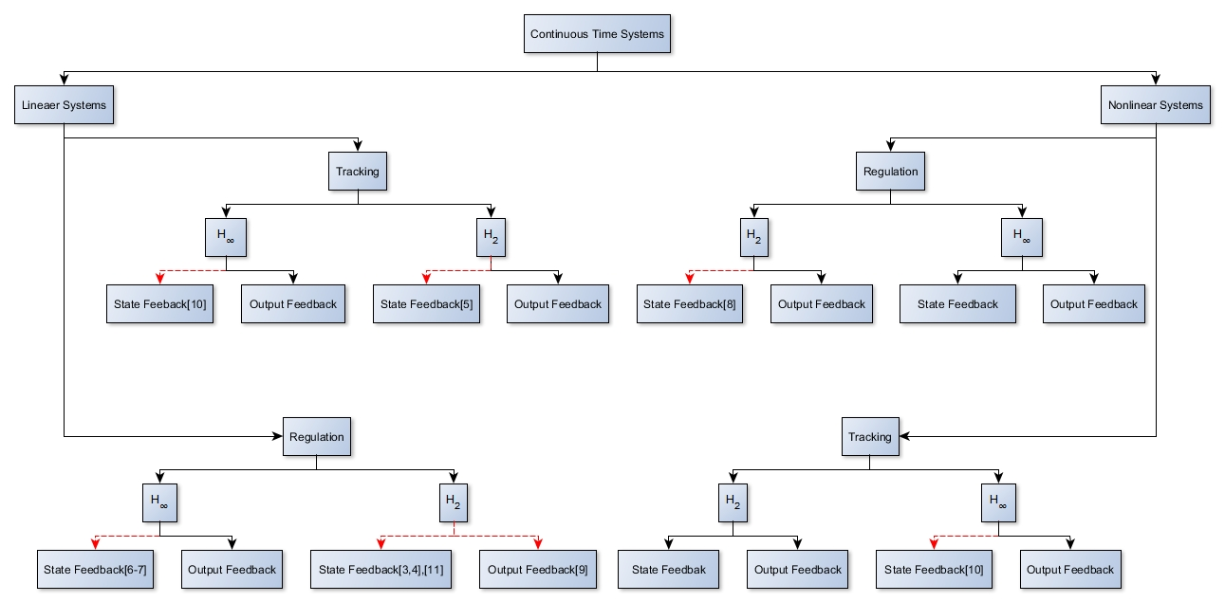
Recently developed ADP algorithms

